Slide 1
Univariate Data
Past Exam Questions

Slide 2
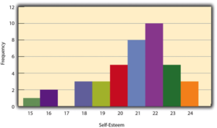
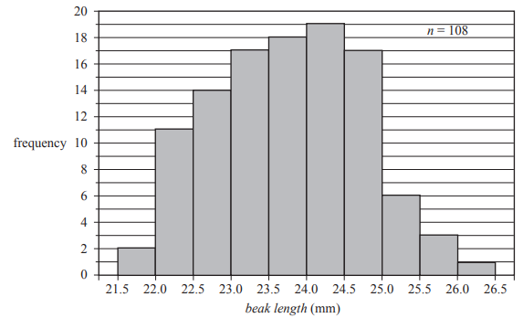
2018 NHT Exam 1 Q3
The histogram below shows the distribution of beak length, in millimetres, of a sample of 108 birds of the same species. Both male and female birds are included in this sample.
The beak length for this sample of 108 birds is most frequently
A. greater than or equal to 22.5 mm and less than 23.0 mm.
B. greater than or equal to 23.0 mm and less than 23.5 mm.
C. greater than or equal to 23.5 mm and less than 24.0 mm.
D. greater than or equal to 24.0 mm and less than 24.5 mm.
E. greater than or equal to 24.5 mm and less than 25.0 mm.

Slide 3
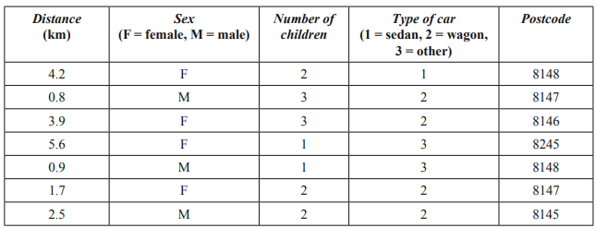
2014 Exam 1 Q4
The following table shows the data collected from a sample of seven drivers who entered a supermarket car park. The variables in the table are:
distance – the distance that each driver travelled to the supermarket from their home
sex – the sex of the driver (female, male)
number of children – the number of children in the car
type of car – the type of car (sedan, wagon, other)
postcode – the postcode of the driver’s home.
The number of categorical variables in this data set is
A. 0
B. 1
C. 2
D. 3
E. 4
29%
Notes:
29%

Slide 4
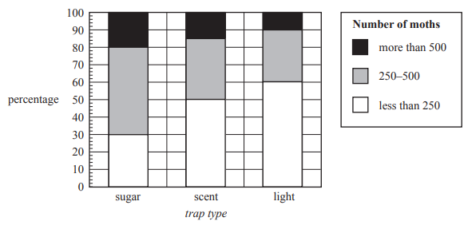
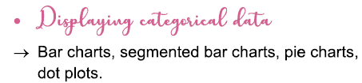
2017 Exam 1 Q7
A study was conducted to investigate the association between the number of moths caught in a moth trap (less than 250, 250–500, more than 500) and the trap type (sugar, scent, light). The results are summarised in the percentaged segmented bar chart below.
The variables number of moths (less than 250, 250–500, more than 500) and trap type (sugar, scent, light) are
A. both nominal variables.
B. both ordinal variables.
C. a numerical variable and a categorical
Variable respectively.
D. a nominal variable and an ordinal
Variable respectively.
E. an ordinal variable and a nominal
Variable respectively
4%
8%
36%
6%
46%

Slide 5
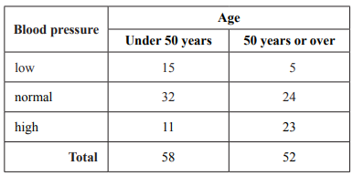
2016 Exam 1 Q2
The blood pressure (low, normal, high) and the age (under 50 years, 50 years or over) of 110 adults were recorded. The results are displayed in the two-way frequency table below.
The variables blood pressure (low, normal, high) and age (under 50 years, 50 years or over) are
A. both nominal variables.
B. both ordinal variables.
C. a nominal variable and an ordinal
variable respectively.
D. an ordinal variable and a nominal
variable respectively.
E. a continuous variable and an ordinal
variable respectively
8%
31%
10%
45%
5%

Slide 6
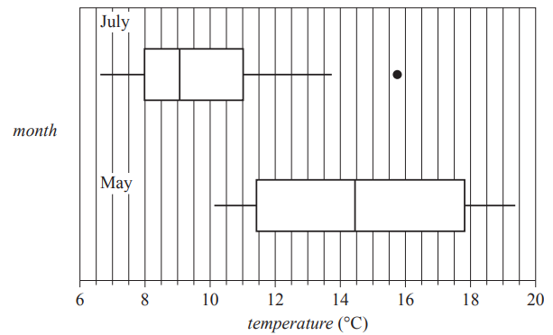
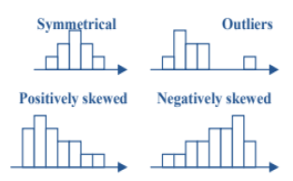
2016 exam 2 Q2bi
The weather station also records daily maximum temperatures.
b. The boxplots below display the distribution of maximum daily temperature for the months of May and July.
i. Describe the shapes of the distributions of daily temperature (including outliers) for July and for May. 1 mark
July
May
56%
Positively skewed
Symmetrical
Notes:
56%

Slide 7
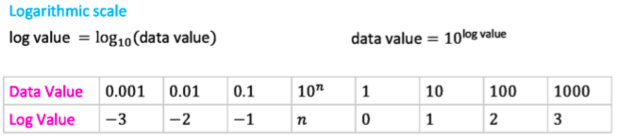

Slide 8
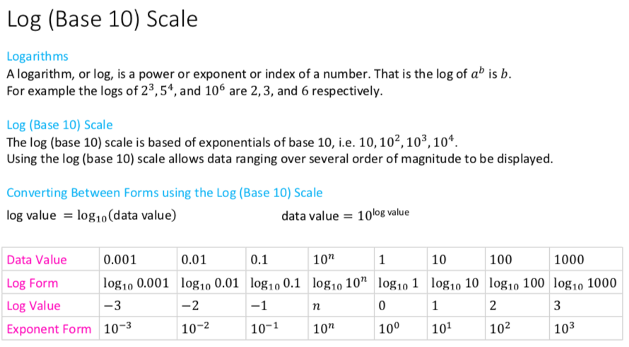

Slide 9
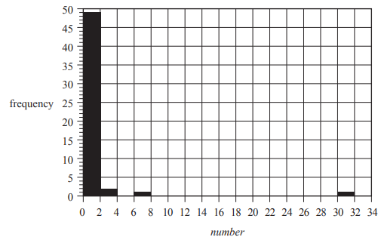
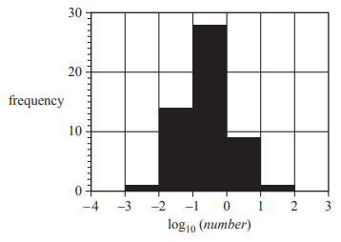

2016 Exam 1 Q7
The histogram below shows the distribution of the number of billionaires per million people for the same 53 countries as in Question 6, but this time plotted on a $\log_{10}{}$ scale.
Based on this histogram, the number of countries with one or more billionaires per million people is
A. 1
B. 3
C. 8
D. 9
E. 10
29%
12%
7%
6%
45%

Slide 10
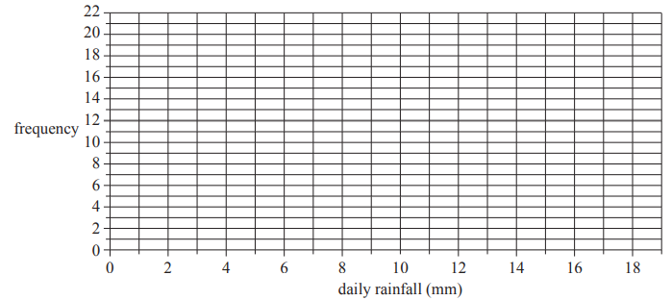
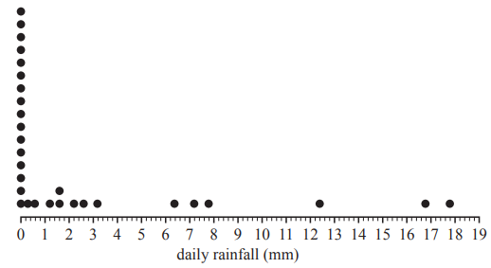
2016 Exam 2 Q1d
The dot plot below shows the distribution of daily rainfall, in millimetres, at a weather station for 30 days in September.
Use the grid below to construct a histogram that displays the distribution of daily rainfall for the month of September. Use interval widths of two with the first interval starting at 0.

Slide 11
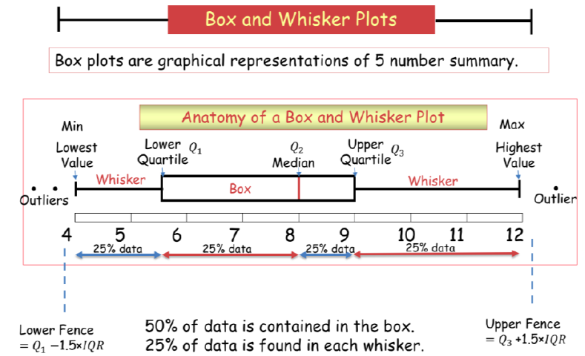
Outliers are valid max/min points

Slide 12
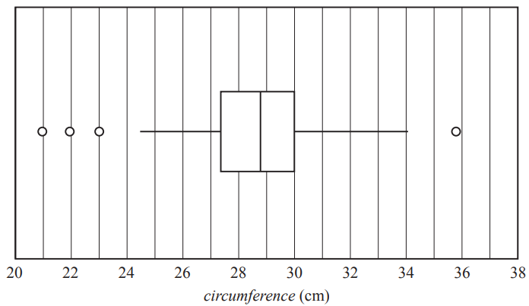
2017 exam 1 Question 2
The boxplot below shows the distribution of the forearm circumference, in centimetres, of 252 people.
The five-number summary for the forearm circumference of these 252 people is closest to
A. 21, 27.4, 28.7, 30, 34
B. 21, 27.4, 28.7, 30, 35.9
C. 24.5, 27.4, 28.7, 30, 34
D. 24.5, 27.4, 28.7, 30, 35.9
E. 24.5, 27.4, 28.7, 30, 36
2%
58%
38%
2%
0%

Slide 13
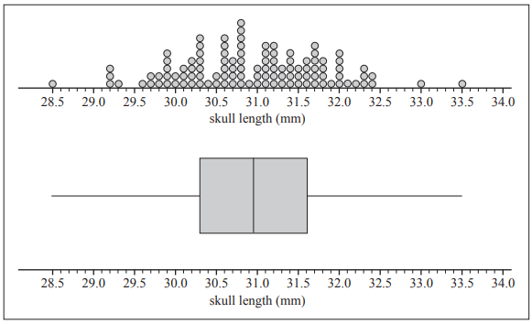
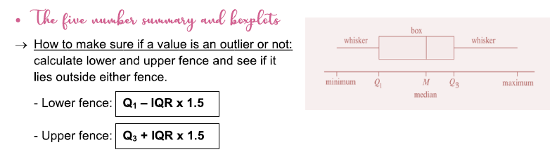

2018 NHT Exam 2 Q1b
The dot plot and boxplot below display the distribution of skull length, in millimetres, for a sample of the same species of bird.
Use information from the plots above to show why the bird with a skull length of 33.5 mm is not plotted as an outlier in the boxplot.
$Q_{3}$= 31.6 $Q_{1}$=30.3
IQR=$Q_{3}$– $Q_{1}$= 1.3
Upper fence= $Q_{3}$+1.5*IQR=31.6+1.5*1.3
=33.55
33.5<33.55
33.5 is not an outlier.

Slide 14

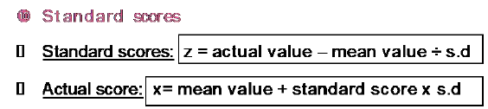
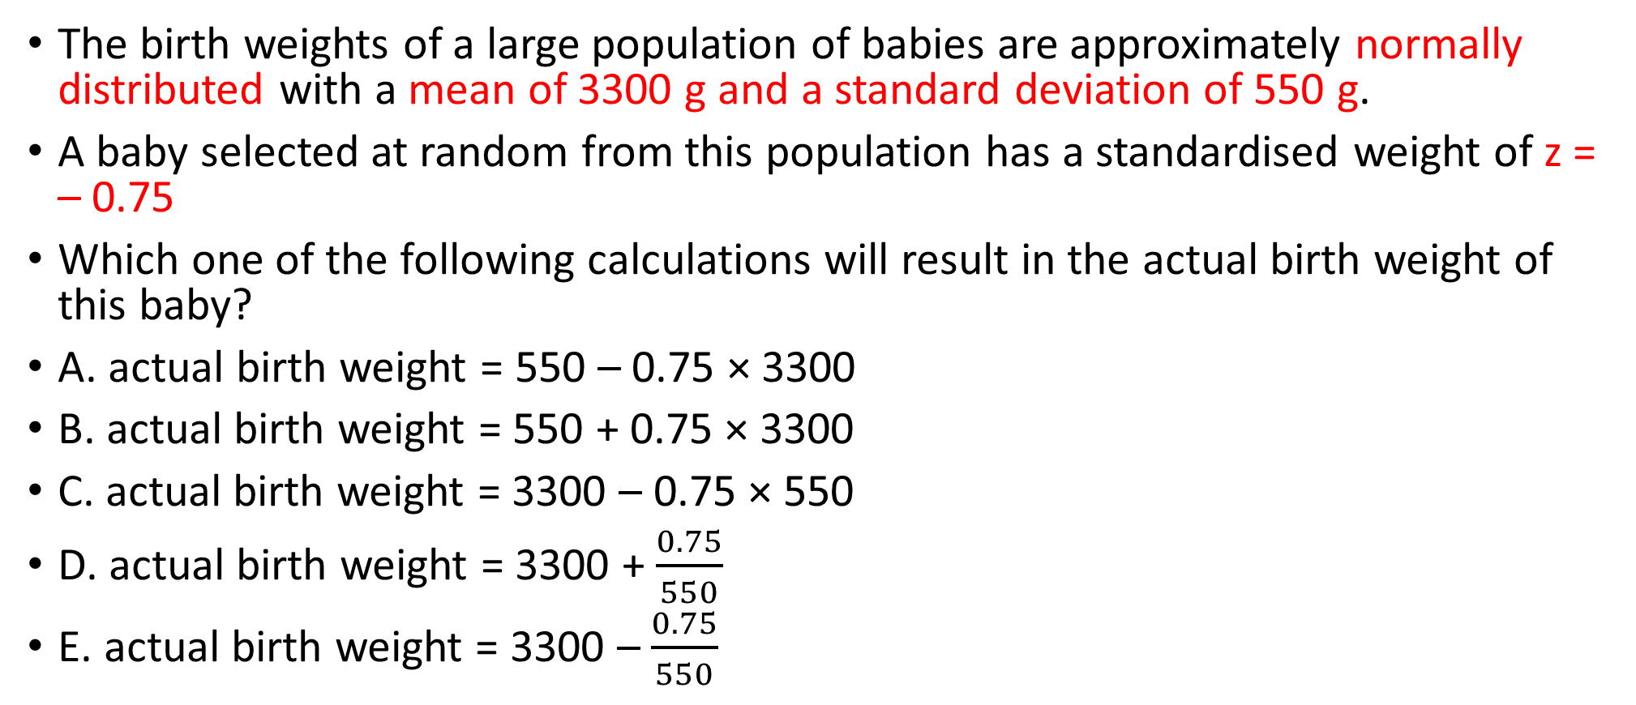
2019 NHT Exam 1 Q5
The birth weights of a large population of babies are approximately normally distributed with a mean of 3300 g and a standard deviation of 550 g.
A baby selected at random from this population has a standardised weight of z = – 0.75
Which one of the following calculations will result in the actual birth weight of this baby?
A. actual birth weight = 550 – 0.75 × 3300
B. actual birth weight = 550 + 0.75 × 3300
C. actual birth weight = 3300 – 0.75 × 550
D. actual birth weight = 3300 + $\frac{0.75}{550}$
E. actual birth weight = 3300 – $\frac{0.75}{550}$

Slide 15
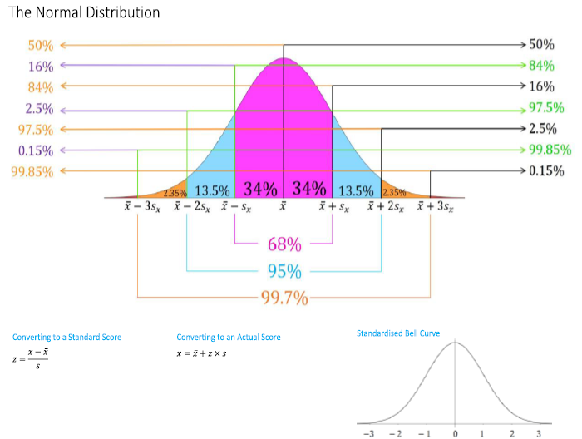
2019 NHT Exam 1 Q6
The birth weights of a large population of babies are approximately normally distributed with a mean of 3300 g and a standard deviation of 550 g.
Using the 68–95–99.7% rule, the percentage of babies with a birth weight of less than 1650 g is closest to
A. 0.14%
B. 0.15%
C. 0.17%
D. 0.3%
E. 2.5%
1650 2200 2750 3300

Slide 16
2019 NHT Exam 1 Q7
The birth weights of a large population of babies are approximately normally distributed with a mean of 3300 g and a standard deviation of 550 g.
A sample of 600 babies was drawn at random from this population.
Using the 68–95–99.7% rule, the number of these babies with a birth weight between 2200 g and 3850 g is
closest to
A. 111
B. 113
C. 185
D. 408
E. 489
13.5%+34%+34%=81.5%
81.5% of 600= 81.5%*600=489
1650 2200 2750 3300 3850

