Slide 1
Associations
Past Exam Q’s

Slide 2
2016 Exam 1 Q8
Parallel boxplots would be an appropriate graphical tool to investigate the association between the monthly median rainfall, in millimetres, and the
A. monthly median wind speed, in kilometres per hour.
B. monthly median temperature, in degrees Celsius.
C. month of the year (January, February, March, etc.).
D. monthly sunshine time, in hours.
E. annual rainfall, in millimetres.
4%
21%
45%
4%
25%
Numerical
Numerical
Categorical
Numerical
Numerical

Slide 4
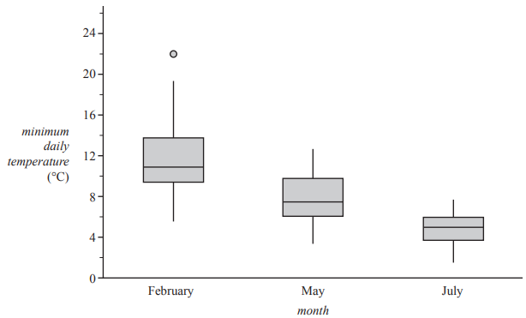
2019 Exam 2 Q3
The five-number summary for the distribution of minimum daily temperature for the months of February, May and July in 2017 is shown in Table 2.
The associated boxplots are shown below the table.
Explain why the information given above supports the contention that minimum daily temperature is associated with the month. Refer to the values of an appropriate statistic in your response.
Compare medians with actual value from the table not estimation from the chart.
Medians → not average or mean
Median values are decreasing from February 10.9 ⁰C, May 7.5 ⁰C to July 5.0 ⁰C. Therefore minimum daily temperature is associated with the month.
IQR are decreasing from February 4.4 ⁰C, May 3.8 ⁰C to July 2.2 ⁰C. Therefore minimum daily temperature is associated with the month.

Slide 6
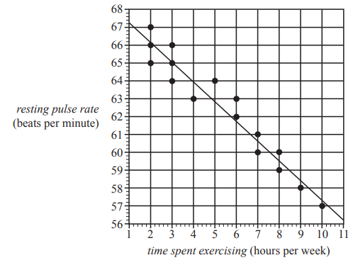
2018 Exam 1 Q9
The scatterplot below displays the resting pulse rate, in beats per minute, and the time spent exercising, in hours per week, of 16 students. A least squares line has been fitted to the data.
The coefficient of determination is 0.8339
The correlation coefficient r is closest to
A. –0.913
B. –0.834
C. –0.695
D. 0.834
E. 0.913
$r^{2}$ = 0.8339
r= $\sqrt{0.8339}$ = $±$0.913 → – 0.913
45%

Slide 7
2019 Exam 1 Q10
A least squares line is used to model the relationship between the monthly average temperature and latitude recorded at seven different weather stations. The equation of the least squares line is found to be
average temperature = 42.9842 – 0.877447 × latitude
The coefficient of determination was calculated to be 0.893743
The value of the correlation coefficient, rounded to three decimal places, is
A. –0.945
B. –0.898
C. 0.806
D. 0.898
E. 0.945
$r^{2}$ = 0.893743
r= $\sqrt{0.893743}$ = $±$0.945 → – 0.945

Slide 9
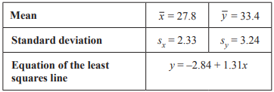
2018 Exam 1 Q13
The statistical analysis of a set of bivariate data involving variables x and y resulted in the information displayed in the table below.
Using this information, the value of the correlation coefficient r for this set of bivariate data is closest to
A. 0.88
B. 0.89
C. 0.92
D. 0.94
E. 0.97
b=1.31=$r×\frac{s_{y}}{s_{x}}$ = $r×\frac{3.24}{2.33}$ = $r×1.39$
r = $\frac{1.31}{1.39}$ = 0.94
49%

