Slide 1
Least Squares Regression
Past Exam Q’s

Slide 2
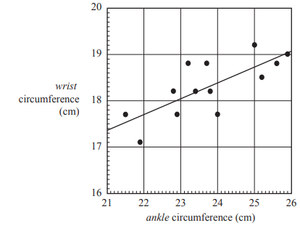
2017 Exam 1 Q8
The scatterplot below shows the wrist circumference and ankle circumference, both in centimetres, of 13 people. A least squares line has been fitted to the scatterplot with ankle circumference as the explanatory variable.
The equation of the least squares line is closest to
A. ankle = 10.2 + 0.342 × wrist
B. wrist = 10.2 + 0.342 × ankle
C. ankle = 17.4 + 0.342 × wrist
D. wrist = 17.4 + 0.342 × ankle
E. wrist = 17.4 + 0.731 × ankle
Which one is EV? Which one is RV?
RV=a+b*EV or y=a+bx
Where does x axis start?
3%
43%
6%
39%
9%

Slide 3
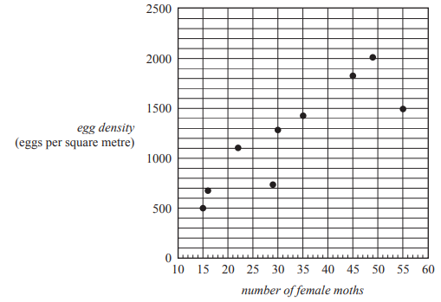
2017 Exam 2 Q3bi
The number of male moths caught in a trap set in a forest and the egg density (eggs per square metre) in the forest are shown in the table below.
b. The number of female moths caught in a trap set in a forest and the egg density (eggs per square metre) in the forest can also be examined.
A scatterplot of the data is shown below.
The equation of the least squares line is
egg density = 191 + 31.3 × number of female moths
i. Draw the graph of this least squares line on the scatterplot.
Number of female moths=10, egg density=504
Number of female moths=60, egg density=2069
26%
Use ruler
(60,2069)
(10,504)

Slide 4
2017 Exam 2 Q3bii
The number of male moths caught in a trap set in a forest and the egg density (eggs per square metre) in the forest are shown in the table below.
b. The number of female moths caught in a trap set in a forest and the egg density (eggs per square metre) in the forest can also be examined.
A scatterplot of the data is shown below.
The equation of the least squares line is
egg density = 191 + 31.3 × number of female moths
ii. Interpret the slope of the regression line in terms of the variables egg density and number of female moths caught in the trap.
On average, egg density increases by 31.3 eggs per square metre for every one number increase in female moths.

Slide 5
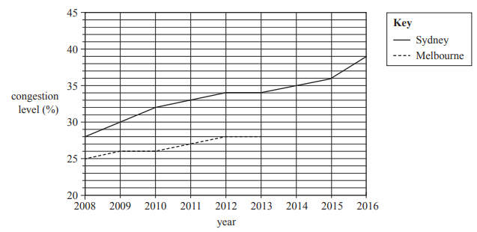
2018 Exam 2 Q3bi
Table 3 shows the yearly average traffic congestion levels in two cities, Melbourne and Sydney, during the period 2008 to 2016. Also shown is a time series plot of the same data.
The time series plot for Melbourne is incomplete.
b. A least squares line is used to model the trend in the time series plot for Sydney. The equation is
congestion level = –2280 + 1.15 × year
i. Draw this least squares line on the time series plot.
year=2008, congestion level=29.2
year=2016, congestion level=38.4
(2016,38.4)
(2008,29.2)

Slide 6
2018 Exam 2 Q3bii
Table 3 shows the yearly average traffic congestion levels in two cities, Melbourne and Sydney, during the period 2008 to 2016. Also shown is a time series plot of the same data.
The time series plot for Melbourne is incomplete.
b. A least squares line is used to model the trend in the time series plot for Sydney. The equation is
congestion level = –2280 + 1.15 × year
ii. Use the equation of the least squares line to determine the average rate of increase in percentage congestion level for the period 2008 to 2016 in Sydney.
Write your answer in the box provided below.
% per year
1.15

Slide 7
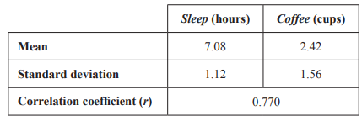
2019 Exam 1 Q11
A study was conducted to investigate the effect of drinking coffee on sleep.
In this study, the amount of sleep, in hours, and the amount of coffee drunk, in cups, on a given day were recorded for a group of adults.
The following summary statistics were generated.
On average, for each additional cup of coffee drunk, the amount of sleep
A. decreased by 0.55 hours.
B. decreased by 0.77 hours.
C. decreased by 1.1 hours.
D. increased by 1.1 hours.
E. increased by 2.3 hours.
EV=Coffee→x RV=Sleep→y
$S_{x}$= 1.56 $S_{y}$=1.12
b =$r×\frac{s_{y}}{s_{x}}$ = $−0.770×\frac{1.12}{1.56}$ = $r×1.39$= $−$0.5528

