Slide 1
Prediction, Residuals Statistics
Exam Q’s

Slide 2
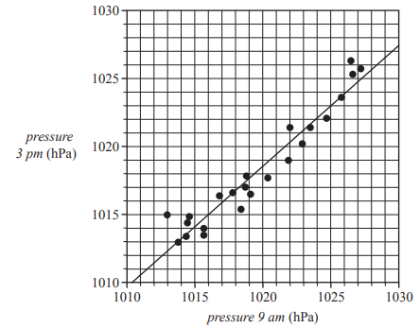
2019 Exam 2 Q5d
The scatterplot below shows the atmospheric pressure, in hectopascals (hPa), at 3 pm (pressure 3 pm) plotted against the atmospheric pressure, in hectopascals, at 9 am (pressure 9 am) for 23 days in November 2017 at a particular weather station.
A least squares line has been fitted to the scatterplot as shown.
The equation of this line is
pressure 3 pm = 111.4 + 0.8894 × pressure 9 am
d. Determine the residual when the atmospheric pressure at 9 am is 1013 hPa.
Round your answer to the nearest whole number.
Actual value= 1015
Predicted value=111.4+0.8894*1013=1012.3622
Residual= 1015– 1012.3622=2.6378=3

Slide 3
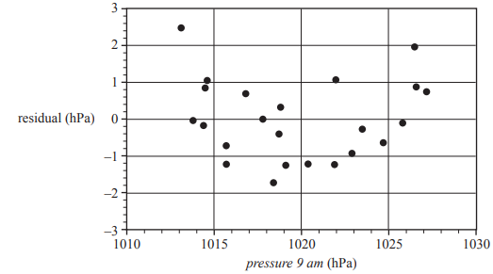
2019 Exam 2 Q5f
The scatterplot below shows the atmospheric pressure, in hectopascals (hPa), at 3 pm (pressure 3 pm) plotted against the atmospheric pressure, in hectopascals, at 9 am (pressure 9 am) for 23 days in November 2017 at a particular weather station.
A least squares line has been fitted to the scatterplot as shown.
The equation of this line is
pressure 3 pm = 111.4 + 0.8894 × pressure 9 am
f. The residual plot associated with the least squares line is shown below.
i. The residual plot above can be used to test one of the assumptions about the nature of the association between the atmospheric pressure at 3 pm and the atmospheric pressure at 9 am.
What is this assumption? 1 mark
ii. The residual plot above does not support this assumption.
Explain why
i. Linear relationship
ii. U shape not random pattern therefore not support this assumption

Slide 6
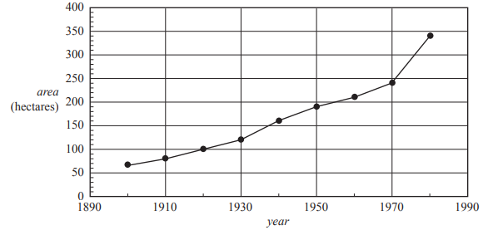
2017 Exam 2 Q4ci
The eggs laid by the female moths hatch and become caterpillars.
The following time series plot shows the total area, in hectares, of forest eaten by the caterpillars in a rural area during the period 1900 to 1980. The data used to generate this plot is also given.
The association between area of forest eaten by the caterpillars and year is non-linear.
A $\log_{10}{}$ transformation can be applied to the variable area to linearise the data.
c. i. The least squares line predicts that the $\log_{10}{}$ (area) of forest eaten by the caterpillars by the year 2020 will be approximately 2.85
Using this value of 2.85, calculate the expected area of forest that will be eaten by the caterpillars by the year 2020.
Round your answer to the nearest hectare
$\log_{10}{(data value)}$ = 2.85
Data value= ${10}^{2.85}$=707.94578=708
29%

Slide 7
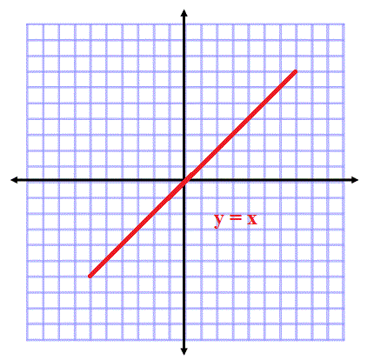
2018 Exam 1 Q14
A least squares line is fitted to a set of bivariate data.
Another least squares line is fitted with response and explanatory variables reversed.
Which one of the following statistics will not change in value?
A. the residual values
B. the predicted values
C. the correlation coefficient r
D. the slope of the least squares line
E. the intercept of the least squares line
42%
19%
13%
42%
13%
13%

Slide 8
2017 Exam 1 Q11
Which one of the following statistics can never be negative?
A. the maximum value in a data set
B. the value of a Pearson correlation coefficient
C. the value of a moving mean in a smoothed time series
D. the value of a seasonal index
E. the value of the slope of a least squares line fitted to a scatterplot
5%
10%
21%
59%
4%

