Slide 1
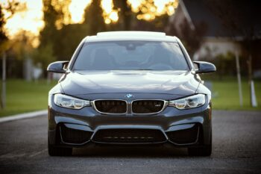
Depreciation
Past exam questions

Slide 2
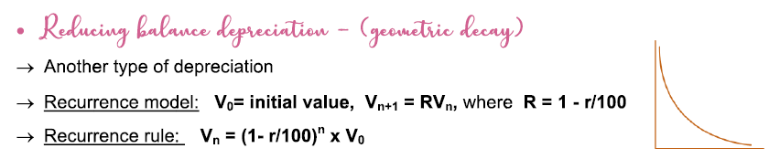
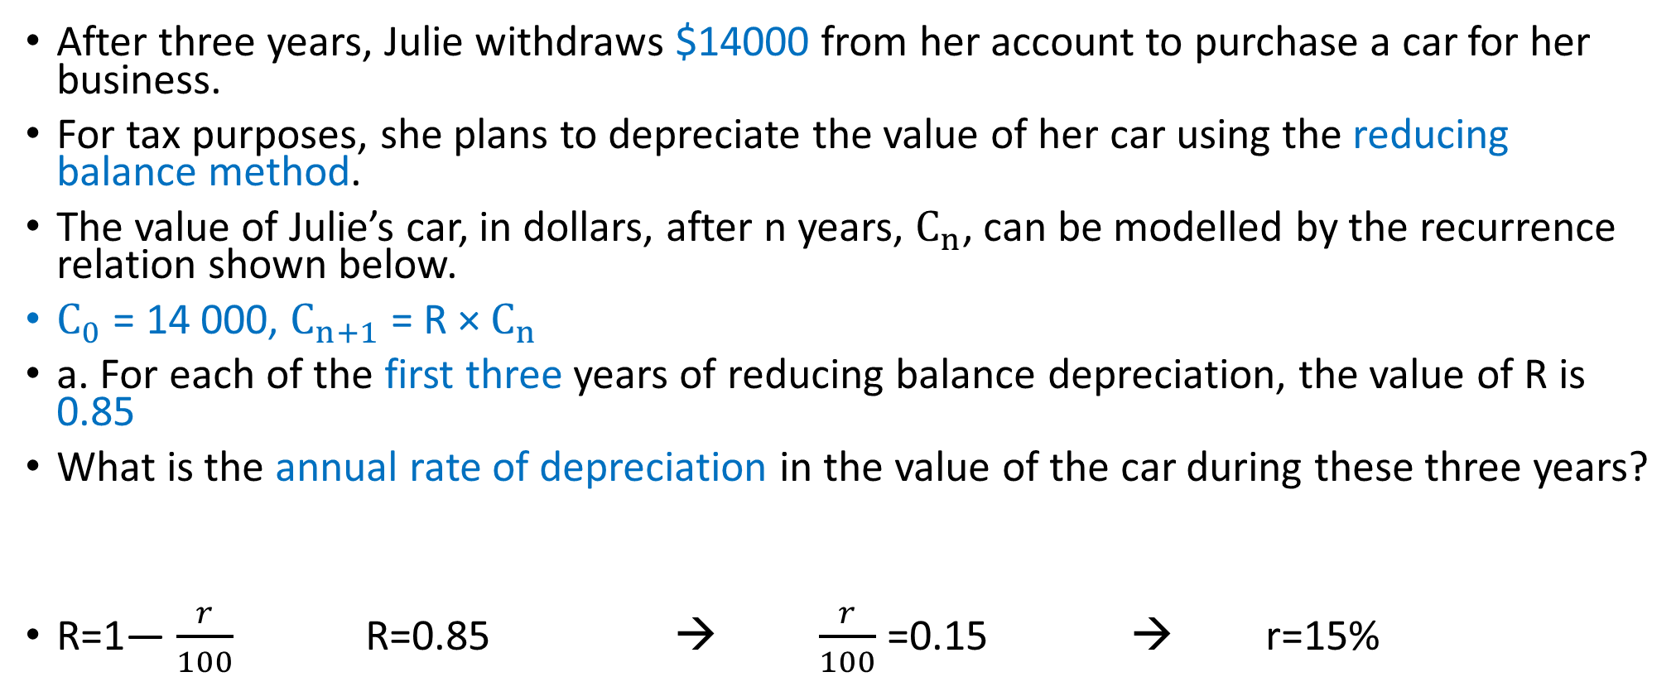
2018 Exam 2 Q5a
After three years, Julie withdraws $14000 from her account to purchase a car for her business.
For tax purposes, she plans to depreciate the value of her car using the reducing balance method.
The value of Julie’s car, in dollars, after n years, $C_{n}$, can be modelled by the recurrence relation shown below.
$C_{0}$ = 14 000, $C_{n+1}$ = R × $C_{n}$
a. For each of the first three years of reducing balance depreciation, the value of R is 0.85
What is the annual rate of depreciation in the value of the car during these three years?
R=1— $\frac{r}{100}$ R=0.85 → $\frac{r}{100}$ =0.15 → r=15%

Slide 3
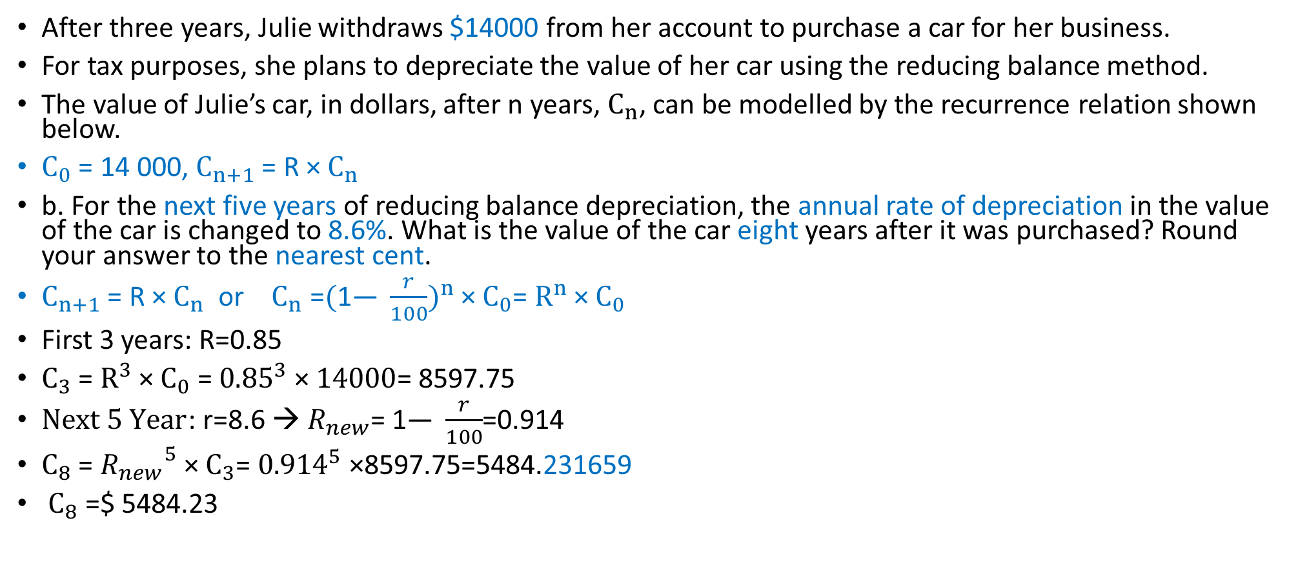
2018 Exam 2 Q5b
After three years, Julie withdraws $14000 from her account to purchase a car for her business.
For tax purposes, she plans to depreciate the value of her car using the reducing balance method.
The value of Julie’s car, in dollars, after n years, $C_{n}$, can be modelled by the recurrence relation shown below.
$C_{0}$ = 14 000, $C_{n+1}$ = R × $C_{n}$
b. For the next five years of reducing balance depreciation, the annual rate of depreciation in the value of the car is changed to 8.6%. What is the value of the car eight years after it was purchased? Round your answer to the nearest cent.
$C_{n+1}$ = R × $C_{n}$ or $C_{n}$ =${(\text{1— }\frac{r}{100})}^{n}$ × $C_{0}$= $R^{n}$ × $C_{0}$
First 3 years: R=0.85
$C_{3}$ = $R^{3}$ × $C_{0}$ = ${0.85}^{3}$ × $14000$= 8597.75
$Next 5 Year$: r=8.6 → $R_{new}$= $\text{1— }\frac{r}{100}$=0.914
$C_{8}$ = ${R_{new}}^{5}$ × $C_{3}$= ${0.914}^{5}$ ×8597.75=5484.231659
$C_{8}$ =$ 5484.23

Slide 4
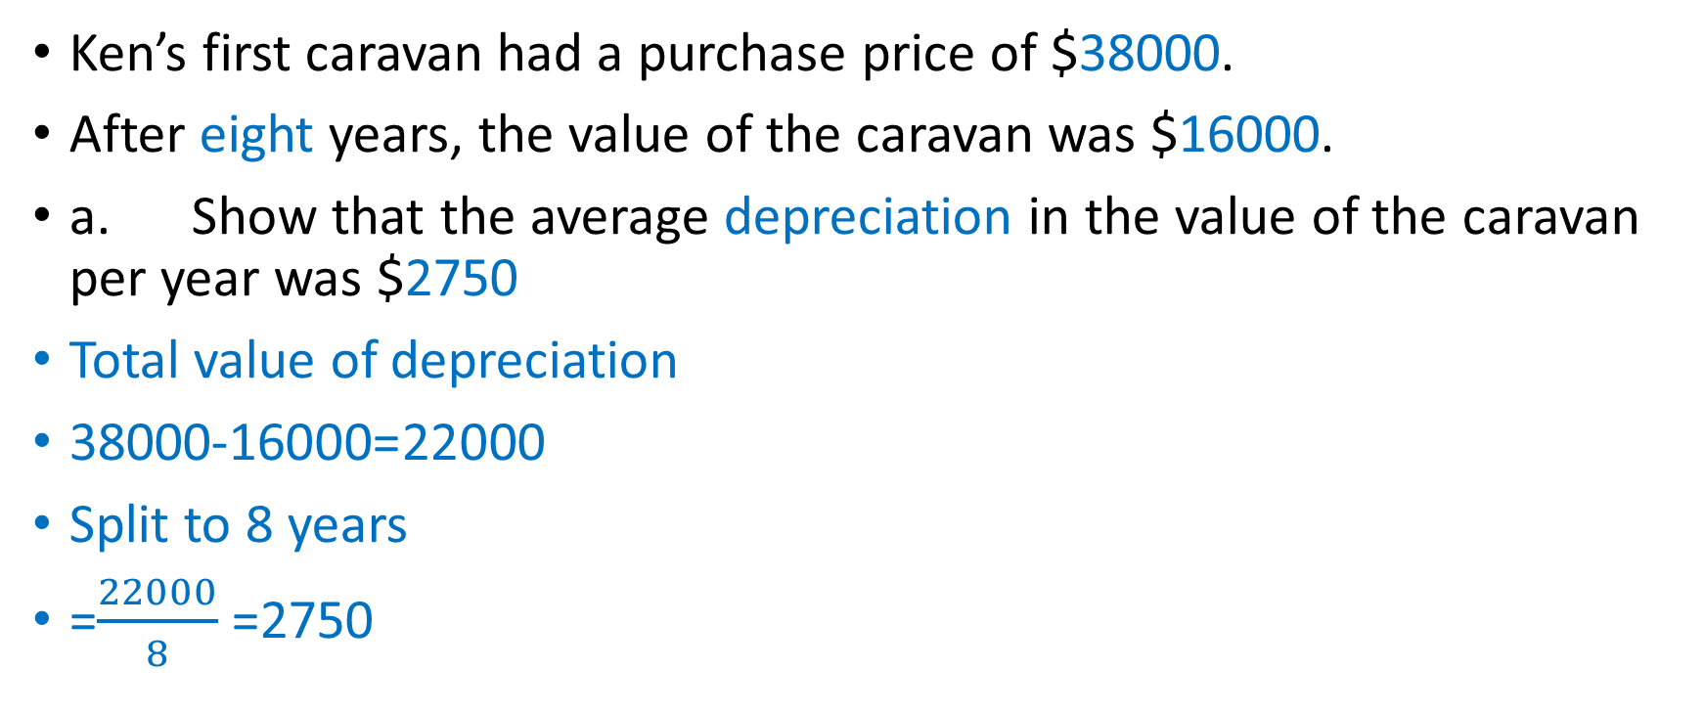
2016 Exam 2 Q6a
Ken’s first caravan had a purchase price of $38000.
After eight years, the value of the caravan was $16000.
a. Show that the average depreciation in the value of the caravan per year was $2750
Total value of depreciation
38000-16000=22000
Split to 8 years
=$\frac{22000}{8}$ =2750

Slide 5
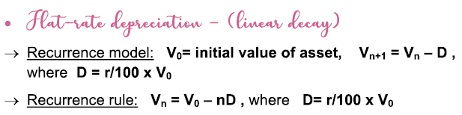
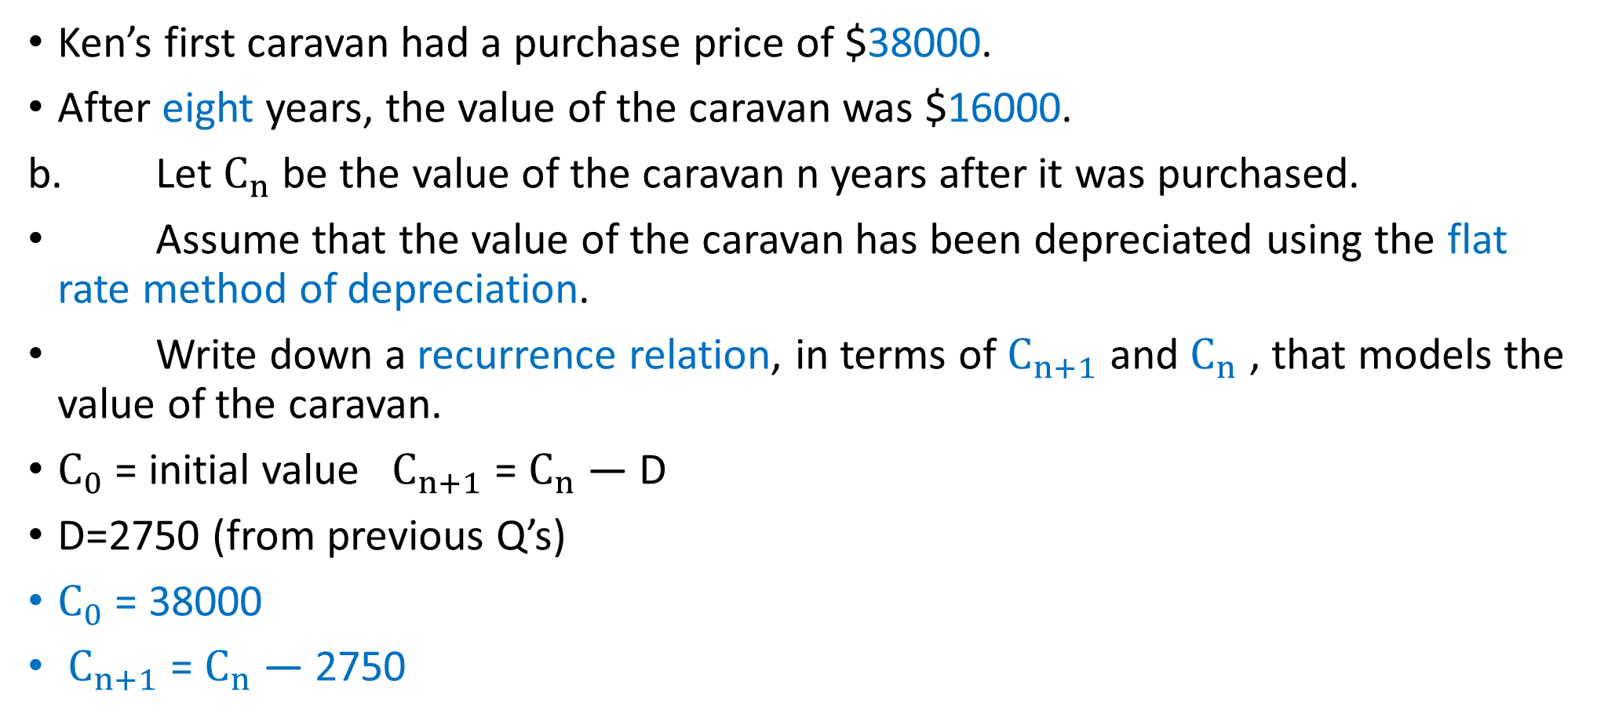
2016 Exam 2 Q6b
Ken’s first caravan had a purchase price of $38000.
After eight years, the value of the caravan was $16000.
b. Let $C_{n}$ be the value of the caravan n years after it was purchased.
Assume that the value of the caravan has been depreciated using the flat rate method of depreciation.
Write down a recurrence relation, in terms of $C_{n+1}$ and $C_{n}$ , that models the value of the caravan.
$C_{0}$ = initial value $C_{n+1}$ = $C_{n}$ — D
D=2750 (from previous Q’s)
$C_{0}$ = 38000
$C_{n+1}$ = $C_{n}$ — 2750

Slide 6
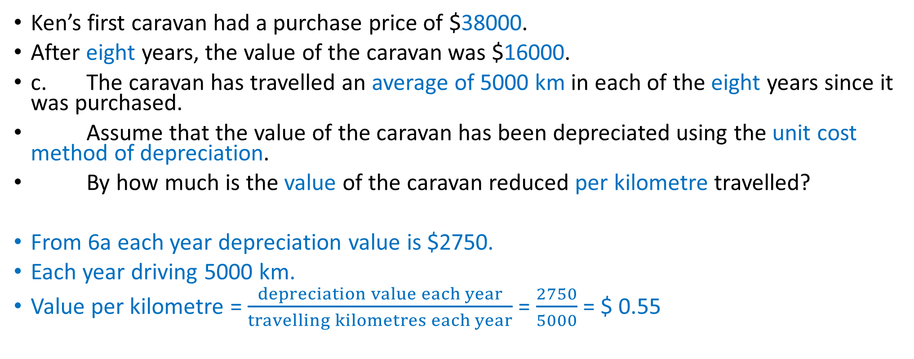
2016 Exam 2 Q6c
Ken’s first caravan had a purchase price of $38000.
After eight years, the value of the caravan was $16000.
c. The caravan has travelled an average of 5000 km in each of the eight years since it was purchased.
Assume that the value of the caravan has been depreciated using the unit cost method of depreciation.
By how much is the value of the caravan reduced per kilometre travelled?
From 6a each year depreciation value is $2750.
Each year driving 5000 km.
Value per kilometre = $\frac{depreciation value each year}{travelling kilometres each year}$ = $\frac{2750}{5000}$ = $ 0.55

