Slide 1
Amortisation
Table

Slide 2
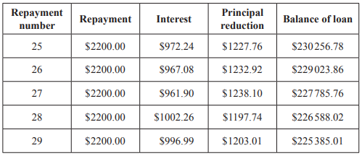
2018 Exam 1 Q23
Five lines of an amortisation table for a reducing balance loan with monthly repayments are shown below.
The interest rate for this loan changed immediately before repayment number 28.
This change in interest rate is best described as
A. an increase of 0.24% per annum.
B. a decrease of 0.024% per annum.
C. an increase of 0.024% per annum.
D. a decrease of 0.0024% per annum.
E. an increase of 0.00024% per annum.
Interest rate = r = $\frac{interest earned}{balance of loan last month}$
$r_{26}$ = $\frac{967.08}{230256.78}$ = 0.0042= 0.42%
$r_{27}$ = $\frac{961.90}{229023.86}$ = 0.0042= 0.42%
$r_{28}$ = $\frac{1002.26}{227785.76}$ = 0.0044= 0.44% $r_{28}$ – $r_{27}$ = 0.02% Monthly = 0.02*12% = 0.24% Annum

Slide 3
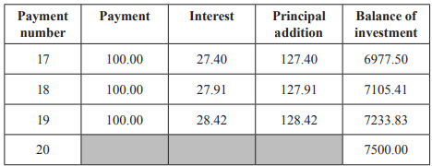
2017 Exam 1 Q23
Four lines of an amortisation table for an annuity investment are shown below.
The interest rate for this investment remains constant, but the payment value may vary.
The balance of the investment after payment number 20 is $7500.
The value of payment number 20 is closest to
A. $29
B. $100
C. $135
D. $237
E. $295
Principal addition = Balance of investment – Previous Balance of investment
Number 20 Principal addition = 7500.00 – 7233.83= 266.17
Interest rate = r = $\frac{interest earned}{balance of loan last month}$ = $\frac{28.42}{7105.41}$ = 0.0040 = 0.40%
Interest = r* Previous balance of investment = 0.0040 * 7233.83 = 28.94
Payment = Principal addition – Interest = 266.17 – 28.94 = 237.23

