Slide 1
Matrices Revision
Advice

Slide 2
Content summary
Types of matrices
Matrix arithmetic
Inverse/ determinant
Matrices to represent numerical information
Binary & permutation matrices
Communication & dominance matrices
Simultaneous equations
Transition matrices

Slide 3
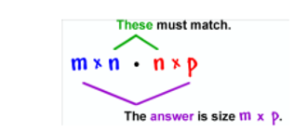
Technic to complete your paper
Be selective in the use of technology
Have an understanding of matrix multiplication by hand
Check reasonable solution especially in terms of whole number
$T⋅S$= $\left[\begin{matrix}r1 & & \\ r2 & & \\ r3 & & \end{matrix}\right]⋅\left[c1 c2 c3\right]=\left[\begin{matrix}r1c1 & r1c2 & r1c3 \\ r2c1 & r2c2 & r2c3 \\ r3c1 & r3c2 & r3c3\end{matrix}\right]$

