Slide 1
Time Series
Exam Q’s

Slide 2
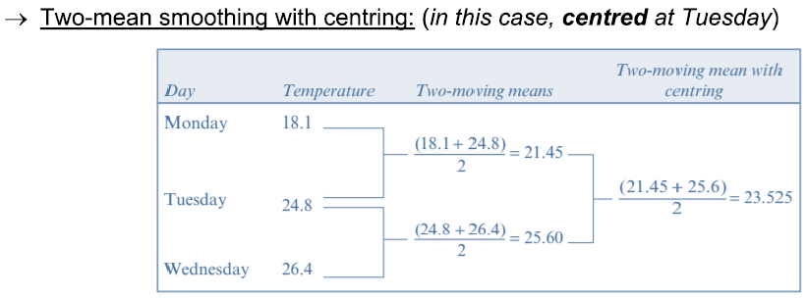
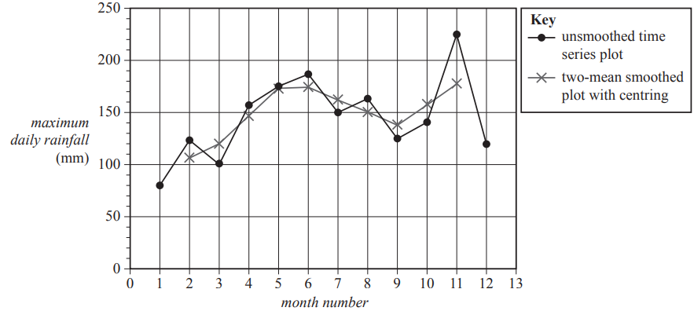
2016 Exam 2 Q4b
The time series plot below shows the minimum rainfall recorded at the weather station each month plotted against the month number (1 = January, 2 = February, and so on). Rainfall is recorded in millimetres.
The data was collected over a period of one year.
The maximum daily rainfall each month was also recorded at the weather station.
The table below shows the maximum daily rainfall each month for a period of one year.
The data in the table has been used to plot maximum daily rainfall against month number in the time series plot below.
b. Two-mean smoothing with centring has been used to smooth the time series plot above.
The smoothed values are marked with crosses (×).
Using the data given in the table, show that the two-mean smoothed rainfall centred on October is 157.25 mm.
$\frac{124+140}{2}=$132
$\frac{140+225}{2}$=182.5
$\frac{132+182.5}{2}$=157.25

Slide 3
2017 Exam 1 Q16
The seasonal index for the sales of cold drinks in a shop in January is 1.6
To correct the January sales of cold drinks for seasonality, the actual sales should be
A. reduced by 37.5%
B. reduced by 40%
C. reduced by 62.5%
D. increased by 60%
E. increased by 62.5%
SI=1.6→ way above average → to correct=should be reduced
$\frac{100}{1.6}$ = 62.5
The sales should be decreased by 37.5%.(100-62.5)
32%
11%
22%
27%
6%

