Slide 1
Simultaneous equations and long term transition
Past Exam Paper

Slide 2
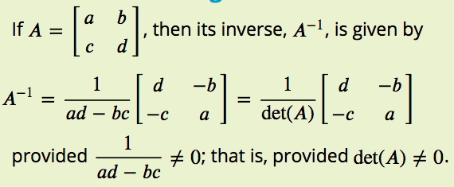
2018 NHT Exam 1 Q6
$$\left[\begin{matrix}a & b \\ c & d\end{matrix}\right]\left[\begin{matrix}x \\ y\end{matrix}\right]=\left[\begin{matrix}3 \\ −1\end{matrix}\right]$$
$$\left[\begin{matrix}x \\ y\end{matrix}\right]={\left[\begin{matrix}a & b \\ c & d\end{matrix}\right]}^{−1}\left[\begin{matrix}3 \\ −1\end{matrix}\right]$$
$${\left[\begin{matrix}a & b \\ c & d\end{matrix}\right]}^{−1}=\left[\begin{matrix}−4 & 3 \\ 3 & −2\end{matrix}\right]$$
$$\left[\begin{matrix}a & b \\ c & d\end{matrix}\right]={\left[\begin{matrix}−4 & 3 \\ 3 & −2\end{matrix}\right]}^{−1}$$
The solution to a system of simultaneous linear equations is determined by evaluating the matrix product
$\left[\begin{matrix}x \\ y\end{matrix}\right]=\left[\begin{matrix}−4 & 3 \\ 3 & −2\end{matrix}\right]\left[\begin{matrix}3 \\ −1\end{matrix}\right]$
One of these linear equations could be
A. –4x + 3y = 3
B. –4x – 2y = 3
C. 2x + 3y = 3
D. 3x + 3y = –1
E. 3x + 4y = 3
$\left[\begin{matrix}a & b \\ c & d\end{matrix}\right]=\frac{1}{(−2)×(−4)−3×3}\left[\begin{matrix}−2 & −3 \\ −2 & −4\end{matrix}\right]$= ($−$1) $\left[\begin{matrix}−2 & −3 \\ −2 & −4\end{matrix}\right]$= $\left[\begin{matrix}2 & 3 \\ 2 & 4\end{matrix}\right]$
$$\left[\begin{matrix}2 & 3 \\ 2 & 4\end{matrix}\right]\left[\begin{matrix}x \\ y\end{matrix}\right]=\left[\begin{matrix}3 \\ −1\end{matrix}\right]$$
$$\left\{\begin{matrix}2x+3y=3 \\ 2x+4y=−1\end{matrix}\right.$$

Slide 3
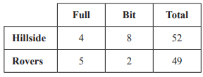
2019 NHT Exam 1 Q4
In a game between two teams, Hillside and Rovers, each team can score points in two ways.
The team may hit a Full or the team may hit a Bit.
More points are scored for hitting a Full than for hitting a Bit.
A team’s total point score is the sum of the points scored from hitting Fulls and Bits.
The table below shows the scores at the end of the game.
Let f be the number of points scored by hitting one Full.
Let b be the number of points scored by hitting one Bit.
Which one of the following matrix products can be evaluated to find the matrix $\left[\begin{matrix}f \\ b\end{matrix}\right]?$
A. ${\left[\begin{matrix}4 & 8 \\ 5 & 2\end{matrix}\right]}^{−1}×\left[\begin{matrix}52 \\ 49\end{matrix}\right]$ B. $\left[\begin{matrix}4 & 8 \\ 5 & 2\end{matrix}\right]×\left[\begin{matrix}52 \\ 49\end{matrix}\right]$ C. $\left[52 49\right]\left[\begin{matrix}4 & 8 \\ 5 & 2\end{matrix}\right]$
D. $\left[52 49\right]$ ${\left[\begin{matrix}4 & 8 \\ 5 & 2\end{matrix}\right]}^{−1}$ E. ${\left[\begin{matrix}4 & 8 & 52 \\ 5 & 2 & 49\end{matrix}\right]}^{−1}$
$$\left[\begin{matrix}4 & 8 \\ 5 & 2\end{matrix}\right]\left[\begin{matrix}f \\ b\end{matrix}\right]=\left[\begin{matrix}52 \\ 49\end{matrix}\right]$$
$$\left[\begin{matrix}f \\ b\end{matrix}\right]={\left[\begin{matrix}4 & 8 \\ 5 & 2\end{matrix}\right]}^{−1}\left[\begin{matrix}52 \\ 49\end{matrix}\right]$$

Slide 4
2017 Exam 1 Q8
Consider the matrix recurrence relation below.
Matrix T is a regular transition matrix
$S_{0}=\left[\begin{matrix}40 \\ 15 \\ 20\end{matrix}\right],S_{n+1}=TS_{n}$ where T=$\left[\begin{matrix}0.3 & 0.2 & V \\ 0.2 & 0.2 & W \\ X & Y & Z\end{matrix}\right]$
Given the above and that $S_{1}=\left[\begin{matrix}29 \\ 13 \\ 33\end{matrix}\right]$, which one of the following expressions is not true?
A. W > Z
B. Y > X
C. V > Y
D. V + W + Z = 1
E. X + Y + Z > 1
$$S_{1}=TS_{0}$$
$\left[\begin{matrix}29 \\ 13 \\ 33\end{matrix}\right]$= $\left[\begin{matrix}0.3 & 0.2 & V \\ 0.2 & 0.2 & W \\ X & Y & Z\end{matrix}\right]$ $\left[\begin{matrix}40 \\ 15 \\ 20\end{matrix}\right]$= $\left[\begin{matrix}0.3×40+0.2×15+V×20 \\ 0.2×40+0.2×15+W×20 \\ X×40+Y×15+Z×20\end{matrix}\right]$
$0.3×40+0.2×15+V×20$=29 → V=0.7
$0.2×40+0.2×15+W×20$=13 → W=0.1
$0.3+0.2+x=1$→ x=0.5 0.2+0.2+y=1 → y=0.6
V+W+Z=1 → Z=0.2

Slide 5
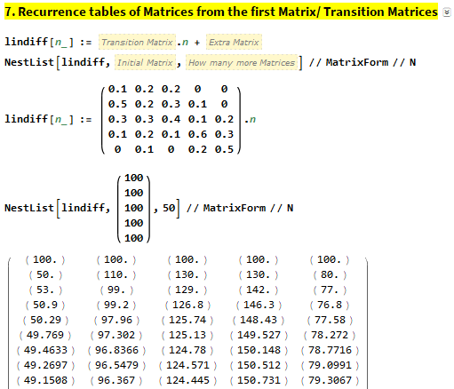
2018 Exam 1 Q8
A public library organised 500 of its members into five categories according to the number of books each member borrows each month.
These categories are
J = no books borrowed per month
K = one book borrowed per month
L = two books borrowed per month
M = three books borrowed per month
N = four or more books borrowed per month
The transition matrix, T, below shows how the number of books borrowed per month by the members is expected to change from month to month.
this month
J K L M N
$T=\left[\begin{matrix}0.1 & 0.2 & 0.2 & 0 & 0 \\ 0.5 & 0.2 & 0.3 & 0.1 & 0 \\ 0.3 & 0.3 & 0.4 & 0.1 & 0.2 \\ 0.1 & 0.2 & 0.1 & 0.6 & 0.3 \\ 0 & 0.1 & 0 & 0.2 & 0.5\end{matrix}\right]\begin{matrix}J \\ k \\ L \\ M \\ N\end{matrix} next month$
In the long term, which category is expected to have approximately 96 members each month?
A. J B. K C. L D. M E. N

Slide 6
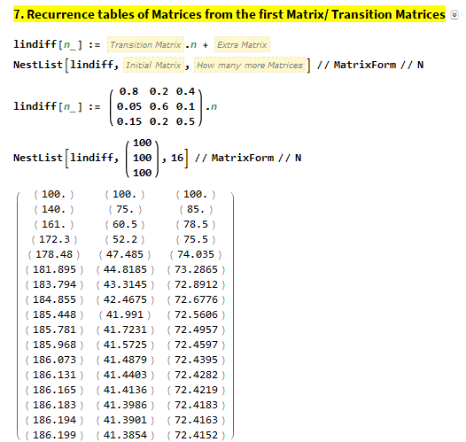
2019 Exam 1 Q6
A water park is open from 9 am until 5 pm.
There are three activities, the pool (P), the slide (S) and the water jets (W), at the water park.
Children have been found to change their activity at the water park each half hour, as shown in the transition matrix, T, below.
this half hour
P S W
$T=\left[\begin{matrix}0.80 & 0.20 & 0.40 \\ 0.05 & 0.60 & 0.10 \\ 0.15 & 0.20 & 0.50\end{matrix}\right]\begin{matrix}P \\ S \\ W\end{matrix} next half hour$
A group of children has come to the water park for the whole day.
The percentage of these children who are expected to be at the slide (S) at closing time is closest to
A. 14%
B. 20%
C. 24%
D. 25%
E. 62%
$\frac{41.3853}{300}=$0.137951=13.7951%

