Slide 1
Transition Matrices with a change
Past Exam Paper

Slide 2
2017 Exam 1 Q7
At a fish farm:
young fish (Y) may eventually grow into juveniles (J) or they may die (D)
juveniles (J) may eventually grow into adults (A) or they may die (D)
adults (A) eventually die (D).
The initial state of this population, $F_{0}$ , is shown below.
$F_{0}=\left[\begin{matrix}50 000 \\ 10 000 \\ 7000 \\ 0\end{matrix}\right]\begin{matrix}Y \\ J \\ A \\ D\end{matrix}$
Every month, fish are either sold or bought so that the number of young, juvenile and adult fish in the farm remains constant.
The population of fish in the fish farm after n months, $F_{n}$ , can be determined by the recurrence rule
$F_{n+1}=\left[\begin{matrix}0.65 & 0 & 0 & 0 \\ 0.25 & 0.75 & 0 & 0 \\ 0 & 0.20 & 0.95 & 0 \\ 0.10 & 0.05 & 0.05 & 1\end{matrix}\right]F_{n}+B$
where B is a column matrix that shows the number of young, juvenile and adult fish bought or sold each month and the number of dead fish that are removed.
Each month, the fish farm will
A. sell 1650 adult fish.
B. buy 1750 adult fish.
C. sell 17500 young fish.
D. buy 50 000 young fish.
E. buy 10000 juvenile fish
$F_{1}=TF_{0}+B=F_{0}=\left[\begin{matrix}0.65 & 0 & 0 & 0 \\ 0.25 & 0.75 & 0 & 0 \\ 0 & 0.20 & 0.95 & 0 \\ 0.10 & 0.05 & 0.05 & 1\end{matrix}\right]×\left[\begin{matrix}50 000 \\ 10 000 \\ 7000 \\ 0\end{matrix}\right]$+ $\left[\begin{matrix}a \\ b \\ c \\ d\end{matrix}\right]$= $\left[\begin{matrix}50 000 \\ 10 000 \\ 7000 \\ 0\end{matrix}\right]$ $\begin{matrix}Y \\ J \\ A \\ D\end{matrix}$
$\left[\begin{matrix}0.65 & 0 & 0 & 0 \\ 0.25 & 0.75 & 0 & 0 \\ 0 & 0.20 & 0.95 & 0 \\ 0.10 & 0.05 & 0.05 & 1\end{matrix}\right]×\left[\begin{matrix}50 000 \\ 10 000 \\ 7000 \\ 0\end{matrix}\right]=$ $\left[\begin{matrix}32 500 \\ 20 000 \\ 8650 \\ 5850\end{matrix}\right]$
$\left[\begin{matrix}32 500 \\ 20 000 \\ 8650 \\ 5850\end{matrix}\right]$+ $\left[\begin{matrix}a \\ b \\ c \\ d\end{matrix}\right]$= $\left[\begin{matrix}50 000 \\ 10 000 \\ 7000 \\ 0\end{matrix}\right]$ $\begin{matrix}Y \\ J \\ A \\ D\end{matrix}$
$\left[\begin{matrix}32 500 \\ 20 000 \\ 8650 \\ 5850\end{matrix}\right]$+ $\left[\begin{matrix}17 500 \\ −10 000 \\ −1650 \\ −5850\end{matrix}\right]$= $\left[\begin{matrix}50 000 \\ 10 000 \\ 7000 \\ 0\end{matrix}\right]$ $\begin{matrix}Y \\ J \\ A \\ D\end{matrix}$
$\left[\begin{matrix}17 500 \\ −10 000 \\ −1650 \\ −5850\end{matrix}\right]$ $\begin{matrix}Y buy \\ J sell \\ A sell \\ D die \end{matrix}$

Slide 3
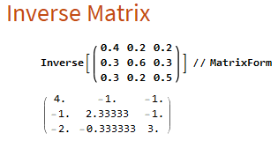
2018 Exam 1 Q7
A study of the antelope population in a wildlife park has shown that antelope regularly move between three locations, east (E), north (N) and west (W).
Let $A_{n}$ be the state matrix that shows the population of antelope in each location n months after the study began.
The expected population of antelope in each location can be determined by the matrix recurrence rule
$A_{n+1}$ = T$A_{n}$ – D
where
this month
E N W
$T=\left[\begin{matrix}0.4 & 0.2 & 0.2 \\ 0.3 & 0.6 & 0.3 \\ 0.3 & 0.2 & 0.5\end{matrix}\right]\begin{matrix}E \\ N \\ W\end{matrix}$ next month
And
$D=\left[\begin{matrix}50 \\ 50 \\ 50\end{matrix}\right]$ $\begin{matrix}E \\ N \\ W\end{matrix}$
The state matrix, $A_{3}$ , below shows the population of antelope three months after the study began.
$A_{3}=\left[\begin{matrix}1616 \\ 2800 \\ 2134\end{matrix}\right]$ $\begin{matrix}E \\ N \\ W\end{matrix}$
The number of antelope in the west (W) location two months after the study began, as found in the state matrix $A_{2}$ , is closest to
A. 2060 B. 2130 C. 2200 D. 2240 E. 2270
$A_{3}$ = T$A_{2}$ – D
$A_{3}=\left[\begin{matrix}1616 \\ 2800 \\ 2134\end{matrix}\right]$ = $\left[\begin{matrix}0.4 & 0.2 & 0.2 \\ 0.3 & 0.6 & 0.3 \\ 0.3 & 0.2 & 0.5\end{matrix}\right]$ $A_{2}$ – $\left[\begin{matrix}50 \\ 50 \\ 50\end{matrix}\right]$
$\left[\begin{matrix}1616 \\ 2800 \\ 2134\end{matrix}\right]$+ $\left[\begin{matrix}50 \\ 50 \\ 50\end{matrix}\right]$= $\left[\begin{matrix}0.4 & 0.2 & 0.2 \\ 0.3 & 0.6 & 0.3 \\ 0.3 & 0.2 & 0.5\end{matrix}\right]$ $A_{2}$
$\left[\begin{matrix}1666 \\ 2850 \\ 2184\end{matrix}\right]$= $\left[\begin{matrix}0.4 & 0.2 & 0.2 \\ 0.3 & 0.6 & 0.3 \\ 0.3 & 0.2 & 0.5\end{matrix}\right]$ $A_{2}$
${\left[\begin{matrix}0.4 & 0.2 & 0.2 \\ 0.3 & 0.6 & 0.3 \\ 0.3 & 0.2 & 0.5\end{matrix}\right]}^{−1}\left[\begin{matrix}1666 \\ 2850 \\ 2184\end{matrix}\right]$= $A_{2}$
$$\left[\begin{matrix}1630 \\ 2000 \\ 2270\end{matrix}\right]\begin{matrix}E \\ N \\ W\end{matrix}=A_{2}$$

Slide 4
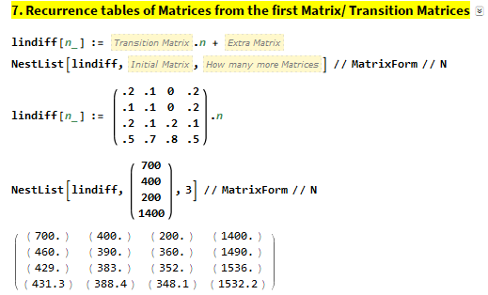
2018 Exam 2 Q3d
The Hiroads company has a contract to maintain and improve 2700 km of highway. Each year sections of highway must be graded (G), resurfaced (R) or sealed (S).
The remaining highway will need no maintenance (N) that year.
Let $S_{n}$ be the state matrix that shows the highway maintenance schedule for the n^{th} year after 2018.
The maintenance schedule for 2018 is shown in matrix $S_{0}$ below.
$S_{0}=\left[\begin{matrix}700 \\ 400 \\ 200 \\ 1400\end{matrix}\right]\begin{matrix}G \\ R \\ S \\ N\end{matrix}$
The type of maintenance in sections of highway varies from year to year, as shown in the transition matrix, T, below.
this year
G R S N
$T=\left[\begin{matrix}0.2 & 0.1 & 0.0 & 0.2 \\ 0.1 & 0.1 & 0.0 & 0.2 \\ 0.2 & 0.1 & 0.2 & 0.1 \\ 0.5 & 0.7 & 0.8 & 0.5\end{matrix}\right]\begin{matrix}G \\ R \\ S \\ N\end{matrix}$ next year
The state matrix describing the highway maintenance schedule for the n^{th} year after 2018 is given by $S_{n+1}=TS_{n}$
d. In 2020, 1536 km of highway is expected to require no maintenance (N). Of these kilometres, what percentage is expected to have had no maintenance (N) in 2019?
Round your answer to one decimal place.
$S_{1}=\left[\begin{matrix}460 \\ 390 \\ 360 \\ 1490\end{matrix}\right]$ $S_{2}=\left[\begin{matrix}429 \\ 383 \\ 352 \\ 1536\end{matrix}\right]$
0.5 $×$1490=745
$\frac{745}{1536}$ = 0.4850= 48.5%

Slide 5
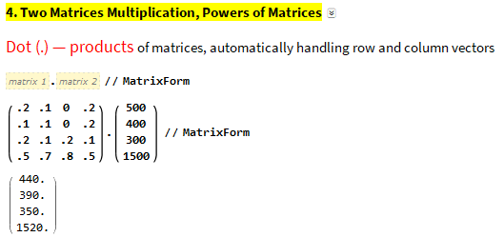
2018 Exam 2 Q4a
Beginning in the year 2021, a new company will take over maintenance of the same 2700 km highway with a new contract.
Let $M_{n}$ be the state matrix that shows the highway maintenance schedule of this company for
the n^{th} year after 2020.
The maintenance schedule for 2020 is shown in matrix $M_{0}$ below.
For these 2700 km of highway, the matrix recurrence relation shown below can be used to determine the number of kilometres of this highway that will require each type of maintenance from year to year.
$M_{n+1}$ = T$M_{n}$ + B
where
this year
G R S N
$M_{0}=\left[\begin{matrix}500 \\ 400 \\ 300 \\ 1500\end{matrix}\right]\begin{matrix}G \\ R \\ S \\ N\end{matrix} T=\left[\begin{matrix}0.2 & 0.1 & 0.0 & 0.2 \\ 0.1 & 0.1 & 0.0 & 0.2 \\ 0.2 & 0.1 & 0.2 & 0.1 \\ 0.5 & 0.7 & 0.8 & 0.5\end{matrix}\right]\begin{matrix}G \\ R \\ S \\ N\end{matrix}$ next year $B=\left[\begin{matrix}k \\ 20 \\ 10 \\ −60\end{matrix}\right]$
a. Write down the value of k in matrix B.
$\left[\begin{matrix}0.2 & 0.1 & 0.0 & 0.2 \\ 0.1 & 0.1 & 0.0 & 0.2 \\ 0.2 & 0.1 & 0.2 & 0.1 \\ 0.5 & 0.7 & 0.8 & 0.5\end{matrix}\right]×\left[\begin{matrix}500 \\ 400 \\ 300 \\ 1500\end{matrix}\right]=$ $\left[\begin{matrix}440 \\ 390 \\ 350 \\ 1520\end{matrix}\right]$
$\left[\begin{matrix}440 \\ 390 \\ 350 \\ 1520\end{matrix}\right]$+ $\left[\begin{matrix}k \\ 20 \\ 10 \\ −60\end{matrix}\right]$= $\left[\begin{matrix}440+k \\ 410 \\ 360 \\ 1460\end{matrix}\right]$
440+k+410+360+1460=2700
2670+k=2700
K=30

Slide 6
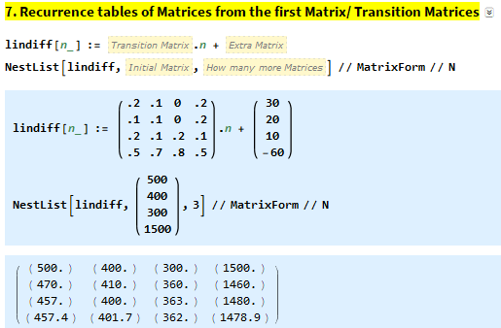
2018 Exam 2 Q4b
Beginning in the year 2021, a new company will take over maintenance of the same 2700 km highway with a new contract.
Let $M_{n}$ be the state matrix that shows the highway maintenance schedule of this company for
the n^{th} year after 2020.
The maintenance schedule for 2020 is shown in matrix $M_{0}$ below.
For these 2700 km of highway, the matrix recurrence relation shown below can be used to determine the number of kilometres of this highway that will require each type of maintenance from year to year.
$M_{n+1}$ = T$M_{n}$ + B
where
this year
G R S N
$M_{0}=\left[\begin{matrix}500 \\ 400 \\ 300 \\ 1500\end{matrix}\right]\begin{matrix}G \\ R \\ S \\ N\end{matrix} T=\left[\begin{matrix}0.2 & 0.1 & 0.0 & 0.2 \\ 0.1 & 0.1 & 0.0 & 0.2 \\ 0.2 & 0.1 & 0.2 & 0.1 \\ 0.5 & 0.7 & 0.8 & 0.5\end{matrix}\right]\begin{matrix}G \\ R \\ S \\ N\end{matrix}$ next year $B=\left[\begin{matrix}k \\ 20 \\ 10 \\ −60\end{matrix}\right]$
b. How many kilometres of highway are expected to be graded (G) in the year 2022?
$M_{2}=$ $\left[\begin{matrix}457 \\ 400 \\ 363 \\ 1480\end{matrix}\right]$ $\begin{matrix}G \\ R \\ S \\ N\end{matrix}$ → 457 km =G

Slide 7
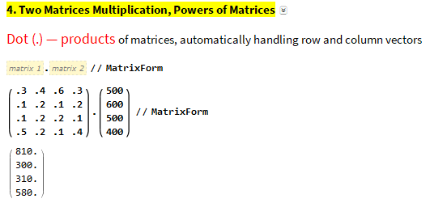
2019 Exam 2 Q3bi
On Sunday, matrix V is used when calculating the expected number of visitors at each location every hour after 10 am. It is assumed that the park will be at its capacity of 2000 visitors for all of Sunday.
Let $L_{0}$ be the state matrix that shows the number of visitors at each location at 10 am on Sunday.
The number of visitors expected at each location at 11 am on Sunday can be determined by the matrix product
$\text{this} \text{hour}$
$\text{A} \text{F} \text{G} \text{W}$
$V×L_{0} {Where L}_{0}=\left[\begin{matrix}500 \\ 600 \\ 500 \\ 400\end{matrix}\right]\begin{matrix}A \\ F \\ G \\ W\end{matrix} V=\left[\begin{matrix}0.3 & 0.4 & 0.6 & 0.3 \\ 0.1 & 0.2 & 0.1 & 0.2 \\ 0.1 & 0.2 & 0.2 & 0.1 \\ 0.5 & 0.2 & 0.1 & 0.4\end{matrix}\right]\begin{matrix}A \\ F \\ G \\ W\end{matrix} \text{next} \text{hour}$
b. Whenever more than 600 visitors are expected to be at a location on Sunday, the first 600 visitors can stay at that location and all others will be moved directly to Ground World (G).
State matrix $R_{n}$ contains the number of visitors at each location n hours after 10 am on Sunday, after the safety restrictions have been enforced.
Matrix $R_{1}$ can be determined from the matrix recurrence relation
$R_{0}=\left[\begin{matrix}500 \\ 600 \\ 500 \\ 400\end{matrix}\right]\begin{matrix}A \\ F \\ G \\ W\end{matrix} R_{1}$ = V $×$ $R_{0}$ + $B_{1}$
where matrix $B_{1}$ shows the required movement of visitors at 11 am.
i. Determine the matrix $B_{1}$
$B_{1}$ =
$\text{V} × R_{0}=$ $\left[\begin{matrix}810 \\ 300 \\ 310 \\ 580\end{matrix}\right]\begin{matrix}A \\ F \\ G \\ W\end{matrix}$ → $B_{1}$ = $\left[\begin{matrix}−210 \\ 0 \\ 210 \\ 0\end{matrix}\right]$

Slide 8
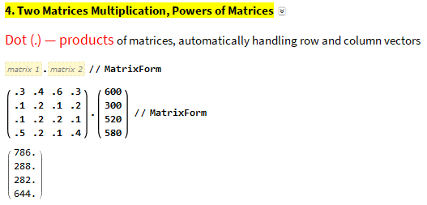
2019 Exam 2 Q3bii
On Sunday, matrix V is used when calculating the expected number of visitors at each location every hour after 10 am. It is assumed that the park will be at its capacity of 2000 visitors for all of Sunday.
Let $L_{0}$ be the state matrix that shows the number of visitors at each location at 10 am on Sunday.
The number of visitors expected at each location at 11 am on Sunday can be determined by the matrix product
$\text{this} \text{hour}$
$\text{A} \text{F} \text{G} \text{W}$
$V×L_{0} {Where L}_{0}=\left[\begin{matrix}500 \\ 600 \\ 500 \\ 400\end{matrix}\right]\begin{matrix}A \\ F \\ G \\ W\end{matrix} V=\left[\begin{matrix}0.3 & 0.4 & 0.6 & 0.3 \\ 0.1 & 0.2 & 0.1 & 0.2 \\ 0.1 & 0.2 & 0.2 & 0.1 \\ 0.5 & 0.2 & 0.1 & 0.4\end{matrix}\right]\begin{matrix}A \\ F \\ G \\ W\end{matrix} \text{next} \text{hour}$
b. Whenever more than 600 visitors are expected to be at a location on Sunday, the first 600 visitors can stay at that location and all others will be moved directly to Ground World (G).
State matrix $R_{n}$ contains the number of visitors at each location n hours after 10 am on Sunday, after the safety restrictions have been enforced.
Matrix $R_{1}$ can be determined from the matrix recurrence relation
$R_{0}=\left[\begin{matrix}500 \\ 600 \\ 500 \\ 400\end{matrix}\right]\begin{matrix}A \\ F \\ G \\ W\end{matrix} R_{1}$ = V $×$ $R_{0}$ + $B_{1}$
where matrix $B_{1}$ shows the required movement of visitors at 11 am.
ii. State matrix $R_{2}$ can be determined from the new matrix rule
$R_{2}$ = V$R_{1}$ + $B_{2}$
where matrix $B_{2}$ shows the required movement of visitors at 12 noon.
Determine the state matrix $R_{2}$ .
$R_{2}$ =
$\text{V} × R_{0}=$ $\left[\begin{matrix}810 \\ 300 \\ 310 \\ 580\end{matrix}\right]\begin{matrix}A \\ F \\ G \\ W\end{matrix}$ → $B_{1}$ = $\left[\begin{matrix}−210 \\ 0 \\ 210 \\ 0\end{matrix}\right] R_{1}$= $\left[\begin{matrix}600 \\ 300 \\ 520 \\ 580\end{matrix}\right]$
$\text{V} × R_{1}=$ $\left[\begin{matrix}786 \\ 288 \\ 282 \\ 644\end{matrix}\right]\begin{matrix}A \\ F \\ G \\ W\end{matrix}$ → $B_{2}$ = $\left[\begin{matrix}−186 \\ 0 \\ 230 \\ −44\end{matrix}\right] R_{2}$= $\left[\begin{matrix}600 \\ 288 \\ 512 \\ 600\end{matrix}\right]$

