Slide 1
Critical Paths Analysis
Past Exam Q’s

Slide 2
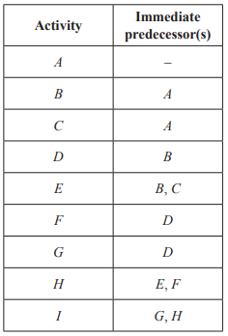
2019 Exam 1 Q7
A project involves nine activities, A to I.
The immediate predecessor(s) of each activity is shown in the table below.
A directed network for this project will require a dummy activity.
The dummy activity will be drawn from the end of
A. activity B to the start of activity C.
B. activity B to the start of activity E.
C. activity D to the start of activity E.
D. activity E to the start of activity H.
E. activity E to the start of activity F.

Slide 3
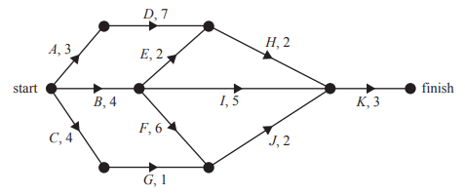
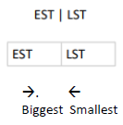
2018 Exam 1 Q5
The directed network below shows the sequence of 11 activities that are needed to complete a project.
The time, in weeks, that it takes to complete each activity is also shown.
How many of these activities could be delayed without affecting the minimum completion time of the project?
A. 3
B. 4
C. 5
D. 6
E. 7
3 | 3
10 | 10
3
10
6
10
0
8
12
15 | 15
0 | 0
7
0
4 | 4
9
12
5
4
12 | 12
10
10
9
5
4 | 9
10 | 10

Slide 4
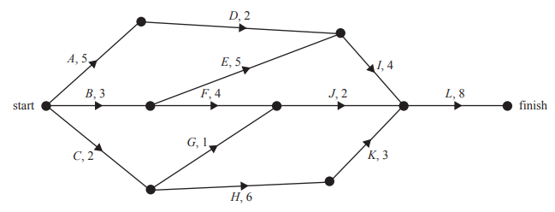
2016 Exam 1 Q7
The directed graph below shows the sequence of activities required to complete a project. All times are in hours.
There is one critical path for this project.
Three critical paths would exist if the duration of activity
A. I were reduced by two hours.
B. E were reduced by one hour.
C. G were increased by six hours.
D. K were increased by two hours.
E. F were increased by two hours.
5 | 6
8 | 8
7
8
1
3 | 3
3
12
20 | 20
7 | 10
9
7
0
6
11
0 | 0
1
3
12 | 12
9
3
8 | 9
2 | 3

Slide 5
2019 Exam 2 Q3d
Fencedale High School is planning to renovate its gymnasium. This project involves 12 activities, A to L.
The directed network below shows these activities and their completion times, in weeks.
The minimum completion time for the project is 35 weeks.
It is possible to reduce the completion time for activities C, D, G, H and K by employing more workers.
d. The completion time for each of these five activities can be reduced by a maximum of two weeks.
What is the minimum time, in weeks, that the renovation project could take?
D 2 weeks & C 1 week
G 2 weeks & H 1 week
K 2 weeks
29 Weeks
11 | 12
20 | 20
6 | 6
25
7
14
16
20
24
0 | 0
6
15
35 | 35
15 | 15
17
22
29
21
29 | 29
2 | 2
22 | 22
16 | 16

Slide 6
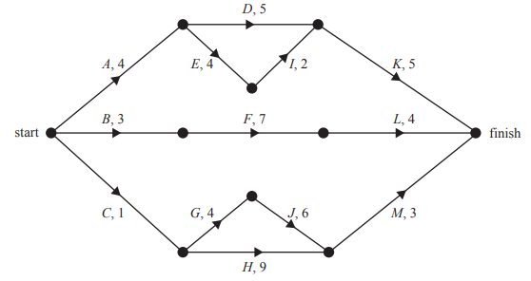
2016 Exam 2 Q3c
A new skateboard park is to be built in Beachton.
This project involves 13 activities, A to M.
The directed network below shows these activities and their completion times in days.
c. Which activity has a float time of two days?
4 | 4
10 | 10
9
5
4
10
D 10—4—5=1
B 4—0—3=1
F 11—3—7=1
L 15—10—4=1
C 2—0—1=1
G 6—1—4=1
J 12—5—6=1
H 12—1—9=2
M 15—11—3=1
8 | 8
0
15
1
0 | 0
14
15 | 15
3 | 4
10 | 11
14
1
5 | 6
2
11
2
10
1 | 2
11 | 12

Slide 7
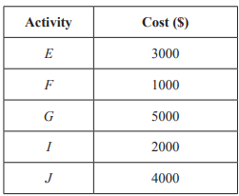
2016 Exam 2 Q3d
A new skateboard park is to be built in Beachton.
This project involves 13 activities, A to M.
The directed network below shows these activities and their completion times in days.
d. The completion times for activities E, F, G, I and J can each be reduced by one day.
The cost of reducing the completion time by one day for these activities is shown in the table below.
What is the minimum cost to complete the project in the shortest time possible?
4 | 4
10 | 10
9
5
I ↓1 day as cheaper than E $2000
Total completing 14 hours
4
10
8 | 8
0
15
1
0 | 0
14
15 | 15
3 | 4
10 | 11
14
1
5 | 6
2
11
2
10
1 | 2
11 | 12

Slide 8
2016 Exam 2 Q3ei
A new skateboard park is to be built in Beachton.
This project involves 13 activities, A to M.
The directed network below shows these activities and their completion times in days.
e. The skateboard park project on page 22 will be repeated at Campville, but with the addition of one extra activity.
The new activity, N, will take six days to complete and has a float time of one day.
Activity N will finish at the same time as the project.
i. Add activity N to the network below.?
4 | 4
10 | 10
9
5
N= 6 days + 1 day of Float time
I +K=7
F+L=11
M+J=9
M+H=12
N: Beginning of I → Finish
4
10
8 | 8
0
15
1
0 | 0
14
15 | 15
3 | 4
10 | 11
14
1
5 | 6
2
11
2
10
1 | 2
11 | 12

Slide 9
2016 Exam 2 Q3eii
A new skateboard park is to be built in Beachton.
This project involves 13 activities, A to M.
The directed network below shows these activities and their completion times in days.
e. The skateboard park project on page 22 will be repeated at Campville, but with the addition of one extra activity.
The new activity, N, will take six days to complete and has a float time of one day.
Activity N will finish at the same time as the project.
ii. What is the latest start time for activity N?
4 | 4
10 | 10
9
5
N can start at 9 days =15-6
4
10
8 | 8
0
15
1
0 | 0
14
15 | 15
3 | 4
10 | 11
14
1
5 | 6
2
11
2
10
1 | 2
11 | 12

