Slide 1
Allocation and Hungarian Algorithm
Past Exam Q’s

Slide 2
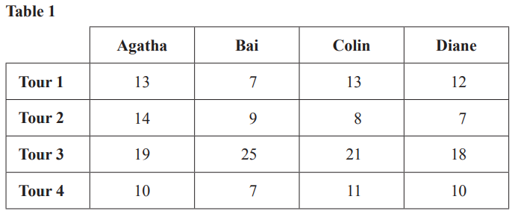
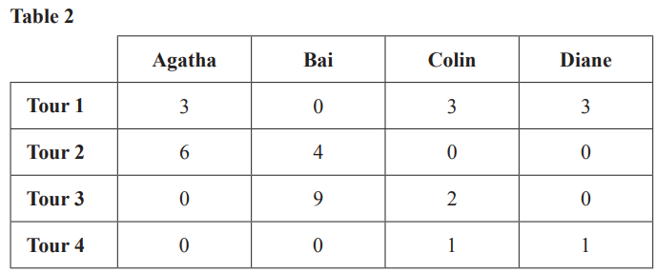
2017 Exam 2 Q2a
Bai joins his friends Agatha, Colin and Diane when he arrives for the holiday in Seatown.
Each person will plan one tour that the group will take.
Table 1 shows the time, in minutes, it would take each person to plan each of the four tours.
The aim is to minimise the total time it takes to plan the four tours.
Agatha applies the Hungarian algorithm to Table 1 to produce Table 2.
Table 2 shows the final result of all her steps of the Hungarian algorithm.
a. In Table 2 there is a zero in the column for Colin.
When all values in the table are considered, what conclusion about minimum total planning time can be made from this zero?
Colin must plan Tour 2

Slide 3
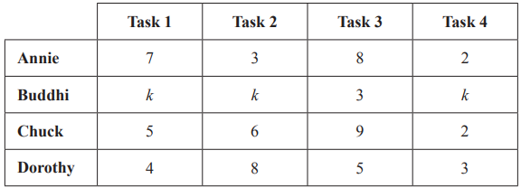
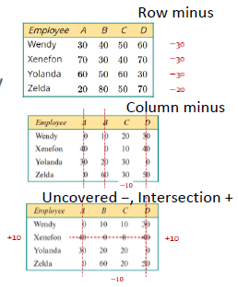
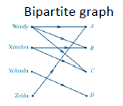
2018 Exam 1 Q8
Annie, Buddhi, Chuck and Dorothy work in a factory.
Today each worker will complete one of four tasks, 1, 2, 3 and 4.
The usual completion times for Annie, Chuck and Dorothy are shown in the table below.
Buddhi takes 3 minutes for Task 3.
He takes k minutes for each other task.
Today the factory supervisor allocates the tasks as follows:
•Task 1 to Dorothy
•Task 2 to Annie
•Task 3 to Buddhi
•Task 4 to Chuck
This allocation will achieve the minimum total completion time if the value of k is at least
A. 0
B. 1
C. 2
D. 3
E. 4
4
3
3
2
Total 12 Minutes

Slide 4
2018 Exam 1 Q8
Annie, Buddhi, Chuck and Dorothy work in a factory.
Today each worker will complete one of four tasks, 1, 2, 3 and 4.
The usual completion times for Annie, Chuck and Dorothy are shown in the table below.
Buddhi takes 3 minutes for Task 3.
He takes k minutes for each other task.
Today the factory supervisor allocates the tasks as follows:
•Task 1 to Dorothy
•Task 2 to Annie
•Task 3 to Buddhi
•Task 4 to Chuck
This allocation will achieve the minimum total completion time if the value of k is at least
A. 0
B. 1
C. 2
D. 3
E. 4
4
3
3
2
Total 12 Minutes
Let k=0 uncovered $−$ intersection +
row minus column minus lines to cover 0s≥4(tasks) Bipartite Graph Allocation
$\begin{matrix}7 & 3 & 8 & 2 \\ 0 & 0 & 3 & 0 \\ 5 & 6 & 9 & 2 \\ 4 & 8 & 5 & 3\end{matrix} \begin{matrix}−2 \\ 0 \\ −2 \\ −3\end{matrix} → \begin{matrix}5 & 1 & 6 & 0 \\ 0 & 0 & 3 & 0 \\ 3 & 4 & 7 & 0 \\ 1 & 5 & 2 & 0\end{matrix} →\begin{matrix}5 & 1 & 4 & 0 \\ 0 & 0 & 1 & 0 \\ 3 & 4 & 5 & 0 \\ 1 & 5 & 0 & 0\end{matrix} \begin{matrix}2 \\ +1 \\ \\ +1\end{matrix} → \begin{matrix}4 & 0 & 3 & 0 \\ 0 & 0 & 1 & 1 \\ 2 & 3 & 4 & 0 \\ 1 & 5 & 0 & 1\end{matrix} →\begin{matrix}A \\ B \\ C \\ D\end{matrix} \begin{matrix}1 \\ 2 \\ 3 \\ 4\end{matrix}$ $→\begin{matrix}A \\ B \\ C \\ D\end{matrix} \begin{matrix}→2 \\ →1 \\ →4 \\ →3\end{matrix}→\begin{matrix}3min \\ 0min \\ 2min \\ 5min\end{matrix}$
0 0 $−2$ 0 total time: 10min

Slide 5
2018 Exam 1 Q8
Annie, Buddhi, Chuck and Dorothy work in a factory.
Today each worker will complete one of four tasks, 1, 2, 3 and 4.
The usual completion times for Annie, Chuck and Dorothy are shown in the table below.
Buddhi takes 3 minutes for Task 3.
He takes k minutes for each other task.
Today the factory supervisor allocates the tasks as follows:
•Task 1 to Dorothy
•Task 2 to Annie
•Task 3 to Buddhi
•Task 4 to Chuck
This allocation will achieve the minimum total completion time if the value of k is at least
A. 0
B. 1
C. 2
D. 3
E. 4
4
3
3
2
Total 12 Minutes
Let k=1 uncovered $−$ intersection +
row minus column minus lines to cover 0s≥4(tasks) Bipartite Graph Allocation
$\begin{matrix}7 & 3 & 8 & 2 \\ 1 & 1 & 3 & 1 \\ 5 & 6 & 9 & 2 \\ 4 & 8 & 5 & 3\end{matrix} \begin{matrix}−2 \\ −1 \\ −2 \\ −3\end{matrix} → \begin{matrix}5 & 1 & 6 & 0 \\ 0 & 0 & 2 & 0 \\ 3 & 4 & 7 & 0 \\ 1 & 5 & 2 & 0\end{matrix} →\begin{matrix}5 & 1 & 4 & 0 \\ 0 & 0 & 0 & 0 \\ 3 & 4 & 5 & 0 \\ 1 & 5 & 0 & 0\end{matrix} \begin{matrix}2 \\ +1 \\ \\ +1\end{matrix} → \begin{matrix}4 & 0 & 3 & 0 \\ 0 & 0 & 0 & 1 \\ 2 & 3 & 4 & 0 \\ 1 & 5 & 0 & 1\end{matrix} →\begin{matrix}A \\ B \\ C \\ D\end{matrix} \begin{matrix}1 \\ 2 \\ 3 \\ 4\end{matrix}$ $→\begin{matrix}A \\ B \\ C \\ D\end{matrix} \begin{matrix}→2 \\ →1 \\ →4 \\ →3\end{matrix}→\begin{matrix}3min \\ 0min \\ 2min \\ 5min\end{matrix}$
0 0 $−2$ 0 total time: 10min

Slide 6
2018 Exam 1 Q8
Annie, Buddhi, Chuck and Dorothy work in a factory.
Today each worker will complete one of four tasks, 1, 2, 3 and 4.
The usual completion times for Annie, Chuck and Dorothy are shown in the table below.
Buddhi takes 3 minutes for Task 3.
He takes k minutes for each other task.
Today the factory supervisor allocates the tasks as follows:
•Task 1 to Dorothy
•Task 2 to Annie
•Task 3 to Buddhi
•Task 4 to Chuck
This allocation will achieve the minimum total completion time if the value of k is at least
A. 0
B. 1
C. 2
D. 3
E. 4
4
3
3
2
Total 12 Minutes
Let k=2 uncovered $−$ intersection +
row minus column minus lines to cover 0s≥4(tasks) Bipartite Graph Allocation
$\begin{matrix}7 & 3 & 8 & 2 \\ 2 & 2 & 3 & 2 \\ 5 & 6 & 9 & 2 \\ 4 & 8 & 5 & 3\end{matrix} \begin{matrix}−2 \\ −2 \\ −2 \\ −3\end{matrix} → \begin{matrix}5 & 1 & 6 & 0 \\ 0 & 0 & 1 & 0 \\ 3 & 4 & 7 & 0 \\ 1 & 5 & 2 & 0\end{matrix} →\begin{matrix}5 & 1 & 5 & 0 \\ 0 & 0 & 0 & 0 \\ 3 & 4 & 6 & 0 \\ 1 & 5 & 1 & 0\end{matrix} \begin{matrix}2 \\ +1 \\ \\ +1\end{matrix} → \begin{matrix}4 & 0 & 4 & 0 \\ 0 & 0 & 0 & 1 \\ 2 & 3 & 5 & 0 \\ 1 & 5 & 0 & 1\end{matrix} →\begin{matrix}A \\ B \\ C \\ D\end{matrix} \begin{matrix}1 \\ 2 \\ 3 \\ 4\end{matrix}$ $→\begin{matrix}A \\ B \\ C \\ D\end{matrix} \begin{matrix}→2 \\ →1 \\ →4 \\ →3\end{matrix}→\begin{matrix}3min \\ 2min \\ 2min \\ 5min\end{matrix}$
0 0 $−1$ 0 total time: 12min

