Slide 1
Finance Recursion
Advice

Slide 8
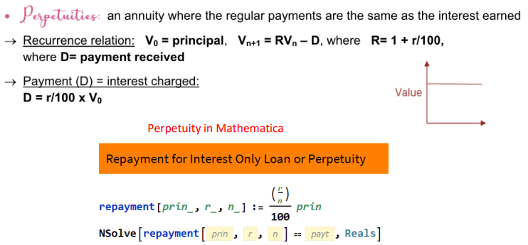

Slide 10
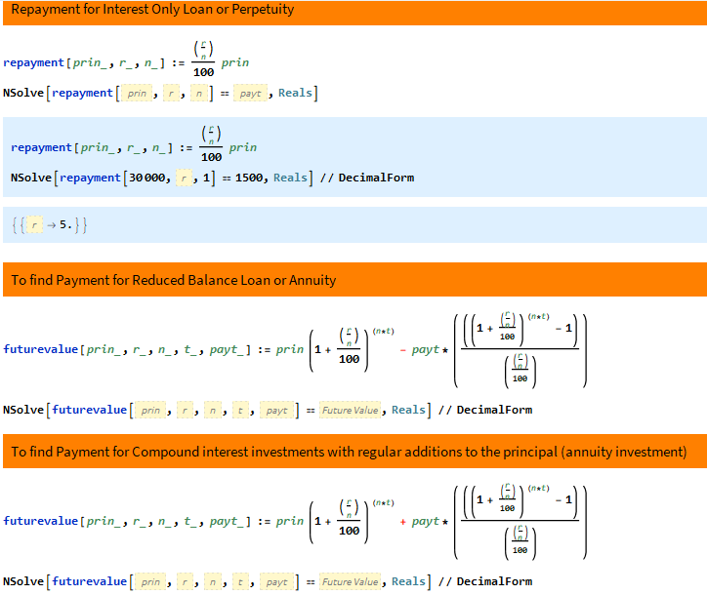

Slide 11
