Slide 1
Review of algebra (Consolidating)
1A

Slide 2
Key ideas-do you know these word?

Slide 3
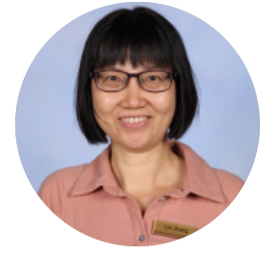

Slide 4
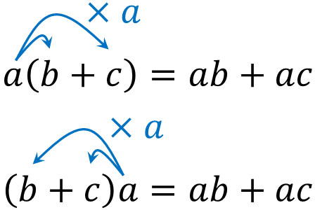

Slide 6
General properties

Slide 7
General properties

Slide 8
General properties

