Slide 1
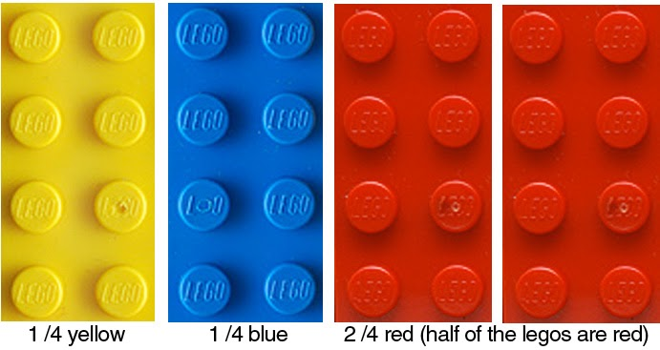
Multiplying and dividing algebraic fractions
1B

Slide 2
Learning intentions
To cancel common factors before multiplying or dividing
To be able to multiply and divide fractions involving algebraic expressions

Slide 3
Warmup, part #1
Simplify the following algebraic fractions
Evaluate the following

Slide 4
Review…
Why is ?
Let’s use general terms to try to understand
Would you agree that ?
Would you agree that ?
Therefore,

Slide 5
Didn’t like that proof?
Let’s try a different one…

Slide 6
Multiplying and dividing algebraic fractions

Slide 7
Example #1
Let’s multiply and
or

Slide 8
Your turn
Simplify

Slide 9
Example #2
Simplify

Slide 10
Your turn
Simplify

Slide 11
Example #3
Simplify
First, factorize as much as possible
Second, rewrite as a multiplication problem

Slide 12
Your turn
Simplify

