Slide 1
Understand that an equation of the form y = mx + c corresponds to a straight line graph
Objectives
Be able to find the gradient and y-intercept from a given line, or graph
Be able to find the gradient between two points
Be able to find the equation of a given straight line
Be able to form the equation of a straight light when given a point (x,y)

Slide 2
Understand that an equation of the form y = mx + c corresponds to a straight line graph

Slide 3
Form of a straight line
$$y=mx+c$$
y-intercept
Gradient
Where the graph crosses the y-axis
‘steepness or slope’
When x = 0, what is y?
Ways to find the gradient of a line:
$$\frac{\text{rise}}{\text{run}}= \frac{\text{y} \text{direction}}{\text{x} \text{direction}}$$
y-intercept

Slide 4
Gradient & y-intercept
Example 1
What is the equation if?
Gradient = 7
y-intercept = -3
∵$y=mx+c, m=7, c=−3$
∴ $y=7x−3$
Gradient = 4
y-intercept = -2
∵$y=mx+c, m=4, c=−2$
∴ $y=4x−2$

Slide 5
Be able to find the gradient and y-intercept from a given line, or graph

Slide 6
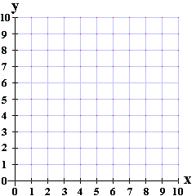
If your line starts low and ends high, the gradient will be positive.
Finding the gradient of a line
Look at the following examples of straight lines and work out their gradients:
y
Ways to find the gradient of a line:
$$\frac{\text{rise}}{\text{run}}= \frac{\text{y}\text{−}\text{direction}}{\text{x}\text{−}\text{direction}}$$
L1
3
x
If your line starts high and ends low, the gradient will be negative.
L1
L2
2
$$\frac{\text{y}\text{−}\text{direction}}{\text{x}\text{−}\text{direction}}$$
$$=−\frac{\text{3}}{\text{2}}$$
3
L3
y
L2
5
$$\frac{\text{y}\text{−}\text{direction}}{\text{x}\text{−}\text{direction}}$$
6
$$=−\frac{\text{3}}{\text{6}}$$
$$=−\frac{\text{1}}{\text{2}}$$
2
x
L3
$$\frac{\text{y}\text{−}\text{direction}}{\text{x}\text{−}\text{direction}}$$
$$=\frac{\text{5}}{\text{2}}$$

Slide 7
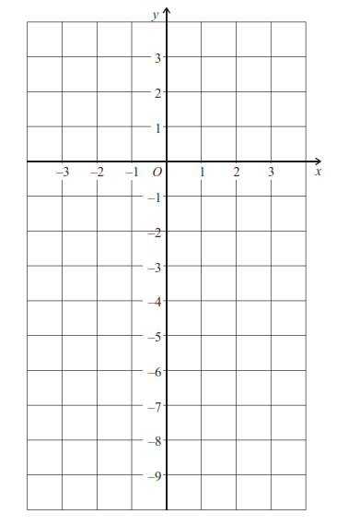
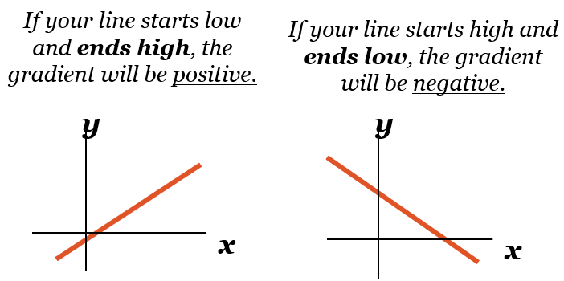
y = mx + c
Example:
Find the equation of the given line.
gradient (slope)
y-intercept (where the line crosses the y-axis)
Gradient of a line:
$$\frac{\text{rise}}{\text{run}}= \frac{\text{y}\text{−}\text{direction}}{\text{x}\text{−}\text{direction}}$$
y = mx + c
y = mx - 6
y = $\frac{\text{6}}{\text{3}}$x - 6
y = 2x - 6

Slide 8
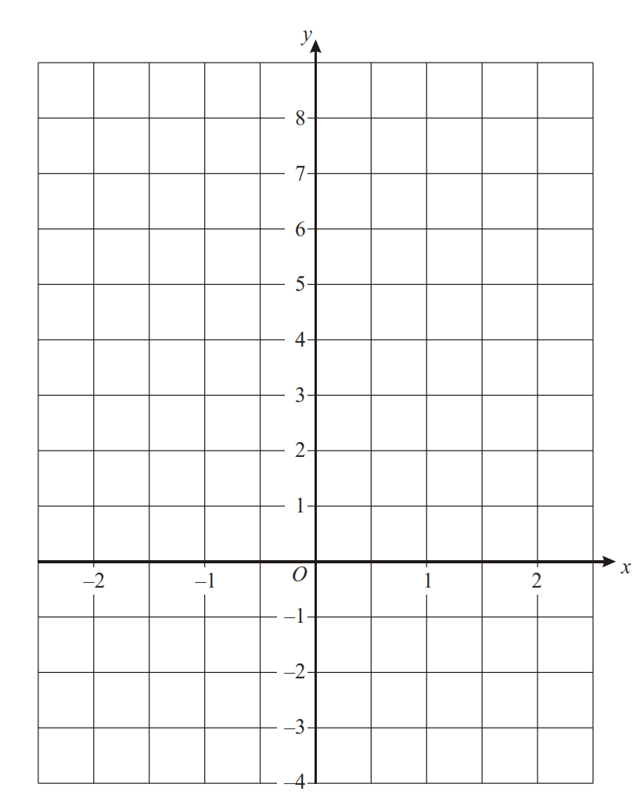
Avoid decimals in your fractions – just double the fraction!
Write down the equation of each line
y = mx + c
y = mx + c
y = $\frac{\text{9}}{\text{2}}$x + c
y = - $\frac{\text{4}}{\text{1.5}}$x + c
y =$\frac{\text{9}}{\text{2}}$x - 2
y = - $\frac{8}{3}$x + c
y = - $\frac{8}{3}$x + 4
y = mx + c
y = - $\frac{\text{1}}{\text{2.5}}$x + c
y = -$\frac{\text{1}}{\text{2.5}}$x + 5
Line end low? Negative gradient
Line end high? Positive gradient
Line end high? Positive gradient

Slide 9
Finding m and c
y
8
Find the Value of c
This is the point at which the line crosses the y-axis.
7
6
5
4
3
So c = 3
2
Find the Value of m The gradient means the rate at which the line is climbing.
Each time the lines moves 1 place to the right, it climbs up by 2 places.
1
x
–7 –6 –5 –4 –3 –2 –1
1 2 3 4 5 6 7 8
⁻1
⁻2
⁻3
⁻4
y = 2x +3
y = mx +c
⁻5
So m = 2
⁻6
Back to Main Page

Slide 10
Finding m and c
y
8
Find the Value of c
This is the point at which the line crosses the y-axis.
7
6
5
y = $−$x +2
y = mx +c
4
So c = 2
3
2
Find the Value of m The gradient means the rate at which the line is climbing.
Each time the line moves 1 place to the right, it moves down by 1 place.
1
x
–7 –6 –5 –4 –3 –2 –1
1 2 3 4 5 6 7 8
⁻1
⁻2
⁻3
⁻4
⁻5
So m = -1
⁻6
Back to Main Page

Slide 11
Some Lines to Identify
y
Line 1
m =
c =
Equation:
8
1
7
2
6
5
y = x + 2
4
Line 2
m =
c =
Equation:
3
1
2
1
-1
x
y = x - 1
–7 –6 –5 –4 –3 –2 –1
1 2 3 4 5 6 7 8
⁻1
⁻2
Line 3
m =
c =
Equation:
⁻3
-2
⁻4
1
⁻5
y = -2x + 1
⁻6
Back to Main Page

Slide 12
Be able to form the equation of a straight light when given a point (x,y)

Slide 13
Forming equations when given a point (x,y)
Remember: the standard format of a straight line graph is y = mx + c
E.g. Find the equation of the straight line that cuts the y-axis at 4 and goes through the point (4, 7)
E.g. Find the equation of the straight line that has a gradient of -2 and goes through the point (-3, -10)
y = mx + c
y-intercept (c) = 4
y = mx + c
y = mx + 4
(4,7) $→$ x = 4, y = 7
Gradient (m) = -2
y = - 2x + c
Sub into y = mx + 4 to find m
(-3,-10) $→$ x = -3, y = -10
7 = m(4) + 4
7 = 4m + 4
Sub into y = -2x + c to find c
- 4
- 4
-10 = -2(-3) + c
3 = 4m
-10 = 6 + c
m = $\frac{\text{3}}{\text{4}}$
- 6
- 6
-16 = c
y = $\frac{\text{3}}{\text{4}}$ x + 4
y = - 2x – 16

Slide 14
Be able to find the gradient between two points

Slide 15
Finding the gradient between 2 points
If you are given two coordinates: (x₁ , y₁) and (x₂ , y₂)
You can find the gradient of the line between these two points by finding the difference in the y’s, and dividing this value by the difference of the x’s
Example 1
AB is a line segment where A(4 , 8) and B(10, 12). Find the gradient of the line segment AB.
(x₁ , y₁) (x₂ , y₂)
$$gradient= \frac{\text{12 − 8}}{\text{1}\text{0 − 4}}$$
$$gradient= \frac{y_{2−}y_{1}}{x_{2−}x_{1}}$$
$$gradient= \frac{\text{4}}{\text{6}}$$
(4 , 8) (10 , 12)
$$= \frac{\text{2}}{\text{3}}$$

Slide 16
Example:
The line passing through A(6 , 6) and B(8, 12). Find the equation.
$$gradient= \frac{y_{2−}y_{1}}{x_{2−}x_{1}}$$
$\text{m}\text{= }\frac{\text{12 −}\text{6}}{\text{8 − 6}}$= $\frac{\text{6} }{\text{2}}=3$
$$\text{∵} y=mx+c, m=\text{3} \text{∴ }y=3x+c$$
$$\text{(}\text{6}\text{,}\text{6}\text{) }→ \text{x}\text{ = }\text{6}\text{, }\text{y}\text{ = }\text{6}$$
Sub into y = 3x + c to find c
6= 3 × 6+ c
6 = 18 + c
- 18
- 18
-12 = c
y = -3x – 12

