Slide 1
Revision
1A-1G

Slide 2
Warmup, part #1
Simplify the following algebraic fractions
Evaluate the following

Slide 3
Review…
Why is ?
Let’s use general terms to try to understand
Would you agree that ?
Would you agree that ?
Therefore,

Slide 4
Multiplying and dividing algebraic fractions

Slide 5
Example #1
Let’s multiply and
or

Slide 6
Example #2
Simplify

Slide 8
Identify the numerator and denominator
Calculate with the numerators
Keep the denominator the same
4$x$
$$x$$
4$x$ -$x$
3$x$
-
=
=
5
5
5
5
-
=

Slide 9
The first way you can do is to check whether one denominator is a factor (goes in to) the other denominator.
e.g.
In this example, 5 goes in to 10 by multiplying it by 2. Whatever we do to the denominator we also need to do to the numerator.
2
3
+
5
10

Slide 10
In this example, 5 goes in to 10 by multiplying it by 2. Whatever we do to the denominator we also need to do to the numerator.
2
x 2
3
+
5
10
x 2
4
3
4 + 3
7
+
=
=
10
10
10
10

Slide 11
The second way is to find LCM. Then make common denominator by times a number for each fraction.
e.g.
LCM of 3 and 4 is 12.
2
3
+
3
4

Slide 12
Whatever we do to the denominator we also need to do to the numerator.
2
x 4
3
x 3
+
3
4
x 4
x 3
8
9
8 + 9
17
+
=
=
12
12
12
12

Slide 13
The third way is to do a butterfly calculation for numbers/algebraic expression which are not easy to find LCM.
e.g.
2
3
+
17
25
$$\frac{1}{x+1}+\frac{2}{x+2}$$

Slide 14
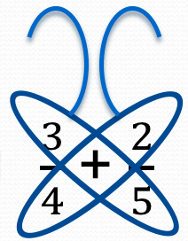
Add & Subtract—unlike denominators
15 + 8
15
8
$$\frac{23}{20}$$
$\frac{3}{4}$+ $\frac{2}{5}$
$\frac{3}{4}$+ $\frac{2}{5}$
20
15
8
$\frac{3}{4}$− $\frac{2}{5}$
$$\frac{7}{20}$$
15 − 8
$\frac{3}{4}$− $\frac{2}{5}$
20

Slide 15
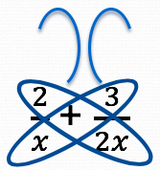
Add & Subtract—different algebraic denominators
$$\frac{7}{2x}$$
4$x$ + 3$x$ = 7$x$
4$x$
3$x$
$$\frac{7x}{2x^{2}}$$
$$\frac{7⋅x}{2⋅x⋅x}$$
$\frac{2}{x}$+ $\frac{3}{2x}$
$\frac{2}{x}$+ $\frac{3}{2x}$
2$x^{2}$
4$x$
3$x$
4$x$ − 3$x$ = $x$
$\frac{2}{x}$− $\frac{3}{2x}$
$\frac{2}{x}$− $\frac{3}{2x}$
$$\frac{x}{2x^{2}}$$
$$\frac{1⋅x}{2⋅x⋅x}$$
$$\frac{1}{2x}$$
2$x^{2}$

Slide 16
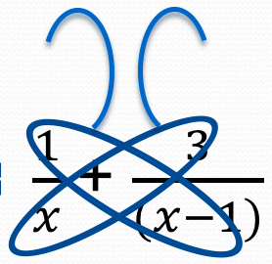
Add & Subtract—different algebraic denominators
($x−1)$ + 3$x$ = $x−1+3x=4x$-1
($x−1)$
3$x$
$\frac{1}{x}$+ $\frac{3}{(x−1)}$
$$\frac{4x−1}{x(x−1)}$$
$\frac{1}{x}$+ $\frac{3}{(x−1)}$
$$x(x−1)$$
($x−1)$ $−$ 3$x$ = $x−1−3x=−2x$-1
($x−1)$
3$x$
$\frac{1}{x}$− $\frac{3}{(x−1)}$
$\frac{1}{x}$− $\frac{3}{(x−1)}$
$$\frac{−2x−1}{x(x−1)}$$
$$x(x−1)$$

Slide 17
Solving Fractional Equations
$$\frac{x}{2}=\frac{7}{4}$$
Solve
Find LCM of 2 and 4.
2, 4, 6,8
4,8,12,16
Get rid of denominator.
Substitute your answer into the original equation to check.
$$\frac{x}{2}=\frac{7}{4}$$
X 2
X 2
$$\frac{2x}{4}=\frac{7}{4}$$
X 4 |  | X 4
2$x$ | = | 7
÷ 2 |  | ÷ 2
$$x$$ | = | 3.5

Slide 18
Solving Fractional Equations
$$x+\frac{4x+5}{6}=2$$
Solve
Get rid of denominator by multiply 6 for each term.
Combine like terms.
Substitute your answer into the original equation to check.
$$x+\frac{4x+5}{6}=2$$
X 6
X 6
X 6
$6x$ + (4$x$+5) =12
– 5 |  | – 5
10$x$ | = | 7
÷ 10 |  | ÷ 10
$$x$$ | = | 0.7
10$x$+5 =12

Slide 19
Solving Equations
Number side
X side
16 – 5x = 6x + 11
Add 5x to both sides
+5x
+5x
16
=
11x
+11
Take 11 from both sides
-11
-11
5
=
11x
Divide both sides by 11
÷ 11
÷ 11
Identify how to solve equations with an unknown on either side

Slide 20
Solve equations with non-integer answers
× 15
× 15
Multiply 15 to both sides
3
5
$$\frac{15\left(2x+1\right)}{5}=\frac{15\left(x−1\right)}{3}$$
1
1
Get rid of brackets
$$3\left(2x+1\right)=5\left(x−1\right)$$
Take 5x from both sides
-5x
$$6x+3=5x−5$$
-5x
-3
$$x+3=−5$$
-3
Take 3 from both sides
$$x=−8$$

Slide 21
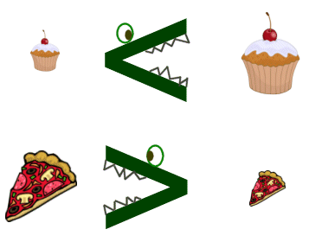
Inequalities
Solve the inequality below, and show the answer on a number line…
8x
≤
32
÷ 8
÷ 8
x
≤
4
1
2
3
4
5

Slide 22
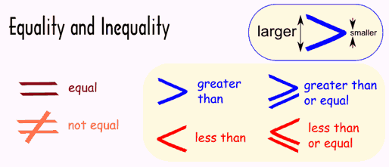
Inequalities
Solve the inequality below, and show the answer on a number line…
3x - 5
>
19
+ 5
+ 5
3x
>
24
÷ 3
÷ 3
x
>
8
6
7
8
9
10

Slide 23
Inequalities
Solve the inequality below, and show the answer on a number line…
6x + 6
≤
36
- 6
- 6
6x
≤
30
÷ 6
÷ 6
x
≤
5
3
4
5
6
7

Slide 24
Be able to find x and y intercepts

Slide 25
Example
Question: Draw the graph of 2x + y = 4
Solution
x = 0
2(0) + y = 4
y = 4
1st Co-ordinate = (0,4)
y = 0
2x + 0 = 4
2x = 4
x = 2
2nd Co-ordinate = (2,0)
Back to Main Page

Slide 26
Understand that an equation of the form y = mx + c corresponds to a straight line graph

Slide 27
y = mx + c
Every straight line can be written in this form. To do this the values for m and c must be found.
c is known as the intercept
y = mx + c
m is known as the gradient
Back to Main Page

Slide 28
Gradient & y-intercept
Example 1
What is the gradient and y-intercept of the line y = 7x – 3?
y
8
7
Find the y-intercept c
c= –3
6
5
4
(1,4)
So (0, – 3) is y-intercept
3
2
1
x
–7 –6 –5 –4 –3 –2 –1
1 2 3 4 5 6 7 8
⁻1
⁻2
(0, – 3)
⁻3
So m = 7
⁻4
⁻5
y = mx +c=7x – 3
⁻6
Back to Main Page

Slide 29
Understand that an equation of the form y = mx + c corresponds to a straight line graph

Slide 30
Gradient & y-intercept
Example 1
What is the equation if?
Gradient = 7
y-intercept = -3
∵$y=mx+c, m=7, c=−3$
∴ $y=7x−3$
Gradient = 4
y-intercept = -2
∵$y=mx+c, m=4, c=−2$
∴ $y=4x−2$

Slide 31
Be able to find the gradient and y-intercept from a given line, or graph

Slide 32
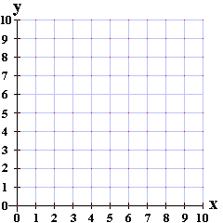
If your line starts low and ends high, the gradient will be positive.
Finding the gradient of a line
Look at the following examples of straight lines and work out their gradients:
y
Ways to find the gradient of a line:
$$\frac{\text{rise}}{\text{run}}= \frac{\text{y}\text{−}\text{direction}}{\text{x}\text{−}\text{direction}}$$
L1
3
x
If your line starts high and ends low, the gradient will be negative.
L1
L2
2
$$\frac{\text{y}\text{−}\text{direction}}{\text{x}\text{−}\text{direction}}$$
$$=−\frac{\text{3}}{\text{2}}$$
3
L3
y
L2
5
$$\frac{\text{y}\text{−}\text{direction}}{\text{x}\text{−}\text{direction}}$$
6
$$=−\frac{\text{3}}{\text{6}}$$
$$=−\frac{\text{1}}{\text{2}}$$
2
x
L3
$$\frac{\text{y}\text{−}\text{direction}}{\text{x}\text{−}\text{direction}}$$
$$=\frac{\text{5}}{\text{2}}$$

Slide 33
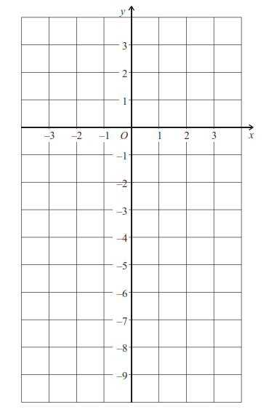
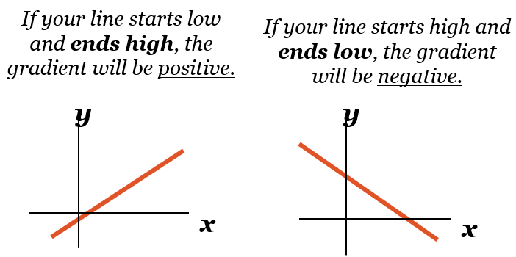
y = mx + c
Example:
Find the equation of the given line.
gradient (slope)
y-intercept (where the line crosses the y-axis)
Gradient of a line:
$$\frac{\text{rise}}{\text{run}}= \frac{\text{y}\text{−}\text{direction}}{\text{x}\text{−}\text{direction}}$$
y = mx + c
y = mx - 6
y = $\frac{\text{6}}{\text{3}}$x - 6
y = 2x - 6

Slide 34
Be able to form the equation of a straight light when given a point (x,y)

Slide 35
Forming equations when given a point (x,y)
Remember: the standard format of a straight line graph is y = mx + c
E.g. Find the equation of the straight line that cuts the y-axis at 4 and goes through the point (4, 7)
E.g. Find the equation of the straight line that has a gradient of -2 and goes through the point (-3, -10)
y = mx + c
y-intercept (c) = 4
y = mx + c
y = mx + 4
(4,7) $→$ x = 4, y = 7
Gradient (m) = -2
y = - 2x + c
Sub into y = mx + 4 to find m
(-3,-10) $→$ x = -3, y = -10
7 = m(4) + 4
7 = 4m + 4
Sub into y = -2x + c to find c
- 4
- 4
-10 = -2(-3) + c
3 = 4m
-10 = 6 + c
m = $\frac{\text{3}}{\text{4}}$
- 6
- 6
-16 = c
y = $\frac{\text{3}}{\text{4}}$ x + 4
y = - 2x – 16

Slide 36
Be able to find the gradient between two points

Slide 37
Finding the gradient between 2 points
If you are given two coordinates: (x₁ , y₁) and (x₂ , y₂)
You can find the gradient of the line between these two points by finding the difference in the y’s, and dividing this value by the difference of the x’s
Example 1
AB is a line segment where A(4 , 8) and B(10, 12). Find the gradient of the line segment AB.
(x₁ , y₁) (x₂ , y₂)
$$gradient= \frac{\text{12 − 8}}{\text{1}\text{0 − 4}}$$
$$gradient= \frac{y_{2−}y_{1}}{x_{2−}x_{1}}$$
$$gradient= \frac{\text{4}}{\text{6}}$$
(4 , 8) (10 , 12)
$$= \frac{\text{2}}{\text{3}}$$

Slide 38
Example:
The line passing through A(6 , 6) and B(8, 12). Find the equation.
$$gradient= \frac{y_{2−}y_{1}}{x_{2−}x_{1}}$$
$\text{m}\text{= }\frac{\text{12 −}\text{6}}{\text{8 − 6}}$= $\frac{\text{6} }{\text{2}}=3$
$$\text{∵} y=mx+c, m=\text{3} \text{∴ }y=3x+c$$
$$\text{(}\text{6}\text{,}\text{6}\text{) }→ \text{x}\text{ = }\text{6}\text{, }\text{y}\text{ = }\text{6}$$
Sub into y = 3x + c to find c
6= 3 × 6+ c
6 = 18 + c
- 18
- 18
-12 = c
y = -3x – 12

