Slide 1
3B Adding and subtracting surds
Sunday, 20 February 2022
How to add and subtract surds.
Success criteria
Know: what a surd is.
Understand: why we leave a number in surds form.
Be able to: add and subtract surds.
Key words
-Evaluate
-Square root
-Surd
-Simplify
-form
Topic: Factors, multiples, primes, standard form and surds

Slide 2
Sunday, 20 February 2022
Key words
-Evaluate
-Square root
-Surd
-Simplify
-form
How to add and subtract surds.
Know what a surd is.
Investigation
Evaluate the three expressions below without a calculator:
$$\sqrt{4}$$
$$\sqrt{16}$$
$$\sqrt{8}$$
$$±2$$
$$±4$$
$$±\text{2.82842712}$$
Rather than write the long decimal and for accuracy, we keep it in its original form.
These are called surds.

Slide 3
Sunday, 20 February 2022
Key words
-Evaluate
-Square root
-Surd
-Simplify
-form
How to add and subtract surds.
Know what a surd is.
Surds
$$\sqrt{8}$$
$$\sqrt{101}$$
$$\sqrt{17}$$
Surds are irrational numbers that can't be represented accurately as a fraction or recurring decimal, so they are left as a square root.
$$\sqrt{50}$$
$$\sqrt{2}$$
$$\sqrt{11}$$

Slide 4
Sunday, 20 February 2022
Key words
-Evaluate
-Square root
-Surd
-Simplify
-form
How to add and subtract surds.
Know what a surd is.
True or False
This is a surd true or false?
$$\sqrt{12}$$
TRUE
FALSE

Slide 5
Sunday, 20 February 2022
Key words
-Evaluate
-Square root
-Surd
-Simplify
-form
How to add and subtract surds.
Know what a surd is.
True or False
This is a surd true or false?
$$\sqrt{25}$$
$$±5$$
TRUE
FALSE

Slide 6
Sunday, 20 February 2022
Key words
-Evaluate
-Square root
-Surd
-Simplify
-form
How to add and subtract surds.
Know what a surd is.
True or False
This is a surd true or false?
$$\sqrt{27}$$
TRUE
FALSE

Slide 7
Sunday, 20 February 2022
Key words
-Evaluate
-Square root
-Surd
-Simplify
-form
How to add and subtract surds.
Know what a surd is.
True or False
This is a surd true or false?
$$\sqrt{143}$$
TRUE
FALSE

Slide 8
Sunday, 20 February 2022
Key words
-Evaluate
-Square root
-Surd
-Simplify
-form
How to add and subtract surds.
Know what a surd is.
True or False
This is a surd true or false?
$$\sqrt{225}$$
$$±15$$
TRUE
FALSE

Slide 9
Sunday, 20 February 2022
Key words
-Evaluate
-Square root
-Surd
-Simplify
-form
How to add and subtract surds.
Know what a surd is.
True or False
This is a surd true or false?
$$\sqrt{196}$$
$$±14$$
TRUE
FALSE

Slide 10
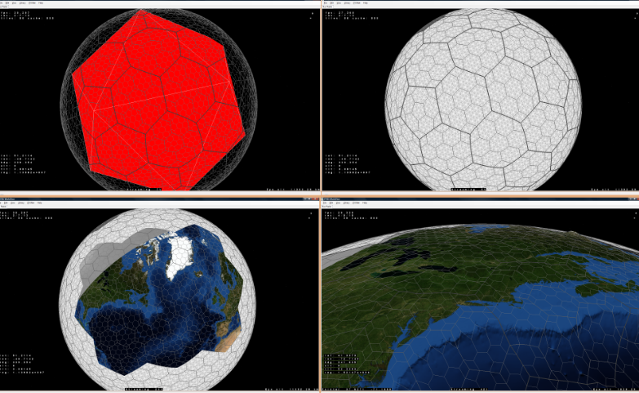
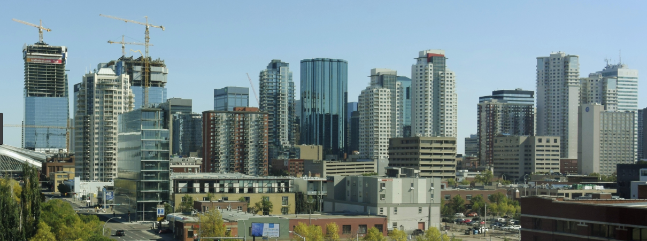
Sunday, 20 February 2022
Key words
-Evaluate
-Square root
-Surd
-Simplify
-form
How to add and subtract surds.
Know what a surd is.
Importance of surds
Measurements
Engineering and architecture.
Anything where accuracy is important.
3D modelling in computer games
$$\sqrt{3}$$
1
2

Slide 11
Sunday, 20 February 2022
Key words
-Evaluate
-Square root
-Surd
-Simplify
-form
How to add and subtract surds.
Know what a surd is.
Investigation
Solve the questions below without a calculator:
What do you notice?
The answer is the same number as radicand (what is inside the root)
Therefore, we can make a rule:
$$Rule: \sqrt{a} x \sqrt{a}=a$$
$$\sqrt{4} x \sqrt{4}=$$
2 x 2
= 4
$$\sqrt{9} x \sqrt{9}=$$
3 x 3
= 9
$$\sqrt{5} x \sqrt{5}=$$
2.23.. x 2.23..
= 5

Slide 12
Sunday, 20 February 2022
Key words
-Evaluate
-Square root
-Surd
-Simplify
-form
How to add and subtract surds.
Know what a surd is.
What is Kumar talking about?
Link to video

Slide 13
Sunday, 20 February 2022
Key words
-Evaluate
-Square root
-Surd
-Simplify
-form
How to add and subtract surds.
Be able to add and subtract surds.
Simplifying
For our next part we are going to look at simplifying algebra first.
When we add and subtract whilst using algebra the power stays the same and the coefficient changes.
2a + 3a = 5a
However we can’t add two different variables together.
A
2a + 3b = 2a + 3b
A
8b + 11b = 19b
A
2a + 4a – 2b +3 = 6a – 2b + 3
A
19b - 5b = 13b
A
13b + 5a – 3b = 10b +5a
A
$a^{2}$ + 6$a^{2}$ = 7$a^{2}$
$a^{3}$ + 6$a^{2}$ = $a^{3}$ + 6$a^{2}$
A
A

Slide 14
Sunday, 20 February 2022
Key words
-Evaluate
-Square root
-Surd
-Simplify
-form
How to add and subtract surds.
Be able to add and subtract surds.
Multiple choice
Timer
Which one is the correct answer after we have simplified this expression?
End
1
2
3
4
5
6
7
8
9
10
11
12
13
14
15
16
17
18
19
20
21
22
23
24
25
26
27
28
29
30
7a + 3a
A 21a
B 10a
If you’re done why would some students have chosen the other answers?
C 10$a^{2}$
D 7a + 3a

Slide 15
Sunday, 20 February 2022
Key words
-Evaluate
-Square root
-Surd
-Simplify
-form
How to add and subtract surds.
Be able to add and subtract surds.
Multiple choice
Timer
Which one is the correct answer after we have simplified this expression?
End
1
2
3
4
5
6
7
8
9
10
11
12
13
14
15
16
17
18
19
20
21
22
23
24
25
26
27
28
29
30
7a + 3b – 6a
A 13a – 3b
B a +3b
If you’re done why would some students have chosen the other answers?
C 16ab
D 13a +3b

Slide 16
Sunday, 20 February 2022
Key words
-Evaluate
-Square root
-Surd
-Simplify
-form
How to add and subtract surds.
Be able to add and subtract surds.
Multiple choice
Timer
Which one is the correct answer after we have simplified this expression?
End
1
2
3
4
5
6
7
8
9
10
11
12
13
14
15
16
17
18
19
20
21
22
23
24
25
26
27
28
29
30
3a - 3b – 6a + 7b -5
A 9a – 10b -5
B 19ab -5
If you’re done why would some students have chosen the other answers?
C -3a +4b -5
D 3a +4b -5

Slide 17
Sunday, 20 February 2022
Key words
-Evaluate
-Square root
-Surd
-Simplify
-form
How to add and subtract surds.
Be able to add and subtract surds.
Multiple choice
Timer
Which one is the correct answer after we have simplified this expression?
End
1
2
3
4
5
6
7
8
9
10
11
12
13
14
15
16
17
18
19
20
21
22
23
24
25
26
27
28
29
30
${4a}^{2}$ - 2b + 6$a^{2}$
A ${10a}^{2}$ - 2b
B 52$a^{2}$
If you’re done why would some students have chosen the other answers?
C ${4a}^{2}$ - 2b + 6$a^{2}$
D ${8a}^{2}$b

Slide 18
Sunday, 20 February 2022
Key words
-Evaluate
-Square root
-Surd
-Simplify
-form
Be able to add and subtract surds.
Multiple choice
How to add and subtract surds.
Timer
Which one is the correct answer after we have simplified this expression?
End
1
2
3
4
5
6
7
8
9
10
11
12
13
14
15
16
17
18
19
20
21
22
23
24
25
26
27
28
29
30
${3a}^{5}$ - 5$b^{2}$ + 6$a^{2}$- 11$b^{2}$
A ${3a}^{5}$ + 6$b^{2}$ + 6$a^{2}$
B ${9a}^{7}$ - 16$b^{2}$
C ${3a}^{5}$ +6$a^{2}$ -16$b^{2}$
D ${3a}^{5}$ - 6$b^{2}$ + 6$a^{2}$

Slide 19
Sunday, 20 February 2022
Key words
-Evaluate
-Square root
-Surd
-Simplify
-form
How to add and subtract surds.
Be able to add and subtract surds.
Examples
Adding and subtracting surds works the same as algebra
2a + 3a = 5a
Just like algebra we can’t add and subtract different surds.
4a + 5b = 4a + 5b
2$\sqrt{3}$ + 3$\sqrt{3}$ = 5$\sqrt{3}$
A
4$\sqrt{3}$ + 5$\sqrt{5}$ = 4$\sqrt{3}$ + 5$\sqrt{5}$
A
7b – 6b = b
8a - 5b + 3a = 11a - 5b
7$\sqrt{5}$ - 6$\sqrt{5}$ = $\sqrt{5}$
A
8$\sqrt{3}$ - 5$\sqrt{5}$ +3$\sqrt{3}$= 11$\sqrt{3}$ - 5$\sqrt{5}$
A
$$Rule:a\sqrt{c} ±b\sqrt{c}=(a±b)\sqrt{c}$$

Slide 20
Sunday, 20 February 2022
Key words
-Evaluate
-Square root
-Surd
-Simplify
-form
Quick fire questions
How to add and subtract surds.
Be able to add and subtract surds.
Timer
$\sqrt{5}+2\sqrt{5}$
$2\sqrt{2} −\sqrt{5}+2\sqrt{2}$
3 minutes
$3\sqrt{5}$
$\sqrt{5}$
A
A
$9\sqrt{3}−2\sqrt{3}$
$9\sqrt{11} −4\sqrt{7}+2\sqrt{11}−3\sqrt{7}$
$11\sqrt{11}−7\sqrt{7}$
$7\sqrt{3}$
A
A

Slide 21
Plenary
Sunday, 20 February 2022
Key words
-Evaluate
-Square root
-Surd
-Simplify
-form
WALT: how to add and subtract surds.
WILF: Know what a surd is.
WILF: Understand why we leave a number in surds form.
WILF: Be able to add and subtract surds.
Exit questions
Simplify $\sqrt{17} x \sqrt{17}$
Simplify 5$\sqrt{11}$ + 3$\sqrt{11}$
Simplify 9$\sqrt{13}$ - 3$\sqrt{13}$
Simplify 9$\sqrt{3}$ + 3$\sqrt{5}$ - 6$\sqrt{5}$
17
A
8$\sqrt{11}$
A
6$\sqrt{13}$
A
9$\sqrt{3} −\text{3}\sqrt{5}$
A

Slide 22
Reflection
Sunday, 20 February 2022
Key words
-Evaluate
-Square root
-Surd
-Simplify
-form
WALT: how to add and subtract surds.
WILF: Know what a surd is.
WILF: Understand why we leave a number in surds form.
WILF: Be able to add and subtract surds.
Complete a FUSE on todays lesson
 | Rank yourself out of five on your confidence in these areas. Five being high
F – Do you know the facts?
U – How well do you understand the topic?
S – Do you have the skills to answer questions?
E – Could you explain it to the class?

