Slide 1
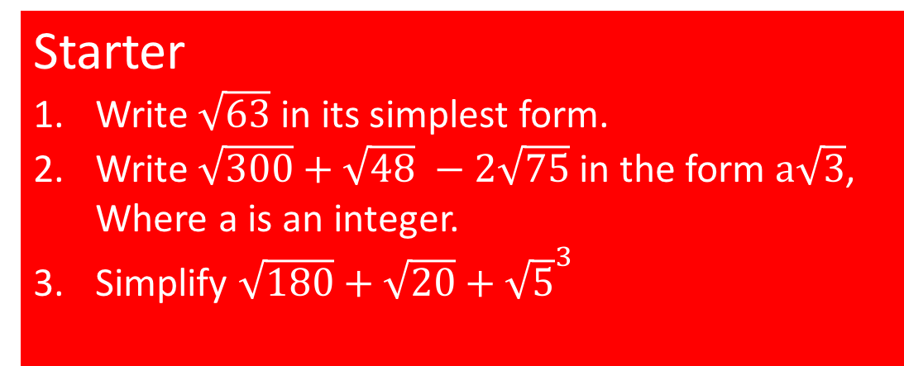
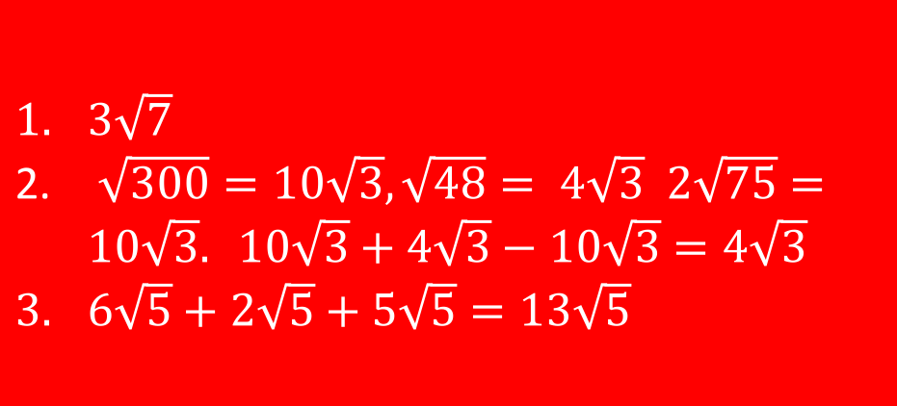
Surds
LO: Can I multiple surds in brackets?
Success Criteria
Multiplying surds together and simplifying the answer.
Expanding double brackets which involved surds.
Starter
Write $\sqrt{63}$ in its simplest form.
Write $\sqrt{300}+\sqrt{48} −2\sqrt{75}$ in the form $a\sqrt{3}$, Where a is an integer.
Simplify $\sqrt{180}+\sqrt{20}+{\sqrt{5}}^{3}$
$3\sqrt{7}$
$\sqrt{300}=10\sqrt{3}, \sqrt{48}= 4\sqrt{3} 2\sqrt{75}=10\sqrt{3}. 10\sqrt{3}+4\sqrt{3}−10\sqrt{3}=4\sqrt{3}$
$6\sqrt{5}+2\sqrt{5}+5\sqrt{5}=13\sqrt{5}$

Slide 2




Equal or not equal
$$≠$$
$$=$$
$$≠$$
$$≠$$
$$=$$
$$=$$
$$=$$
$$=$$

Slide 3
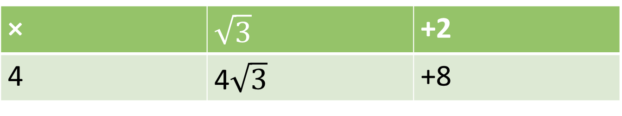


Expanding brackets
When expanding brackets, we multiply every term with the number outside the brackets.
This works the same with surds involved.
For example
$$4\left(\sqrt{3}+2\right)$$
× | $$\sqrt{3}$$ | +2
4 | 4$\sqrt{3}$ | +8
$$4\left(\sqrt{3}+2\right)=4\sqrt{3}+8$$

Slide 4
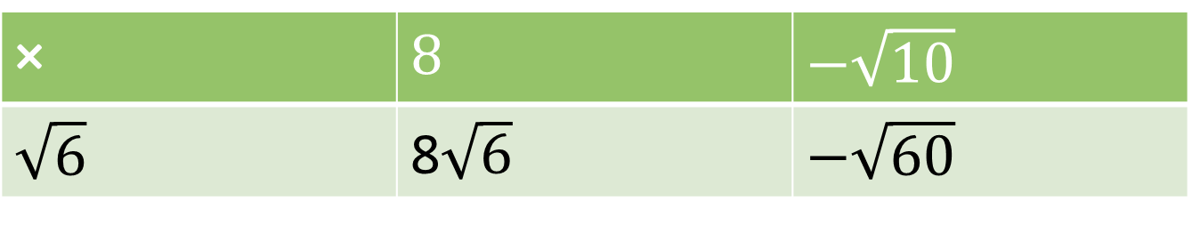


Expanding brackets
When expanding brackets, we multiply every term with the number outside the brackets.
This works the same with surds involved.
For example
$$\sqrt{6}\left(8−\sqrt{10}\right)$$
× | $$8$$ | $$−\sqrt{10}$$
$$\sqrt{6}$$ | 8$\sqrt{6}$ | $$−\sqrt{60}$$
$\sqrt{60}$= $\sqrt{4\text{× }15}$ = $\sqrt{4}$ ×$\sqrt{15}$ =2 $\sqrt{15}$
$$\sqrt{6}\left(8−\sqrt{10}\right)=8\sqrt{6} − \sqrt{60}=8\sqrt{6} −2\sqrt{15}$$

Slide 5
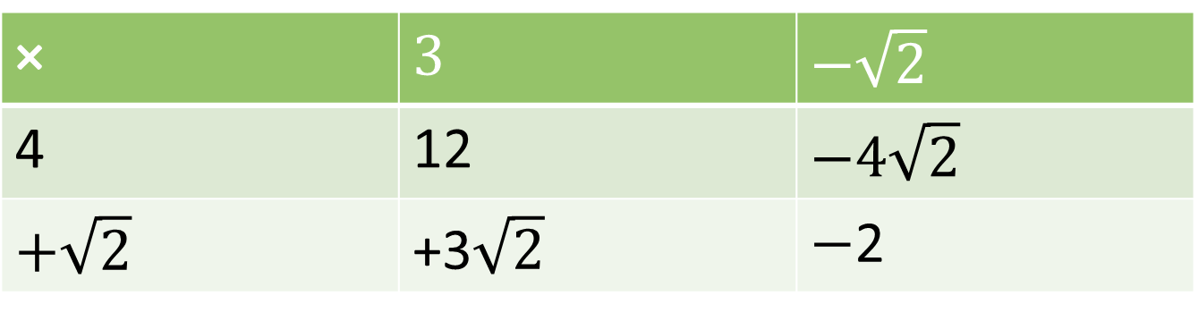

Expanding brackets
When expanding brackets, we multiply every term with the number outside the brackets.
This works the same with surds involved.
For example
$$\left(4+\sqrt{2}\right)\left(3−\sqrt{2}\right)$$
× | $$3$$ | $$−\sqrt{2}$$
4 | 12 | $$−4\sqrt{2}$$
$$+\sqrt{2}$$ | +3$\sqrt{2}$ | $−$2
$$\left(4+\sqrt{2}\right)\left(3−\sqrt{2}\right)=12 −4\sqrt{2}+3\sqrt{2} −2=10−\sqrt{2}$$

Slide 6
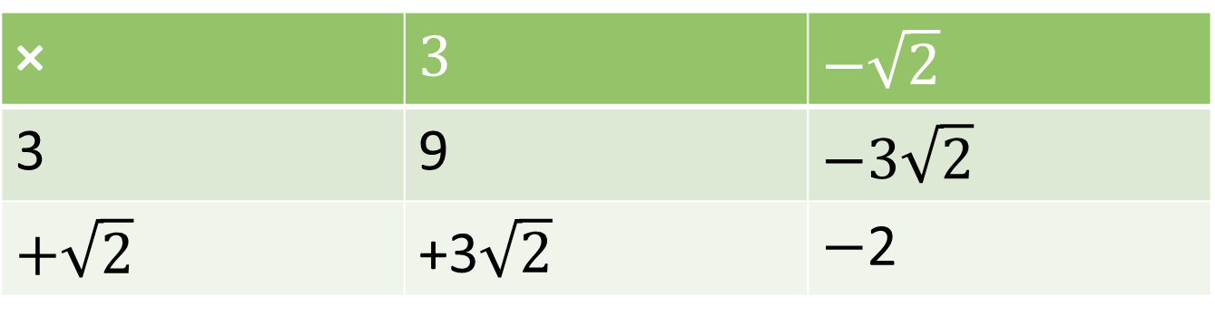

Expanding brackets
When expanding brackets, we multiply every term with the number outside the brackets.
This works the same with surds involved.
For example
$$\left(3+\sqrt{2}\right)\left(3−\sqrt{2}\right)$$
× | $$3$$ | $$−\sqrt{2}$$
3 | 9 | $$−3\sqrt{2}$$
$$+\sqrt{2}$$ | +3$\sqrt{2}$ | $−$2
$$\left(3+\sqrt{2}\right)\left(3−\sqrt{2}\right)=9 −3\sqrt{2}+3\sqrt{2} −2=9−2=7$$

Slide 7
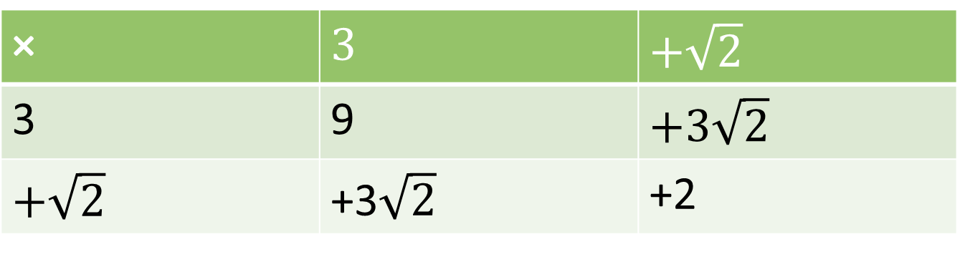
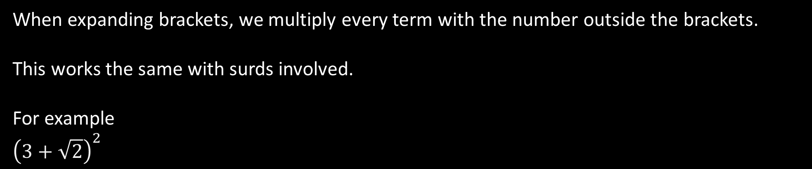
Expanding brackets
When expanding brackets, we multiply every term with the number outside the brackets.
This works the same with surds involved.
For example
$${\left(3+\sqrt{2}\right)}^{2}$$
× | $$3$$ | $$+\sqrt{2}$$
3 | 9 | $$+3\sqrt{2}$$
$$+\sqrt{2}$$ | +3$\sqrt{2}$ | +2
$$\left(3+\sqrt{2}\right)\left(3+\sqrt{2}\right)=9+3\sqrt{2}+3\sqrt{2}+2=9+2+6\sqrt{2}=11+6\sqrt{2}$$

Slide 8
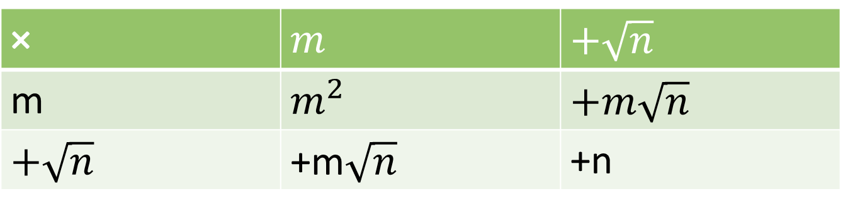
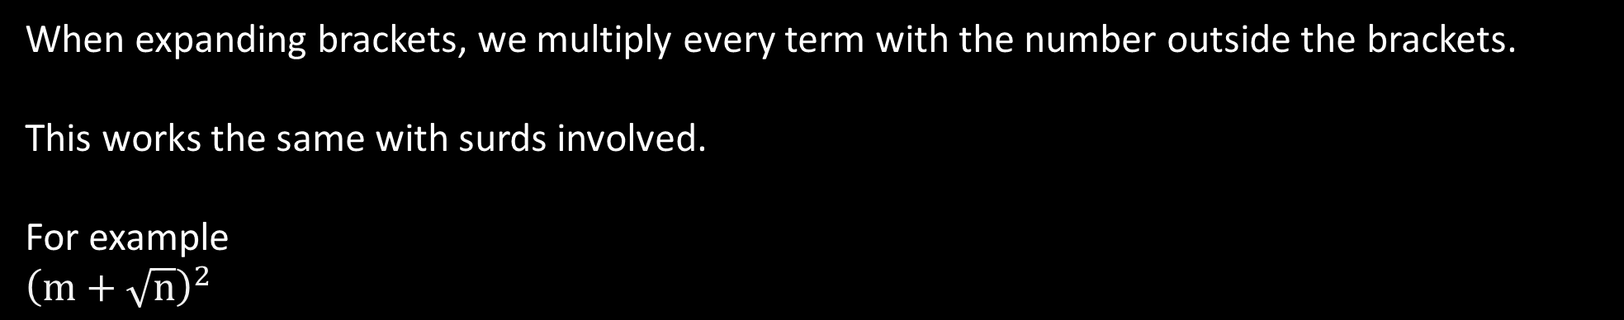
Expanding brackets
When expanding brackets, we multiply every term with the number outside the brackets.
This works the same with surds involved.
For example
$${\left(m+\sqrt{n}\right)}^{2}$$
× | $$m$$ | $$+\sqrt{n}$$
m | $$m^{2}$$ | $$+m\sqrt{n}$$
$$+\sqrt{n}$$ | +m$\sqrt{n}$ | +n
$${\left(m+\sqrt{n}\right)}^{2}=m^{2}+m\sqrt{n}+m\sqrt{n}+n=m^{2}+n+2m\sqrt{n}$$

Slide 9


Whiteboards
$$\sqrt{2}\left(3+\sqrt{5}\right)$$
$$\sqrt{2}\left(3\sqrt{2}+5\right)$$
$$2\sqrt{5}\left(\sqrt{5}+3\sqrt{2}\right)$$
$$\left(5+\sqrt{3}\right)\left(\sqrt{6}−2\right)$$
$$\left(2\sqrt{5}−3\sqrt{2}\right)\left(2\sqrt{5}+3\sqrt{2}\right)$$
$$3\sqrt{2}+\sqrt{10}$$
$$6+5\sqrt{2}$$
$$10+6\sqrt{10}$$
$$5\sqrt{6} −10+\sqrt{18} −2\sqrt{3}=5\sqrt{6} −10+3\sqrt{2} −2\sqrt{3}$$
$$20+6\sqrt{10} −6\sqrt{10} −18=2$$

