Slide 1



Index Notation
Gwaith Dosbarth
Gorffennaf 11
LO:
A.M.S:
To identify and use rules of indices
Will be able to write numbers in index notation
Will be able to write negative powers in index notation
Will be able to sum up our learning in exam questions
ALL-
MOST-
SOME-
Lets feedback our answers. Get GREEN pens READY!
Starter:
Exam Practise:
[2]
$$£1248$$
$$8$$
[2]
$$24$$
[2]

Slide 2
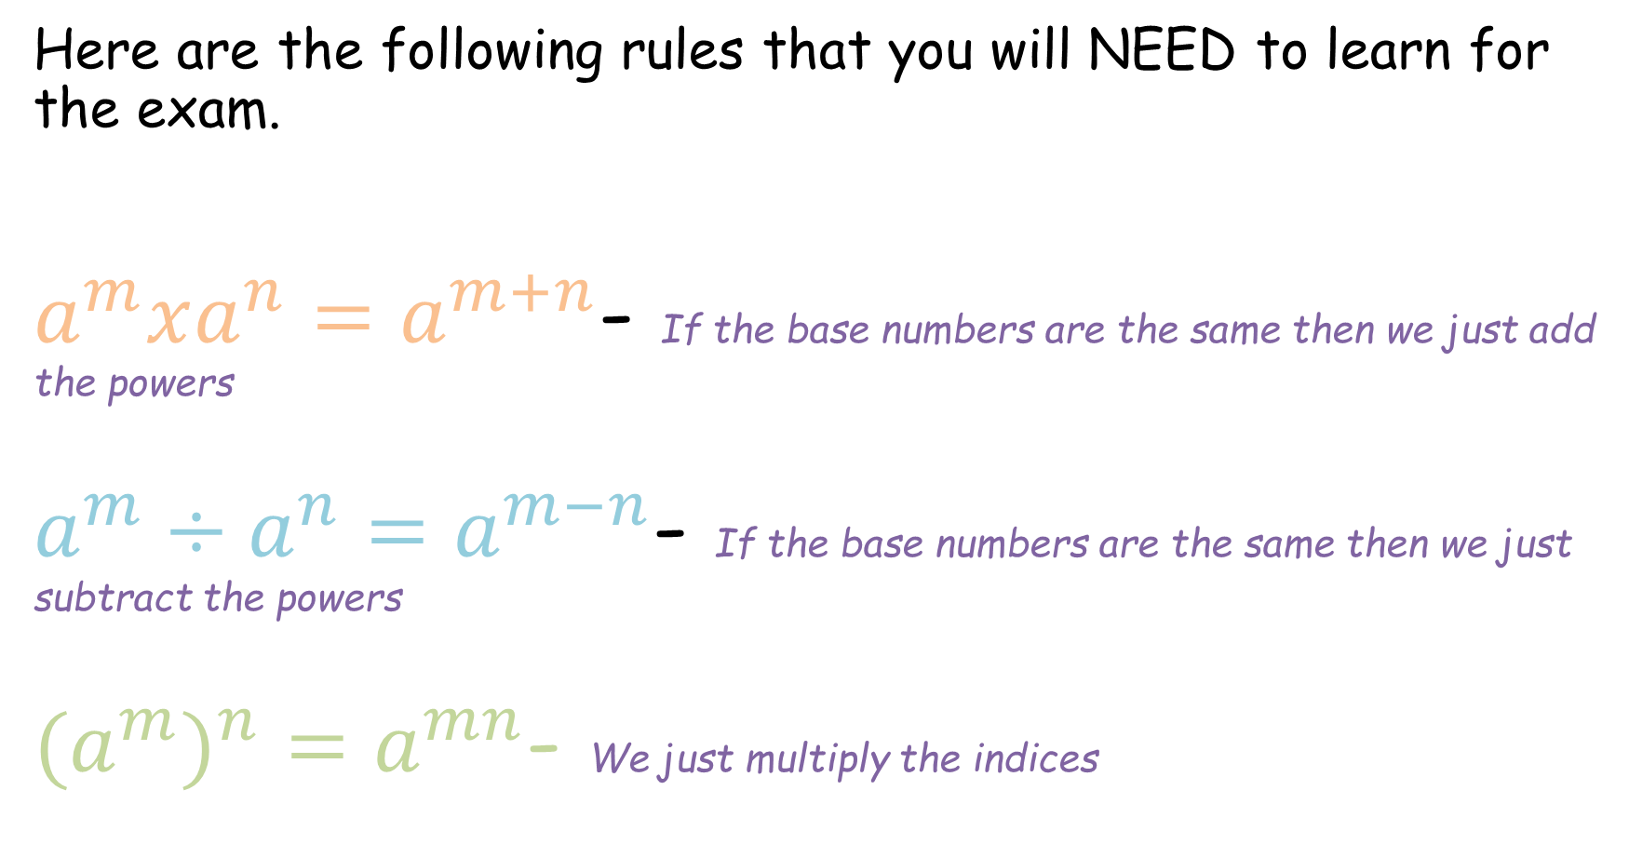
TOP TIP FOR THE EXAM!
Here are the following rules that you will NEED to learn for the exam.
$a^{m}xa^{n}=a^{m+n}$- If the base numbers are the same then we just add the powers
$a^{m}÷a^{n}=a^{m−n}$- If the base numbers are the same then we just subtract the powers
$(a^{m})^{n}=a^{mn}$- We just multiply the indices

Slide 3
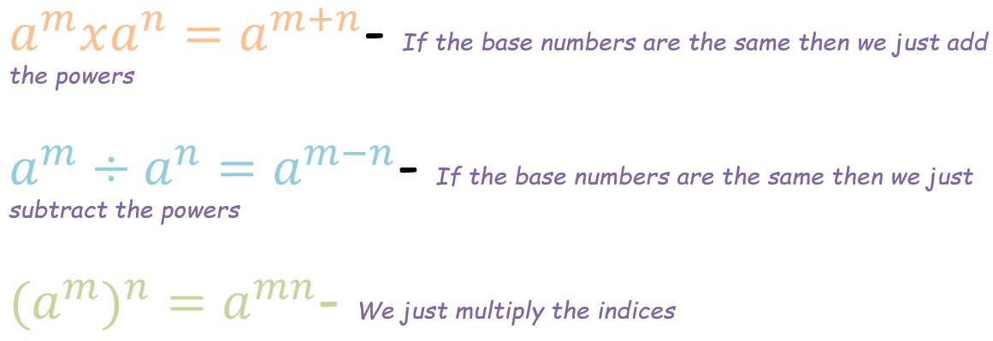



Examples: Evaluate each of the following
This is the answer because the two base numbers are the same so we just have to add the powers.
a⁸ x a⁹ =
2.a¹² ÷ a³ =
3.(a⁵)⁴ =
$$a^{17}$$
This is the answer because the two base numbers are the same so we just have to subtract the powers
$$a^{9}$$
This is the answer because the rule states for us to multiply the inside power by the outside power
$$a^{20}$$

Slide 4

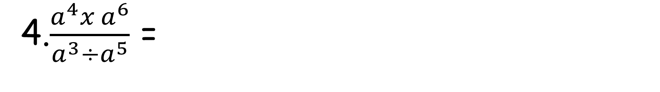
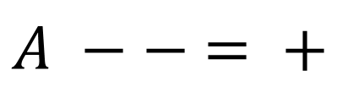
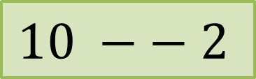

Examples: Evaluate each of the following
$$\frac{a^{10}}{a^{−2}}$$
4.$\frac{a^{4}x a^{6}}{a^{3}÷a^{5}}$ =
$$10 −− 2$$
$$a^{12}$$
$$A −− = +$$

Slide 5








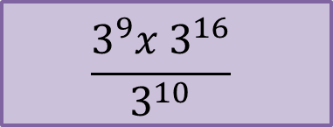


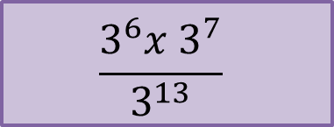



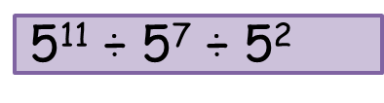














Exercise 1a:
Evaluate each of the following
$$\text{5}\text{5 }\text{x} 5^{5}$$
$$5^{10}$$
5¹¹$\text{ ÷ 5}\text{7}\text{ ÷ 5}\text{2}$
$$5^{2}$$
$$\text{5}\text{7} \text{x} 5^{3}$$
$$5^{10}$$
$$\text{(}\text{a}\text{3}\text{)}\text{5}$$
$$a^{15}$$
$$\text{5}\text{6} \text{x} 5^{4}$$
$$5^{10}$$
$$\text{(}\text{a}\text{2}\text{)}\text{7}$$
$$a^{14}$$
$$\text{3}\text{2 }\text{x} 3^{4} \text{x} 3^{7}$$
$$3^{13}$$
$$\text{(}\text{a}\text{9}\text{)}\text{4}$$
$$a^{36}$$
$$\text{10 }\text{x} {10}^{2} \text{x} {10}^{3}$$
$${10}^{6}$$
$$\text{(}\text{a}\text{9}\text{)}\text{9}$$
$$a^{81}$$
$$\text{5}\text{3}\text{ ÷ 5}\text{2}$$
$$5^{1}$$
$$\frac{3^{6}x 3^{7}}{3^{13}}$$
$$3^{5}$$
$$\text{5}\text{6}\text{ ÷ 5}\text{3}$$
$$5^{3}$$
$$\frac{3^{9}x 3^{16}}{3^{10}}$$
$$\text{5}\text{22 }\text{÷ 5}\text{18}$$
$$3^{15}$$
$$5^{4}$$

Slide 6

TOP TIP FOR THE EXAM!
Here is the rule for a negative power;
$a^{−b}= \frac{1}{a^{b}}$
E.g. $4^{−3}=$
$\frac{1}{4^{3}}$ =
$\frac{1}{64}$ =
64

Slide 7



Exam Practise:
$$m^{9}$$
$$p^{6}$$
$${16n}^{12}$$

Slide 8



Exam Practise:
$${24x}^{10}y^{7}$$
$$a^{3}$$
$$q^{6}$$

Slide 9

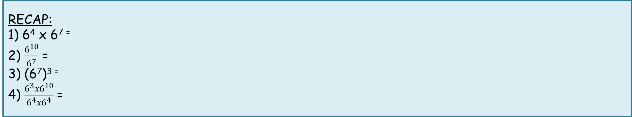



Fractional Indices
Gwaith Dosbarth
Gorffennaf 11
LO:
A.M.S:
To understand and use fractional indices
Will be able to recap on index notation.
Will be able to solve fractional indices
Will be able to sum up our learning in exam questions
ALL-
MOST-
SOME-
Lets feedback our answers. Get GREEN pens READY!
Starter:
RECAP:
1) 6⁴ x 6⁷ ⁼
2) $\frac{6^{10}}{6^{7}}$ =
3) (6⁷)³ ⁼
4) $\frac{6^{3}x6^{10}}{6^{4}x6^{4}}$ =
$$6^{11}$$
$$6^{3}$$
DON’T FORGET anything that you didn’t understand you will need to make a TOP TIP on it in your books.
$$6^{21}$$
$$6^{5}$$

Slide 10
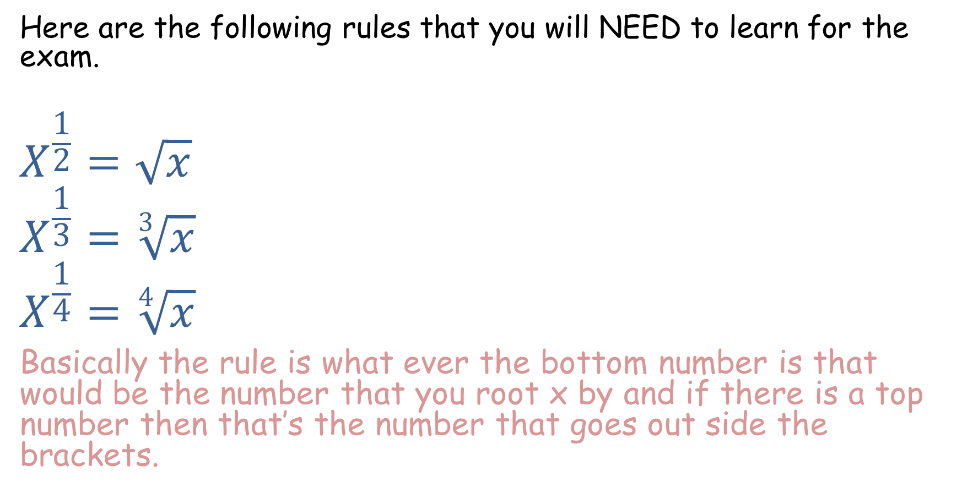
TOP TIP FOR THE EXAM!
Here are the following rules that you will NEED to learn for the exam.
$$X^{\frac{1}{2}}=\sqrt{x}$$
$$X^{\frac{1}{3}}=\sqrt[3]{x}$$
$$X^{\frac{1}{4}}=\sqrt[4]{x}$$
Basically the rule is what ever the bottom number is that would be the number that you root x by and if there is a top number then that’s the number that goes out side the brackets.

Slide 11
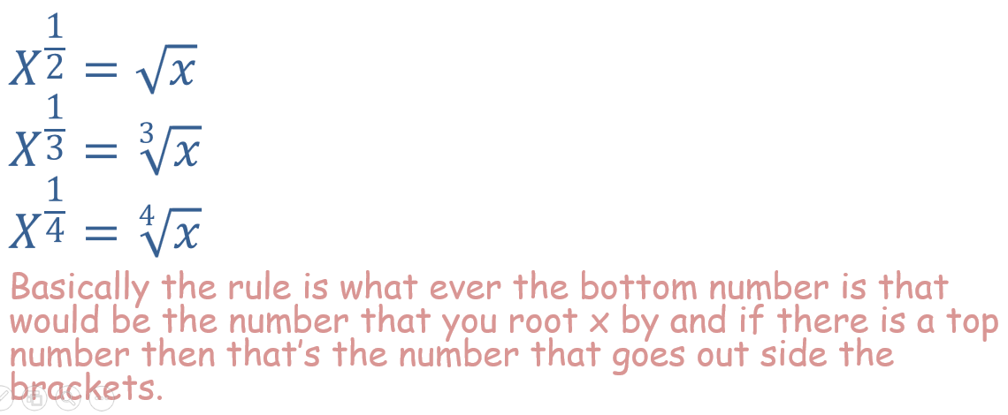
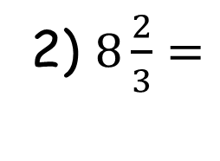
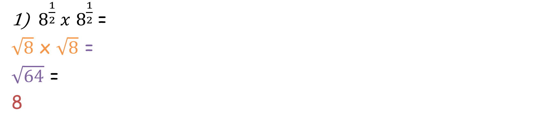
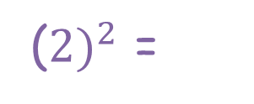
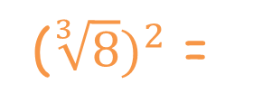
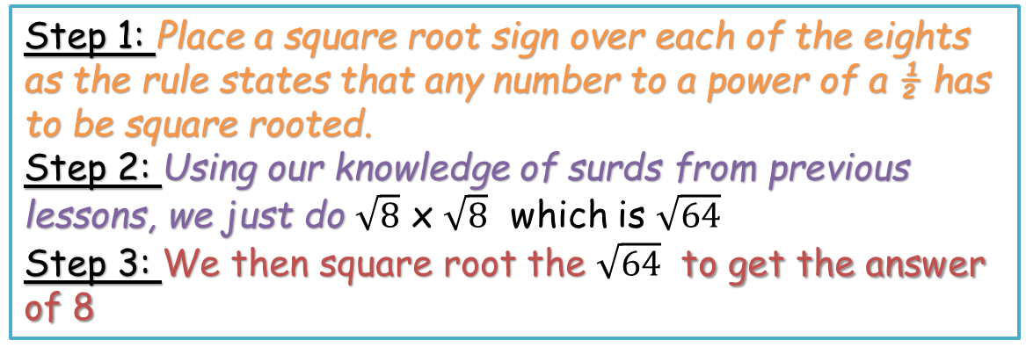
Examples: Evaluate each of the following.
Step 1: Place a square root sign over each of the eights as the rule states that any number to a power of a ½ has to be square rooted.
Step 2: Using our knowledge of surds from previous lessons, we just do $\sqrt{8}$ x $\sqrt{8}$ which is $\sqrt{64}$
Step 3: We then square root the $\sqrt{64}$ to get the answer of 8
$8^{\frac{1}{2}} x$ $8^{\frac{1}{2}}$=
$\sqrt{8}$ x $\sqrt{8}$ =
$\sqrt{64}$ =
8
Step 1: The rule states that we have the bottom number as what we root 8 by and the top number goes on the outside.
Step 2: We cube root 8 first
Step 3: We then square the answer to get …
2) $8\frac{2}{3}=$
($\sqrt[3]{8})^{2}$ =
($2)^{2}$ =
4

Slide 12

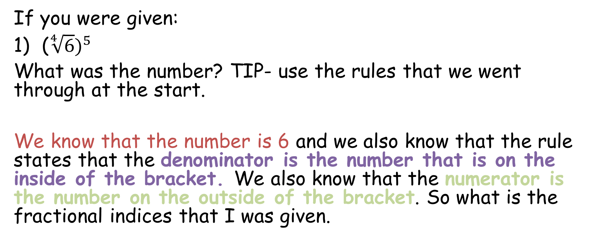

Examples: If given the rule then find the number.
If you were given:
($\sqrt[4]{6})^{5}$
What was the number? TIP- use the rules that we went through at the start.
We know that the number is 6 and we also know that the rule states that the denominator is the number that is on the inside of the bracket. We also know that the numerator is the number on the outside of the bracket. So what is the fractional indices that I was given.
$$6^{\frac{5}{4}}$$

Slide 13








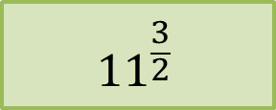
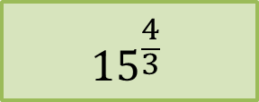



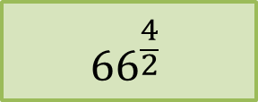






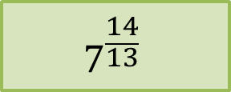







Exercise 1b:
Evaluate each of the following
$$8^{\frac{1}{2}}$$
$$2$$
$$\sqrt{75}$$
$$8.6$$
$$4^{\frac{3}{2}}$$
$$8$$
$$(\sqrt{11})^{3}$$
$$11^{\frac{3}{2}}$$
$${625}^{\frac{1}{4}}$$
$$5$$
$$(\sqrt[3]{15})^{4}$$
$$15^{\frac{4}{3}}$$
$${36}^{\frac{3}{2}}$$
$$216$$
$$(\sqrt[3]{3})^{8}$$
$$3^{\frac{8}{3}}$$
$${1331}^{\frac{1}{3}}$$
$$11$$
$$(\sqrt[8]{3})^{3}$$
$$3^{\frac{3}{8}}$$
$$(\sqrt[13]{7})^{14}$$
$$7^{\frac{14}{13}}$$
$${100}^{\frac{1}{2}}$$
$$10$$
$$(\sqrt{66})^{4}$$
$${66}^{\frac{4}{2}}$$
$${225}^{\frac{1}{2}}$$
$$15$$

