Slide 1
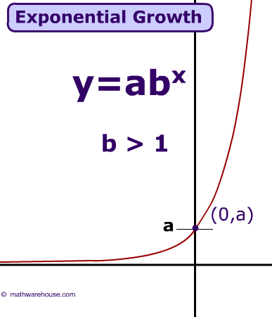
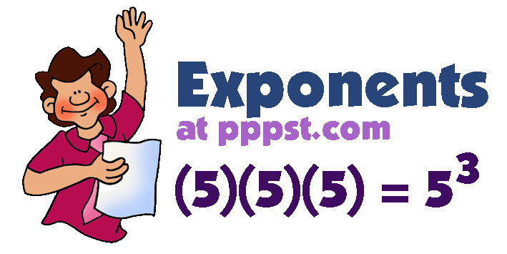
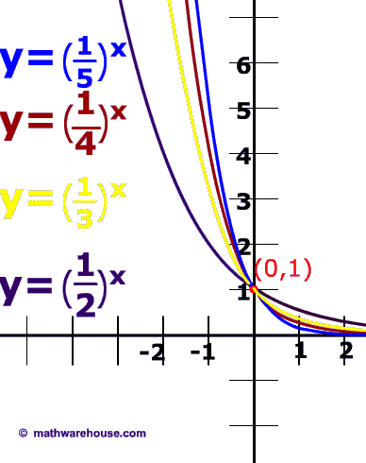
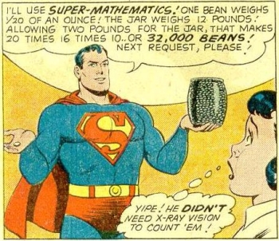
Exponential Equations

Slide 2

Starter
Find the value of:
2) Solve these equations:
$$c) 49^{\frac{1}{2}}$$
$$d) {64}^{−\frac{1}{3}}$$
$$e) {16}^{−\frac{3}{4}}$$
$$a) 6^{−1}$$
$$b) 8^{−2}$$
$$=\frac{1}{6}$$
$$=\frac{1}{64}$$
$$=\frac{1}{4}$$
$$=\frac{1}{8}$$
$$=7$$
$$a) 3x+5=9$$
$$b) 2x+1=6x−7$$
$$c) x^{2}+5x=0$$
Subtract 5
Subtract 2x
Factorise
$$3x=4$$
$$1=4x−7$$
$$x(x+5)=0$$
Divide by 3
Add 7
Either ‘part’ could be 0…
$$x=\frac{4}{3}$$
$$8=4x$$
Divide by 4
$$x=0 or 5$$
$$2=x$$
$$d) x^{2}+4x+3=0$$
3) Simplify
Factorise
$$(x+3)(x+1)=0$$
$$a) a^{3}×a^{4}$$
$$b) r^{4}÷r^{3}$$
$$c) {\left(x^{2}\right)}^{5}$$
Either bracket could be 0…
$$x=−3 or −1$$
$$=a^{7}$$
$$=r$$
$$=x^{10}$$

Slide 3
Exponential Equations
You have seen how to solve lots of different types of equation
Today we will be looking at solving equations where the unknown is part of a power (Index/Indices)
Equations like this can be completely solved using methods taught at A-level, but for now we can use different ways to solve some of them!

Slide 4
Exponential Equations
$$2^{x}=8$$
Write 8 as a power of 2
$$2^{x}=2^{3}$$
Now, we can see that the powers must be equal!
$$x=3$$
Solving these types of problem will involve changing one (or both) sides of the equation, so they are written with the same ‘base’ (in this case, the base is 2)
→ Then you compare the powers and create an equation out of them!

Slide 5
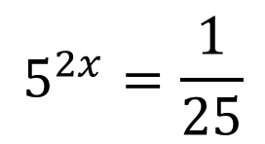
Exponential Equations
$$5^{2x}=\frac{1}{25}$$
Write ¹/₂₅ as a power of 5
$$5^{2x}=5^{−2}$$
The powers must be equal, as we have the same base
$$2x=−2$$
Divide by 2
$$x=−1$$

Slide 6
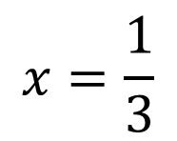
Exponential Equations
$$4^{3x+1}=16$$
Write 16 as a power of 4
$$4^{3x+1}=4^{2}$$
The powers must be equal, as we have the same base
$$3x+1=2$$
Subtract 1
$$3x=1$$
$$x=\frac{1}{3}$$
Divide by 3

Slide 7
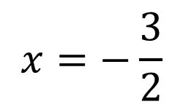
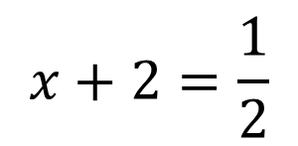
Exponential Equations
$${36}^{x+2}=6$$
Write 6 as a power of 36
$${36}^{x+2}={36}^{\frac{1}{2}}$$
The powers must be equal, as we have the same base
$$x+2=\frac{1}{2}$$
Subtract 2
$$x=−\frac{3}{2}$$
Or you could use decimals
$$x=−1.5$$

Slide 8
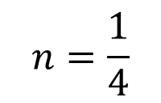
Exponential Equations
$$9^{2n+1}=27$$
Write both sides as powers of 3
$${\left(3^{2}\right)}^{2n+1}=3^{3}$$
Multiply the powers on the left side
$$3^{4n+2}=3^{3}$$
Now equate the powers
$$4n+2=3$$
Subtract 2
$$4n=1$$
$$n=\frac{1}{4}$$
Divide by 4

Slide 9

Plenary
1)
$$3^{x}=\sqrt[4]{3^{5}}$$
Write the right side as a power
$$3^{x}=3^{\frac{5}{4}}$$
$$x=\frac{5}{4}$$
Equate the powers
2)
Find the value of x if:
$$2^{x^{2}}={16}^{2x−3}$$
$$x^{2}=8x−12$$
Write 16 as a power of 2
Subtract 8x, Add 12
$$2^{x^{2}}={\left(2^{4}\right)}^{2x−3}$$
$$x^{2}−8x+12=0$$
Multiply the powers on the right
Factorise
$$2^{x^{2}}=2^{8x−12}$$
$$\left(x−6\right)\left(x−2\right)=0$$
Equate the powers
Solve
$$x^{2}=8x−12$$
$$x=6 or 2$$
This is a quadratic equation…

Slide 10
Summary
We recapped solving different types of equation, as well as index laws
We have seen how to solve some exponential equations
The main focus is to rewrite each side if needed, so that they both have the same base

