Slide 1
Graphing Exponential Functions
Objectives:
1. Graph exponential growth functions.
2. Graph exponential decay functions.

Slide 2
y

Slide 3
y
y

Slide 4
Graph of Exponential Function (a > 1)
The graph of y = b^{x}, b > 1
y
4
Range: (0, ∞)
(0, 1)
x
4
Horizontal Asymptote y = 0
Domain: (–∞, ∞)

Slide 5
Graph of Exponential Function (0 < a < 1)
The graph of y= b^{x}, 0 < b < 1
Since a< 1; a is decay factor.
y
4
Range: (0, ∞)
Horizontal Asymptote y = 0
(0, 1)
x
4
Domain: (–∞, ∞)

Slide 6
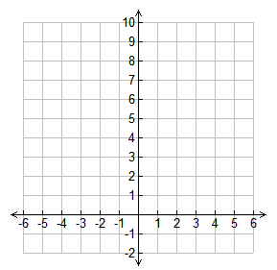
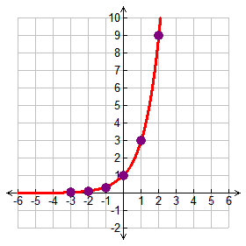
Example 1
Graph y = 3^{x}.
Complete the table.
Substitute -3 for x
y = 3⁻³
y = 1/27 or 0.04
x | y
-3
-2
-1
0
1
2
0.04
Write 0.04 in the table
0.1
Substitute -2 for x
y = 3⁻²
y = 1/9 or 0.1
0.3
1
Write 0.1 in the table
Continue substituting numbers for x until the table is complete
3
9
Plot the points on the graph and connect the points with a smooth curve with arrows at both ends – DO NOT CROSS THE x-axis!

Slide 7
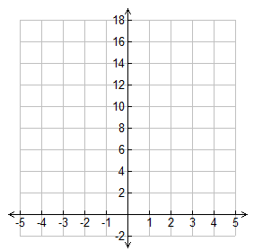
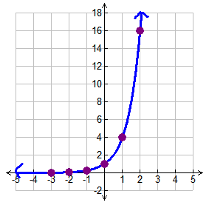
Practice.
1. Graph y = 4^{x}.
x | y
-3
-2
-1
0
1
2
x | y
-3 | 0.02
-2 | 0.06
-1 | 0.25
0 | 1
1 | 4
2 | 16

Slide 8
y
y

