Slide 1
Exponential Functions

Slide 2
Notes:
https://www.transum.org/Maths/Display/Optical_illusion/

Slide 3
Exponential Function
A function in the form:
Base is Constant
Exponent is the Independent Variable

Slide 4
Percent Increase and Decrease
You can model growth or decay by a constant percent increase or percent decrease with the formula:
A = $A_{0}$ (1 $±$ $\frac{r}{100}$)^{n}
1+ $\frac{r}{100}$ is growth factor
1– $\frac{r}{100}$ is decay factor
Initial Amount
Number of Time Periods
Final Amount
Rate of Increase

Slide 5
Exponential Growth Functions
If a quantity increases by the same proportion r in each unit of time, then the quantity displays exponential growth and can be modeled by the equation
A = $A_{0}$ (1 $+$ $\frac{r}{100}$)^{n}
Where
$A_{0}$ = initial amount
r = growth rate
n = time where n ≠0
(1 $+$ $\frac{r}{100}$) = growth factor where 1 $+$ $\frac{r}{100}$> 1

Slide 6
Example: Compound Interest
You deposit $1500 in an account that pays 2.3% interest compounded yearly,
What was the initial principal ($A_{0}$ ) invested?
What is the growth rate (r)? The growth factor?
Using the equation A = $A_{0}$ (1 $+$ $\frac{r}{100}$)^{n}, how much money would you have after 2 years if you didn’t deposit any more money?
The initial principal ($A_{0}$ ) is $1500.
The growth rate (r) is 2.3. The growth factor is 1.023.
A = $A_{0}$ (1 $+$ $\frac{r}{100}$)^{n}

Slide 7
Exponential Decay Functions
If a quantity decreases by the same proportion r in each unit of time, then the quantity displays exponential decay and can be modeled by the equation
A = $A_{0}$ (1 $−$ $\frac{r}{100}$)^{n}
Where
$A_{0}$ = initial amount
r = growth rate
n = time where n ≠ 0
(1 $−$ $\frac{r}{100}$) = decay factor where 1 $−$ $\frac{r}{100}$< 1

Slide 8
Example: Exponential Decay
You buy a new car for $22,500. The car depreciates at the rate of 7% per year,
What was the initial amount invested?
What is the decay rate? The decay factor?
What will the car be worth after the first year? The second year?
The initial investment was $22,500.
The decay rate is 7. The decay factor is 0.93.
A = $A_{0}$ (1 $−$ $\frac{r}{100}$)^{n}

Slide 9
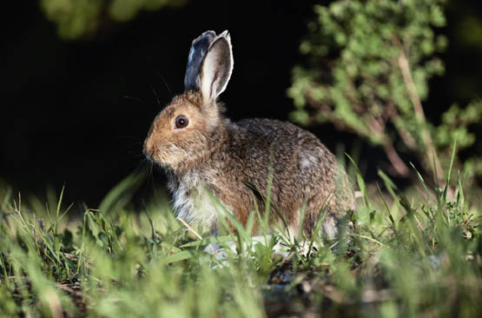
Writing an Exponential Growth Model
A population of 20 rabbits is released into a wildlife region. The population triples each year for 5 years.

Slide 10
Writing an Exponential Growth Model
A population of 20 rabbits is released into a wildlife region.
The population triples each year for 5 years.
b. What is the population after 5 years?
Help
SOLUTION
After 5 years, the population is
A = $A_{0}$ (1 + $\frac{r}{100}$) ^{n}
Exponential growth model
= 20(1 + 2) ⁵
Substitute $A_{0}$ , r, and n
= 20 • 3 ⁵
Simplify.
= 4860
Evaluate.
There will be about 4860 rabbits after 5 years.

