Slide 1
The Binomial
Expanding

Slide 2
Do Now Activity
My answer is 64.
What could my question have been?
Most unusual answer wins.
64

Slide 3
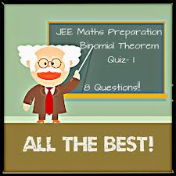
Binomials
x represent a number or letter
a represent a number or letter
n represents a power
For example: (1 + x)² = or (x + 2)³ =
Questions… Find Multiply
Expand the binomial What is..?

Slide 4
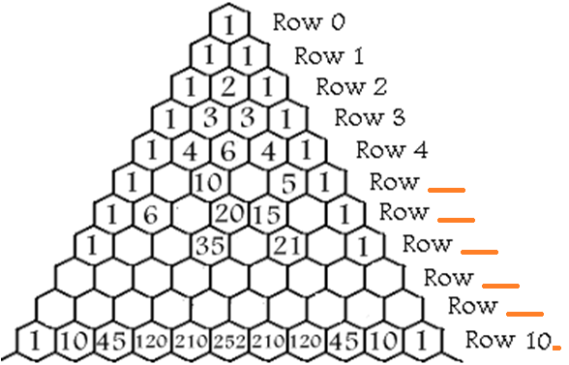
Binomial Theorem
part 1: (Pascal ∆)
Fill in the missing numbers for this triangle on your paper

Slide 5
The Sums of the Rows
The sum of the numbers in any row is equal to 2 to the n^{th} power or 2^{n}, when n is the number of the row. For example:
Describe the patterns
part 1: (Pascal ∆)
2⁰ = 1 2¹ = 1+1 = 2 2² = 1+2+1 = 4 2³ = 1+3+3+1 = 8 2⁴ = 1+4+6+4+1 = 16
The sum of the numbers in any row is equal to ___ to the nth power or ____ when n is ___________________.
2
2^{n}
the number of the row

Slide 6
A binomial is a polynomial with two terms such as x + a. Often we need to raise a binomial to a power. In this section we'll explore a way to do just that without lengthy multiplication.
Can you see a pattern?
Can you make a guess what the next one would be?
We can easily see the pattern on the x's and the a's. But what about the coefficients? Make a guess and then as we go we'll see how you did.

Slide 7
Let's list all of the coefficients on the x's and the a's and look for a pattern.
1
1 1
1 2 1
1 3 3 1
1 4 6 4 1
+
+
+
+
+
+
+
+
+
+
1 5 10 10 5 1
Can you guess the next row?

Slide 8
This is good for lower powers but could get very large. We will introduce some notation to help us and generalize the coefficients with a formula based on what was observed here.
1
1 1
1 2 1
1 3 3 1
1 4 6 4 1
1 5 10 10 5 1
This is called Pascal's Triangle and would give us the coefficients for a binomial expansion of any power if we extended it far enough.

Slide 9
Expanding Brackets
To expand brackets, multiply everything inside the brackets by what is outside them
x
4(a + 6)
4a
+ 24
x

Slide 10
Expanding Brackets
To expand brackets, multiply everything inside the brackets by what is outside them
Expand: 4(a + 6)
x | a | +6
4
4a
+24
4(a + 6) = 4a + 24

Slide 11
Expanding Brackets
Team
To expand brackets, multiply everything inside the brackets by what is outside them
x
9(c + 3)
9c
+ 27
x

Slide 12
Expanding Brackets
To expand brackets, multiply everything inside the brackets by what is outside them
Expand: (4+b)(a + 6)
x | a | +6
4
+b | +ab | +6b
4a
+24
(4+b)(a + 6) = 4a + 24 + ab + 6b

Slide 13
Corners
B
C
A
FRONT
D

Slide 14
Corners
4(y + 2)
A) 4y + 2
B) y + 8
C) 4y + 8
D) 6y

Slide 15
Corners
4(y – 5)
A) 4y - 5
B) 4y - 9
C) 4y + 20
D) 4y - 20

Slide 16
Corners
7(y - 9)
A) 7y - 9
B) 7y - 63
C) 7y - 54
D) 7y - 16

Slide 17
Corners
3(4 – y)
A) 3y - 12
B) 12 – 3y
C) 12 - y
D) 7 - y

Slide 18
Corners
3(2y + 2)
A) 6y + 6
B) 6y - 6
C) 5y + 6
D) 6y + 2

Slide 19
Corners
6(3y – 5)
A) 6y - 30
B) 18y + 30
C) 6y + 30
D) 18y - 30

Slide 20
Corners
C
4y(3y – 5m)
A) 12y - 5m
B) 12y² - 20ym
C) 12y – 20m
D) 12y² - 20m

