Slide 1
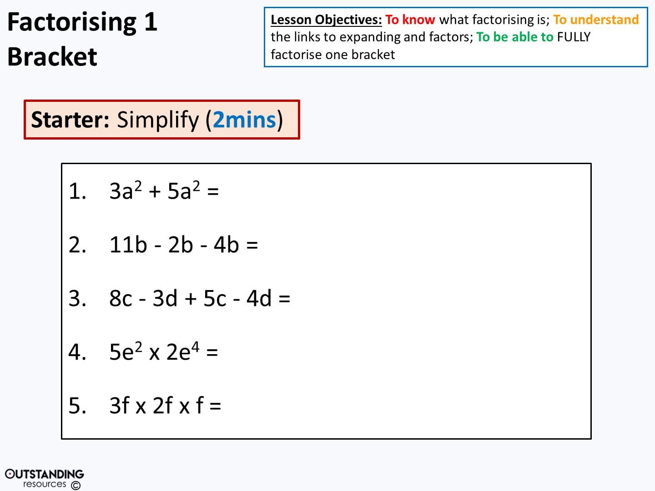
8a²
5b
13c – 7d
10e⁶
6f³

Slide 2
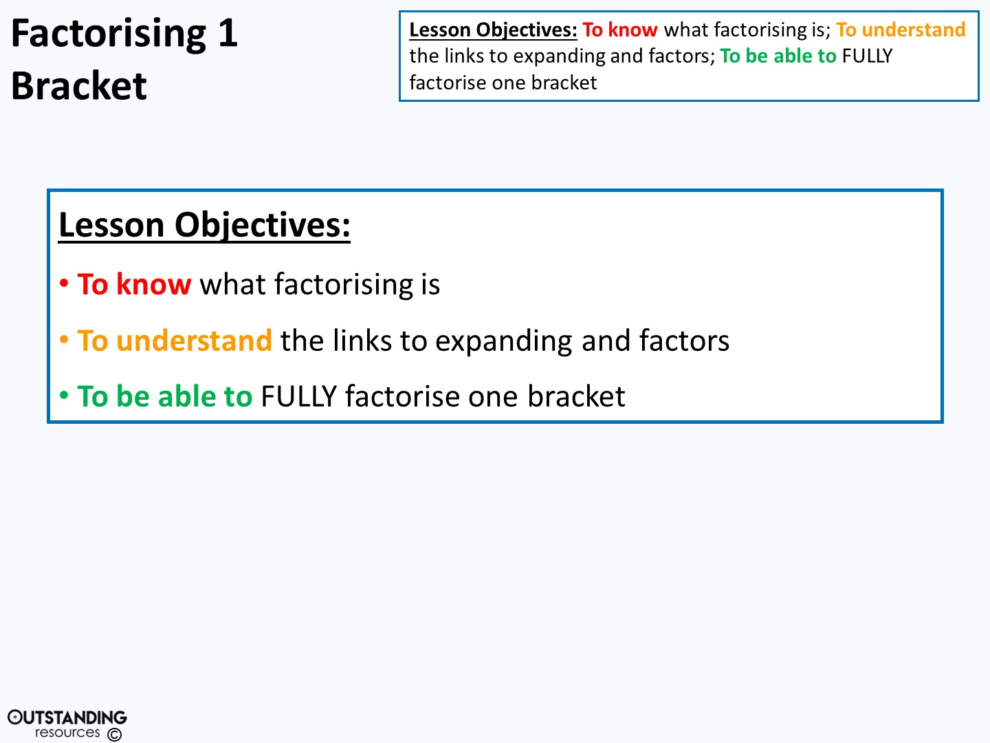

Slide 3
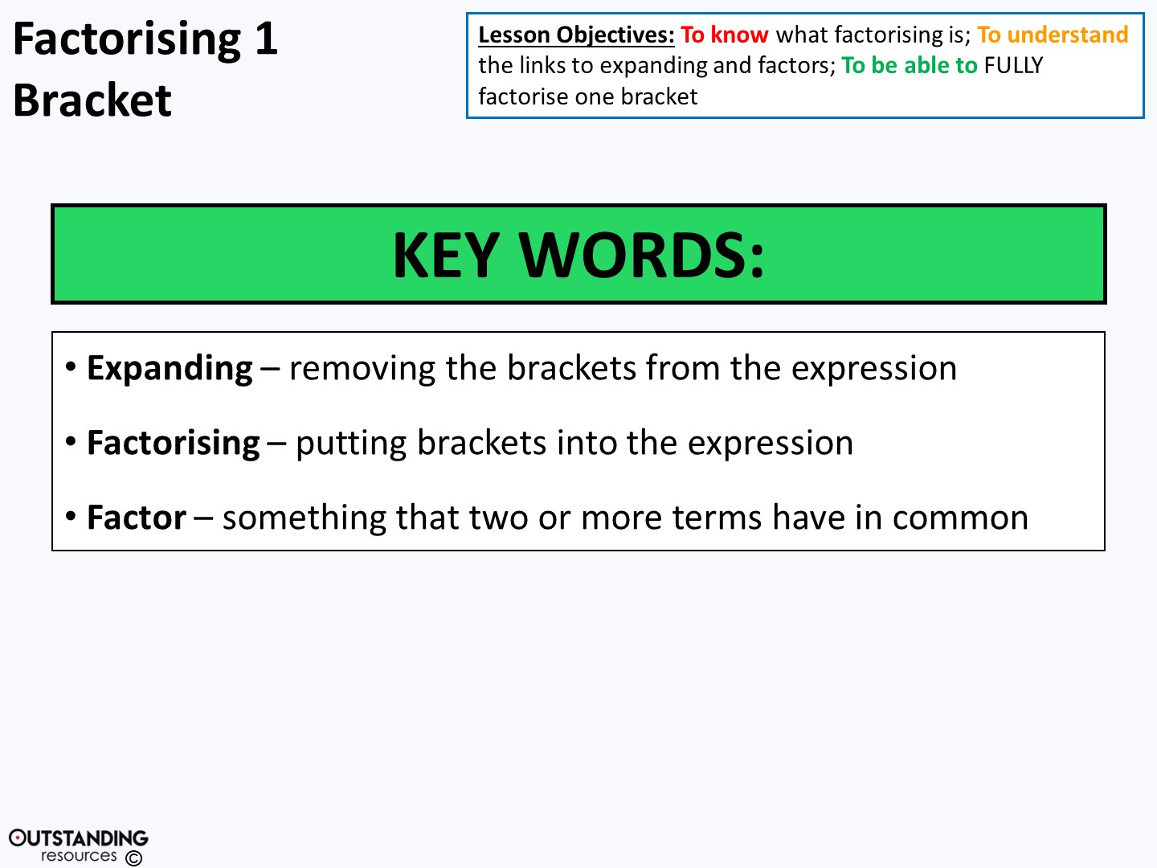

Slide 4
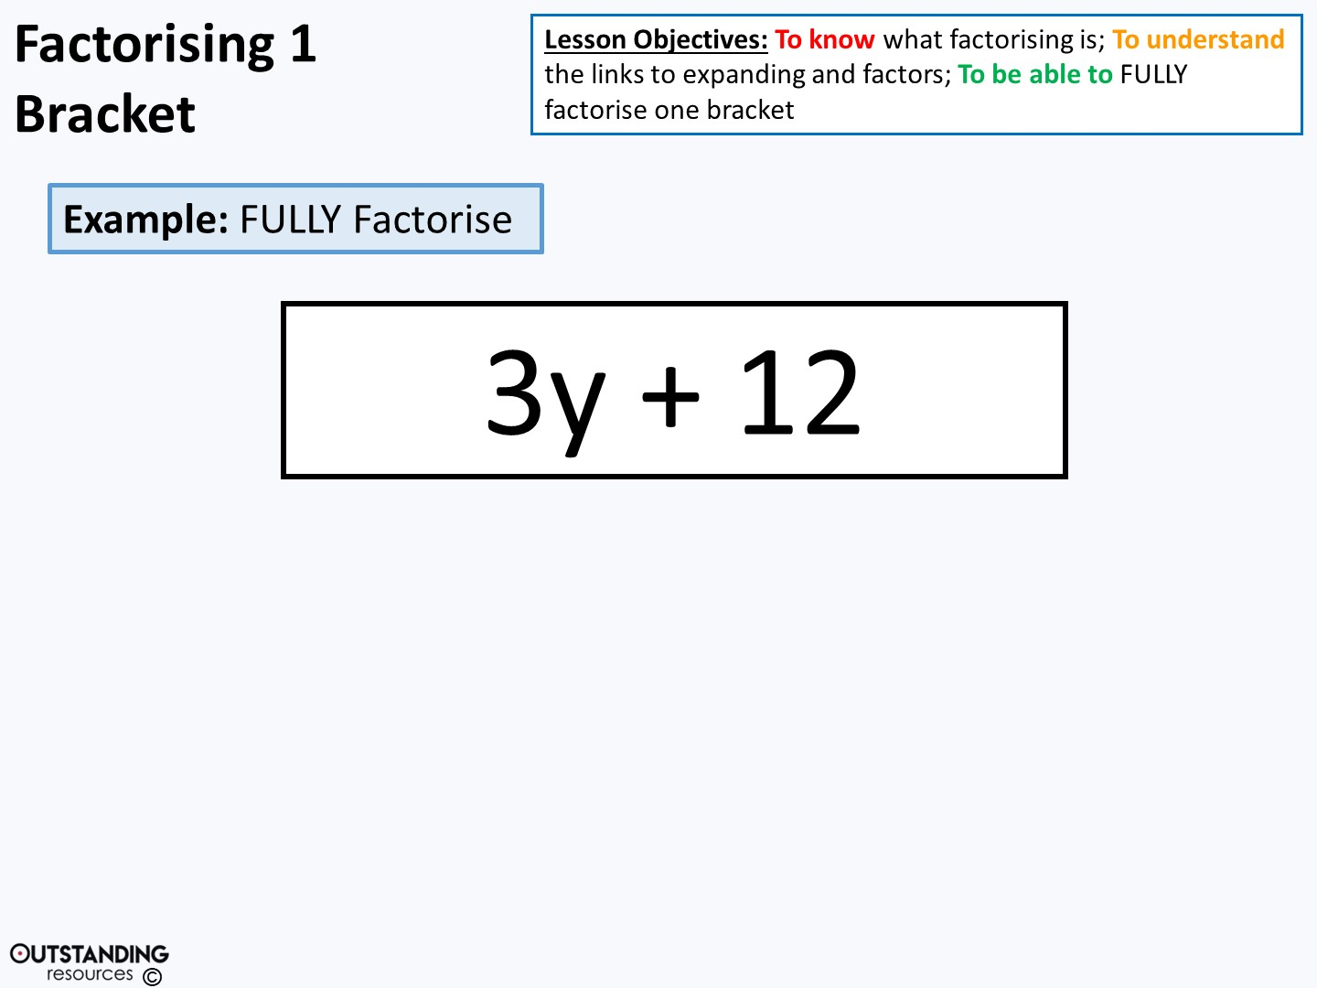
3•y
3•4
Term
Term
y
= 3( + )
4

Slide 5

5•x
3•5
Term
Term
x
= 5( + )
3

Slide 6
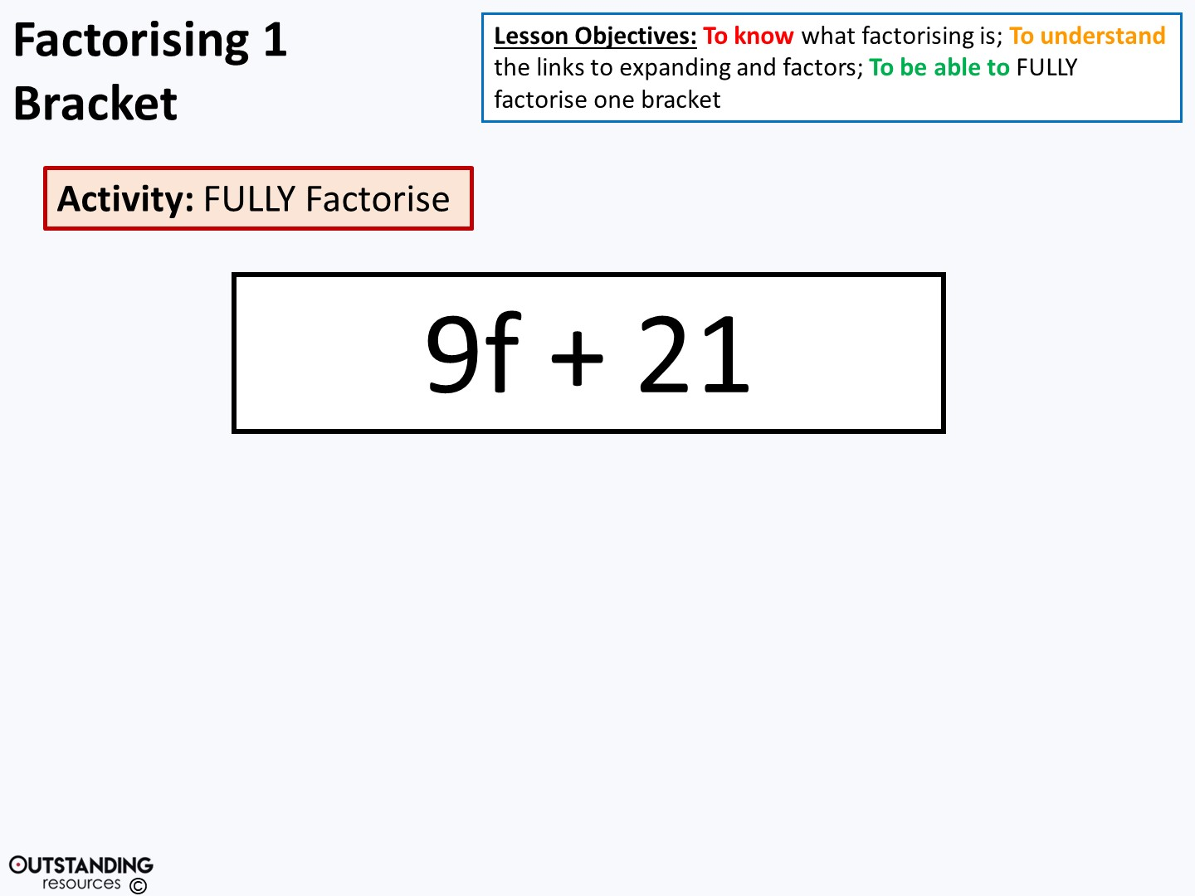
3•3•f
3•7
Term
Term
= 3( + )
3f
7

Slide 7
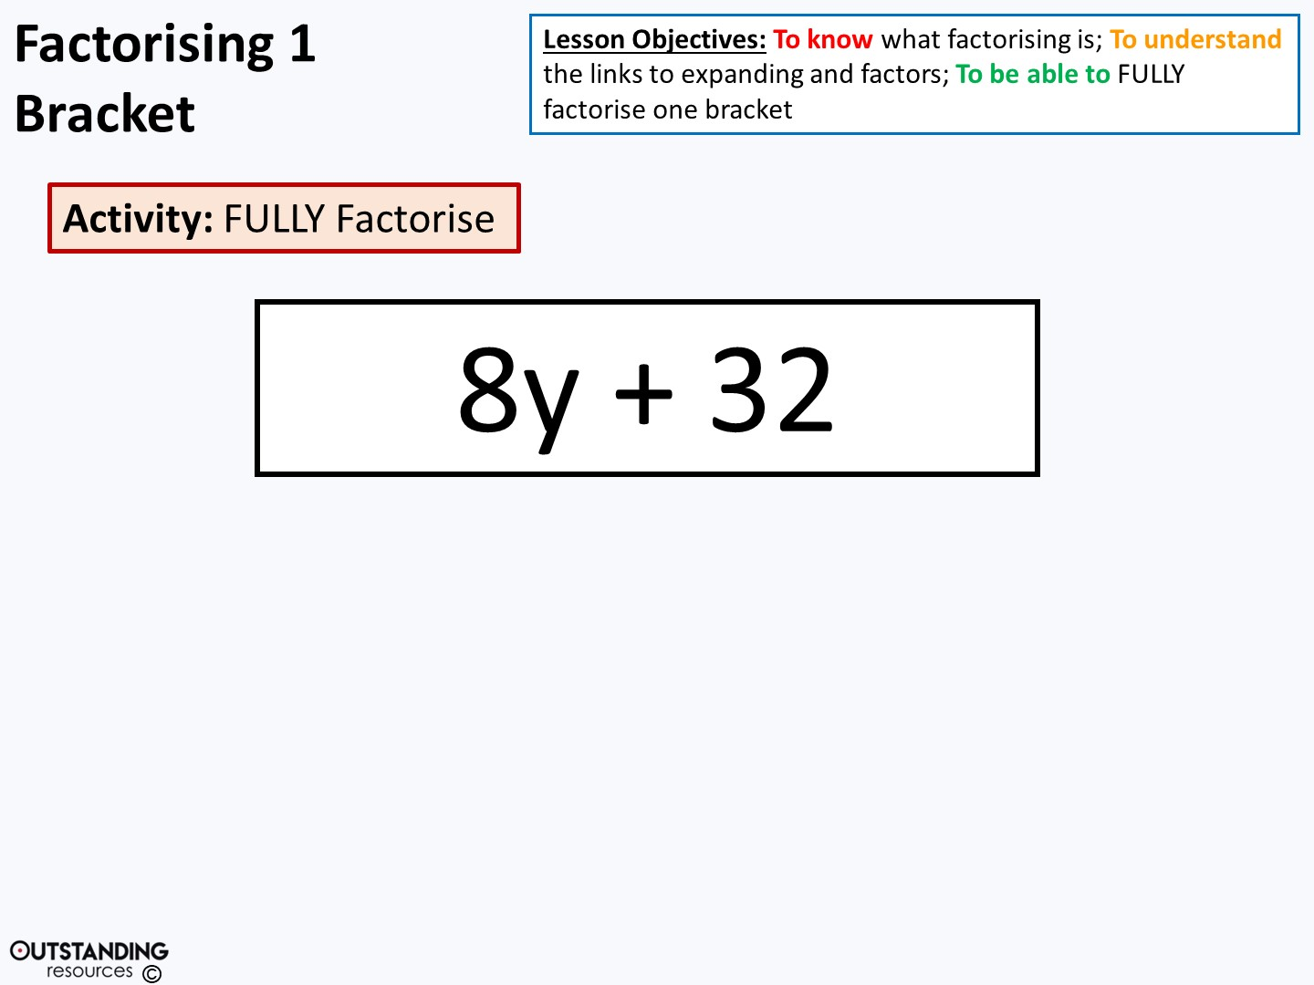
8•y
8•4
Term
Term
y
= 8( + )
4

Slide 8
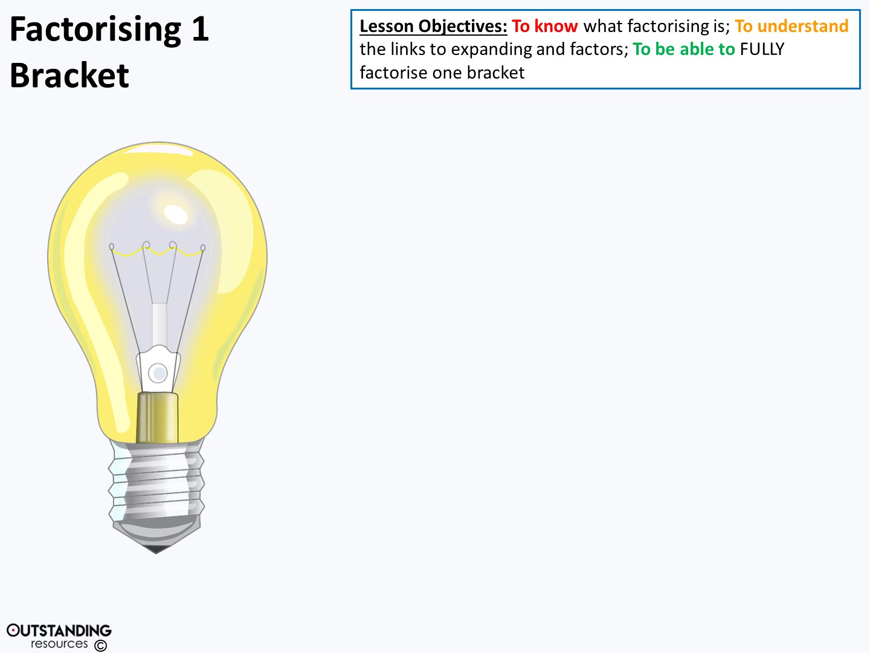
The terms still have 2 (i.e. a factor) in common
= 4(2y + 8)
When expanded it equals …
8y + 32 but
It is NOT FULLY factorised.
Notes:
NOTE: The easiest way to see if it is NOT fully factorised is to look into the brackets and see if you can still factorise. Yes, not fully factorised and if no then it is!
Clipart - Light Bulb on : taken from - https://openclipart.org/detail/116581/light-bulb-onhttp://creativecommons.org/licenses/publicdomain/

Slide 9
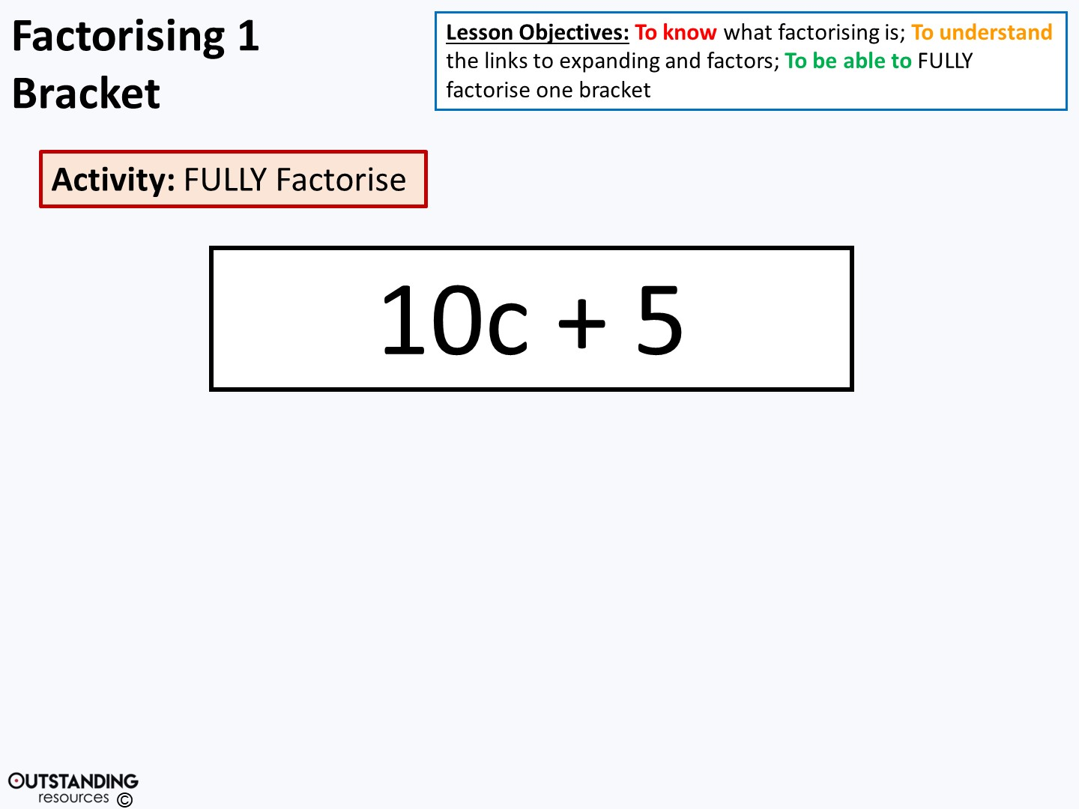
5•2•c
5•1
Term
Term
= 5( + )
2c
1

Slide 10
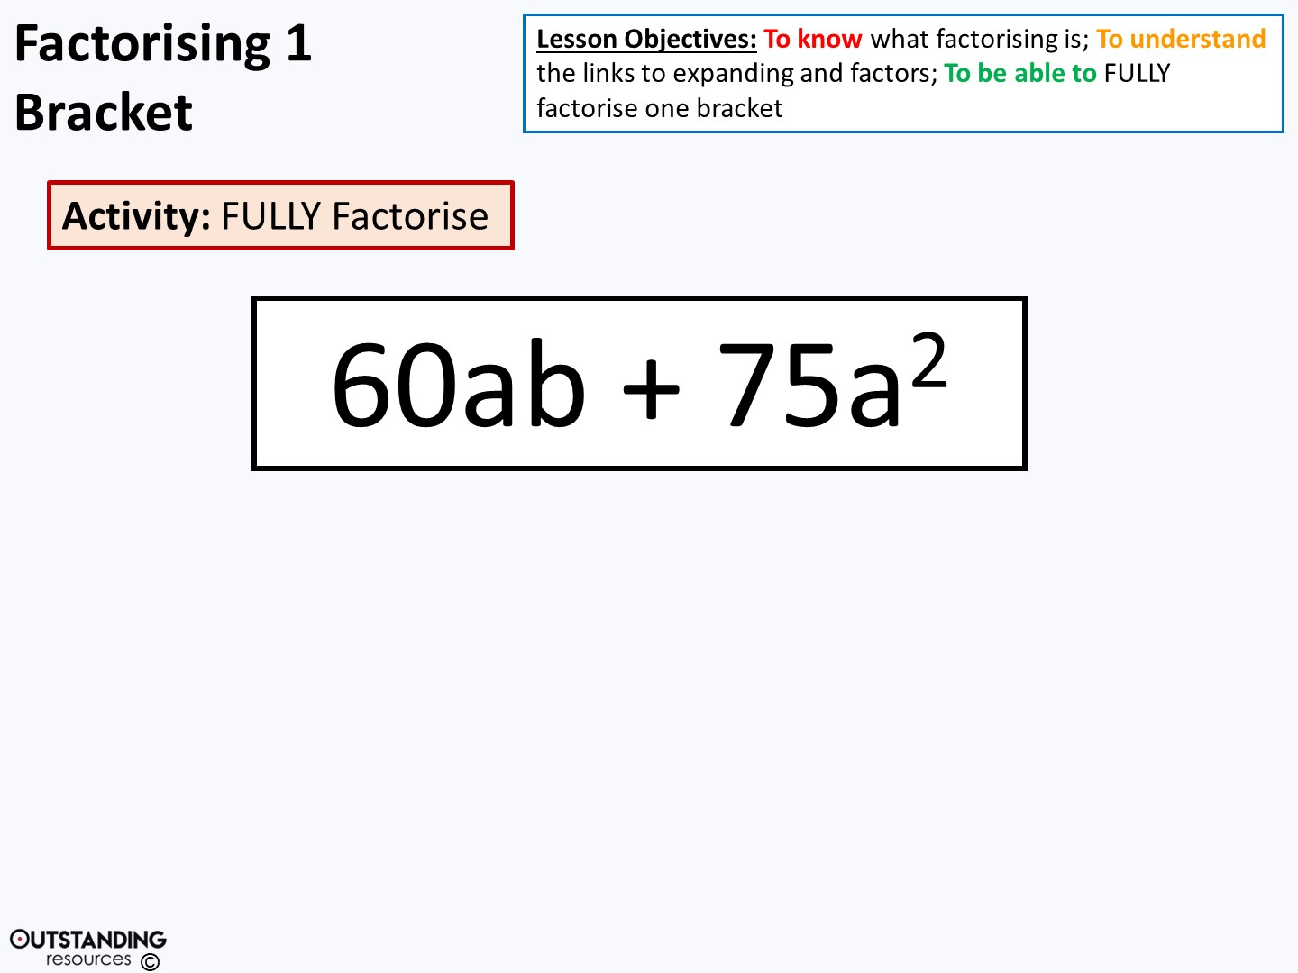
4•15•a•b
5•15•a•a
Term
Term
5a
= 15a( + )
4b

Slide 11
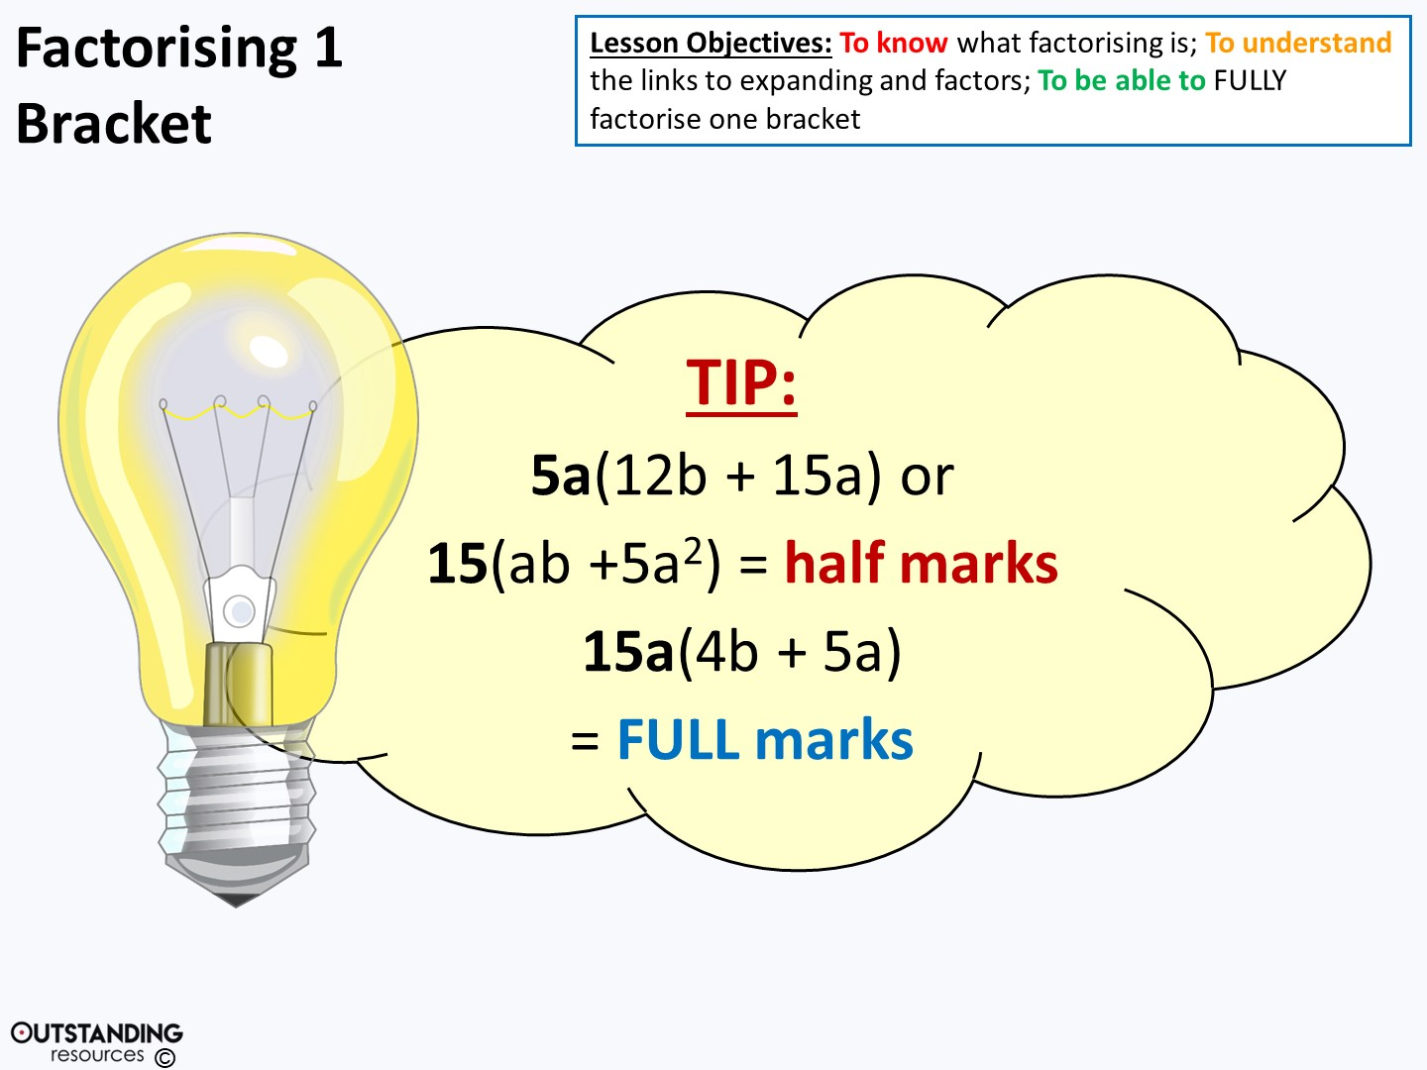
Notes:
NOTE: There is other combinations that would be factorised by NOT fully factorised.
Clipart - Light Bulb on : taken from - https://openclipart.org/detail/116581/light-bulb-onhttp://creativecommons.org/licenses/publicdomain/

Slide 12

a•a•b
a•1
Term
Term
ab
1
= a( + )

Slide 13
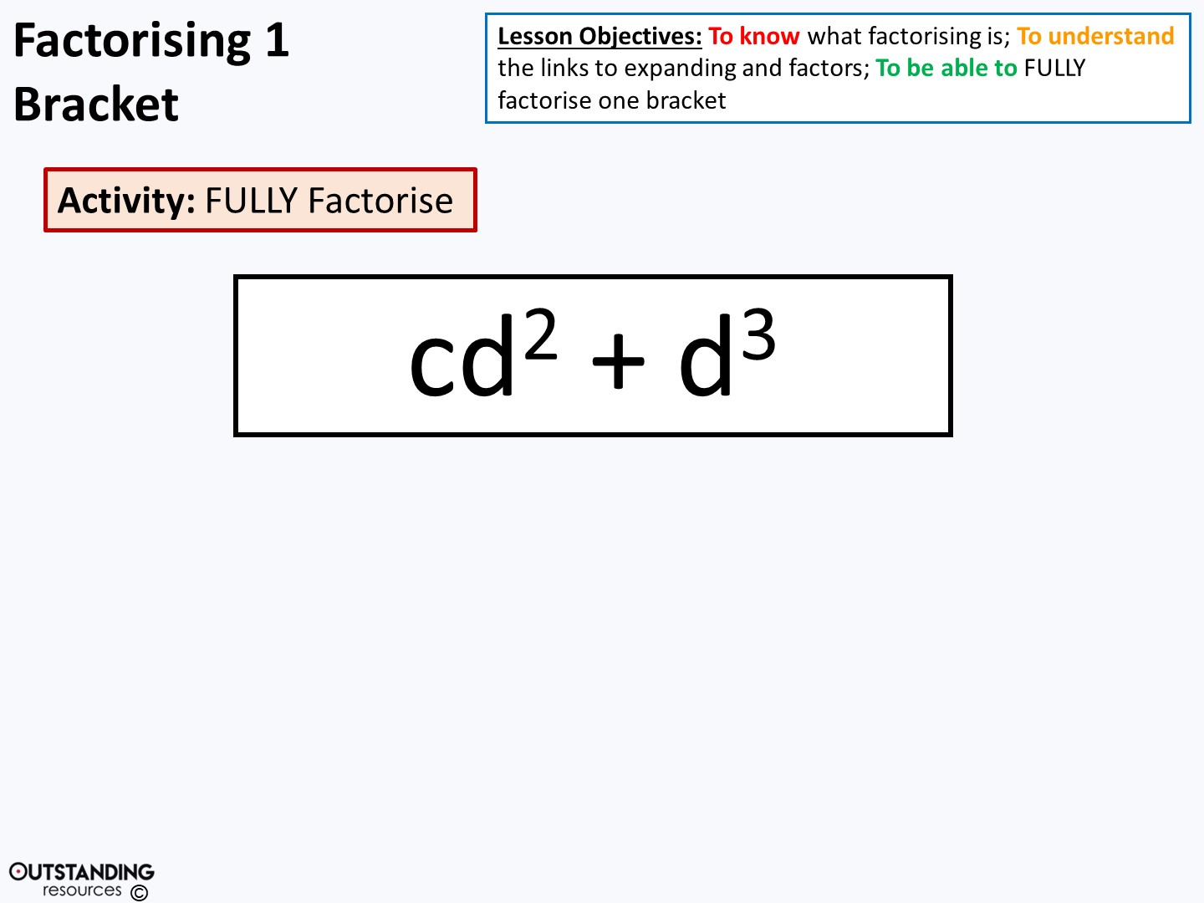
c•d•d
d•d•d
Term
Term
c
= d² ( + )
d

Slide 14
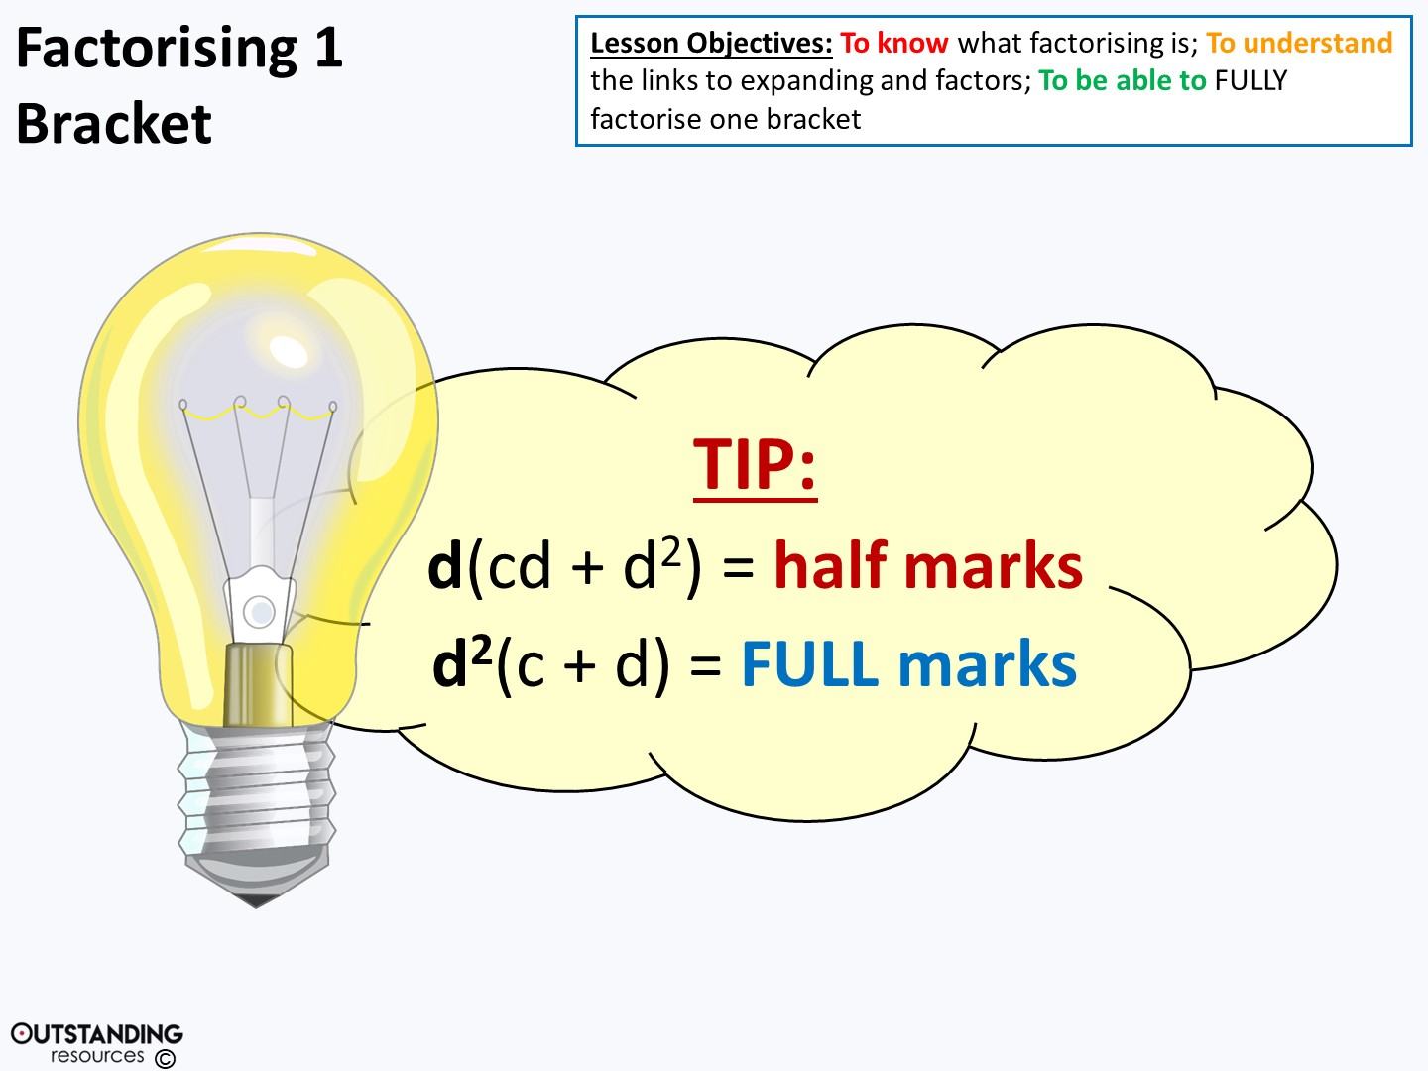
Notes:
Clipart - Light Bulb on : taken from - https://openclipart.org/detail/116581/light-bulb-onhttp://creativecommons.org/licenses/publicdomain/

Slide 15
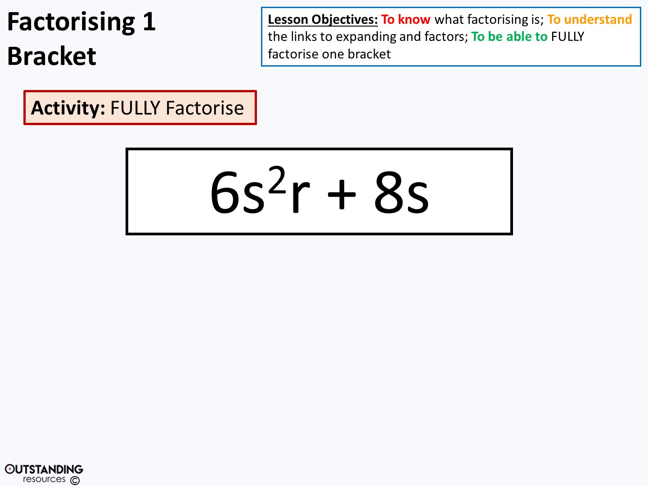
3•2•s•s•r
4•2•s
Term
Term
= 2s( + )
3sr
4

Slide 16
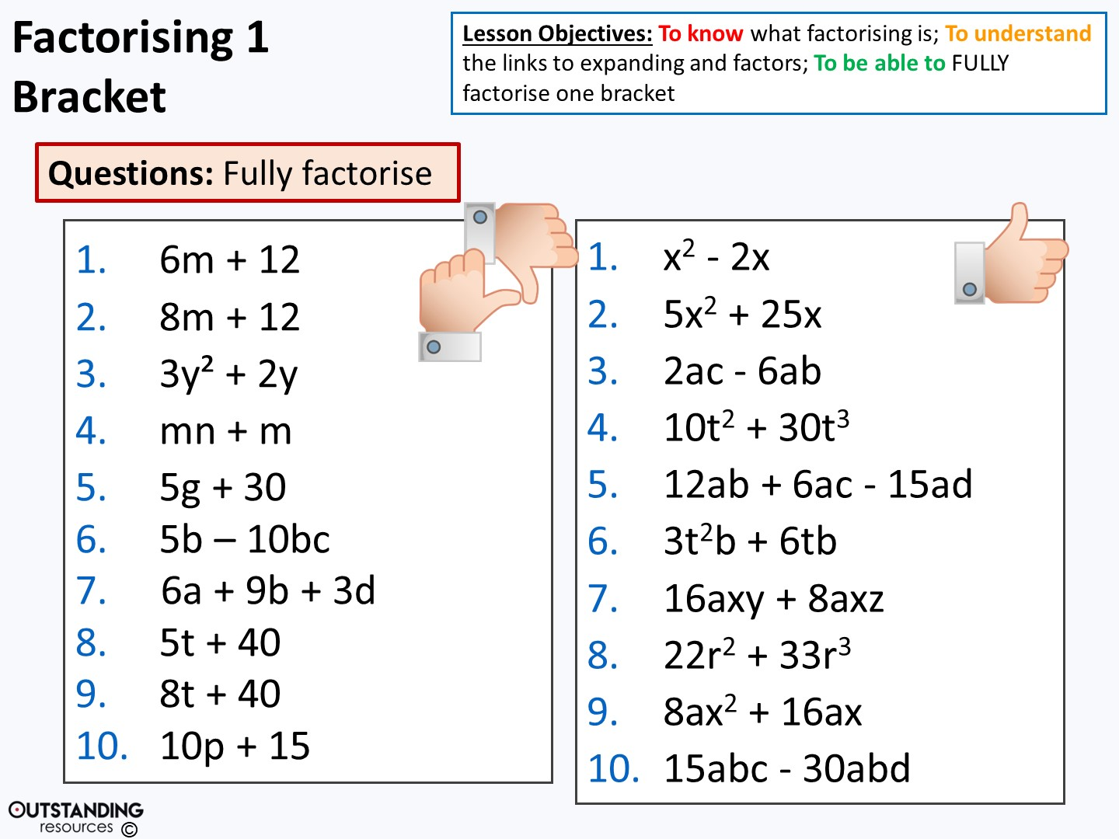
Notes:
Clipart - Thumbs Up Like Hand : taken from - https://openclipart.org/detail/241293/thumbs-up-like-handhttp://creativecommons.org/licenses/publicdomain/

Slide 17
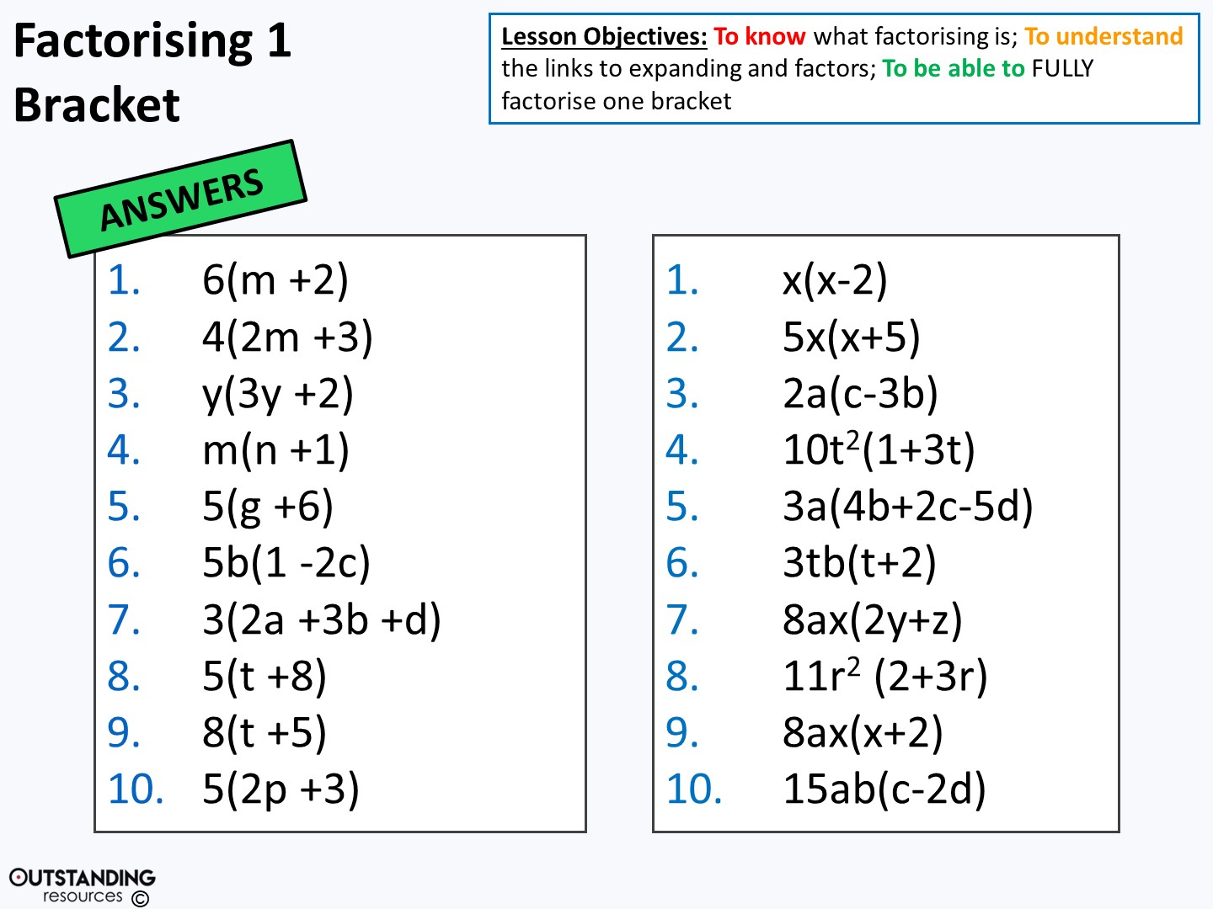

Slide 18
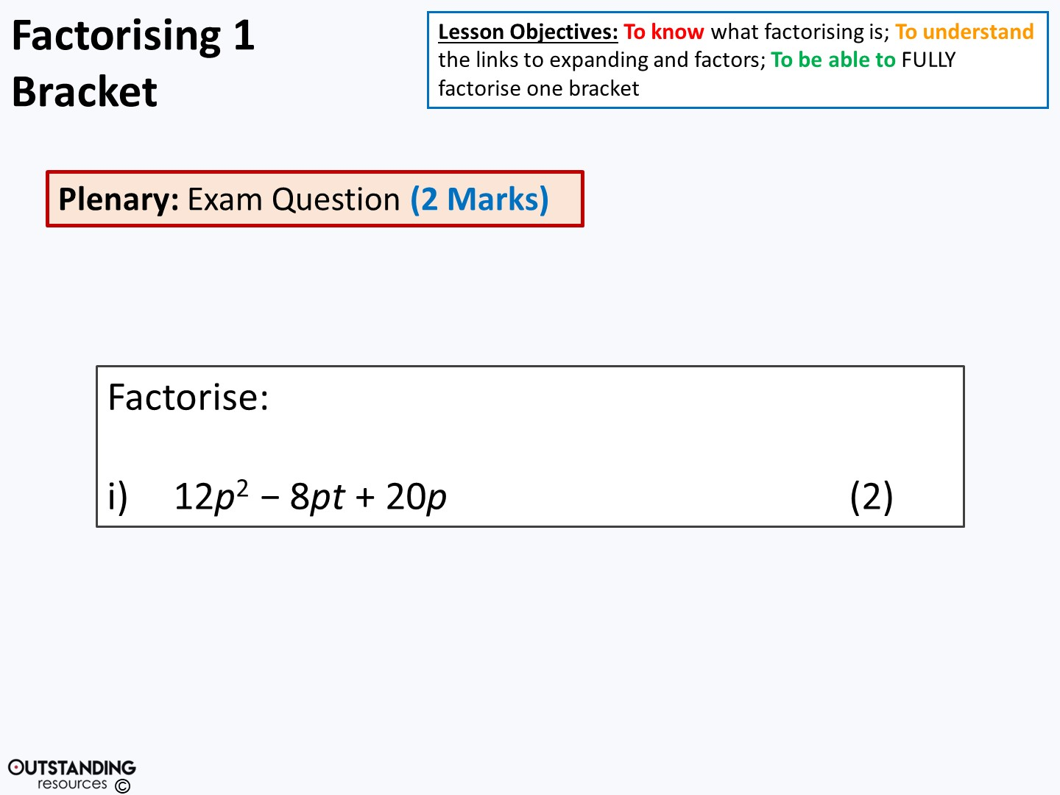
Very straight forward!
= 4p(3p – 2t + 5)
Notes:
NOTE: It is a trinomial (three terms) but it would only factorise to 2 brackets if the terms had nothing in common (no factors)

Slide 19
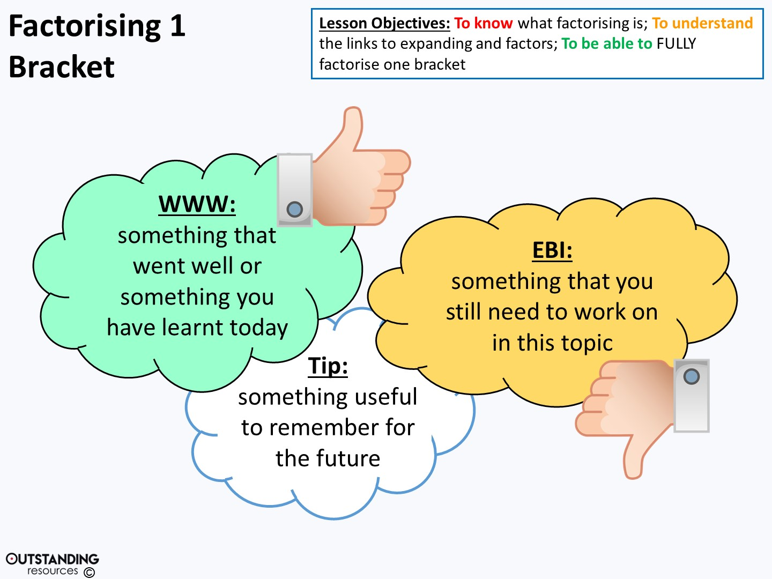
Notes:
Clipart - Thumbs Up Like Hand : taken from - https://openclipart.org/detail/241293/thumbs-up-like-handhttp://creativecommons.org/licenses/publicdomain/

