Slide 1
Starter
Find the highest common factor of…
$$12 and 20 4$$
$$24 and 60 12$$
$$10, 12 and 20 2$$
$$15, 35, 60 5$$
$$12x, 11x, 5x x$$
$$24x, 16x, 80x 8x$$
$x^{4}, x^{5}, x^{7} x^{4}$
?
?
?
?
?
?
?
Notes:
https://www.transum.org/software/SW/Starter_of_the_day/Students/Factorising.asp

Slide 2
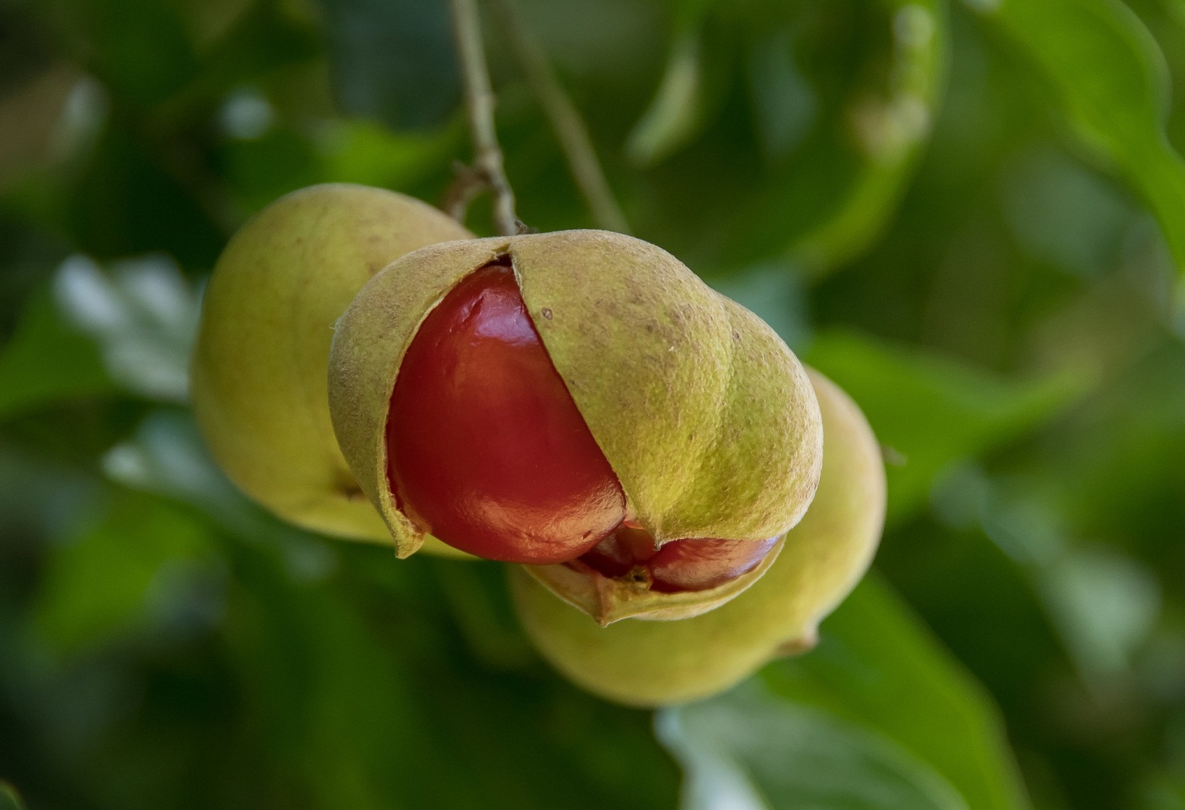
Monday, 25 April 2022
Factorising Expressions
Objective:
To factorise a linear expression
To factorise an expression into a single set of brackets
image © PIXAbay/Eelffica

Slide 3
Factorising Expressions
Example | Thoughts? | Your Turn
$$5y+20$$
$$7y+21$$
$$24x−60$$
$$24x−40$$
A term in an expression is part of an expression, separated by a $−$ or a $+$. In this example $2x$ and $6$ are terms in the expression.

Slide 4
Factorising Expressions
Example | Thoughts? | Your Turn
$$5y^{2}+20y$$
$7y^{2}+21$y
$$24a^{4}b−60a^{2}$$
$$24a^{4}b−40a^{2}$$

Slide 5
Factorising Expressions
A sometimes helpful idea
$$4x^{4}+6x^{5}$$
$$2$$
$$3$$
$$3$$
$$4xxxx+6xxxxx$$
$$2 is a factor$$
$$2(2xxxx+3xxxxx)$$
$$2xxxx(2+3x)$$
$$2x^{4}(2+3x)$$

Slide 6
Factorising Expressions
Has each question been factorised properly? If not, why not? How can you tell if it has been factorised properly or not?
$$7a−21≡7(a−3)$$
$$4b+20≡4(b+20)$$
$$6c+18≡3(2c+6)$$
$$6e+5≡1(6e+5)$$
$$6f^{2}+9f≡3(2f^{2}+3f)$$
Notes:
This is designed as a whole class discussion. Try and draw out that if we have something like $3(2b+6)$ this cannot be factorised completely as the terms inside the bracket have a common factor. Also: is there a point in placing the 1 outside the brackets? (no)

Slide 7
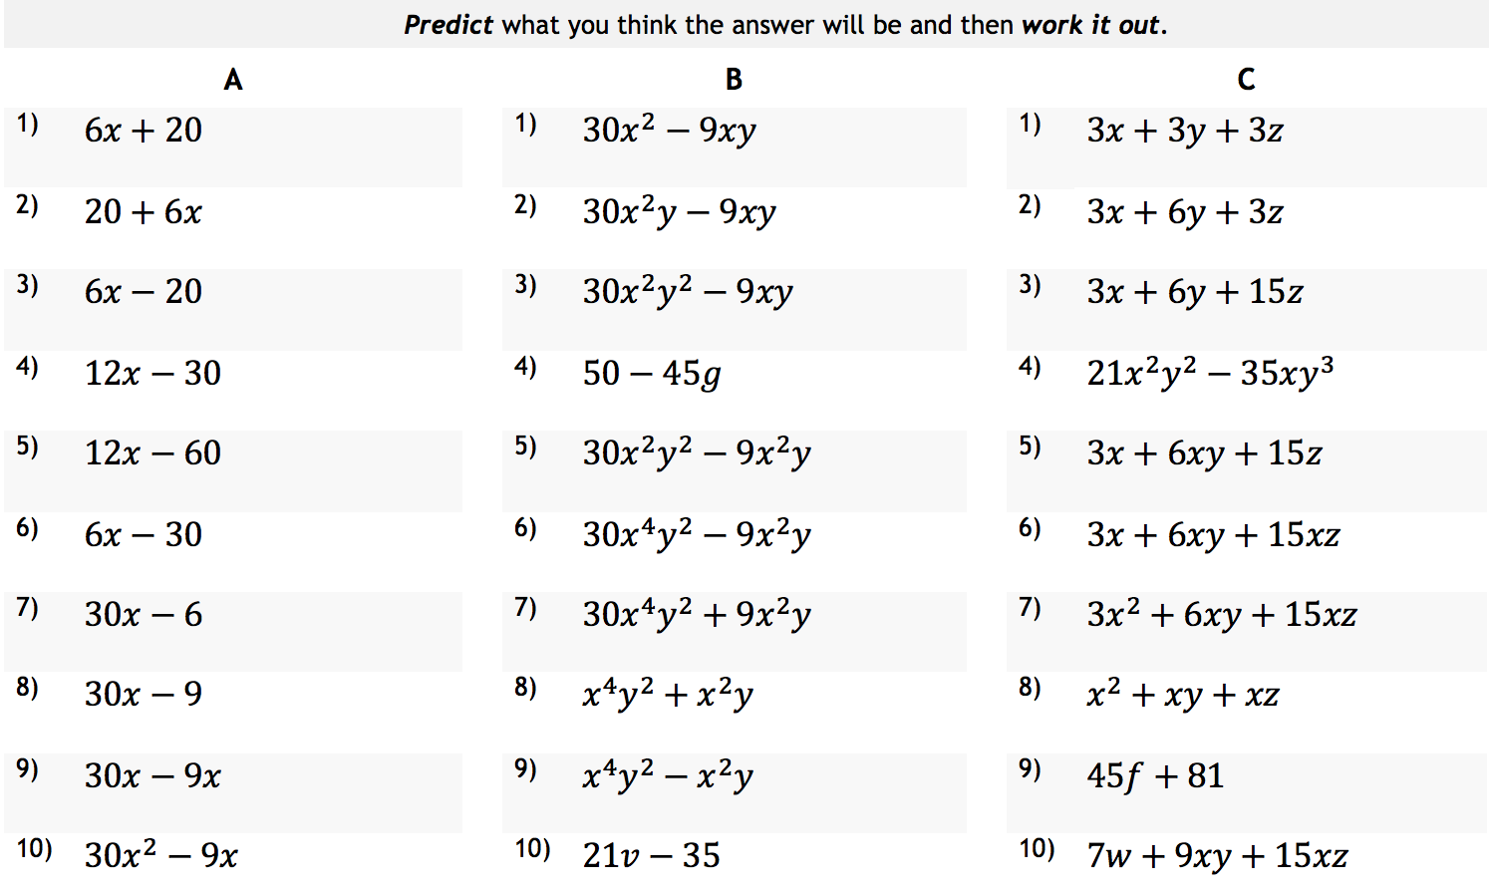
Factorising Expressions

Slide 8
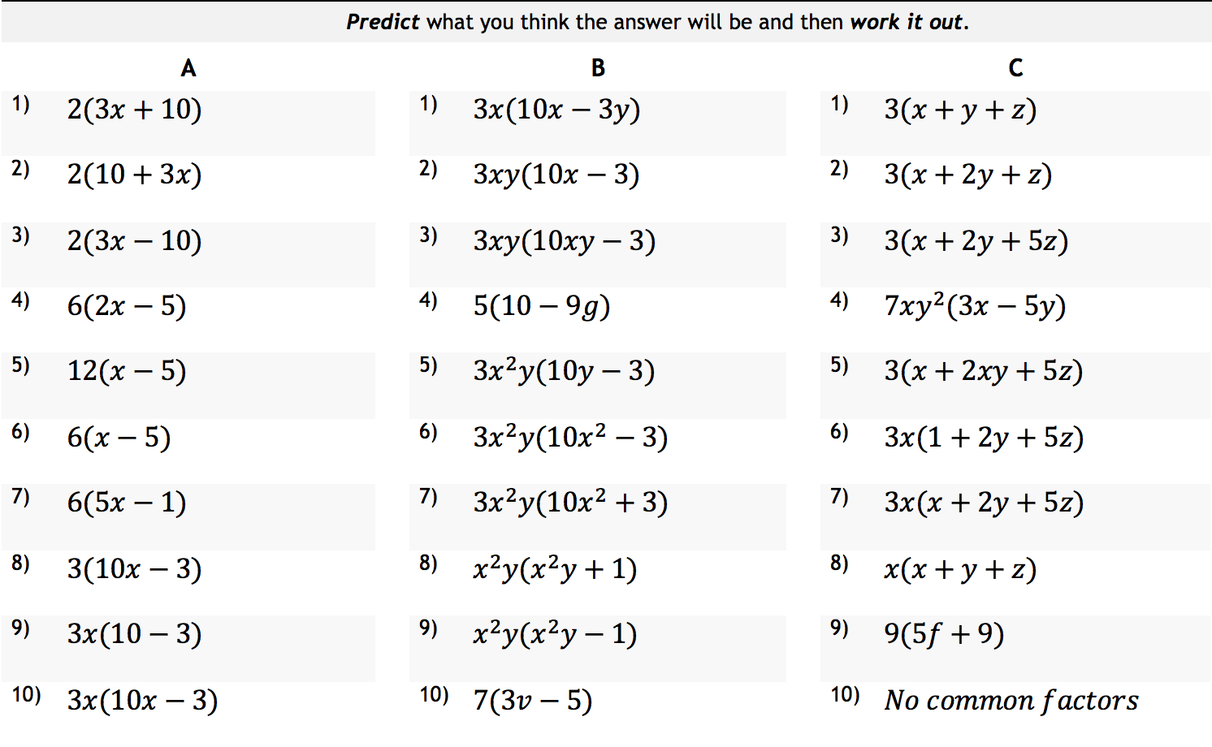
Factorising Expressions

Slide 9
Factorising Expressions
Ex2. Factorise the expressions. Why have they been grouped in rows like this? Could there be any other groups?
$$a) 10x+5$$ | $$b) 20+5x$$ | $$c) 24x+16$$ | $$d) 15x−10$$
$$e) 10x+15y$$ | $$f) 12x+3y$$ | $$g) 14x−21y$$ | $$h) 8x+5y$$
$$i) 3n^{2}+5n$$ | $$j) 3n^{2}+4n$$ | $$k) 8n^{3}−5n^{2}$$ | $$l) 9n^{2}+7n$$
$$m) 4y^{2}+2y$$ | $$n) 15y^{2}−10y$$ | $$o) 20y^{4}+5y^{2}$$ | $$p) 9y^{4}−6y^{3}$$
$$q) 10x+6y+8$$ | $$r) 15x+10y−5$$ | $$s) 20x−4y−8$$ | $$t) 18x+9y−6$$

Slide 10
Factorising Expressions
Answers
$$a) 5(2x+1)$$ | $$b) 5(4+x)$$ | $$c) 8(3x+2)$$ | $$d) 5(3x−2)$$
$$e) 5(2x+3y)$$ | $$f) 3(4x+y)$$ | $$g) 7(2x−3y)$$ | $$h) Cannot be \\ facotrised$$
$$i) n(3n+5)$$ | $$j) n(3n+4)$$ | $$k) n^{2}(8n−5)$$ | $$l) n(9n+7)$$
$$m) 2y(2y+1)$$ | $$n) 5y(3y−2)$$ | $$o) 5y^{2}(4y^{2}+1)$$ | $$p) 3y^{3}(3y−2)$$
$$q) 2(5x+3y+4)$$ | $$r) 5(3x+2y−1)$$ | $$s) 4(5x−y−2)$$ | $$t) 3(6x+3−2)$$

Slide 11
Factorising Expressions
Ex3. Mark the work. Which is right. Which is wrong. Say why.
$$3x(x−2)$$
Correct
$$p^{2}(p−5)$$
$$3t^{2}(t+2)$$
$$6a(3a+2b)$$
$$4p(4p−3q)$$

Slide 12
Factorising Expressions
Example | Thoughts? | Your Turn
$$5\left(a+b\right)+v\left(a+b\right)$$
$$3x^{2}\left(x+4y\right)−5y\left(x+4y\right)$$
Term
5•(a+b)
v•(a+b)
$3x^{2}$•(x+4y)
5y•(x+4y)
= (a+b)(5+v)
= (x+4y)($3x^{2}−5y$)
We can use previous methods to check each term.

Slide 13
Factorising Expressions
Example | Thoughts? | Your Turn
$$8x+xz−16y−2yz$$
$$2x+18yz+12xy+3z$$
$$(8\text{•}x+x\text{•}z)−(2\text{•}8\text{•}y+2\text{•}y\text{•}z)$$
$$2x+12xy+18yz+3z$$
$$\left(2\text{•}x+2\text{•}6\text{•}x\text{•}y\right)+(3\text{•}6\text{•}y\text{•}z+3\text{•}z)$$
$$8(x+z)−2y(x+z)$$
$$2x\left(1+6y\right)+3z\left(6y+1\right)$$
Term
8•(x+z)
$−$2y•(x+z)
$2x$•(1+6y)
+3z•(1+6y)
= (x+z)(8-2y)
= (1+6y)($2x+3z$)
Step 1: separate four terms into two groups;
Step 2: factorizing each group;
Step 3: use previous methods to factorise further.

Slide 14
Factorising Expressions
Question 1
Factorise
$$5v+10$$
Timer

Slide 15
Factorising Expressions
Question 2
Factorise
$$5x+6xy$$
Timer

Slide 16
Factorising Expressions
Question 3
Factorise
$$2t^{2}+t$$
Timer

Slide 17
Factorising Linear Expressions
Question 4
Factorise
$$2t^{2}−14t+8$$
Timer

Slide 18
Factorising Expressions
Question 5
Factorise
$$24a^{2}b−8a^{3}+16a$$
Timer

Slide 19
Factorising Expressions
Your answers:
$5(v+2)$
$x(5+6y)$
$t\left(2t+1\right)$
$2{(t}^{2}−7t+4)$
$8a(3ab−a^{2}+2)$

