Slide 1
Completing the Square
Solving Quadratics
By
Completing the Square
Must be a
perfect
Square

Slide 2
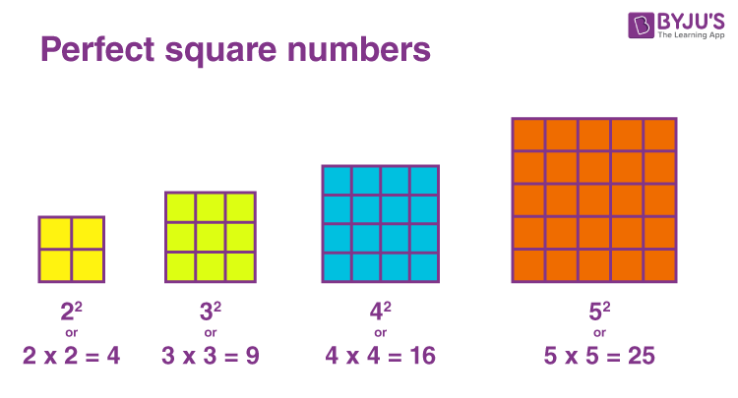
Perfect Squares Numbers Perfect Quadratic Squares Perfect Square Trinomials

Slide 3
Perfect Quadratic Squares

Slide 4
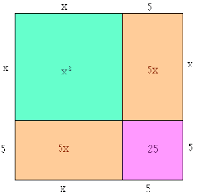
Perfect Quadratic Squares

Slide 5
Short Cut
To expand a perfect square binomial:
We can use these relations to find the missing term….To make it a perfect square trinomial that can be factored into a perfect square binomial.
Then

Slide 6
Make this a perfect square trinomial
Take ½ middle term
Then square it
The resulting trinomial is called a perfect square trinomial,
which can be factored into a perfect square binomial.

Slide 7
Factor this Perfect square trinomial
Short cut!
What is the
Square root
of x²
Bring down sign
What is the
Square root
of 36

Slide 8
Factor this Perfect square trinomial
Short cut!
What is the
Square root
of x²
Bring down sign
What is the
Square root
of 9

Slide 9
Factor this Perfect square trinomial
Short cut!
What is the
Square root
of x²
Bring down sign
What is the
Square root
of 9

Slide 10
Factor this Perfect square trinomial
Short cut!
What is the
Square root
of x²
Bring down sign
What is the
Square root
of 9

Slide 11
In a perfect square, there is a relationship between the coefficient of the middle term and the constant term.

Slide 12
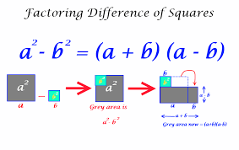
Difference of Squares

Slide 13
Factorising Difference of Squares

Slide 14
Number games: what are two numbers?
Summary
14
7
7
49
Product

Slide 15
Number games: what are two numbers?
Summary
10
?
?
25
Product

Slide 16
Number games: what are two numbers?
Summary
19
?
?
90
Product

Slide 17
Number games: what are two numbers?
Summary
10
?
?
24
Product

Slide 18
Number games: what are two numbers?
Summary
2
?
?
-63
Product

