Slide 1
5F Solving quadratic equations using factorisation
Square Roots →Perfect Square Trinomials

Slide 2
3
2
1
The square of an integer is a perfect square.
The opposite of squaring a number is taking the square root.

Slide 3
Example
For example
asks what number multiplied by itself is equal to 81? That number is 9.
Is there another solution to that problem?

Slide 4
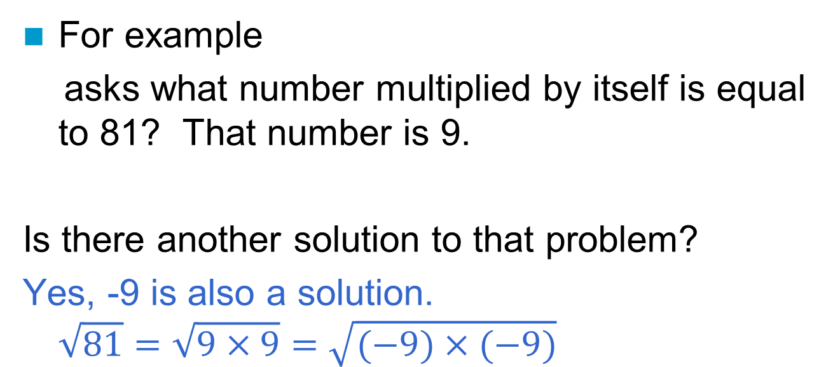
Example
For example
asks what number multiplied by itself is equal to 81? That number is 9.
Is there another solution to that problem?
Yes, -9 is also a solution.
$$\sqrt{81}=\sqrt{9×9}=\sqrt{(−9)×(−9)}$$

Slide 5
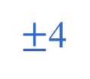
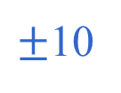


Simplify each square root
10
-10
$±$10
$$\sqrt{100}=\sqrt{10×10}=\sqrt{(−10)×(−10)}$$
-4
-(-4)
$±$4
$$\sqrt{16}=\sqrt{4×4}=\sqrt{(−4)×(−4)}$$
$$−\sqrt{16}=−\sqrt{4×4}=−\sqrt{(−4)×(−4)}$$

Slide 6

Squares and roots
Here is a list that will be helpful:
$$\sqrt{1}=±1 \\ \sqrt{4}=±2 \\ \sqrt{9}=±3 \\ \sqrt{16}=±4 \\ \sqrt{25}=±5 \\ \sqrt{36}=±6 \\ \sqrt{49}=±7 \\ \sqrt{64}=±8 \\ \sqrt{81}=±9 \\ \sqrt{100}=±10 \\ \sqrt{121}=±11 \\ \sqrt{144}=±12$$

Slide 7
Do you see that squares and square roots are inverses (opposites) of each other?

Slide 8
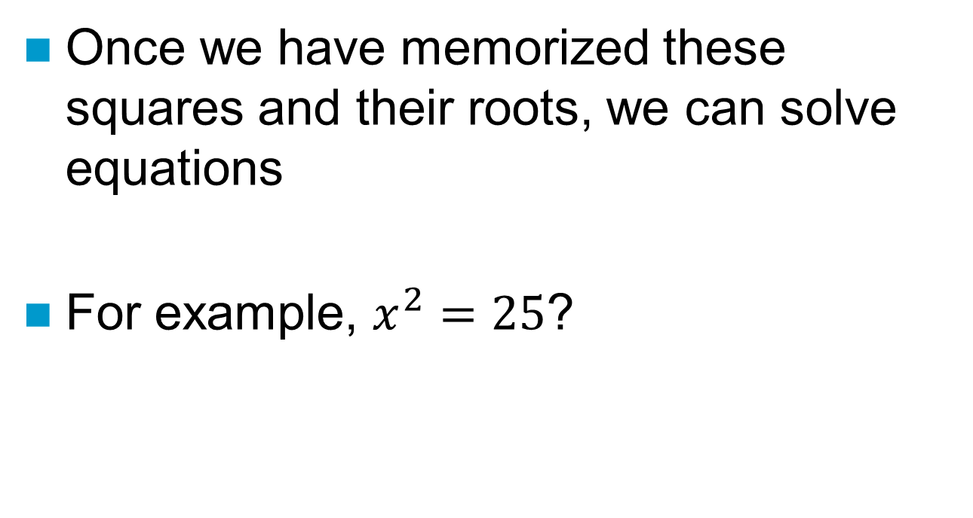
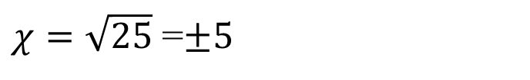
Solving Equations

Slide 9
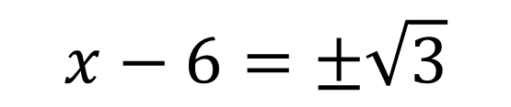
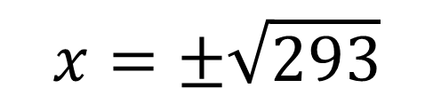
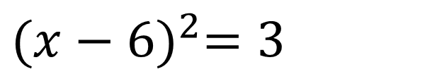
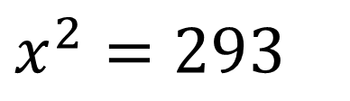

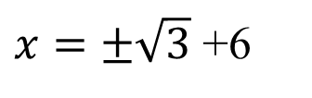
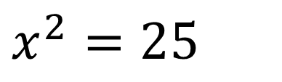

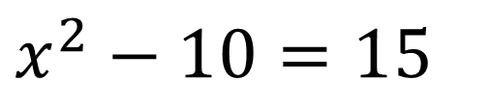

TRY THIS: Use surds if we have to
$$x^{2}=293$$
$$x=±\sqrt{293}$$
$$x^{2}−10=15$$
$$x^{2}=25$$
$$x=±5$$
+10 +10
$$x−6=±\sqrt{3}$$
$${(x−6)}^{2}=3$$
+6 +6
$$x=\left\{\begin{matrix}\sqrt{3}+6 \\ −\sqrt{3}+6\end{matrix}\right.$$
$$\left\{\begin{matrix}x_{1}=\sqrt{3}+6 \\ x_{2}=−\sqrt{3}+6\end{matrix}\right.$$
or
or
$x=±\sqrt{3}$ +6

Slide 10
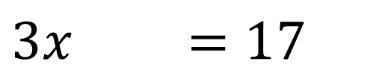
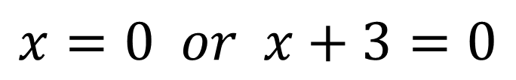

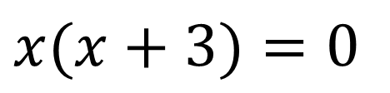
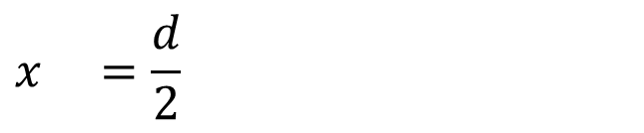
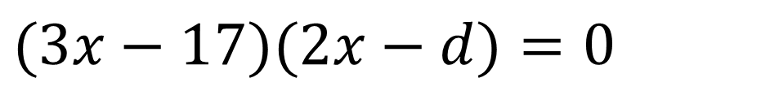
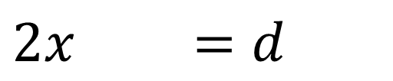
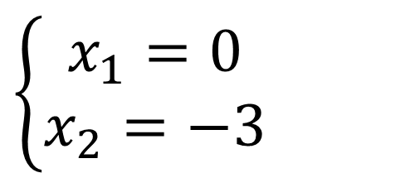
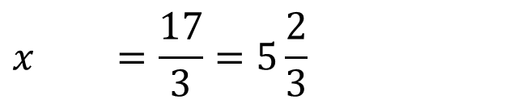
TRY THIS: Use surds if we have to
$$x(x+3)=0$$
$$\left\{\begin{matrix}x_{1}=0 \\ x_{2}=−3\end{matrix}\right.$$
$$x=0 or x+3=0$$
$$(3x−17)(2x−d)=0$$
$$3x−17=0 or 2x−d=0$$
+17 +17
+d +d
$$3x =17$$
$$2x =d$$
÷3 ÷3
÷2 ÷2
$$\left\{\begin{matrix}x_{1}=\frac{17}{3}=5\frac{2}{3} \\ x_{2}=\frac{d}{2}\end{matrix}\right.$$
$$x =\frac{17}{3}=5\frac{2}{3}$$
$$x =\frac{d}{2}$$

Slide 11
Rational number- can be written as a fraction
Irrational number- cannot be written as a fraction because:
    it is a non-terminating decimal
    it is a decimal that does NOT repeat
* The square roots of ALL perfect squares are rational.
* The square roots of numbers that are NOT perfect squares are irrational.

Slide 12
Try This: Identify each number as rational or irrational
Irrational
Rational
Rational
Rational
Irrational

