Slide 1
Starter
Match the quadratic equation to the sketch of its graph
$$x^{2}−4x+4=0$$
$$x^{2}−25=0$$
$$x^{2}+4=0$$
$$y$$
$$y$$
$$y$$
$$x=−5$$
$$x$$
$$x$$
$$x$$
$$x=5$$
$$x=2$$
$$x^{2}−25=0$$
$$x^{2}−4x+4=0$$
$$x^{2}+4=0$$

Slide 2
Completing The Square
Grade A
04/05/2022
Learning Objectives:
Able to solve a quadratic equation by
factorising
Able to complete the square
Able to solve a quadratic equation by
completing the square

Slide 3
Completing The Square
Completing the square is another method to solve a quadratic equation
Answers when completing the square are usually given to a specified number of decimal places or left in surd form

Slide 4
Completing the Square
$${\left(x+a\right)}^{2}$$
This can be re-arranged to give:
$$x^{2}+2ax={(x+a)}^{2}−a^{2}$$
This is the principle of completing the square.
$$=x^{2}+2ax+a^{2}$$

Slide 5
Completing the Square
Re-write the expression $x^{2}+6x+5$ in the form ${(x+a)}^{2}−b$
Remember that $x^{2}+6x={(x+3)}^{2}−3^{2}$
So: $x^{2}+6x+5=$
${(x+3)}^{2}−3^{2}+5$
${=(x+3)}^{2}−4$

Slide 6
Completing the Square
Re-write the expression $x^{2}−20x−11$ in the form ${(x+a)}^{2}−b$
$x^{2}−20x=$
$={(x−10)}^{2}−100$
$x^{2}−20x−11$
${(x−10)}^{2}−{(−10)}^{2}$
$${=(x−10)}^{2}−100−11$$
$${=(x−10)}^{2}−111$$

Slide 7
Completing the Square
On your whiteboards, write these quadratic expressions in the form ${(x+a)}^{2}−b$
$$x^{2}+8x+20$$
$$x^{2}−2x−13$$
$$x^{2}+24x−6$$
$$x^{2}+5x+8$$
$$x^{2}−18x+50$$

Slide 8
Completing The Square
Grade A
04/05/2022
Write these quadratic expressions in the form ${(x+a)}^{2}−b$
1) $x^{2}+14x$ 2) $x^{2}−12x$
$x^{2}+6x+19$ 4) $x^{2}−x+4$
5) ${ x}^{2}+ 8x+6$ 6) $x^{2}−10x−10$
EXTENSION:
Solve these quadratic equations using a method of completing the square. Give your answers correct to 2 decimal places:
7) $x^{2}+2x−10=0$ 8) $x^{2}−12x+24=0$
$$={(x+7)}^{2}−49$$
$$={(x−6)}^{2}−36$$
$$={(x+3)}^{2}+10$$
$$={(x−0.5)}^{2}+3.75$$
$$={(x+4)}^{2}−10$$
$$={(x−5)}^{2}−35$$
$$x=2.32 or x=−4.32$$
$$x=9.46 or x=2.56$$

Slide 9
Starter
Solve the equation:
$$x^{2}−9x−22=0$$
Write the following expressions in the form ${\left(x+a\right)}^{2}+b$
$$x^{2}+18x+50$$
$$x^{2}−24x+6$$
Make each of the expressions above equal to zero and solve the resulting equations

Slide 10
Solve the following equation by completing the square. Give your answer correct to 2 decimal places.
$$x^{2}+24x−6=0$$
$${(x+12)}^{2}−144−6=0$$
$${(x+12)}^{2}−150=0$$
$${(x+12)}^{2} =150$$
$$x+12=±\sqrt{150}$$
$$x=−12±\sqrt{150}$$
$$x=0.25 or x=−24.25$$
1. Complete the square
2. Re-arrange
Remember the square root gives a positive AND a negative solution
3. Square root both sides
4. Solve the equation as normal

Slide 11
Solve the following equation by completing the square. Leave your answer in the form $a± \sqrt{b}$
$$x^{2}−6x−9=0$$
$${(x−3)}^{2}−9−9=0$$
$${(x−3)}^{2}−18=0$$
$${(x−3)}^{2} =18$$
$$x−3=±\sqrt{18}$$
$$x=3±\sqrt{18}$$
$$x=3+\sqrt{18} or x=3−\sqrt{18}$$
1. Complete the square
2. Re-arrange
Remember the square root gives a positive AND a negative solution
3. Square root both sides
4. Solve the equation as normal, but leave the answer in surd form

Slide 12
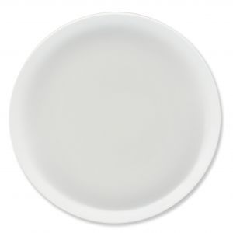
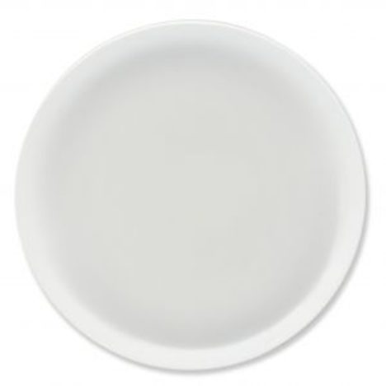
$$x^{2}+4x−3=0$$
$$x^{2}+8x+17=0$$
Can you guess which thing
Before I finish my soonnnggg.
is not like the other things
One of these things, it doesn’t belong.
One of these things is not like the other thing
$$x^{2}+6x+7=0$$
$$x^{2}−10x−1=0$$

Slide 13
$$x^{2}+4x−3=0$$
$$x^{2}+8x+17=0$$
$$x^{2}+6x+7=0$$
$$x^{2}−10x−1=0$$

