Slide 1
Completing the square

Slide 2
Completing The Square
Learning Aim
We are learning to change quadratic expressions x² + bx + c
into the completed square form (x + p)² + q
Success Criteria
I can express a quadratic expression in completed square form (ALL)
I can check that my answers are correct by multiplying out and simplifying (MOST)
I can identify minimums by using the ‘completed square form’. (SOME)

Slide 3
Starter
Multiply out the brackets:
(x+3)(x+2)
(2x+2)(9x-3)
(x+5)²

Slide 4
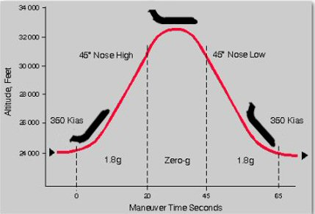
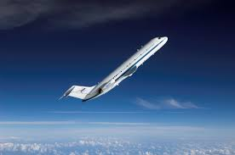
The path to ZERO gravity
NASA’s KC135A aircraft, which flies in steep parabolic paths in order to simulate the effects of zero gravity

Slide 5
Short Cut
To expand a perfect square binomial:
We can use these relations to find the missing term….To make it a perfect square trinomial that can be factored into a perfect square binomial.
Then

Slide 6
x² + 6x + 9
Extension
Expand and simplify to check your answer
(x+6)²
(x+3)²
A)
B)
(x+9)²
(x+4)²
C)
D)
Keywords: quadratic, coefficient, squared, complete the square, minimum point

Slide 7
x² + 10x + 25
Extension
Expand and simplify to check your answer
(x+5)² +20
(x+10)²
A)
B)
(x+5)² +10
(x+5)²
C)
D)
Keywords: quadratic, coefficient, squared, complete the square, minimum point

Slide 8
Make this a perfect square trinomial
Take ½ middle term
Then square it
The resulting trinomial is called a perfect square trinomial,
which can be factored into a perfect square binomial.

Slide 9
Make this a perfect square trinomial
$$\frac{1}{4}$$
$$x^{2}+x+____$$
$$(x+\frac{1}{2})^{2}$$
$$=\frac{1}{2}$$
Take ½ middle term
Then square it
The resulting trinomial is called a perfect square trinomial,
which can be factored into a perfect square binomial.
$$1÷2$$
$$(\frac{1}{2})^{2}$$
$$=\frac{1^{2}}{2^{2}}=\frac{1}{4}$$

Slide 10
Completing the Square: This is not a perfect square.
x² + 10x + 31
= $x^{2}+10x+25−25+31$
This number will be half the coefficient of x
This number is 5 squared
(x+5)²
-25
+ 31
(x+5)²
+ 6
(x+5)² +6
Check
Expand and simplify
Key words: quadratic, coefficient, squared, complete the square, minimum point

Slide 11
Completing the Square: This is not a perfect square.
x² + 18x
= $x^{2}+18x+81−81$
This number will be half the coefficient of x
This number is 9 squared
(x+9)²
-81
(x+9)²
- 81
(x+9)² - 81
Check
Expand and simplify
Key words: quadratic, coefficient, squared, complete the square, minimum point

Slide 12
Completing the Square: This is not a perfect square.
x² + 9x + 16
= $x^{2}+9x+{\left(\frac{9}{2}\right)}^{2}−{\left(\frac{9}{2}\right)}^{2}+16$
This number will be half the coefficient of x
(x+ $\frac{9}{2}$)²
- ${\left(\frac{9}{2}\right)}^{2}$
This number is 9/2 squared
+ 16
(x+ $\frac{9}{2}$)²
- $\frac{81}{4}$ + $\frac{64}{4}$
Check
Expand and simplify
(x+ $\frac{9}{2}$)² - $\frac{17}{4}$
Key words: quadratic, coefficient, squared, complete the square, minimum point

Slide 13
x² + 6x + 10
Extension
Expand and simplify to check your answer
(x+6)² + 1
(x+3)² + 10
A)
B)
(x+3)² - 1
(x+3)² + 1
C)
D)
Keywords: quadratic, coefficient, squared, complete the square, minimum point

Slide 14
x² + 10x + 24
Extension
Expand and simplify to check your answer
(x+5)² +1
(x+5)² -1
A)
B)
(x+5)² -2
(x+5)² +4
C)
D)
Keywords: quadratic, coefficient, squared, complete the square, minimum point

Slide 15
Completing the Square: This is not a perfect square.
x² + 8x + 6
= $x^{2}+8x+4^{2}−4^{2}+6$
This number is 8/2 squared
This number will be half the coefficient of x
=(x+ $4$)²
+ 6
$−$ $4^{2}$
=(x+ $4$)²
$−$ $16$+ $10$
Check
Expand and simplify
=(x+ $4$)² $−$ $6$
=(x+4+$\sqrt{6}$)(x+4 $−$ $\sqrt{6}$)
Key words: quadratic, coefficient, squared, complete the square, minimum point

