Slide 1
Starter
Solve this equation by factorising:
$$x^{2}−9x+18$$
Solve this equation by completing the square. Leave your answer in the form $a± \sqrt{b}$
$$x^{2}+8x−4$$
Solve this equation by completing the square. Give your answers correct to 3 significant figures.
$$x^{2}−12x−13$$
B
A*
A*

Slide 2
The Quadratic Formula
Grade A
17/05/2022
Learning Objectives:
Able to identify a, b and c in the quadratic formula
Able to substitute into the quadratic
formula correctly
Able to solve a quadratic equation using
the quadratic formula

Slide 3
The Quadratic Formula
Another alternative to solving quadratic equations which don’t factorise easily is to use the quadratic formula.
For equations of the form ${ax}^{2}+bx+c=0$:
Discriminant = $b^{2}−4ac$
$$x=\frac{−b± \sqrt{b^{2}−4ac}}{2a}$$
This formula is given to you in the formula book

Slide 4
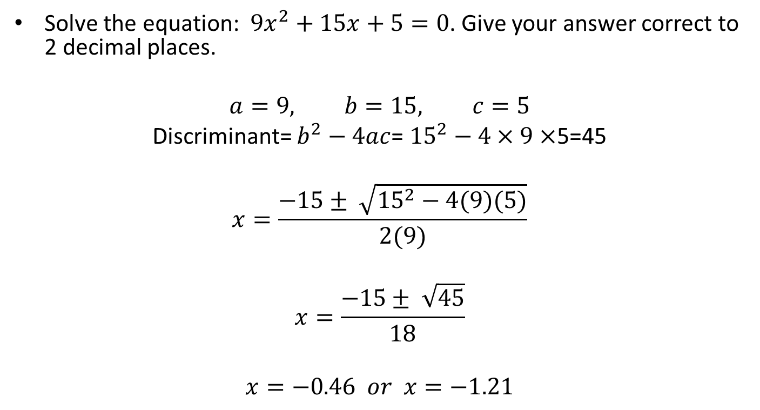
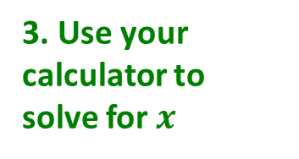
The Quadratic Formula
Solve the equation: ${9x}^{2}+15x+5=0$. Give your answer correct to 2 decimal places.
$$a=9, b=15, c=5$$
Discriminant= $b^{2}−4ac$= ${15}^{2}−4×9×$5=45
$$x=\frac{−15± \sqrt{{15}^{2}−4(9)(5)}}{2(9)}$$
$$x=\frac{−15± \sqrt{45}}{18}$$
$$x=−0.46 or x=−1.21$$
1. Identify a, b and c
2. Substitute into the formula
3. Use your calculator to solve for $x$

Slide 5
The Quadratic Formula
On your mini whiteboard, use the quadratic formula to solve the equation:
$${3x}^{2}+8x+2=0$$
$$x=\frac{−8± \sqrt{8^{2}−4(3)(2)}}{2(3)}$$
$$x=\frac{−8± \sqrt{40}}{6}$$
$$x=−0.28 or x=−2.39$$

Slide 6
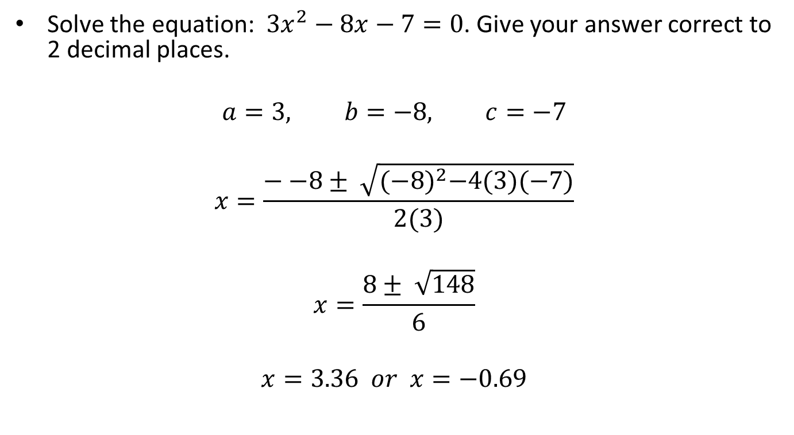
The Quadratic Formula
Solve the equation: ${3x}^{2}−8x−7=0$. Give your answer correct to 2 decimal places.
$$a=3, b=−8, c=−7$$
$$x=\frac{−−8± \sqrt{{(−8)}^{2}−4(3)(−7)}}{2(3)}$$
$$x=\frac{8± \sqrt{148}}{6}$$
$$x=3.36 or x=−0.69$$

Slide 7
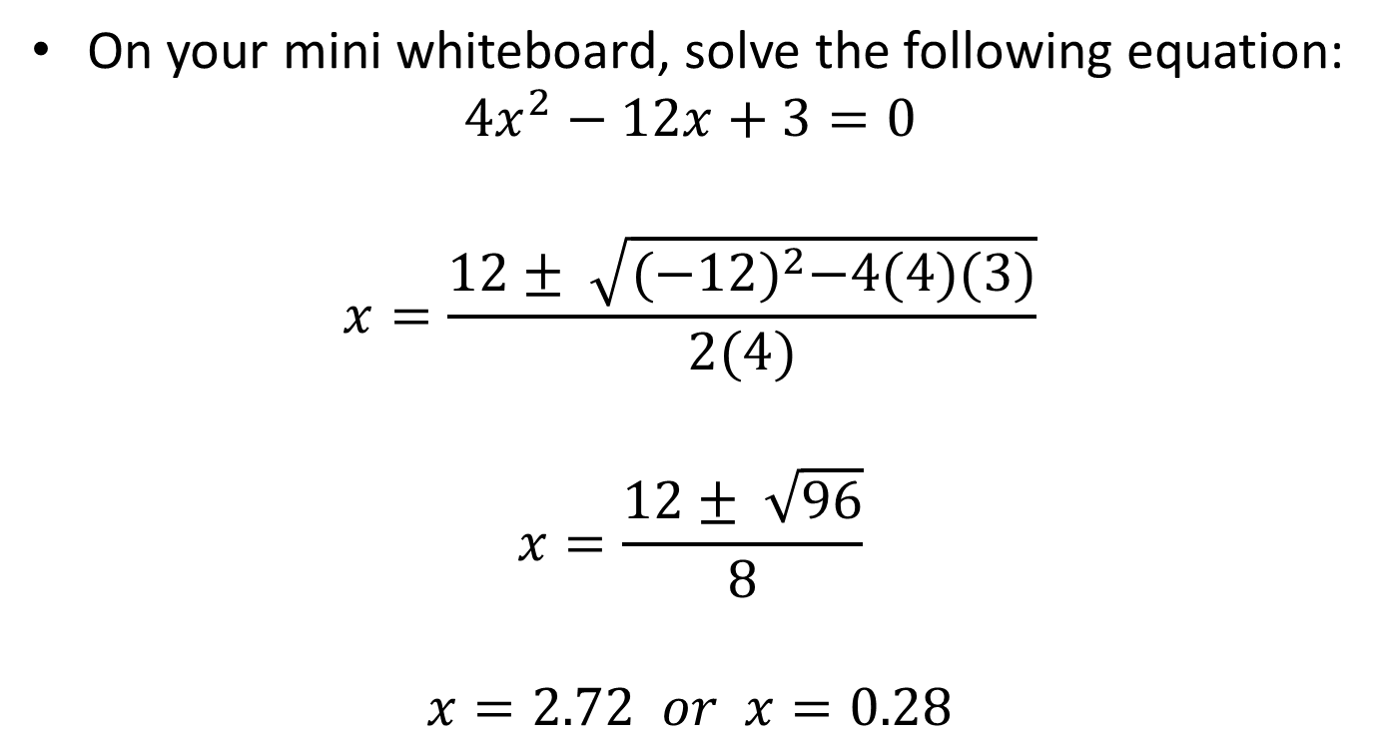
The Quadratic Formula
On your mini whiteboard, solve the following equation:
$${4x}^{2}−12x+3=0$$
$$x=\frac{12± \sqrt{{(−12)}^{2}−4(4)(3)}}{2(4)}$$
$$x=\frac{12± \sqrt{96}}{8}$$
$$x=2.72 or x=0.28$$

Slide 8
The Quadratic Formula
Grade A
17/05/2022
Solve these quadratic expressions. Give your answers correct to 2 decimal places
1) ${2x}^{2}+11x+8=0$ 2) ${3x}^{2}+5x+1=0$
${7x}^{2}+12x+2=0$ 4) ${6x}^{2}+22x+19=0$
5) ${ x}^{2}−x−10=0$ 6) ${3x}^{2}−7x+1=0$
7) $4x^{2}−9x+4=0$ 8) ${5x}^{2}−10x+1=0$
9) ${ 2x}^{2}+5x+7=3−6x$ 10) ${10x}^{2}+x−2=x(3x−2)$
A
$$x=−0.86 or x=−4.64$$
$$x=−0.23 or x=−1.44$$
$$x=−0.19 or x=−1.53$$
$$x=−1.39 or x=−2.27$$
A
$$x=3.70 or x=−2.70$$
$$x=2.18 or x=0.15$$
$$x=1.64 or x=0.61$$
$$x=1.89 or x=0.11$$
A*
$$x=−0.39 or x=−5.11$$
$$x=0.36 or x=−0.79$$

Slide 9

The Quadratic Formula
Solve the equation: ${7x}^{2}−9x−3=0$. Give your answer correct to 2 decimal places.
$$a=7, b=−9, c=−3$$
$$x=\frac{−−9± \sqrt{{(−9)}^{2}−4(7)(−3)}}{2(7)}$$
$$x=\frac{9± \sqrt{81−−84}}{14}$$
$$x=\frac{9± \sqrt{165}}{14}$$
$$x=1.56 or x=−0.27$$

Slide 10
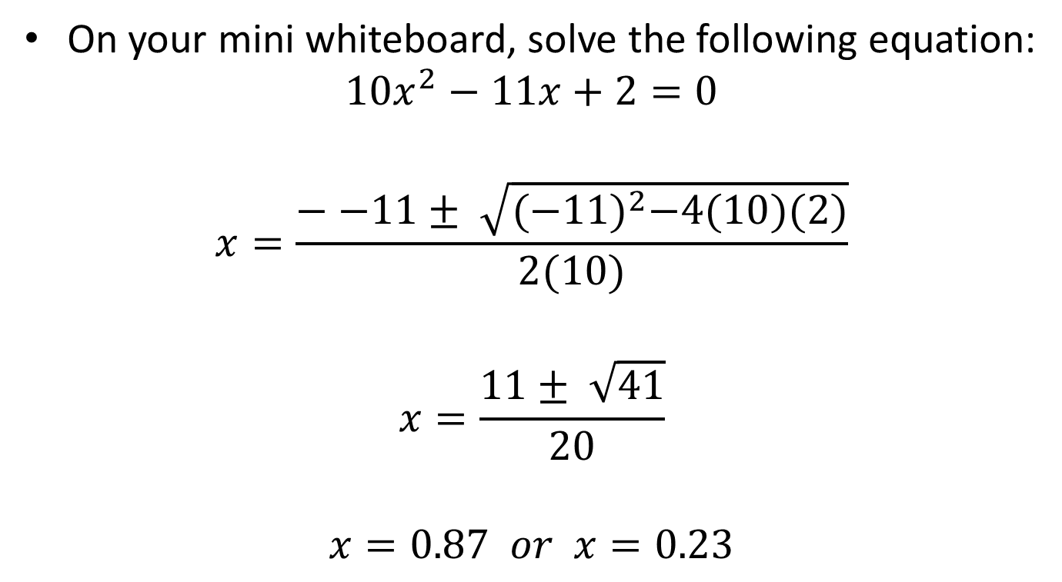
The Quadratic Formula
On your mini whiteboard, solve the following equation:
$${10x}^{2}−11x+2=0$$
$$x=\frac{−−11± \sqrt{{(−11)}^{2}−4(10)(2)}}{2(10)}$$
$$x=\frac{11± \sqrt{41}}{20}$$
$$x=0.87 or x=0.23$$

Slide 11
The Quadratic Formula
Grade A
17/05/2022
Solve these quadratic expressions. Give your answers correct to 2 decimal places
1) ${2x}^{2}+11x+8=0$ 2) ${3x}^{2}+5x+1=0$
${7x}^{2}+12x+2=0$ 4) ${6x}^{2}+22x+19=0$
5) ${ x}^{2}−x−10=0$ 6) ${3x}^{2}−7x+1=0$
7) $4x^{2}−9x+4=0$ 8) ${5x}^{2}−10x+1=0$
9) ${ 2x}^{2}+5x+7=3−6x$ 10) ${10x}^{2}+x−2=x(3x−2)$
A
$$x=−0.86 or x=−4.64$$
$$x=−0.23 or x=−1.44$$
$$x=−0.19 or x=−1.53$$
$$x=−1.39 or x=−2.27$$
A
$$x=3.70 or x=−2.70$$
$$x=2.18 or x=0.15$$
$$x=1.64 or x=0.61$$
$$x=1.89 or x=0.11$$
A*
$$x=−0.39 or x=−5.11$$
$$x=0.36 or x=−0.79$$

Slide 12
Starter
Show that you get the same answer regardless of method use to solve the equation:
$$x^{2}−6x+8=0$$
using:
factorising
the formula
completing the square

Slide 13
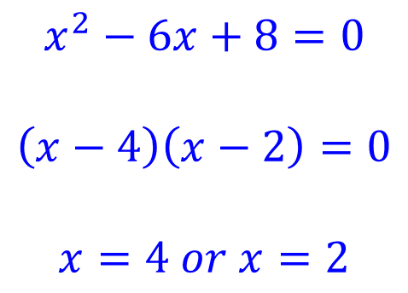
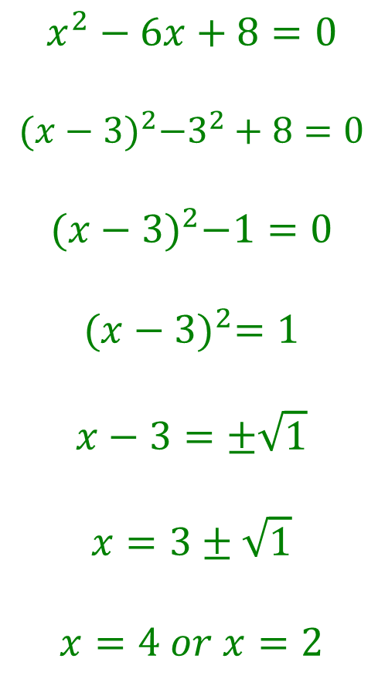
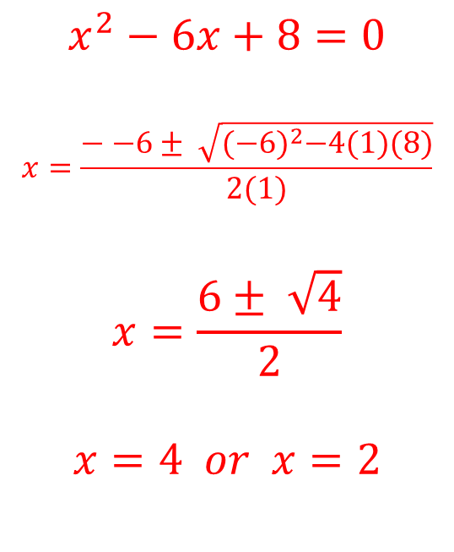
Starter
$$x^{2}−6x+8=0$$
$$\left(x−4\right)\left(x−2\right)=0$$
$$x=4 or x=2$$
$$x^{2}−6x+8=0$$
$$x=\frac{−−6± \sqrt{{(−6)}^{2}−4(1)(8)}}{2(1)}$$
$$x=\frac{6± \sqrt{4}}{2}$$
$$x=4 or x=2$$
$$x^{2}−6x+8=0$$
$${(x−3)}^{2}−3^{2}+8=0$$
$${(x−3)}^{2}−1=0$$
$${(x−3)}^{2}=1$$
$$x−3=±\sqrt{1}$$
$$x=3±\sqrt{1}$$
$$x=4 or x=2$$
Always try to factorise first!
If the question says to give your answer to $x$dp or $x$sf, it doesn’t factorise, so use the formula or complete the square!

Slide 14
Solving Problems with Quadratics
Grade A/A*
17/05/2022
Learning Objectives:
Able to form a quadratic equation
Able to solve the quadratic equation
Able to interpret the answer in the
context of the question

Slide 15


A right angled triangle has sides of lengths shown. Calculate the value of $x$. Give your answer correct to 3sf.
Using Pythagoras:
$${(x+7)}^{2}+{(x−4)}^{2}={15}^{2}$$
$$x^{2}+7x+7x+49+x^{2}−4x−4x+16=225$$
$${2x}^{2}+6x+65=225$$
$${2x}^{2}+6x−160=0$$
$$x=\frac{−6±\sqrt{6^{2}−4(2)(−160)}}{2(2)}$$
$$x=\frac{−6±\sqrt{1316}}{4}$$
$$15$$
$$x+7$$
$$x−4$$
$$x=7.57 or x=−10.6$$
Therefore:
$$x=7.57 (3sf)$$

Slide 16


The trapezium below has an area of 80cm². Calculate the value of $x$ correct to 2dp.
$$x+2$$
Area of trapezium = ½(a + b)h
$$\frac{1}{2}\left(x+2+x+8\right)(3x)=80$$
$$\frac{1}{2}\left(2x+10\right)\left(3x\right)=80$$
$$(x+5)(3x)=80$$
$${3x}^{2}+5x=80$$
$${3x}^{2}+5x−80=0$$
$$3x$$
$$x+8$$
$$x=\frac{−5±\sqrt{5^{2}−4(3)(−80)}}{2(3)}$$
$$x=\frac{−5±\sqrt{985}}{6}$$
$$x=4.40 or x=−6.06$$
so $x=4.40 (2dp)$

Slide 17


The length of a carpet is 1m longer than its width. Its area is 9m². Find the dimensions of the carpet to 2 decimal places.
$$x+1$$
$$\left(x+1\right)\left(x\right)=9$$
$$x^{2}+x=9$$
$$x^{2}+x−9=0$$
$$x=\frac{−1±\sqrt{1^{2}−4(1)(−9)}}{2(1)}$$
$$x=\frac{−1±\sqrt{37}}{2}$$
$$x=2.54 or x=−3.54$$
$$x$$
Therefore $x = 2.54$
DIMENSIONS:
Length = 2.54 + 1 = 3.54m
Width = 2.54m (2dp)

