Slide 1
Trigonometry Ratios
Finding a side

Slide 2
Learning intentions
Use the previous knowledge of Pythagoras
Theorem to find sides of a right-angle triangle.
Determine trigonometric ratios of a right-angle triangle.

Slide 3
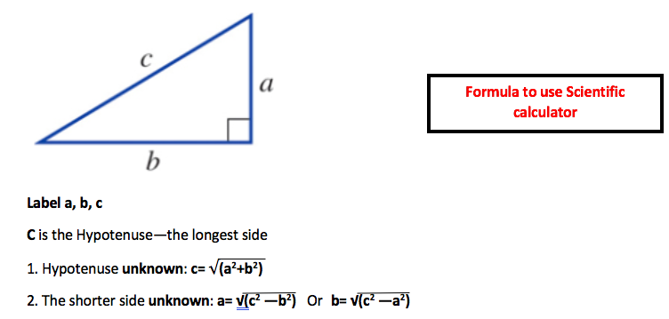
Do it by scientific calculator!
On your calculator:
$$√$$
($a^{2}+b^{2}$)
=
On your calculator:
$$√$$
($c^{2}−b^{2}$)
=

Slide 4
Both working on Right Angle Triangle
Label right angle ⊾
Label a b, c
Working with Three sides, One of them unknown.
Label O, A, H
Working with Two sides, One angle, One of them unknown.

Slide 5
The Trigonometric Functions we will be looking at
SINE
COSINE
TANGENT

Slide 6
The Trigonometric Functions
SINE
COSINE
TANGENT

Slide 7
Labelling Triangles
Before we even consider using trigonometry to solve problems, we need to know how to label right-angled triangles.
This is the hypotenuse. It is the longest side and always opposite the right angle
This is called the opposite. It is opposite the labelled angle.
H
O
A
The is called the adjacent. It is next to the angle.

Slide 8
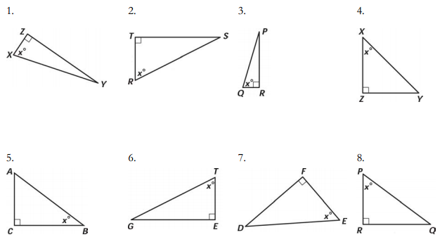
Label the following triangles…

Slide 9
SOH-CAH-TOA
When we are faced with a trigonometry problem in a right-angled triangle, you need to remember…
SOH-CAH-TOA
This is the SINE triangle
This is the TANGENT triangle
These triangles allow us to easily remember each formula.
This is the COSINE triangle

Slide 10
Now it’s time to test your knowledge!
Ex paper

