Slide 1
How do I use bearings to solve trig problems?
Topic: Trigonometry

Slide 2
What are bearings?
NOTES: There are two kinds of bearings. The first are compass bearings. The second are called “three-figure bearings” (also known as “true bearings”).

Slide 3
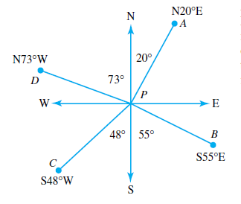
compass bearings
NOTES: To read a compass bearing, say whether the direction is North or South first, then the degrees, then if it is East or West. The degrees are measured from the vertical line.
For example:

Slide 4
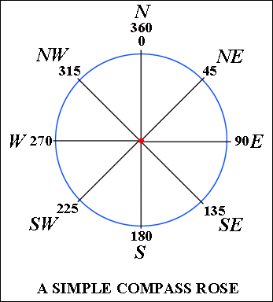
Compass bearings
You will be expected to know how many degrees each direction means. For example, if a question says a plane flew due East, it means it travelled 90° from North.
Top tip: Draw a compass like the one on the left before starting a question to determine direction.

Slide 5
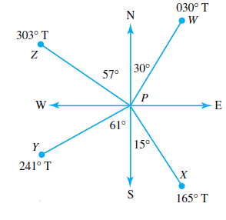
Three-figure bearings (a.k.a. true bearings)
NOTES: Three-figure bearings are measured from North in a clockwise direction. If a bearing does not have three numbers, it is customary to put zeroes before the digits.
For example:

Slide 6
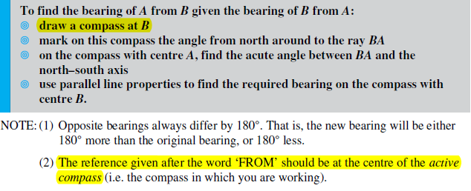
Constructing diagrams:

Slide 7
Worked example 1:
Kevin drove due north from A to B for 50km. He then turned and drove due west to C, which is 72km from B. Find the bearing of C from A.

Slide 8
Remember the steps
Draw a diagram (if you don’t have one)
Label your sides
Identify correct ratio
Put info from question into ratio
i) If unknown is on top, multiply
ii) If unknown is on bottom, divide
iii) If unknown is the angle, use inverse trig function on calculator
Kevin drove due north from A to B for 50km. He then turned and drove due west to C, which is 72km from B. Find the bearing of C from A.

Slide 9
Remember the steps
Draw a diagram (if you don’t have one)
Label your sides
Identify correct ratio
Put info from question into ratio
i) If unknown is on top, multiply
ii) If unknown is on bottom, divide
iii) If unknown is the angle, use inverse trig function on calculator
Kevin drove due north from A to B for 50km. He then turned and drove due west to C, which is 72km from B. Find the bearing of C from A.

Slide 10
Remember the steps
Draw a diagram (if you don’t have one)
Label your sides
Identify correct ratio
Put info from question into ratio
i) If unknown is on top, multiply
ii) If unknown is on bottom, divide
iii) If unknown is the angle, use inverse trig function on calculator
Kevin drove due north from A to B for 50km. He then turned and drove due west to C, which is 72km from B. Find the bearing of C from A.

Slide 11
Worked example 2:
Q A yacht sailed 11.2 km due east from T, then turned around a buoy at U and sailed due south to V. The bearing of V from T is 138°. How far was the yacht then from its starting point?

Slide 12
Remember the steps
Draw a diagram (if you don’t have one)
Label your sides
Identify correct ratio
Put info from question into ratio
i) If unknown is on top, multiply
ii) If unknown is on bottom, divide
iii) If unknown is the angle, use inverse trig function on calculator
Q A yacht sailed 11.2 km due east from T, then turned around a buoy at U and sailed due south to V. The bearing of V from T is 138°. How far was the yacht then from its starting point?

Slide 13
Worked example 3:
Q Two cars A and B left home at the same time. Car A travelled due west at 70 km/h whilst car B travelled due north at 90 km/h. Find, after 2 hours:
a the distance between the cars
b the bearing of B from A.

Slide 14
Remember the steps
Draw a diagram (if you don’t have one)
Label your sides
Identify correct ratio
Put info from question into ratio
i) If unknown is on top, multiply
ii) If unknown is on bottom, divide
iii) If unknown is the angle, use inverse trig function on calculator
Q Two cars A and B left home at the same time. Car A travelled due west at 70 km/h whilst car B travelled due north at 90 km/h. Find, after 2 hours: a the distance between the cars b the bearing of B from A.

