Slide 1
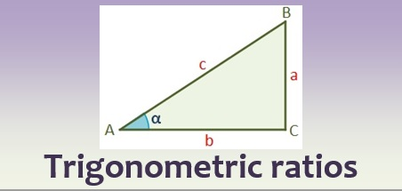
Chapter 5 Trigonometry
Revision

Slide 2
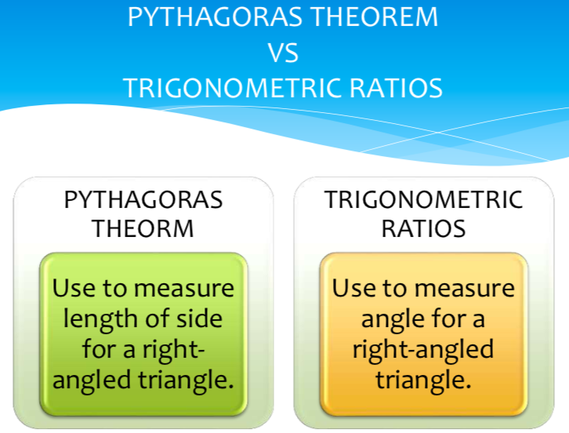
Both working on Right Angle Triangle
Label right angle ⊾
Label a b, c
Working with Three sides, One of them unknown.
Label O, A, H
Working with Two sides, One angle, One of them unknown.

Slide 3
The Pythagorean Theorem
a² + b² = c²
OR
a² = c² – b²
c
a
Which side is the hypotenuse?
b
The right angle points to the hypotenuse.
It’s the side labelled “c”.

Slide 4
Can you label the triangle?
c
leg
b
hypotenuse
a
leg
a, b are legs
c is the hypotenuse
(c is across from the hypotenuse)

Slide 5


Pythagoras – QUICK METHOD
Decide if the side you are LOOKING FOR is the HYPOTENUSE, or one of the two SHORTER SIDES
Use one of these quick and easy methods to work out what you need
Looking for the LONGEST SIDE?
(the hypotenuse!)
Square it
Square it
Add it
Square root it
Looking for a SHORTER SIDE?
(not the hypotenuse!)
Square it
Square it
Subtract it
Square root it

Slide 6
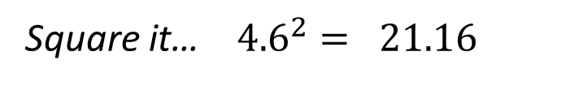
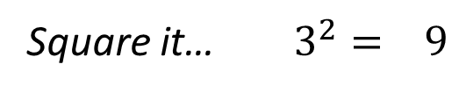
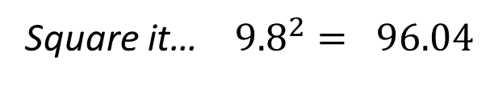
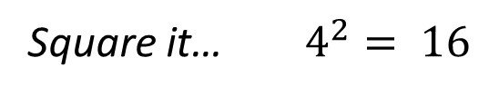
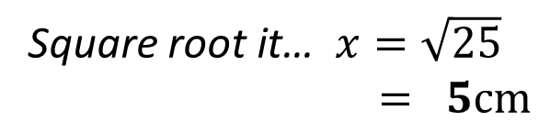



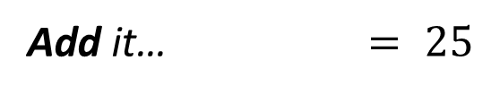
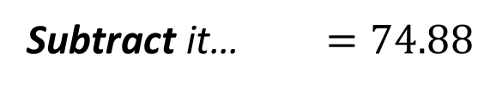
Example – Quick method
1
Square it… $4^{2}= 16$
Square it… $3^{2}= 9$
$$+$$
x
3 cm
Add it… $= 25$
Square root it… $x=\sqrt{25}$
$= 5cm$
4 cm
Square it… ${9.8}^{2}= 96.04$
2
$$−$$
Square it… ${4.6}^{2}= 21.16$
9.8 cm
4.6 cm
Subtract it… $=74.88$
Square root it…$x=\sqrt{74.88}$
$=8.653…$
$=8.7 cm$ (1dp)
y

Slide 7
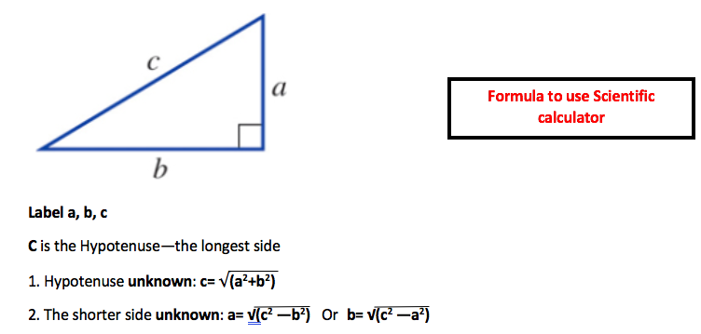




Or simply do it by scientific calculator!
On your calculator:
$$√$$
($a^{2}+b^{2}$)
=
On your calculator:
$$√$$
($c^{2}−b^{2}$)
=

Slide 8
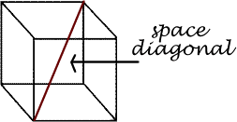
In a rectangular prism, a space diagonal is a line that goes from a vertex of the prism, through the center of the prism to the opposite vertex.
aka, ‘stick in the box’
A rectangular prism has 4 space diagonals.

Slide 9
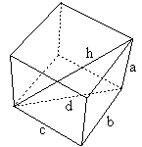
Pythagorean Theorem
2D vs 3D
d
c
b

Slide 10
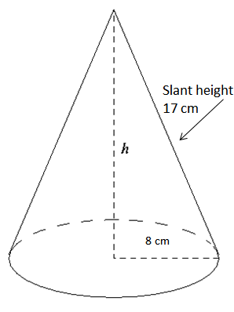
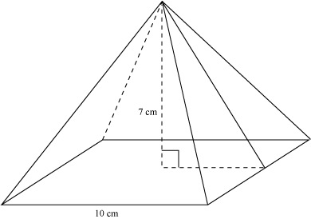
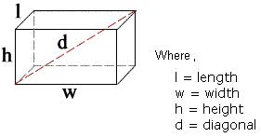
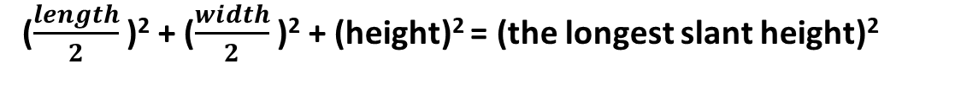
To Find the Space Diagonal of a 3D Prism
3D Figures
To Find the slant height of a cone
(radius)² + (height)² = (slant height)²
To Find the height of a rectangle based pyramid
($\frac{length}{2}$ )² + ($\frac{width}{2}$ )² + (height)² = (the longest slant height)²
(length)² + (width)² + (height)² = (space diagonal of prism)²

Slide 11
Both working on Right Angle Triangle
Label right angle ⊾
Label a b, c
Working with Three sides, One of them unknown.
Label O, A, H
Working with Two sides, One angle, One of them unknown.

Slide 12
The Trigonometric Functions we will be looking at
SINE
COSINE
TANGENT

Slide 13
The Trigonometric Functions
SINE
COSINE
TANGENT

Slide 14

Labelling Triangles
Before we even consider using trigonometry to solve problems, we need to know how to label right-angled triangles.
This is the hypotenuse. It is the longest side and always opposite the right angle
This is called the opposite. It is opposite the labelled angle.
H
O
A
The is called the adjacent. It is next to the angle.

Slide 15
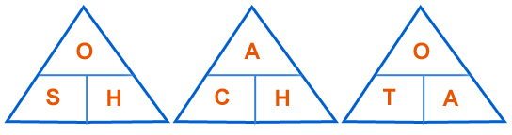
SOH-CAH-TOA
When we are faced with a trigonometry problem in a right-angled triangle, you need to remember…
SOH-CAH-TOA
This is the SINE triangle
This is the TANGENT triangle
These triangles allow us to easily remember each formula.
This is the COSINE triangle

Slide 16

On your calculator:
Find the length of x in the following triangle
12
12
12
12
tan
(35)
$$×\text{12}$$
=
Label the triangle
H
$$x$$
Decide which rule to use.
O
Use the cover-up method
$$35°$$
$$Opposite=tan\left(x\right)×adjacent$$
A
$$12cm$$
Substitute in your values
$$Opposite=tan\left(35\right)×12$$
$$Opposite=8.4cm$$

Slide 17
On your calculator:
Find the length of x in the following triangle
12
12
12
12
6
$$÷$$
$$tan40$$
=
Label the triangle
H
$$6cm$$
Decide which rule to use.
O
Use the cover-up method
$$40°$$
$$Adjacent= \frac{opposite}{tan(x)}$$
A
$$x$$
Substitute in your values
$$Adjacent= \frac{6}{tan(40)}$$
$$Adjacent=7.15cm$$

Slide 18






On your calculator:
shift
Find the angle x in the following triangle
12
(7 ÷ 12)
=
tan
12
inverse
12
12
Label the triangle
H
$$7cm$$
Decide which rule to use.
O
Use the cover-up method
$$x°$$
$$tan\left(x\right)= \frac{opposite}{adjacent}$$
A
$$12cm$$
Substitute in your values
$$tan\left(x\right)= \frac{7}{12}$$
$$\tan^{−1}\left(\frac{7}{12}\right)=30°$$

Slide 19





On your calculator:
shift
Find the angle x in the following triangle
12
9 ÷ 14
=
sin
12
inverse
12
12
Label the triangle
H
$$9cm$$
Decide which rule to use.
$$14cm$$
O
Use the cover-up method
$$x°$$
$$sin\left(x\right)= \frac{opposite}{hypotenuse}$$
A
Substitute in your values
$$sin\left(x\right)= \frac{9}{14}$$
$$\sin^{−1}\left(\frac{9}{14}\right)=40°$$

Slide 20
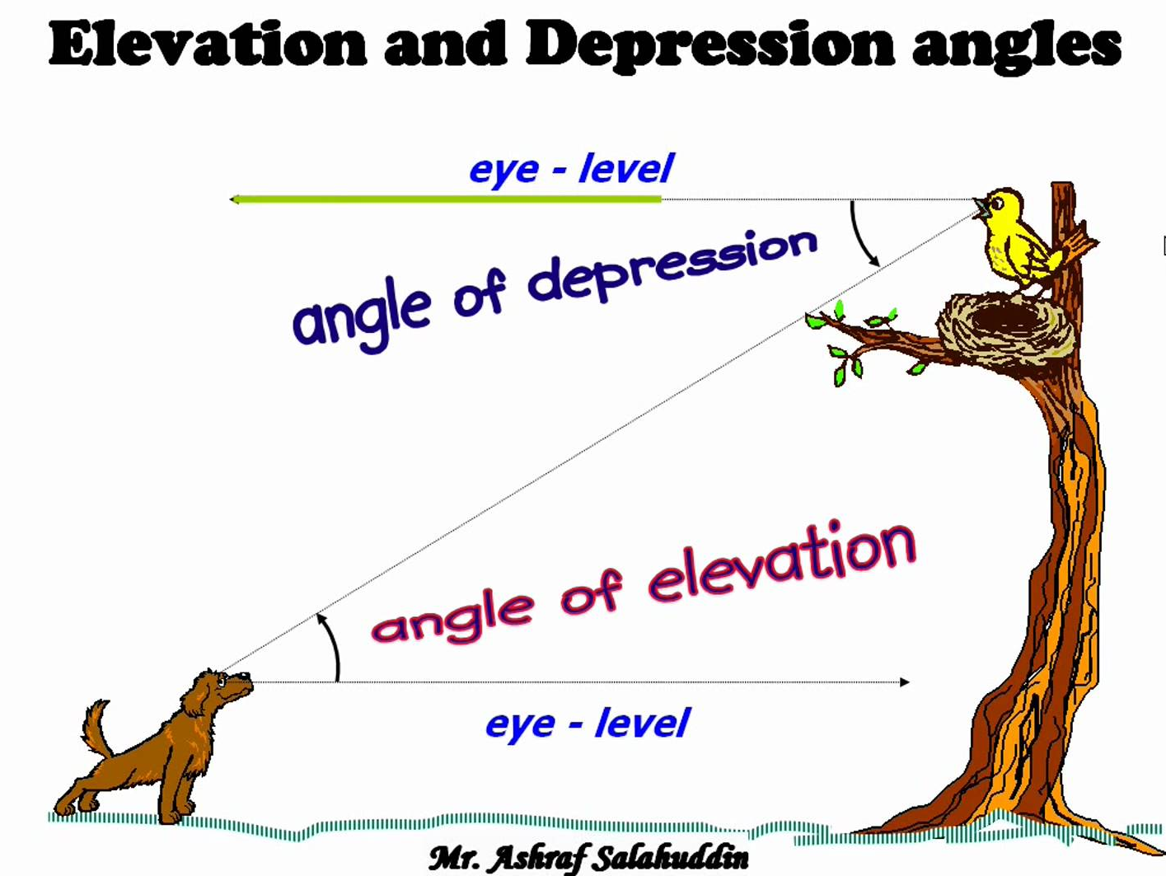

Slide 21
Bob is at the top of a vertical cliff, 80m high. He sees a boat out at sea. The angle of depression from Bob to the boat is 34º. How far from the cliff base is the boat?
x
$$\tan{34°}=\frac{80}{x}$$
$$x\tan{34°}=80$$
$$x=\frac{80}{\tan{34°}}$$
34º
80m
$x=118.6m$ (to 1 d.p.)

Slide 22
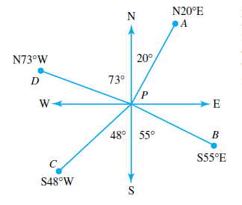
compass bearings
NOTES: To read a compass bearing, say whether the direction is North or South first, then the degrees, then if it is East or West. The degrees are measured from the vertical line.
For example:

Slide 23
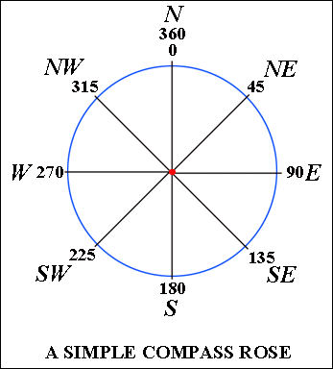
Compass bearings
You will be expected to know how many degrees each direction means. For example, if a question says a plane flew due East, it means it travelled 90° from North.
Top tip: Draw a compass like the one on the left before starting a question to determine direction.

Slide 24
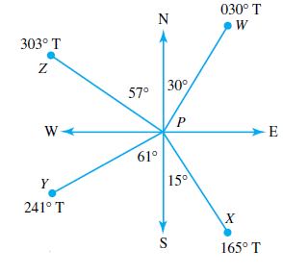
Three-figure bearings (a.k.a. true bearings)
NOTES: Three-figure bearings are measured from North in a clockwise direction. If a bearing does not have three numbers, it is customary to put zeroes before the digits.
For example:

Slide 25
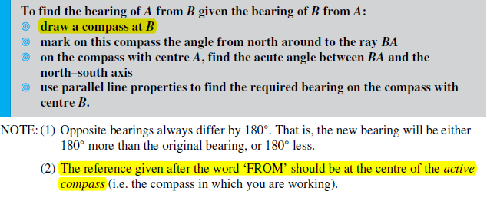
Constructing diagrams:

Slide 26
Remember the steps
Draw a diagram (if you don’t have one)
Label your sides
Identify correct ratio
Put info from question into ratio
i) If unknown is on top, multiply
ii) If unknown is on bottom, divide
iii) If unknown is the angle, use inverse trig function on calculator
Kevin drove due north from A to B for 50km. He then turned and drove due west to C, which is 72km from B. Find the bearing of C from A.

Slide 27
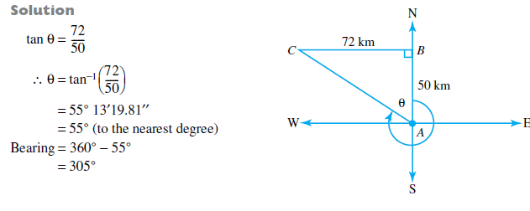
Remember the steps
Draw a diagram (if you don’t have one)
Label your sides
Identify correct ratio
Put info from question into ratio
i) If unknown is on top, multiply
ii) If unknown is on bottom, divide
iii) If unknown is the angle, use inverse trig function on calculator
Kevin drove due north from A to B for 50km. He then turned and drove due west to C, which is 72km from B. Find the bearing of C from A.

Slide 28
Remember the steps
Draw a diagram (if you don’t have one)
Label your sides
Identify correct ratio
Put info from question into ratio
i) If unknown is on top, multiply
ii) If unknown is on bottom, divide
iii) If unknown is the angle, use inverse trig function on calculator
Kevin drove due north from A to B for 50km. He then turned and drove due west to C, which is 72km from B. Find the bearing of C from A.

Slide 29
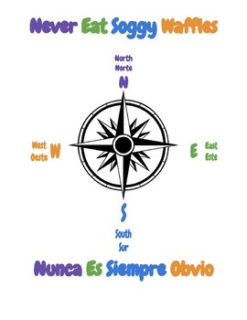
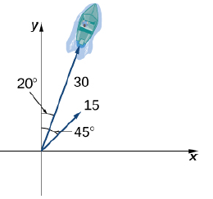


Change following compass bearings to True bearings
N20°E
020°T

Slide 30
