Slide 1
Radian and Degree Measure
20.0

Slide 2
What You Should Learn
Describe angles
Use radian measure
Use degree measure and convert between degree and radian measure
Use angles to model and solve real-life problems

Slide 3
Angles
Consequently, the applications of trigonometry expanded to include a vast number of physical phenomena involving rotations and vibrations, including the following.
  sound waves
  light rays
  planetary orbits
  vibrating strings
  pendulums
  orbits of atomic particles

Slide 4
Angles
An angle is determined by rotating a ray (half-line) about its endpoint. The starting position of the ray is the initial side of the angle, and the position after rotation is the terminal side, as shown in Figure 4.1.
Figure 4.1

Slide 5
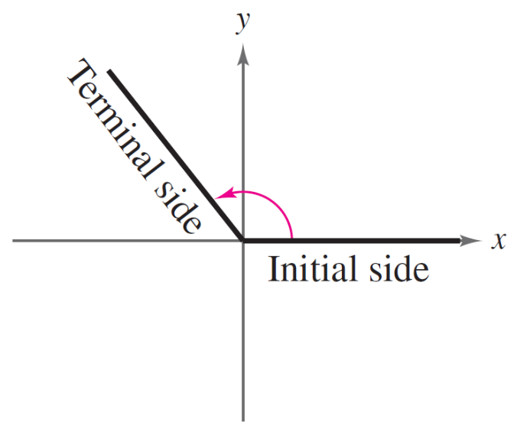
Angles
The endpoint of the ray is the vertex of the angle. This perception of an angle fits a coordinate system in which the origin is the vertex and the initial side coincides with the positive x-axis. Such an angle is in standard position, as shown in Figure 4.2.
Figure 4.2

Slide 6
Angles
Positive angles are generated by counterclockwise rotation, and negative angles by clockwise rotation, as shown in Figure 4.3.
Figure 4.3

Slide 7
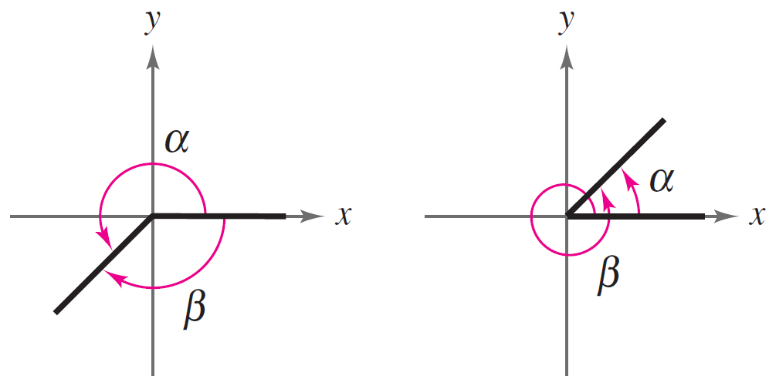
Angles
Angles are labeled with Greek letters such as α (alpha), β (beta), and (theta), as well as uppercase letters such as A,B, and C. In Figure 4.4, note that angles α and β have the same initial and terminal sides. Such angles are coterminal.
Figure 4.4

Slide 8
Radian Measure
The measure of an angle is determined by the amount of rotation from the initial side to the terminal side. One way to measure angles is in radians.
This type of measure is
especially useful in calculus.
To define a radian, you can
use a central angle of a circle.
Figure 4.5

Slide 9
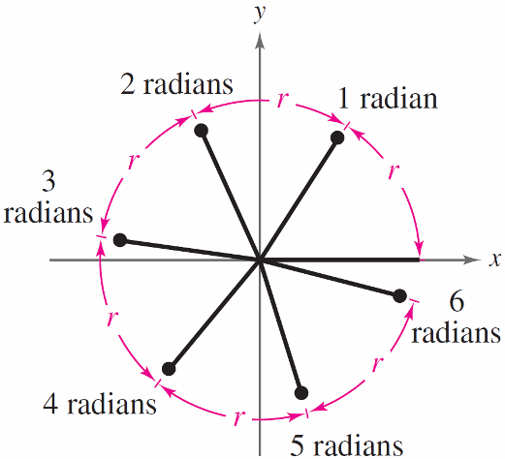
Radian Measure
Moreover, because
2π ≈ 6.28
there are just over six radius lengths in a full circle, as shown in Figure 4.6.
Figure 4.6

Slide 10
Radian Measure
The four quadrants in a coordinate system are numbered I, II, III, and IV. Figure 4.8 shows which angles between 0 and 2π lie in each of the four quadrants.
Figure 4.8

Slide 11
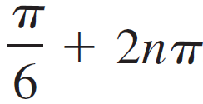
Radian Measure
Two angles are coterminal when they have the same initial and terminal sides. For instance, the angles 0 and 2π are coterminal, as are the angles π/6 and 13π/6.
A given angle θ has infinitely many coterminal angles. For instance θ = π/6, is coterminal with
, where is n an integer.

Slide 12

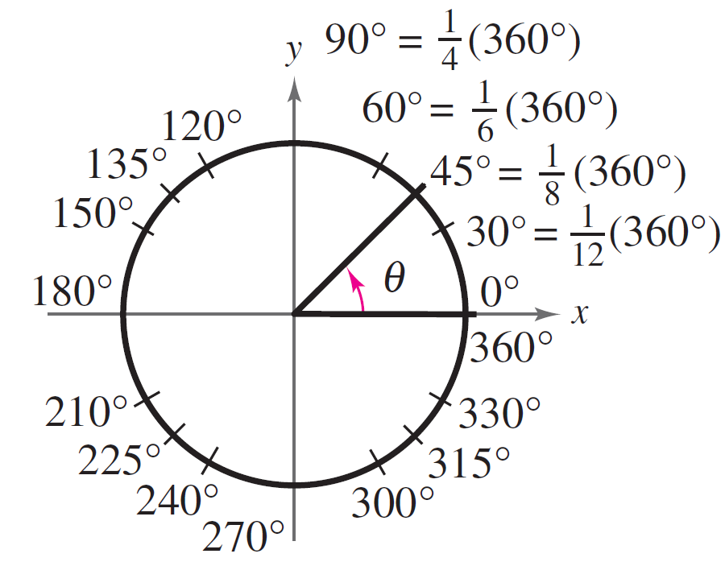
Degree Measure
A second way to measure angles is in terms of degrees, denoted by the symbol °. A measure of one degree (1°) is equivalent to a rotation of of a complete revolution about the vertex.
Figure 4.12

Slide 13
Degree Measure
So, a full revolution (counterclockwise) corresponds to 360° a half revolution to 180°, a quarter revolution to 90 ° and so on.
Because 2π radians corresponds to one complete revolution, degrees and radians are related by the equations
360° = 2π rad and 180° = π rad.

Slide 14
Degree Measure
From the second equation, you obtain
1 ° = rad and 1 rad =

Slide 15

Angles and Angle Measure
Converting Degree Measure to Radian Measure
One half a rotation is
180⁰ or π rad
Convert to radian measure:
a) 210⁰
b) - 315⁰
Exact radian
≈ 3.67
Approximate radian
To convert from degrees
to radians, multiply by

Slide 16
Converting Radian Measure to Degree Measure
Convert to degree measure:
a)
b)
= 120⁰
= -15⁰
To convert from radians
to degrees, multiply by
c) 1.68
= 96.26⁰

Slide 17
Benchmark Conversions
Degrees
Radians
Degrees
Radians
0⁰
30⁰
90⁰
45⁰
180⁰
60⁰
57.3
270⁰
720⁰
360⁰
Angles in Standard Position

Slide 18

Determining the Sector Angle or the Arc Length
Determine the measure of the sector angle:
θ is measured
in radians
5 cm
6.1 cm
Determine the arc length.
Convert 70⁰ to radians:
8 cm
70⁰
a = 9.77
The arc length is 9.77 cm.

