Slide 2
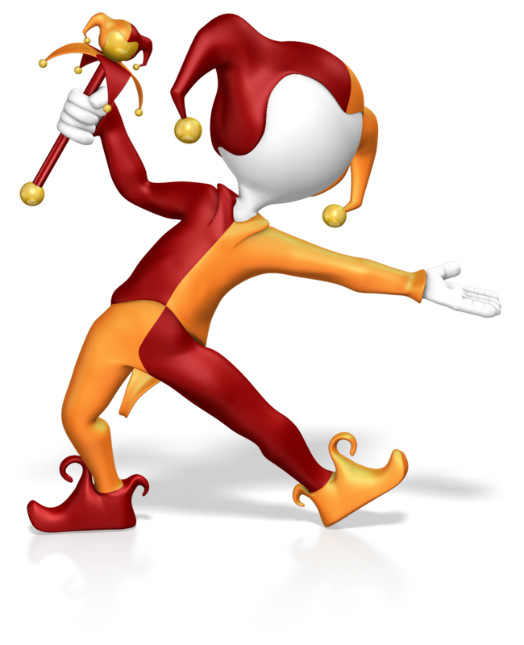
Exact Trig Values

Slide 3
“ Know the exact values of sinϴ and cosϴ for ϴ = 0˚, 30˚, 45˚, 60˚ and 90˚ tanϴ for ϴ = 0˚, 30˚, 45˚ and 60˚"

Slide 4
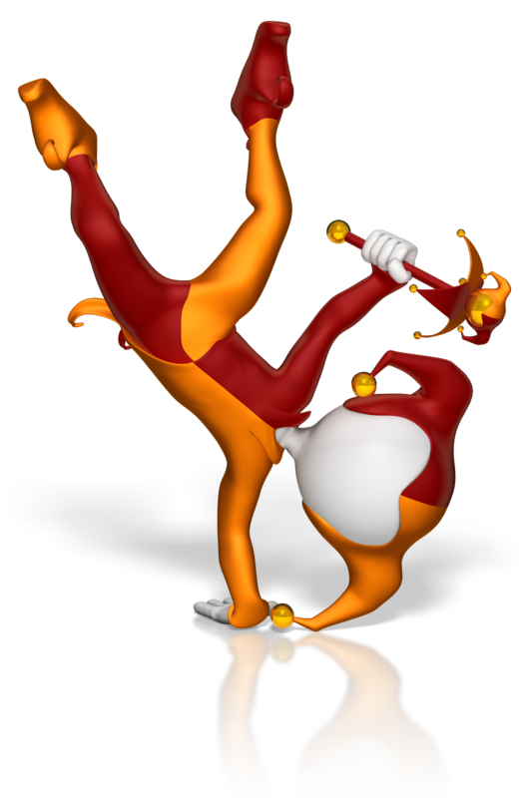
Sine, Cosine and Tangent of 30º, 45º and 60º
Notes:
https://www.interactive-maths.com/trigonometric-exact-values-qqi-bingo.html

Slide 5
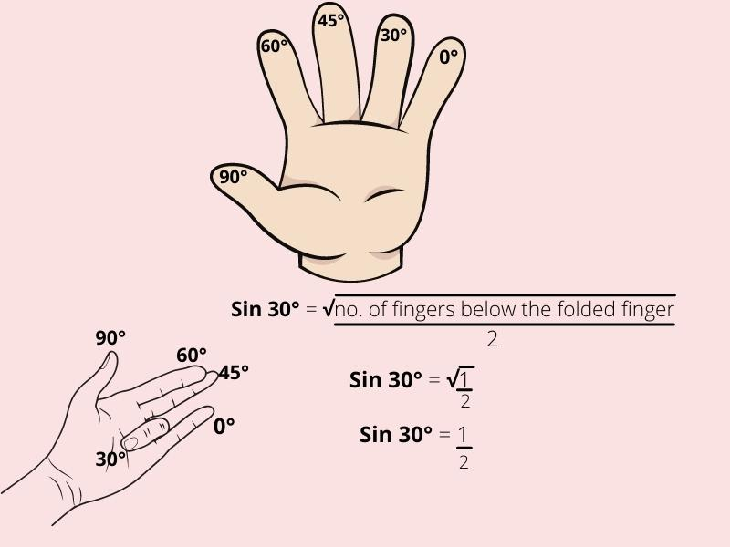
Notes:
https://www.youtube.com/watch?v=PF2nmCVSUEs

Slide 6
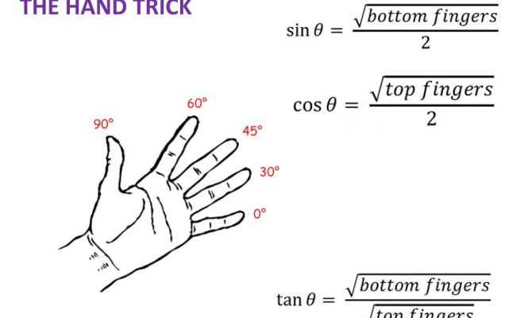

Slide 7
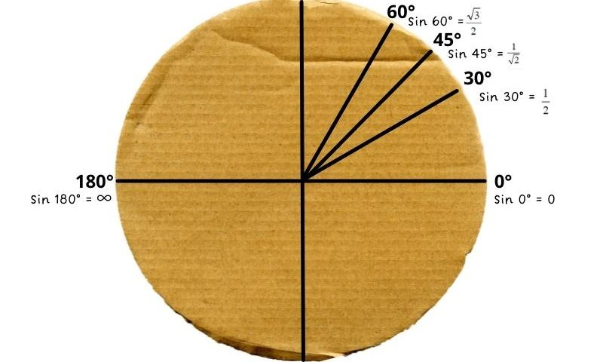
Make a unit circle on a plate

Slide 8
Using an equilateral triangle whose sides are 2 units, write down expressions for the sine, cosine and tangent of 60º and 30º.
30º
2
2
?
√3
60º
?
1
2
?
1

Slide 9
30º
2
2
√3
60º
1
1
√3
1
Cos 60º
√3
=
Tan 60º
Sin 60º
=
=
2
2
1
√3
1
√3
Cos 30º
=
=
Tan 30º
Sin 30º
=
=
2
2
√3
3

Slide 10
Using a right angled isosceles triangle whose equal sides are 1 unit, write down expressions for the sine, cosine and tangent of 45º.
The hypotenuse of the triangle
is √2 units.
45º
√2
1
45º
1

Slide 11
45º
√2
1
45º
1
1
√2
1
√2
Cos 45º
Sin 45º
=
=
=
=
√2
2
√2
2
Tan 45º
1
=

Slide 12
Cos 0º
= 1
Tan 0º
0
Sin 0º
= 0
=
Sin 90º
= 1
Cos 90º
= 0
We will look at why these ratios are true when we look at trig graphs later in the course.

Slide 13
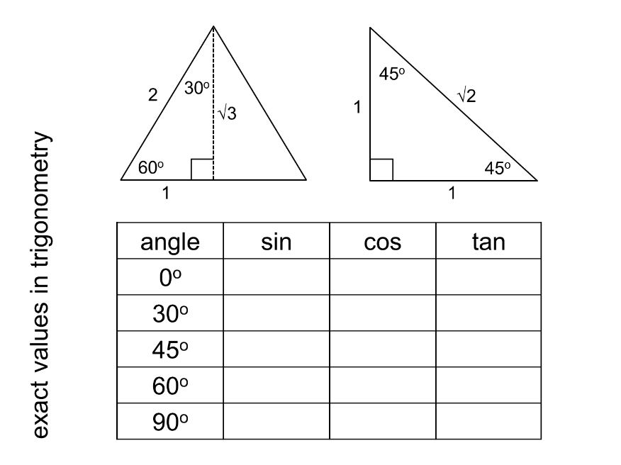

Slide 14
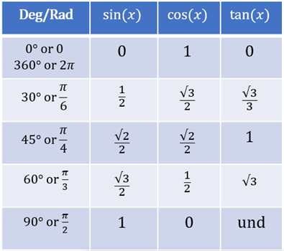

Slide 15
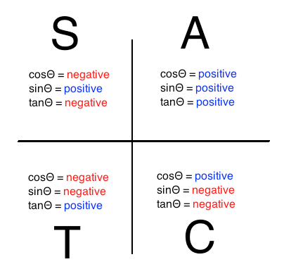
CAST Rule

Slide 16
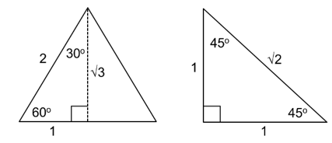
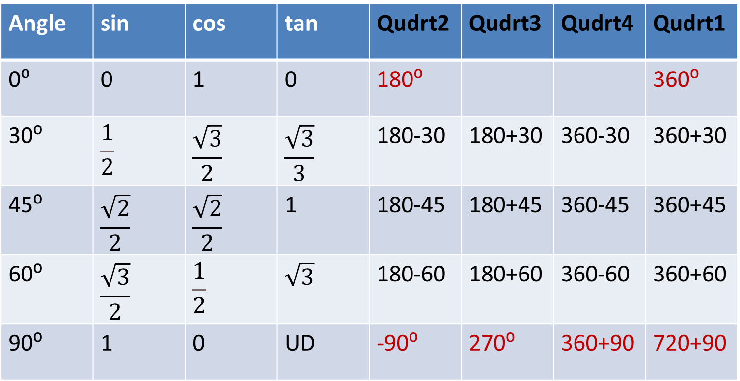
Angle | sin | cos | tan | Qudrt2 | Qudrt3 | Qudrt4 | Qudrt1
0⁰ | 0 | 1 | 0 | 180⁰ |  |  | 360⁰
30⁰ | $$\frac{1}{2}$$ | $$\frac{\sqrt{3}}{2}$$ | $$\frac{\sqrt{3}}{3}$$ | 180-30 | 180+30 | 360-30 | 360+30
45⁰ | $$\frac{\sqrt{2}}{2}$$ | $$\frac{\sqrt{2}}{2}$$ | 1 | 180-45 | 180+45 | 360-45 | 360+45
60⁰ | $$\frac{\sqrt{3}}{2}$$ | $$\frac{1}{2}$$ | $$\sqrt{3}$$ | 180-60 | 180+60 | 360-60 | 360+60
90⁰ | 1 | 0 | UD | -90⁰ | 270⁰ | 360+90 | 720+90

Slide 17
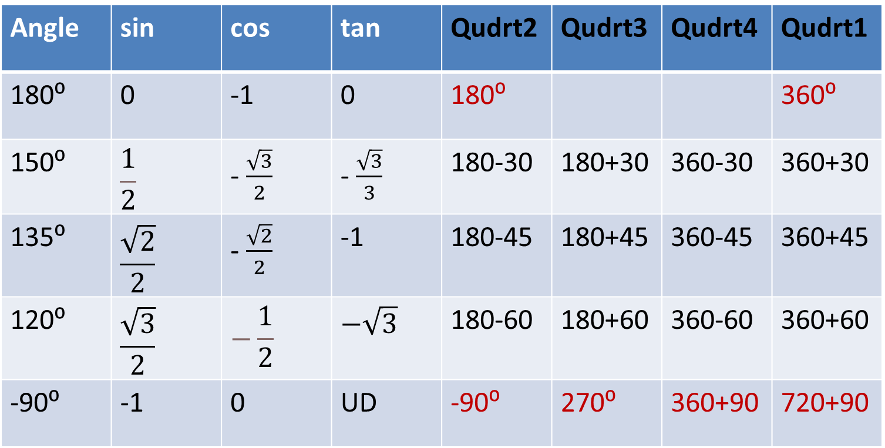
Angle | sin | cos | tan | Qudrt2 | Qudrt3 | Qudrt4 | Qudrt1
180⁰ | 0 | -1 | 0 | 180⁰ |  |  | 360⁰
150⁰ | $$\frac{1}{2}$$ | - $\frac{\sqrt{3}}{2}$ | - $\frac{\sqrt{3}}{3}$ | 180-30 | 180+30 | 360-30 | 360+30
135⁰ | $$\frac{\sqrt{2}}{2}$$ | - $\frac{\sqrt{2}}{2}$ | -1 | 180-45 | 180+45 | 360-45 | 360+45
120⁰ | $$\frac{\sqrt{3}}{2}$$ | $$−\frac{1}{2}$$ | $$−\sqrt{3}$$ | 180-60 | 180+60 | 360-60 | 360+60
-90⁰ | -1 | 0 | UD | -90⁰ | 270⁰ | 360+90 | 720+90

Slide 18
x
Cos 30º
=
30º
8
8
x
√3
x
=
2
8
8√3
x
=
2
x
4√3
=

Slide 19
5
Tan 45º
=
45º
x
x
5
1
=
x
5
5
x
=

Slide 20
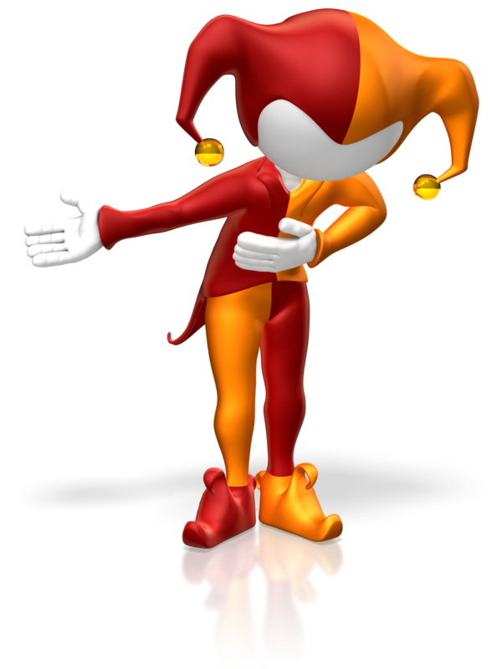
Trig ratio code breaker

Slide 21
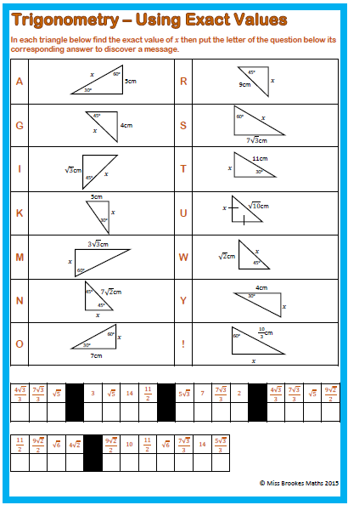
Show all stages of working out in your exercise book

Slide 22
