Slide 1
The graphs of sinθ cosθ and tanθ
Learning Objectives
To learn the shape of a sin cos tan graph
To understand the amplitude period and asymptotes of a graph
To understand how changing the equation of the graph effects the amplitude period and asymptotes.

Slide 2
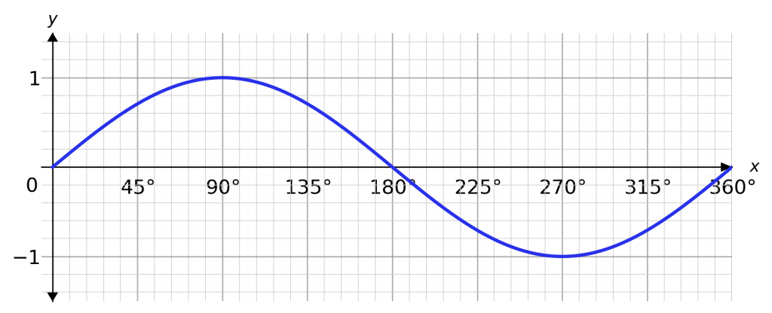
Write down at least 5 things you notice about the graph…
It looks like a wave
The axis are not labelled
y=sinθ
y
θ
It crosses the x-axis at 0, 180 and 360
It crosses the y-axis at 0
It looks like it continues at both ends
Its maximum is at 1
Its minimum is at -1

Slide 3
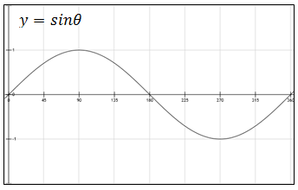
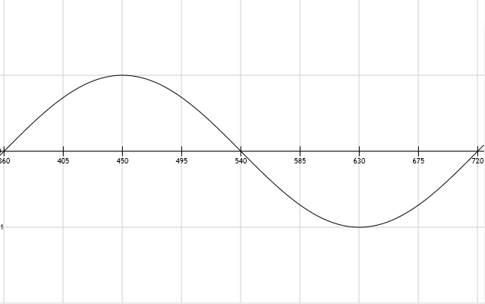
Definitions
The amplitude of a graph is…
The period of a graph is…
the maximum height of the curve
the distance over which the curve repeats itself
amplitude is 1
period is 360˚

Slide 4
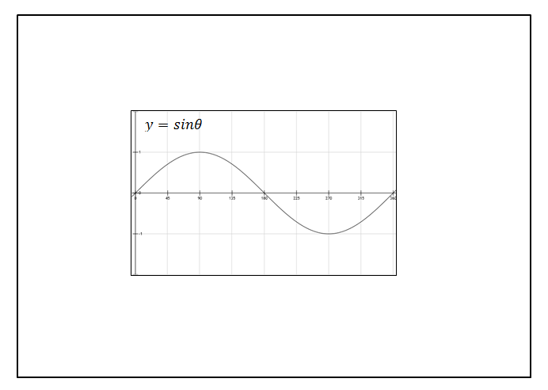
Write down at least 5 things you notice about the graph…
It looks like a wave
The axis are not labelled
y
It crosses the x-axis at 0, 180 and 360
It crosses the y-axis at 0
θ
It looks like it continues at both ends
Its maximum is at 1
Its minimum is at -1
period is 360˚
amplitude is 1

Slide 5
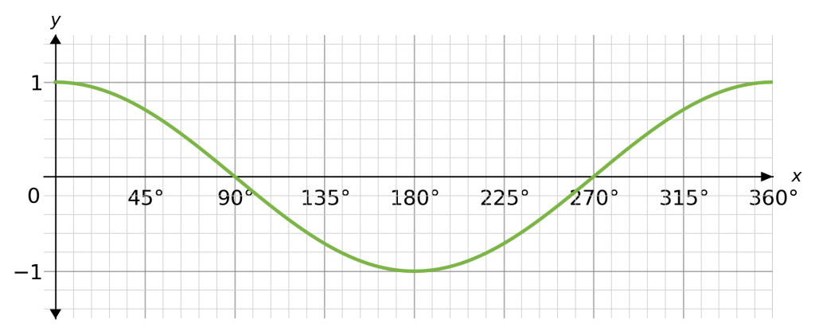
Write down at least 5 things you notice about the graph…
Try to use our new vocabulary
It crosses the x-axis at 90 and 270
It also looks like a wave
y=cosθ
y
It crosses the y-axis at 1
θ
It looks like it continues at both ends
Its maximum is at 1
Its minimum is at -1
period is 360˚
amplitude is 1

Slide 6
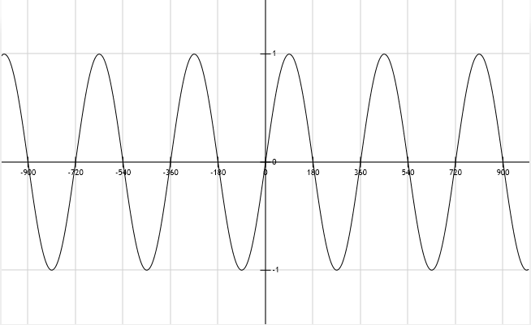
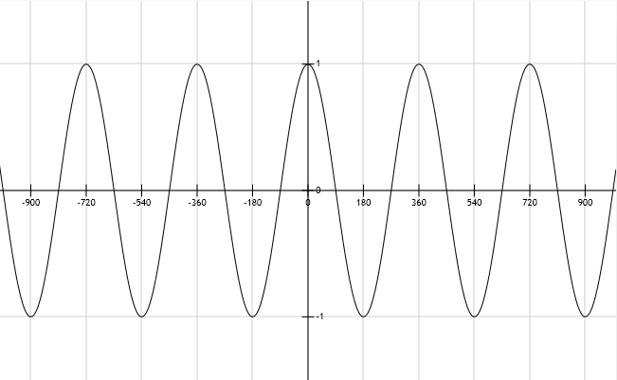
$$y=sinθ$$
$$y=cosθ$$

Slide 7
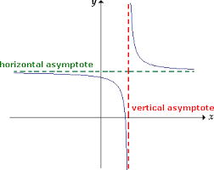
Definitions
The asymptote of a graph is…
a straight line that continually approaches a given curve but does not meet it.

Slide 8
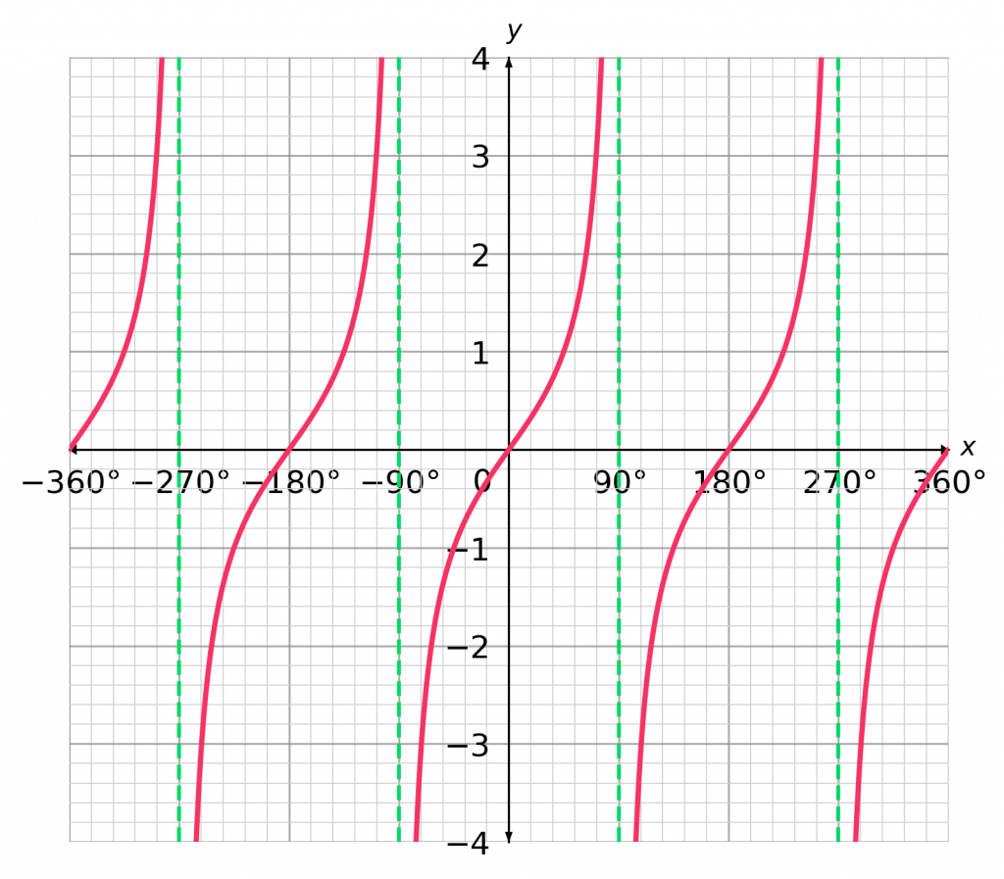
Write down at least 5 things you notice about the graph…
Try to use our new vocabulary
y=tanθ
It crosses the x-axis at 0 and 180
It isn’t a continuous wave.
y
It crosses the y-axis at 0
θ
It looks like it continues at top and bottom ends
It has many lines
of asymptotes
period is 180˚
Asymptotes line are θ=90⁰, θ=90+180=270⁰ ……

Slide 9
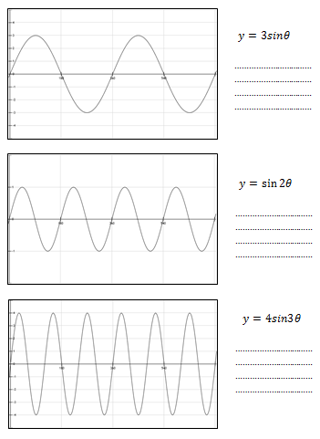
Each graphs you have been given shows y=sinθ between 0˚ and 720˚.
Try to explain what you think the numbers in the equations have done to each graph
The amplitude of a graph is the maximum height of the curve
The period of a graph is the distance over which the curve repeats itself

Slide 10
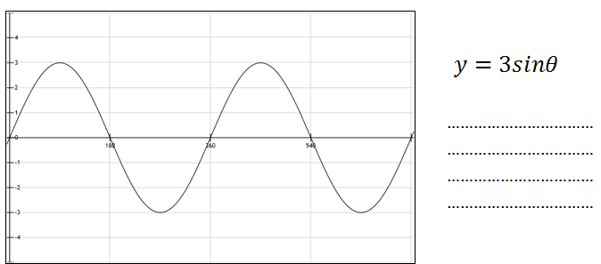
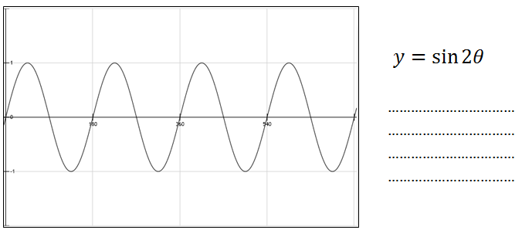
The amplitude has increased to 3
The period has not changed
The period is 180, it has halved

Slide 11
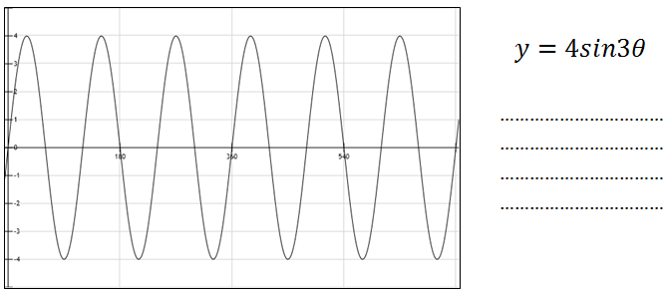
The amplitude has increased to 4
The period is 120, it is a third
In general, for all graphs of type
y = AsinBθ and y = AcosBθ
the amplitude is A
the period is $\frac{360 }{B}$

Slide 12
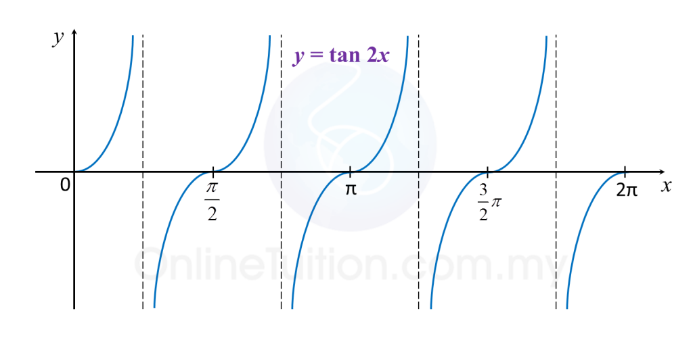
The asymptotes are θ=45 ⁰ , θ=135 ⁰ , θ=225 ⁰ ……
The period is 90°
In general, for all graphs of type
y = AtanBθ
the asymptotes are θ= $\frac{90 }{B}$⁰ , θ= $\frac{90 }{B}$+ $\frac{180 }{B}$⁰, , θ= $\frac{90 }{B}$+ $\frac{180 }{B}$+ $\frac{180 }{B}$⁰
the period is $\frac{180 }{B}$

Slide 13
Radian versus Degree
We will use the following to graph or write equations:
“x” represents radians
“θ” represents degrees
Example: sin x versus sin θ

Slide 14
Key Points in the Sine and Cosine Curves

Slide 15
$$a\sin{b}(x±s)±d$$
Amplitude
Period: 2π/b
Phase Shift: Left (+)
Right (-)
Vertical Shift
Up (+)
Down (-)

Slide 16
Example: y = 2 sin(-3x)
What if a is a negative number?
Graph this function:
y = = –2 sin 3x
2
2
amplitude: 2
period:
=
3
Calculate the five key points.
x
0
y = –2 sin 3x
0
–2
0
2
0
y
( , 2)
x
(0, 0)
( , 0)
( , 0)
( , -2)

