Slide 1
Trigonometry 2 Revision
Unit circle

Slide 2
Angles
An angle is determined by rotating a ray (half-line) about its endpoint. The starting position of the ray is the initial side of the angle, and the position after rotation is the terminal side, as shown in Figure 4.1.
Figure 4.1

Slide 3
Definition of an angle
Terminal Ray
+ Counter clockwise
Initial Ray
- clockwise
Terminal Ray
Notes:
Emphasis direction of angle and sign

Slide 4
Angles
Positive angles are generated by counterclockwise rotation, and negative angles by clockwise rotation, as shown in Figure 4.3.
Figure 4.3

Slide 5

Angles and Angle Measure
Converting Degree Measure to Radian Measure
One half a rotation is
180⁰ or π rad
Convert to radian measure:
a) 210⁰
b) - 315⁰
Exact radian
≈ 3.67
Approximate radian
To convert from degrees
to radians, multiply by

Slide 6
Converting Radian Measure to Degree Measure
Convert to degree measure:
a)
b)
= 120⁰
= -15⁰
To convert from radians
to degrees, multiply by
c) 1.68
= 96.26⁰

Slide 7
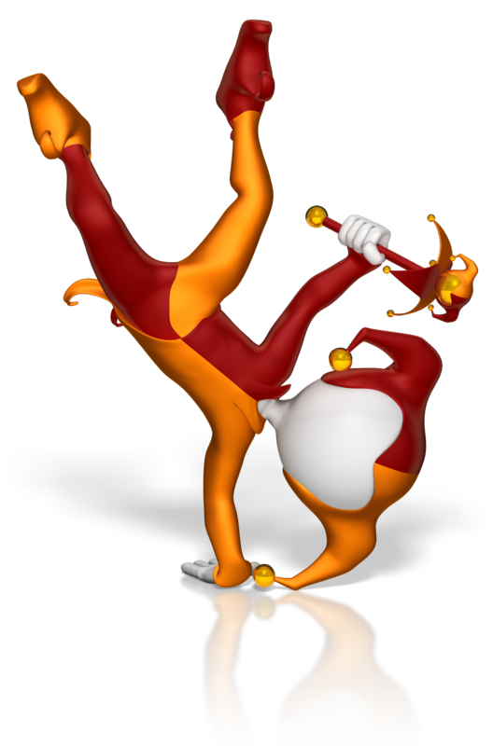
Sine, Cosine and Tangent of 30º, 45º and 60º
Notes:
https://www.interactive-maths.com/trigonometric-exact-values-qqi-bingo.html

Slide 8
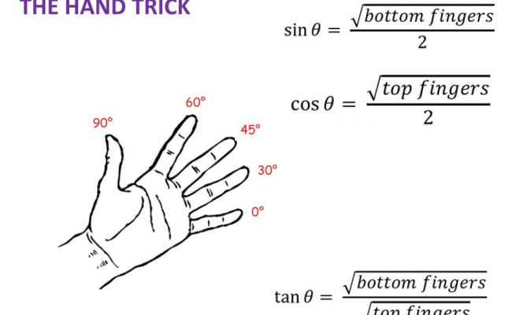

Slide 9
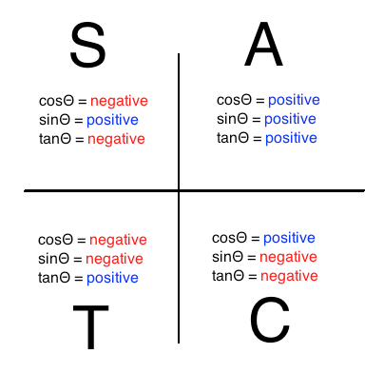
CAST Rule

Slide 10
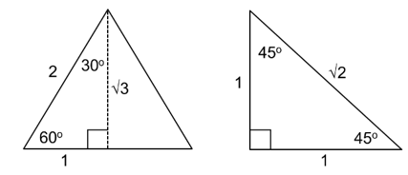
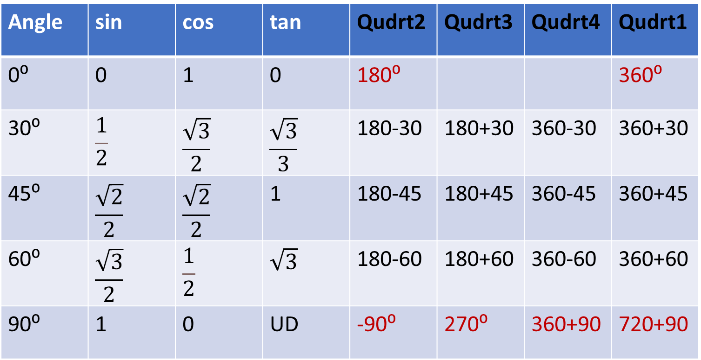
Angle | sin | cos | tan | Qudrt2 | Qudrt3 | Qudrt4 | Qudrt1
0⁰ | 0 | 1 | 0 | 180⁰ |  |  | 360⁰
30⁰ | $$\frac{1}{2}$$ | $$\frac{\sqrt{3}}{2}$$ | $$\frac{\sqrt{3}}{3}$$ | 180-30 | 180+30 | 360-30 | 360+30
45⁰ | $$\frac{\sqrt{2}}{2}$$ | $$\frac{\sqrt{2}}{2}$$ | 1 | 180-45 | 180+45 | 360-45 | 360+45
60⁰ | $$\frac{\sqrt{3}}{2}$$ | $$\frac{1}{2}$$ | $$\sqrt{3}$$ | 180-60 | 180+60 | 360-60 | 360+60
90⁰ | 1 | 0 | UD | -90⁰ | 270⁰ | 360+90 | 720+90

Slide 11
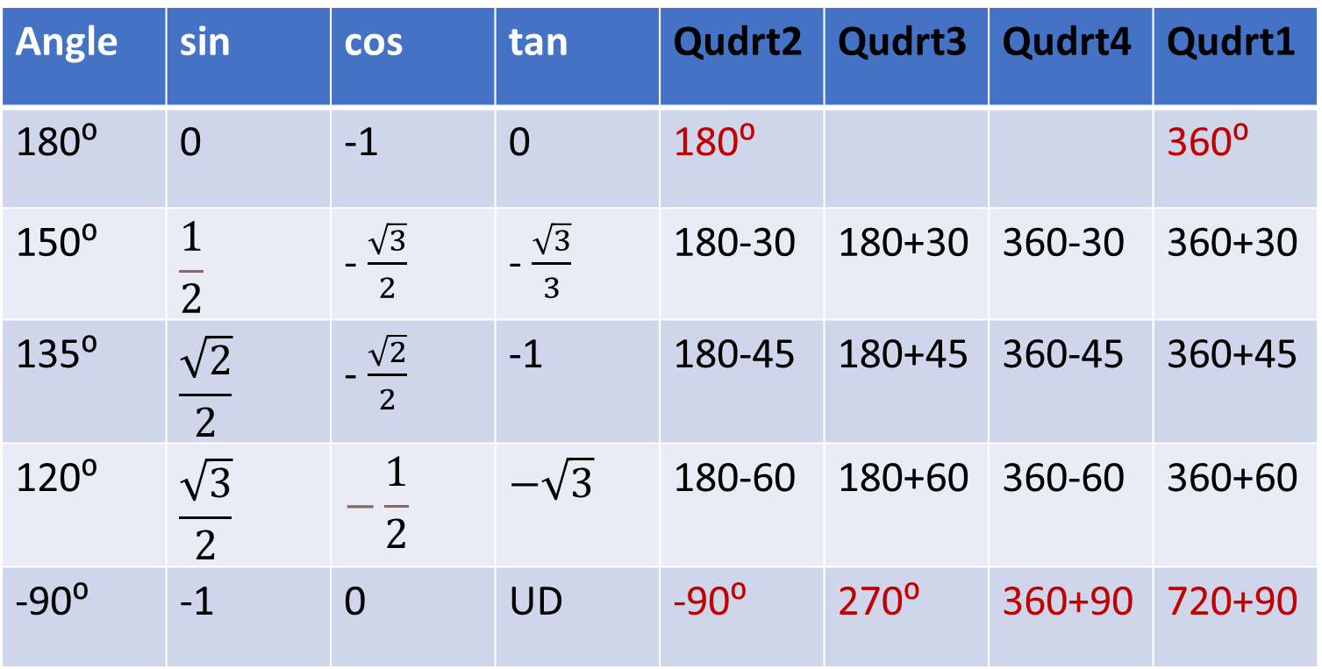
Angle | sin | cos | tan | Qudrt2 | Qudrt3 | Qudrt4 | Qudrt1
180⁰ | 0 | -1 | 0 | 180⁰ |  |  | 360⁰
150⁰ | $$\frac{1}{2}$$ | - $\frac{\sqrt{3}}{2}$ | - $\frac{\sqrt{3}}{3}$ | 180-30 | 180+30 | 360-30 | 360+30
135⁰ | $$\frac{\sqrt{2}}{2}$$ | - $\frac{\sqrt{2}}{2}$ | -1 | 180-45 | 180+45 | 360-45 | 360+45
120⁰ | $$\frac{\sqrt{3}}{2}$$ | $$−\frac{1}{2}$$ | $$−\sqrt{3}$$ | 180-60 | 180+60 | 360-60 | 360+60
-90⁰ | -1 | 0 | UD | -90⁰ | 270⁰ | 360+90 | 720+90

Slide 12
Coterminal angles – angles with a common terminal ray
Terminal Ray
Initial Ray
Notes:
Find second measure by difference from 2π.

Slide 13
Coterminal angles – angles with a common terminal ray
Terminal Ray
Initial Ray
Notes:
Find negative measure by adding 2π to previous negative angle.

Slide 14
Unit Circle – Radian Measure
Degrees
Notes:
Click on degrees to see circle as degrees

Slide 15
Unit Circle – Degree Measure
90
120
60
135
45
150
30
180
0/360
210
330
225
315
240
300
270
Return

Slide 16
Basic ratio definitions
Hypotenuse
Opposite Leg
Reference Angle
θ
Adjacent Leg
Notes:
Review basic triangle definitions

Slide 17
Circle Trigonometry Definitions
(x, y)
Radius = r
Opposite Leg = y
Adjacent Leg = x
reciprocal functions
Notes:
Wait on clicks until after new definition comes in

Slide 18
Unit - Circle Trigonometry Definitions
(x, y)
Radius = 1
Opposite Leg = y
Adjacent Leg = x
1
Notes:
Unit circle rather than any radius, definitions are just coordinates of endpoint of terminal ray

Slide 19
Unit Circle – Trig Ratios
sin
cos
tan
(-, +)
(+, +)
(-, -)
(+, -)
Skip π/4’s
Reference Angles
Notes:
Develops basic chart – show how triangle is just adjusted by quadrant signs.

Slide 20
Unit Circle – Trig Ratios
sin
cos
tan
(-, +)
(+, +)
(-, -)
(+, -)

Slide 21
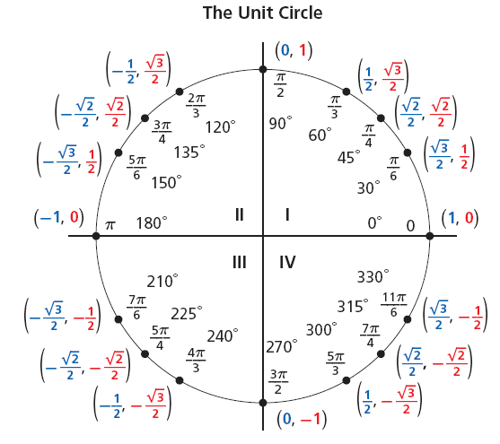



A unit circle is a circle with a radius of 1 unit. For every point P(x, y) on the unit circle, the value of r is 1. Therefore, for an angle θ in the standard position:

Slide 22
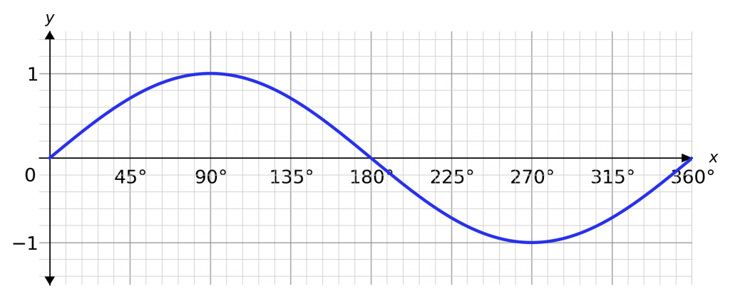
Write down at least 5 things you notice about the graph…
It looks like a wave
The axis are not labelled
y=sinθ
y
θ
It crosses the x-axis at 0, 180 and 360
It crosses the y-axis at 0
It looks like it continues at both ends
Its maximum is at 1
Its minimum is at -1

Slide 23
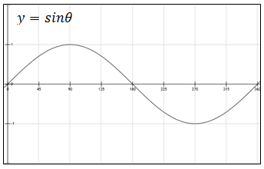
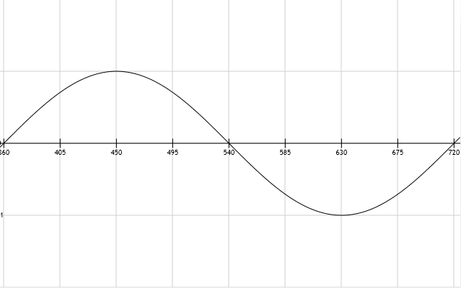
Definitions
The amplitude of a graph is…
The period of a graph is…
the maximum height of the curve
the distance over which the curve repeats itself
amplitude is 1
period is 360˚

Slide 24
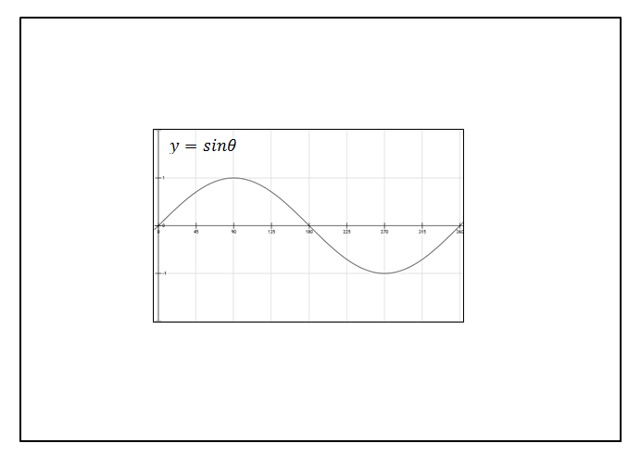
Write down at least 5 things you notice about the graph…
It looks like a wave
The axis are not labelled
y
It crosses the x-axis at 0, 180 and 360
It crosses the y-axis at 0
θ
It looks like it continues at both ends
Its maximum is at 1
Its minimum is at -1
period is 360˚
amplitude is 1

Slide 25
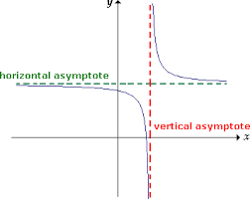
Definitions
The asymptote of a graph is…
a straight line that continually approaches a given curve but does not meet it.

Slide 26
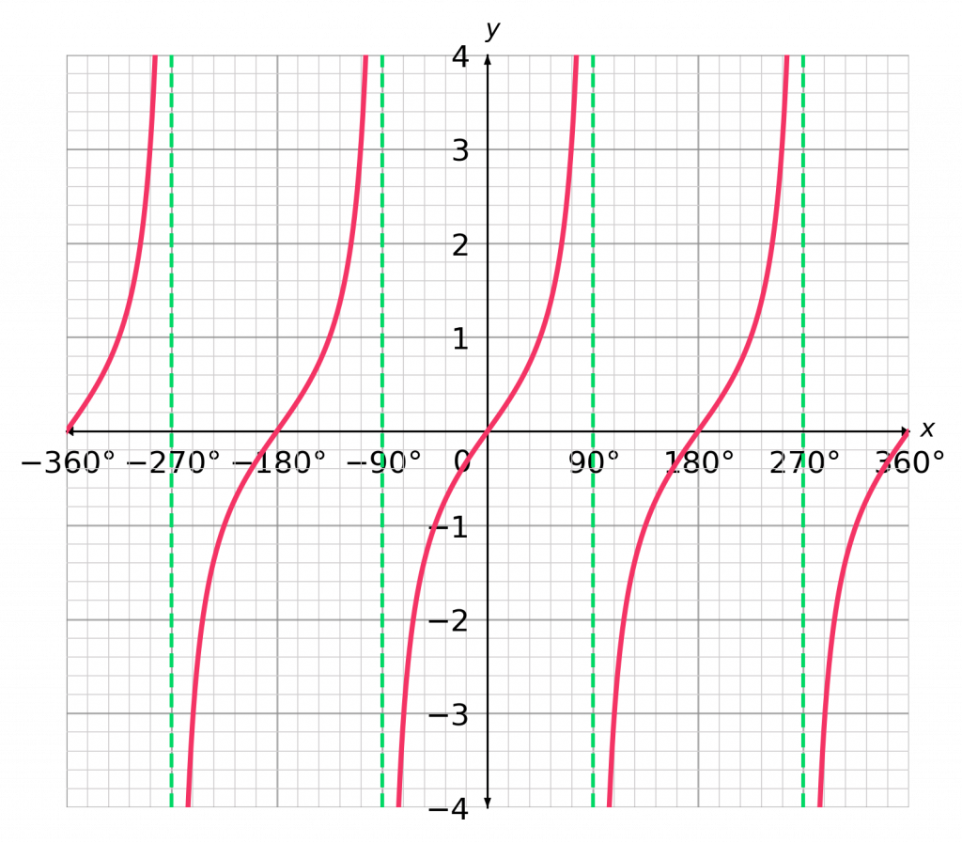
Write down at least 5 things you notice about the graph…
Try to use our new vocabulary
y=tanθ
It crosses the x-axis at 0 and 180
It isn’t a continuous wave.
y
It crosses the y-axis at 0
θ
It looks like it continues at top and bottom ends
It has many lines
of asymptotes
period is 180˚
Asymptotes line are θ=90⁰, θ=90+180=270⁰ ……

Slide 27
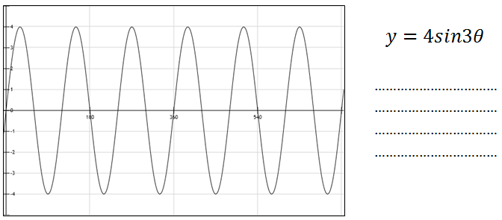
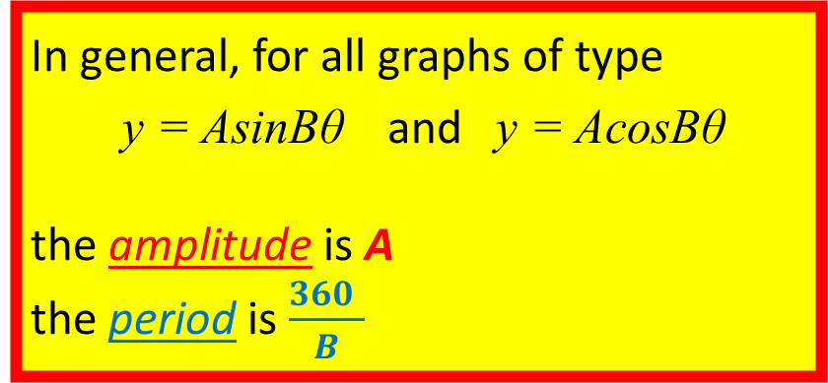
The amplitude has increased to 4
The period is 120, it is a third
In general, for all graphs of type
y = AsinBθ and y = AcosBθ
the amplitude is A
the period is $\frac{360 }{B}$

Slide 28
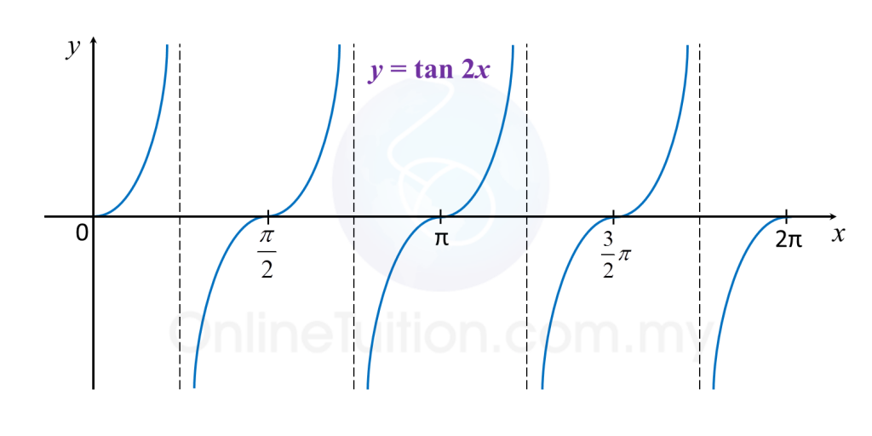
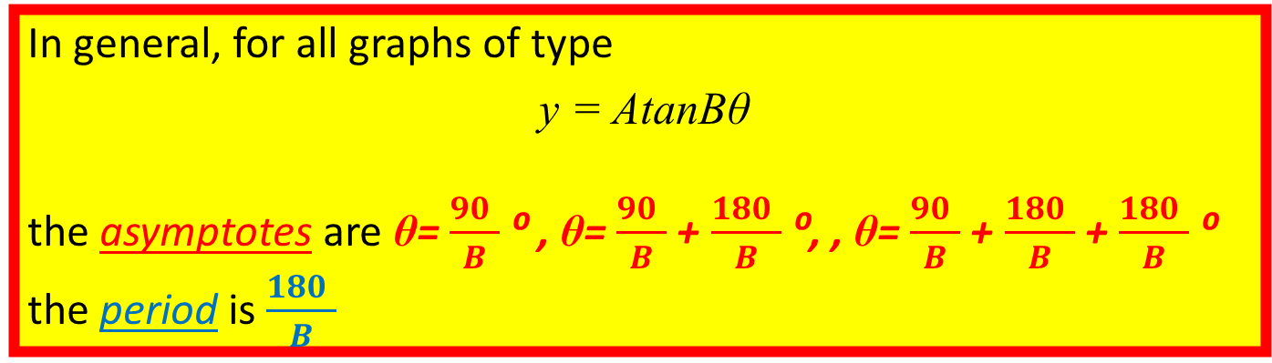
The asymptotes are θ=45 ⁰ , θ=135 ⁰ , θ=225 ⁰ ……
The period is 90°
In general, for all graphs of type
y = AtanBθ
the asymptotes are θ= $\frac{90 }{B}$⁰ , θ= $\frac{90 }{B}$+ $\frac{180 }{B}$⁰, , θ= $\frac{90 }{B}$+ $\frac{180 }{B}$+ $\frac{180 }{B}$⁰
the period is $\frac{180 }{B}$

