Slide 1

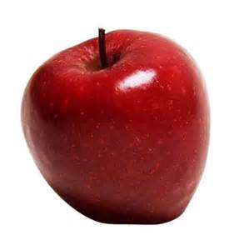



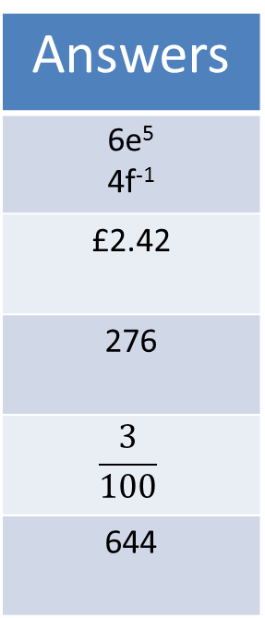
Lesson Focus: To use fractional and negative index laws
Get your ‘5-a-Day’ and Master Your Mathematics!
Try these in the back of your books!
10M3
Simplify:
2e² x 3e³
12f² ÷ 3f³
12 x 23
Write 0.03 as a fraction
Work out 11% of £22
Work out 5152 ÷ 8
Answers
6e⁵ 4f⁻¹
£2.42
276
$$\frac{3}{100}$$
644

Slide 2
Lesson Focus: To use fractional and negative index laws
Real-Life/
Cross Curricular Links!
Waiters and waitresses use algebra to note people’s orders the collect like terms to make the order simple for the chef!
Steps to Success!
Bronze
To recap index laws.
Silver
To use negative index laws.
Gold
To use fractional index laws.
Literacy!
Index
Power
Negative
Fractional

Slide 3
LO: To use fractional and negative index laws (Grade B/A/7)
To recap index laws.
To use negative index laws.
To use fractional index laws.

Slide 4
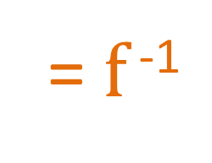
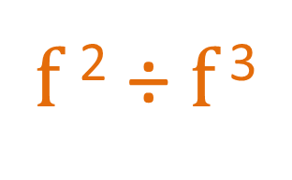
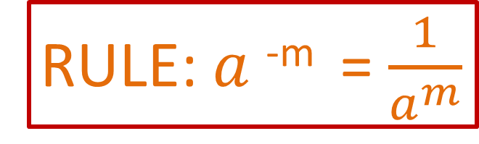
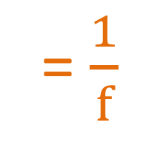
LO: To use fractional and negative index laws
Negative index laws!
We have already looked at an example from our starter:
$f$² ÷ $f$ ³
= $f$ ⁻¹
= $\frac{1}{f}$
RULE: $a$^{-m} = $\frac{1}{a^{m}}$
Examples!

Slide 5
LO: To use fractional and negative index laws
Negative index laws!
We have already looked at an example from our starter:
f ² ÷ f ²
= f ⁰
= 1
If you divide anything by itself you get 1!
RULE: a⁰ = 1

Slide 6
Questions!
LO: To use fractional and negative index laws
Grade A!
a⁻¹
b⁻¹
c⁻²
d⁻³
(e³)⁻¹
(f⁴)⁻¹
(g²)⁻²
(h⁵)⁻¹
(i³)⁻²
(j⁴)⁻²
(a²)⁻²
(b²)⁻⁴
(c²)⁻³
(d⁻¹)⁻¹
(e⁻¹)²
(f⁻¹)³
(g²)⁻⁷
(h⁻²)⁻³
(i²)⁰
(j⁻¹)⁰
(a⁴)⁻¹
(b²)⁻⁹
(c²)⁰
(d⁻⁶)⁰
(e²f³)⁰
(g⁴h³)⁻¹
(i²j³)⁻²
(2k²m³)⁻²
(5n⁵p²)⁻³
3qr³ ⁻¹
2s²
1/a
1/a⁴
1/a⁴
1/b⁸
1/b¹⁸
1/b
1/c²
1/c⁶
1
1/d³
d
1
1/e³
1/e²
1
1/f⁴
1/f³
1/g⁴h³
1/g¹⁴
1/i⁴j⁶
1/g⁴
1/h⁵
h⁶
1/8k⁴m⁶
1/i⁶
1
1/125n¹⁵p⁶
1/j⁸
1
( )
2s²
3qr³

Slide 7
LO: To use fractional and negative index laws (Grade B/A)
To recap index laws.
To use negative index laws.
To use fractional index laws.

Slide 8
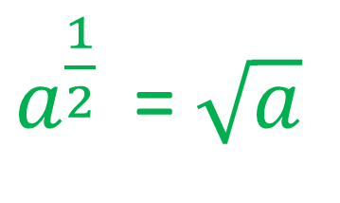
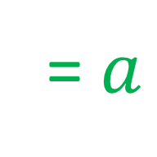
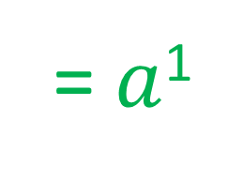
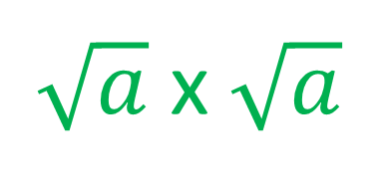
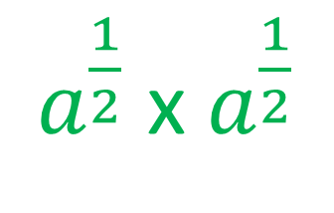
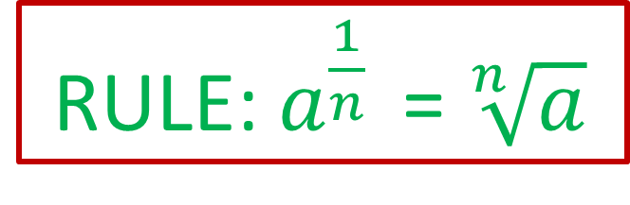

LO: To use fractional and negative index laws
(Grade B/A)
Fractional index laws!
From our knowledge of square roots, we know that:
$\sqrt{a}$ x $\sqrt{a}$
= $a$
Now, using our multiplication rule we can see that:
$a^{\frac{1}{2}}$ x $a^{\frac{1}{2}}$
= $a$¹
= $a$
$a^{\frac{1}{2}}$ = $\sqrt{a}$
RULE: $a^{\frac{1}{n}}$ = $\sqrt[n]{a}$
Examples!

Slide 9
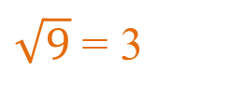
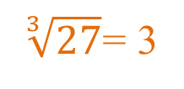
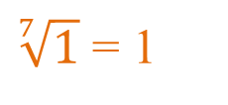
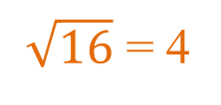

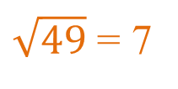
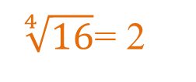
Questions!
LO: To use fractional and negative index laws
9^{1/2}
16^{1/2}
27^{1/3}
16^{1/4}
49^{1/2}
1000^{1/3}
1^{1/7}
(9a⁴)^{1/2}
(16b⁸)^{1/4}
(27c³)^{1/3}
(100d⁴)^{1/2}
(225e²f⁶)^{1/2}
(g¹²h³⁶)^{1/6}
(16i²j⁶)^{-1/2}
$\sqrt{9}$ = 3
3a²
$\sqrt{16}$ = 4
2b²
$\sqrt[3]{27}$= 3
3c
$\sqrt[4]{16}$= 2
10d²
$\sqrt{49}$ = 7
15ef³
$\sqrt[3]{1000}$ = 10
g²h⁶
$\sqrt[7]{1}$ = 1
1/4ij³

Slide 10
LO: To use fractional and negative index laws (Grade B/A)
To recap index laws.
To use negative index laws.
To use fractional index laws.
https://www.interactive-maths.com/indices-qqi-bingo.html
https://www.transum.org/Maths/Activity/Algebra/Indices.asp?Level=1

