Slide 1

Solving two steps equations
Lesson 5F Prep
Notes:
https://create.kahoot.it/share/d1fa9780-be45-440a-8060-bbd565b8b2a4

Slide 2
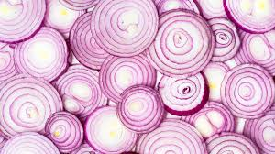
Onion skin peeling method to solve Two Steps Equations

Slide 3
Equations - Onion Skin Method
Turn the whole equation into an "onion", building skins outwards from the letter variable in the center
These onion skins are created by first drawing a centre skin around the letter variable we are solving for.
We then create skins outwards from here, following the BODMAS/PEMDAS order of operations.
The outermost skin should enclose the entire equation.
Now "Peel" inwards doing opposite operations.
Apply these opposites, starting from the single number item which is contained in the outermost onion skin.
Keep applying opposites until we reach the letter variable, that is in the center of the Onion.

Slide 4

Solving Equations Using Onion Skins
Solve the Equation : n + 5 = 7
Draw the first skin around "n", and then draw more skins radiating outwards, until the
whole algebra equation is circled by the final outer skin.
n + 5 = 7
To solve the Equation work from the biggest outer skin, inwards through the smaller skins, applying opposites, until we reach the letter variable center.
Solution for n is: n $=$ 7 $−$ 5 = 2
n=2

Slide 5
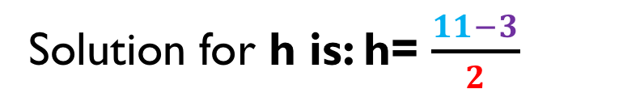
Solving a 2 Step Equation Using Onion Skins
Solve the Equation : 2h + 3 = 11
Draw the first skin around "h", and then draw more skins radiating outwards, until the whole algebra equation is circled by the final outer skin.
2 h + 3 =11
To solve the Equation work from the biggest outer skin, inwards through the smaller skins, applying opposites, until we reach the letter variable.
Solution for h is: h= $\frac{11−3}{2}$
h = 4

Slide 6
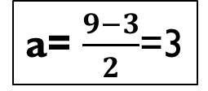

Solving a 2 Step Equation Using Onion Skins
Solve : 9 = 3 + 2a
9 = 3 + 2a
Solution for a is: a= $\frac{9−3}{2}$
a= $\frac{9−3}{2}$=3

Slide 7
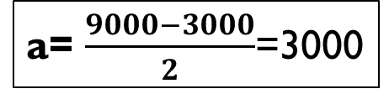

Solving a 2 Step Equation Using Onion Skins
Solve : 9000 = 3000 + 2a
9000 = 3000 + 2a
Solution for a is: a= $\frac{9000−3000}{2}$
a= $\frac{9000−3000}{2}$=3000

Slide 8
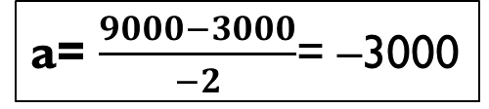

Solving a 2 Step Equation Using Onion Skins
Solve : 9000 = 3000 - 2a
9000 = 3000 – 2a
Solution for a is: a= $\frac{9000−3000}{−2}$
a= $\frac{9000−3000}{−2}$= –3000

Slide 9
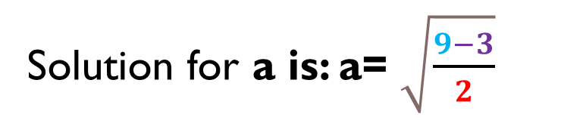

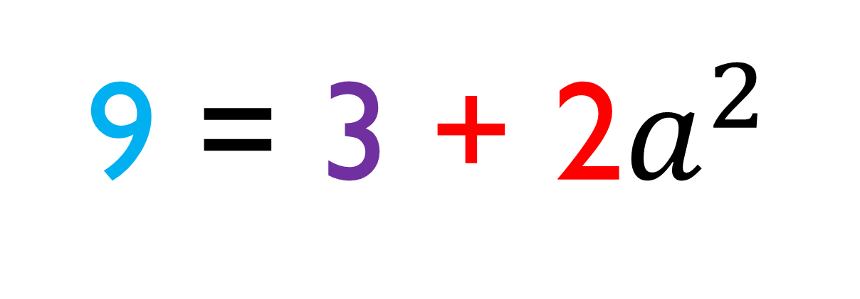
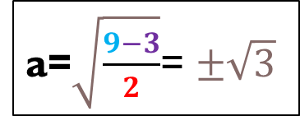
Solving a 2 Step Equation Using Onion Skins
Solve : 9 = 3 + 2$a^{2}$
$$9−3=6$$
$\frac{6}{2}$ =3
$±\sqrt{3}$ = a
9 = 3 + 2$a^{2}$
Solution for a is: a= $\sqrt{\frac{9−3}{2}}$
a=$\sqrt{\frac{9−3}{2}}$= $±\sqrt{3}$

Slide 10
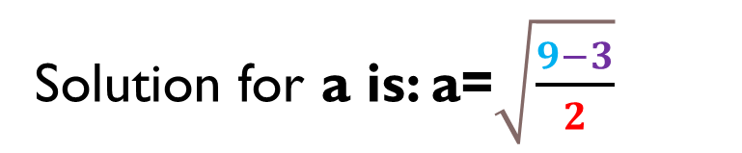
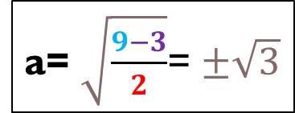
Solving a 2 Step Equation Using Onion Skins
Solve : 9 = 3 + 2$a^{2}$
9 = 3 + 2$a^{2}$
This is for variable appears once!!!
Solution for a is: a=$\sqrt{\frac{9−3}{2}}$
a= $\sqrt{\frac{9−3}{2}}$= $±\sqrt{3}$

Slide 11
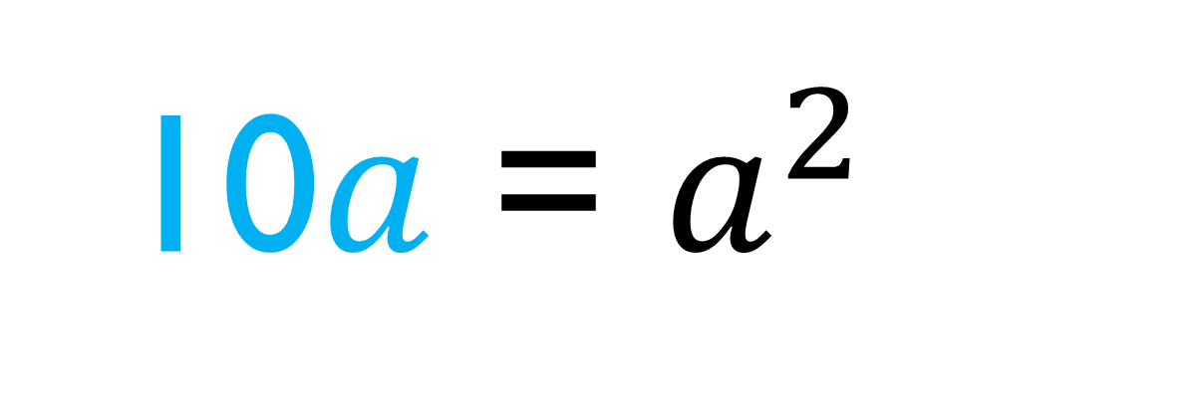
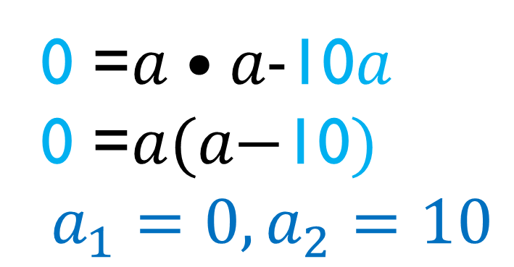
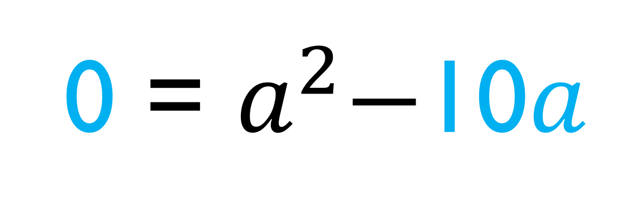
Solving a 2 Step Equation Using Onion Skins
Solve : 10$a$= $a^{2}$
0 =$a•\text{a}\text{−}\text{10}a$
0 =$a(\text{a}\text{−}\text{10})$
$$a_{1}=0, a_{2}=10$$
10$a$ = $a^{2}$
-10a -10a
a appears twice in this equation!!!
0 = $a^{2}\text{−}\text{10}a$

