Slide 1
Graphing Exponential Functions
Objectives:
1. Graph exponential growth functions.
2. Graph exponential decay functions.

Slide 2
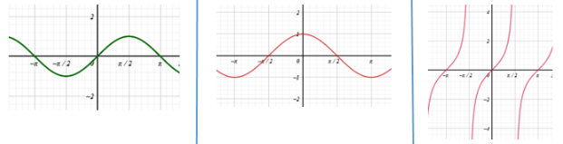
Which Trig graphs?
Amplitude?
Period?
Asymptote?

Slide 3
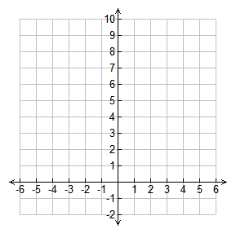
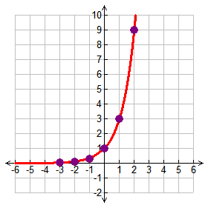
Example 1
Graph y = 3^{x}.
Complete the table.
Substitute -3 for x
y = 3⁻³
y = 1/27 or 0.04
x | y
-3
-2
-1
0
1
2
0.04
Write 0.04 in the table
0.1
Substitute -2 for x
y = 3⁻²
y = 1/9 or 0.1
0.3
1
Write 0.1 in the table
Continue substituting numbers for x until the table is complete
3
9
Plot the points on the graph and connect the points with a smooth curve with arrows at both ends – DO NOT CROSS THE x-axis!

Slide 4
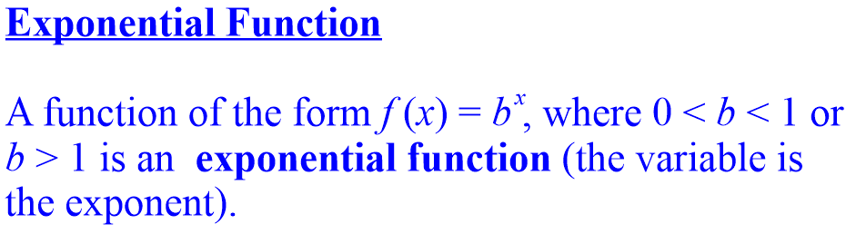
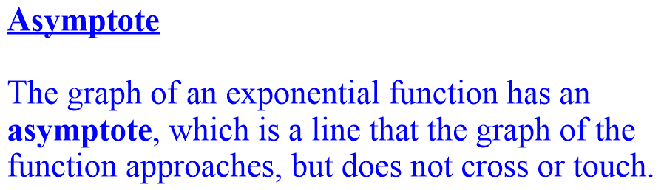
y

Slide 5
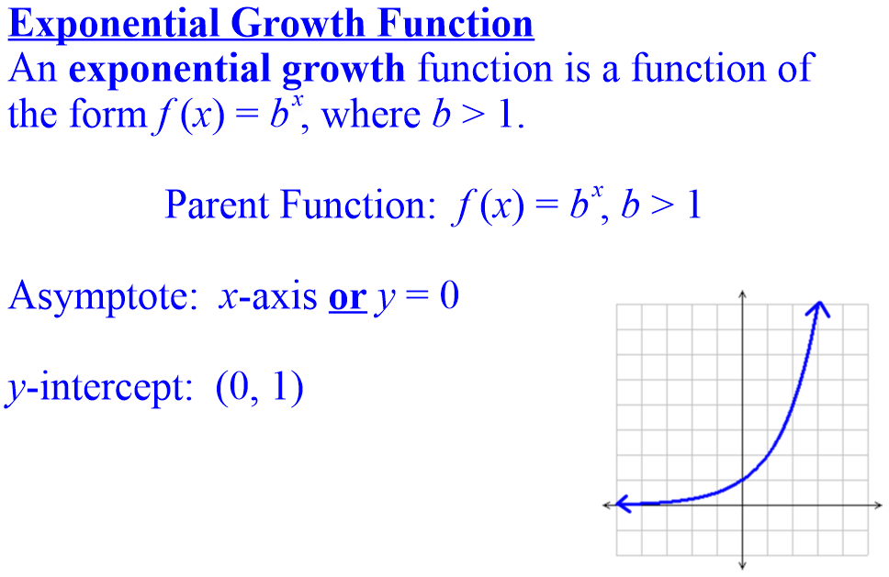
y
y

Slide 6
Graph of Exponential Function (a > 1)
The graph of y = b^{x}, b > 1
y
4
Range: (0, ∞)
(0, 1)
x
4
Horizontal Asymptote y = 0
Domain: (–∞, ∞)

Slide 7
Defs: domain and range
Domain: The set of x components of an equation.
Range: The set of y components of an equation.

Slide 8
Graph of Exponential Function (0 < a < 1)
The graph of y= b^{x}, 0 < b < 1
Since a< 1; a is decay factor.
y
4
Range: (0, ∞)
Horizontal Asymptote y = 0
(0, 1)
x
4
Domain: (–∞, ∞)

Slide 9
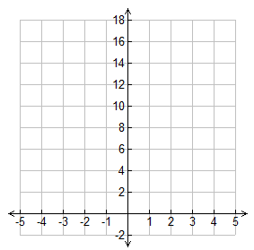
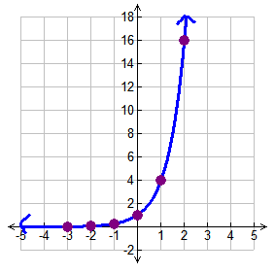
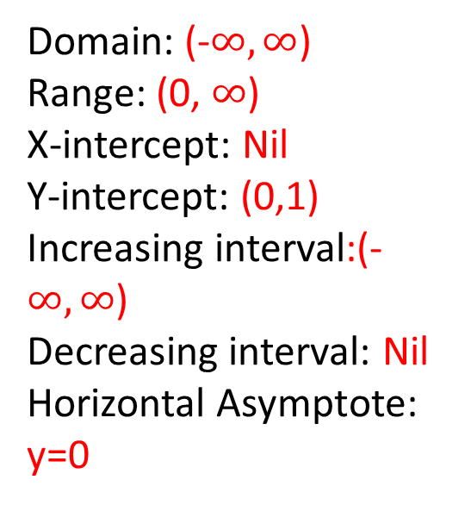
Practice.
1. Graph y = 4^{x}.
x | y
-3
-2
-1
0
1
2
x | y
-3 | 0.02
-2 | 0.06
-1 | 0.25
0 | 1
1 | 4
2 | 16
Domain: (-$∞,∞$)
Range: (0, $∞$)
X-intercept: Nil
Y-intercept: (0,1)
Increasing interval:(-$∞,∞$)
Decreasing interval: Nil
Horizontal Asymptote: y=0

Slide 10
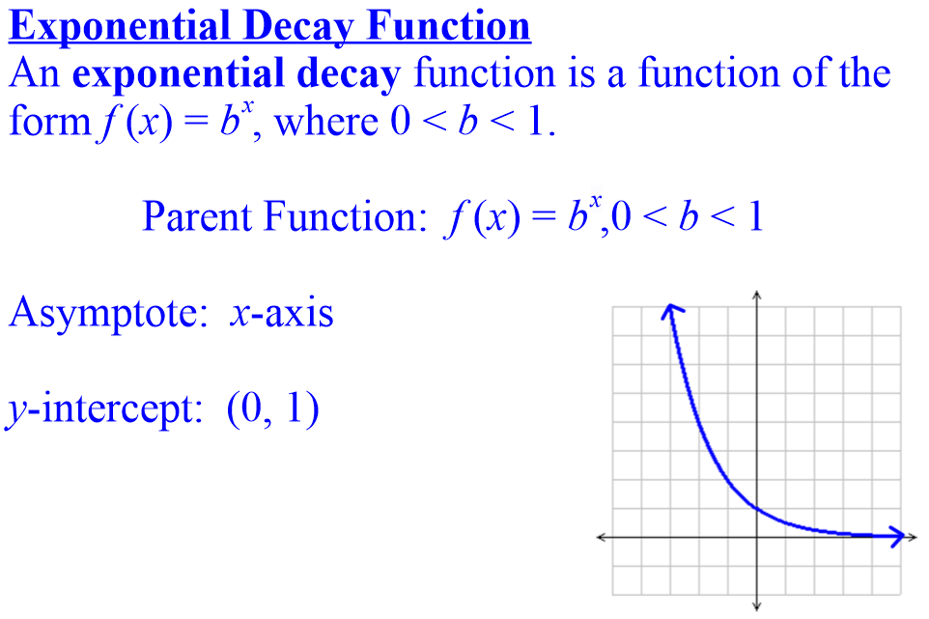
y
y

Slide 11
E.g. 2—Graphing Exp. Functions by Plotting Points
Then, we the plot points to sketch
the graphs.

Slide 12
Graphs of Exponential Functions
The figure shows the graphs of the family
of exponential functions f(x) = a^{x} for various values of the base a.
  All these graphs
  pass through
  the point (0, 1)
  because
  a⁰ = 1 for a ≠ 0.

Slide 13
Graphs of Exponential Functions
You can see from the figure that there are two kinds of exponential functions:
  If 0 < a < 1,
  the function
  decreases rapidly.
  If a > 1, the function
  increases rapidly.

Slide 14
Graphs of Exponential Functions
The x-axis is a horizontal asymptote for
the exponential function f(x) = a^{x}.
This is because:
  When a > 1,
  we have
  a^{x} → 0 as x → –∞.
  When 0 < a < 1,
  we have
  a^{x} → 0 as x → ∞.

Slide 15
Graphs of Exponential Functions
The graph of f has one of these shapes.

Slide 16
E.g. 4—Transformations of Exponential Functions
Use the graph of f(x) = 2^{x} to sketch the graph of each function.
g(x) = 1 + 2^{x}
h(x) = –2^{x}
k(x) = 2^{x –1}

Slide 17
E.g. 4—Transformations
Example (a)
To obtain the graph of g(x) = 1 + 2^{x},
we start with the graph of f(x) = 2^{x} and
shift it upward 1 unit.
  Notice that the line
  y = 1 is now a horizontal
  asymptote.

Slide 18
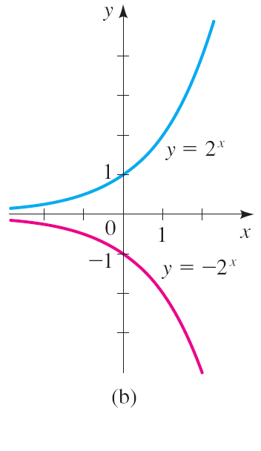
E.g. 4—Transformations
Example (b)
Again, we start with the graph of f(x) = 2^{x}.
However, here,
we reflect in the x-axis
to get the graph of
h(x) = –2^{x}.

Slide 19
E.g. 4—Transformations
Example (c)
This time, we start with the graph of f(x) = 2^{x} and shift it to the right by 1 unit—to get
the graph of k(x) = 2^{x–1}.

Slide 20
Transformations
The graph of f(x) = b represents a parent graph of the exponential functions. The same techniques used to transform the graphs of other functions we have studied can be applied to the graphs of exponential functions.
x

Slide 21







Asymptote: y=k

Slide 22
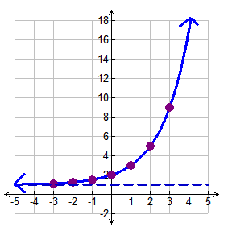
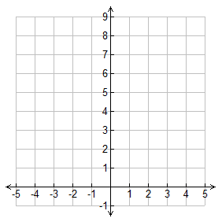
Example 2
Graph each function.
a. y = 2^{x} + 1
Complete the table.
Substitute -3 for x
y = 2⁻³ + 1
y = 1.125
x | y
-3
-2
-1
0
1
2
3
Write 1.1 in the table
1.1
Substitute -2 for x
y = 2⁻² + 1
y = 1.25
1.25
1.5
Write 1.25 in the table
Continue substituting
numbers for x until the table is complete then graph the points and draw the graph
2
3
This graph has a horizontal asymptote at y = 1 because of the +1 after the 2^{x} in the equation, so draw a dashed line at 1 – The graph can NOT cross or touch this line
5
9

Slide 23
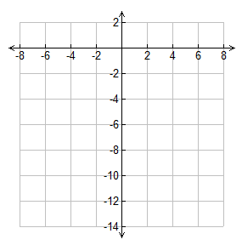
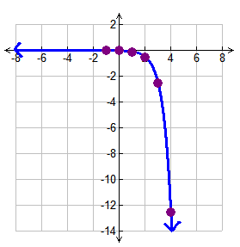


Complete the table.
Substitute -1 for x
Example 2
Graph each function.
y = -0.004
x | y
-1
0
1
2
3
4
Continue substituting
numbers for x until the table is complete then graph the points and draw the graph
-0.004
-0.02
-0.1
-0.5
This graph is reflected because the ½ is negative – the graph does NOT cross or touch the x-axis
-2.5
-12.5

Slide 24
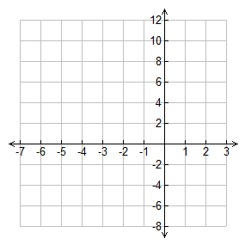
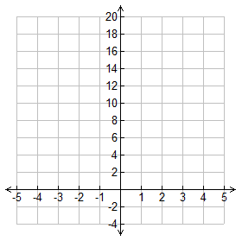
Practice.
Graph each function.
x | y
-5
-4
-3
-2
-1
0
1
x | y
-2
-1
0
1
2
3

Slide 25
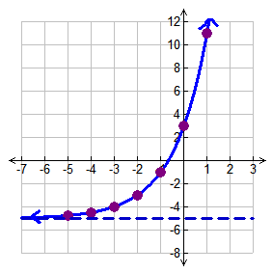
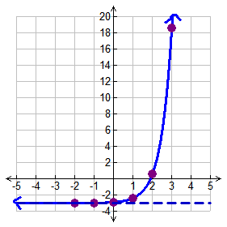
Practice.
Graph each function.
x | y
-5 | -4.75
-4 | -4.5
-3 | -4
-2 | -3
-1 | -1
0 | 3
1 | 11
x | y
-2 | -3
-1 | -2.98
0 | -2.9
1 | -2.4
2 | 0.6
3 | 18.6
There is a horizontal asymptote at y = -5 (This is the dashed line on the graph)
There is a horizontal asymptote at y = -3 (This is the dashed line on the graph)

Slide 27
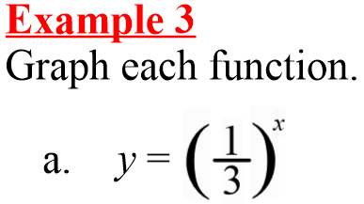
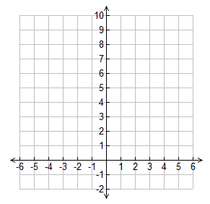
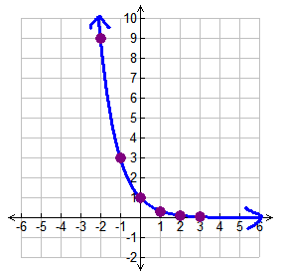

Complete the table.
Substitute -2 for x
x | y
-2
-1
0
1
2
9
y = 9
3
Continue substituting
numbers for x until the table is complete then graph the points and draw the graph
1
0.3
0.1

Slide 28
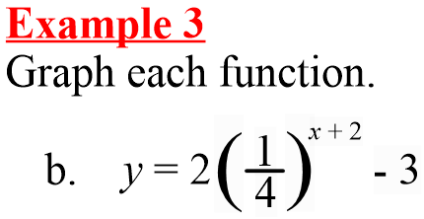
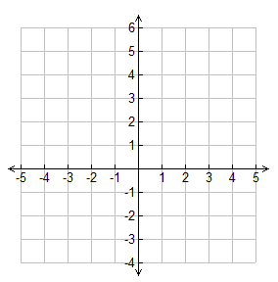
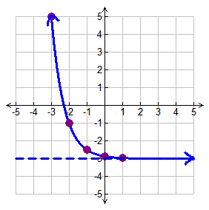
x | y
-3
-2
-1
0
1
Complete the table and sketch the graph.
5
-1
This graph has a horizontal asymptote at y = -3
-2.5
-2.9
-2.97

Slide 29
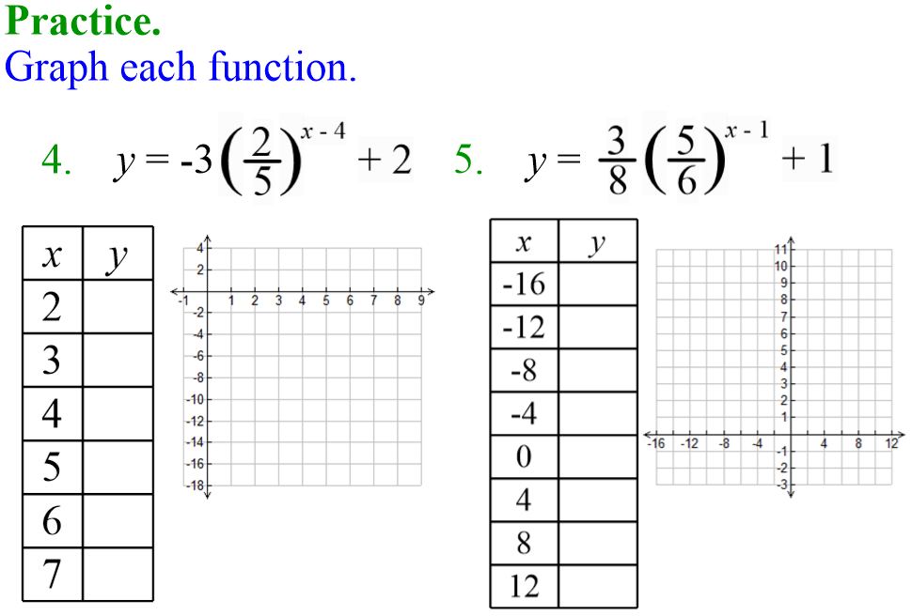

Slide 30
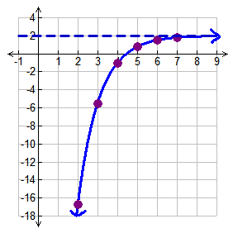
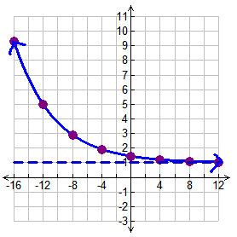
9.3
-16.75
5.01
-5.5
2.9
-1
1.9
0.8
1.45
1.2
1.52
There is a horizontal asymptote at y = 2
1.1
There is a horizontal asymptote at y = 1
1.808
1.05

