Slide 1
STARTER
Solve these equations using onion method.
EXAMPLE
a)
$$20=4x$$
$$16=2x+6$$
b)
$$x+7=13$$
$$− 6$$
$$− 6$$
$$10=2x$$
$$\frac{x}{5}=2$$
$$÷2$$
$$÷2$$
c)
$$5=x$$
d)
$$10=2x+4$$
a)
$$19=3x+7$$
a)
$$8=3x−7$$
b)
$$4=2x−8$$
$$13=\frac{3x+5}{2}$$
b)
c)
$$2=4x+10$$
$$\frac{2x+14}{2}=3$$
c)
$$6=\frac{x+5}{2}$$
d)
d)
$$2x+3=3x−2$$

Slide 2
STARTER
Solve these equations using a clear method.
EXAMPLE
a)
$$20=4x$$
$$x=5$$
$$16=2x+6$$
b)
$$x+7=13$$
$$x=6$$
$$− 6$$
$$− 6$$
$$10=2x$$
$$\frac{x}{5}=2$$
c)
$$x=10$$
$$÷2$$
$$÷2$$
$$5=x$$
d)
$$10=2x+4$$
$$x=3$$
a)
$$19=3x+7$$
$$x=4$$
a)
$$8=3x−7$$
$$x=5$$
b)
$$4=2x−8$$
$$x=6$$
$$13=\frac{3x+5}{2}$$
b)
$$x=7$$
c)
$$2=4x+10$$
$$x=−2$$
$$\frac{2x+14}{2}=3$$
c)
$$x=−4$$
$$6=\frac{x+5}{2}$$
d)
$$x=7$$
d)
$$2x+3=3x−2$$
$$x=5$$

Slide 3
$$x+y=5$$
$$3x+2y=22$$
If, $x=2$, what does $y=$
If, $x=4$, $y=$
A
D
$$x+3y=13$$
$$5x+4y=7$$
If, $y=3$, what does $x=$
If, $x=3$, $y=$
B
E
$$2x+2y=16$$
$$3x−5y=−2$$
If, $x=5$, what does $y=$
If, $x=6$, $y=$
C
F

Slide 4
$$x+y=5$$
$$3x+2y=22$$
If, $x=2$, what does $y=$
If, $x=4$, $y=$
A
$$y=3$$
D
$$y=5$$
$$x+3y=13$$
$$5x+4y=7$$
If, $y=3$, what does $x=$
If, $x=3$, $y=$
B
$$x=4$$
E
$$y=−2$$
$$2x+2y=16$$
$$3x−5y=−2$$
If, $x=5$, what does $y=$
If, $x=6$, $y=$
C
$$y=3$$
F
$$y=4$$

Slide 5
Use the
numbers below
to make…
Count
261
UP
11
7
12
5
4
6
2
3

Slide 6
06 October 2022
4.4 Simultaneous Equations:
Elimination

Slide 7
Jack and Jill go shopping in the same store.
Jack buys 2 doughnuts and 3 apples.
He spends £3.50
Jill buys 2 doughnuts and 2 apples.
She spends £3
How much is 1 doughnut?
How much is 1 apple?
How did you work this out?

Slide 8
We can use maths, and algebra, to solve problems like this.
$$=50p$$
$$=£3.50$$
$$=£3$$
If we calculate the difference between these sums,
we can see how much more Jill spent.
Jill bought 1 more apple and spent 50p more.
1 apple must be 50p
If 1 apple is 50p, 1 doughnut must be £1.

Slide 9
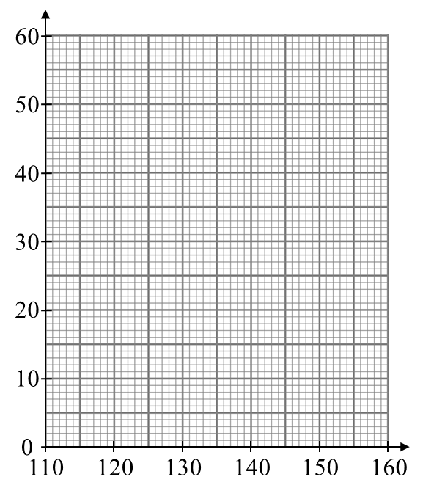
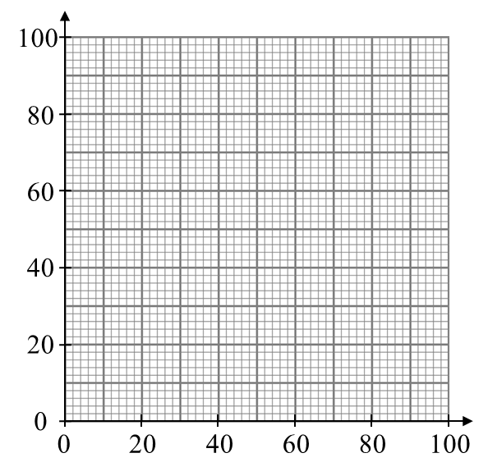
These are called simultaneous equations.
We use them to find the values of linked variables.
One of their uses is in business and economics
to compare unknown inputs and known outputs.

Slide 10
Elimination
Method
$$y$$
$$2x+3y$$
$$x$$
$$x$$
$$y$$
$$y$$
$$=16$$
$$−$$
$$x$$
$$x$$
$$2x+2y$$
$$y$$
$$y$$
$$=12$$
$$y=4$$
Substitute $y$ into either equation to find $x$.
$$2x+(2×4)=12$$
$$2x+8=12$$
How can we check
$x$ and $y$
are correct?
$$2x=4$$
$$x=2$$

Slide 11
Elimination
Method
$$3x+4y=29$$
$$−$$
$$3x+2y=19$$
$$2y=10$$
$$y=5$$
Substitute $y$ into either equation to find $x$.
$$3x+(2×5)=19$$
$$3x+10=19$$
How can we check
$x$ and $y$
are correct?
$$3x=9$$
$$x=3$$

Slide 12
Example
Your Turn
$$2x+4y=18$$
$$−$$
$$2x+3y=16$$
$$y=2$$
Substitute $y$ back in to find $x$.
$$2x+(3×2)=16$$
$$2x+6=16$$
$$2x=10$$
$$x=5$$
$$x=5, y=2$$

Slide 13
Example
Your Turn
$$2x+4y=18$$
$$3x+3y=27$$
$$−$$
$$2x+3y=16$$
$$−$$
$$3x+2y=22$$
$$y=2$$
$$y=5$$
Substitute $y$ back in to find $x$.
Substitute $y$ back in to find $x$.
$$2x+(3×2)=16$$
$$3x+(2×5)=22$$
$$2x+6=16$$
$$3x+10=22$$
$$2x=10$$
$$3x=12$$
$$x=5$$
$$x=4$$
$$x=5, y=2$$
$$x=4, y=5$$

Slide 14
Example
Your Turn
$$2x+4y=18$$
$$2x+5y=22$$
$$−$$
$$2x+3y=16$$
$$−$$
$$2x+4y=18$$
$$y=2$$
$$y=4$$
Substitute $y$ back in to find $x$.
Substitute $y$ back in to find $x$.
$$2x+(3×2)=16$$
$$2x+(4×4)=18$$
$$2x+6=16$$
$$2x+16=18$$
$$2x=10$$
$$2x=2$$
$$x=5$$
$$x=1$$
$$x=5, y=2$$
$$x=1, y=4$$

Slide 15
Example
Your Turn
$$2x+4y=18$$
$$4x+2y=14$$
$$−$$
$$2x+3y=16$$
$$−$$
$$3x+2y=12$$
$$y=2$$
$$x=2$$
Substitute $y$ back in to find $x$.
Substitute $x$ back in to find $y$.
$$2x+(3×2)=16$$
$$\left(3×2\right)+2y=12$$
$$2x+6=16$$
$$6+2y=12$$
$$2x=10$$
$$2y=6$$
$$x=5$$
$$y=3$$
$$x=5, y=2$$
$$x=2, y=3$$

Slide 16
Example
Your Turn
$$2x+4y=18$$
$$3x+6y=33$$
$$−$$
$$2x+3y=16$$
$$−$$
$$3x+4y=27$$
$$2y=6$$
$$y=2$$
$$y=3$$
Substitute $y$ back in to find $x$.
Substitute $y$ back in to find $x$.
$$2x+(3×2)=16$$
$$3x+(4×3)=27$$
$$2x+6=16$$
$$3x+12=27$$
$$2x=10$$
$$3x=15$$
$$x=5$$
$$x=5$$
$$x=5, y=2$$
$$x=5, y=3$$

Slide 17
Example
Your Turn
$$2x+4y=18$$
$$2x+3y=13$$
$$2x+2y=10$$
$$−$$
$$2x+3y=16$$
$$5x+4y=24$$
$$4x+4y=20$$
$$y=2$$
Substitute $y$ back in to find $x$.
$$2x+3y=16$$
$$4x+3y=26$$
$$2x+(3×2)=16$$
$$2x+6=16$$
$$4x+3y=34$$
$$4x+6y=52$$
$$2x=10$$
$$x=5$$
$$3x+5y=19$$
$$4x−5y=2$$
$$x=5, y=2$$

Slide 18
Example
Your Turn
$$2x+4y=18$$
$$2x+3y=13$$
$$2x+2y=10$$
$$x=2$$
$$y=3$$
$$−$$
$$2x+3y=16$$
$$5x+4y=24$$
$$4x+4y=20$$
$$x=4$$
$$y=1$$
$$y=2$$
Substitute $y$ back in to find $x$.
$$2x+3y=16$$
$$4x+3y=26$$
$$x=5$$
$$y=2$$
$$2x+(3×2)=16$$
$$2x+6=16$$
$$4x+3y=34$$
$$4x+6y=52$$
$$x=4$$
$$y=6$$
$$2x=10$$
$$x=5$$
$$3x+5y=19$$
$$4x−5y=2$$
$$x=3$$
$$y=2$$
$$x=5, y=2$$

Slide 19
Example
$$3x+2y=16$$
What is different with
these simultaneous equations?
$$−$$
$$2x−2y=4$$
What happens if we
subtract the equations?
$$x$$
$$+ 4y$$
$$=12$$
To eliminate the $y$ variable,
we must add the equations instead of subtracting.

Slide 20
Example
$$3x+2y=16$$
$$+$$
$$2x−2y=4$$
$$5x=20$$
$$x=4$$
Substitute $x$ back in to find $y$.
$$\left(2×4\right)−2y=4$$
$$8−2y=4$$
$$8=4+2y$$
$$4=2y$$
$$2=y$$
$$x=4, y=2$$

Slide 21
Example
Your Turn
$$3x+2y=16$$
$$4x+3y=18$$
$$+$$
$$2x−2y=4$$
$$+$$
$$3x−3y=3$$
$$5x=20$$
$$7x=21$$
$$x=4$$
$$x=3$$
Substitute $x$ back in to find $y$.
Substitute $x$ back in to find $y$.
$$\left(2×4\right)−2y=4$$
$$\left(3×3\right)−3y=3$$
$$8−2y=4$$
$$9−3y=3$$
$$8=4+2y$$
$$9=3+3y$$
$$4=2y$$
$$6=3y$$
$$2=y$$
$$2=y$$
$$x=4, y=2$$
$$x=3, y=2$$

Slide 22
Example
Your Turn
$$3x+2y=16$$
$$2x+4y=22$$
$$+$$
$$2x−2y=4$$
$$+$$
$$4x−4y=8$$
$$5x=20$$
$$6x=30$$
$$x=4$$
$$x=5$$
Substitute $x$ back in to find $y$.
Substitute $x$ back in to find $y$.
$$\left(2×4\right)−2y=4$$
$$\left(4×5\right)−4y=8$$
$$8−2y=4$$
$$20−4y=8$$
$$8=4+2y$$
$$20=8+4y$$
$$4=2y$$
$$12=4y$$
$$2=y$$
$$3=y$$
$$x=4, y=2$$
$$x=5, y=3$$

Slide 23
Example
Your Turn
$$3x+2y=16$$
$$2x+2y=10$$
$$3x−2y=5$$
$$+$$
$$2x−2y=4$$
$$5x=20$$
$$4x+3y=26$$
$$3x−3y=9$$
$$x=4$$
Substitute $x$ back in to find $y$.
$$\left(2×4\right)−2y=4$$
$$8−2y=4$$
$$3x−5y=−8$$
$$5x+5y=40$$
$$8=4+2y$$
$$4=2y$$
$$2=y$$
$$2x+2y=14$$
$$3x+4y=25$$
$$x=4, y=2$$

Slide 24
Example
Your Turn
$$3x+2y=16$$
$$2x+2y=10$$
$$3x−2y=5$$
$$x=3$$
$$y=2$$
$$+$$
$$2x−2y=4$$
$$5x=20$$
$$4x+3y=26$$
$$3x−3y=9$$
$$x=5$$
$$y=2$$
$$x=4$$
Substitute $x$ back in to find $y$.
$$\left(2×4\right)−2y=4$$
$$8−2y=4$$
$$3x−5y=−8$$
$$5x+5y=40$$
$$x=4$$
$$y=4$$
$$8=4+2y$$
$$4=2y$$
$$2=y$$
$$2x+2y=14$$
$$3x+4y=25$$
$$x=3$$
$$y=4$$
$$x=4, y=2$$

