Slide 1
Solving Simultaneous equations
Notes:
https://dashboard.blooket.com/set/609baec0c3a732001b856f85
https://dashboard.blooket.com/set/61e0a87465df56411c5f0760
https://dashboard.blooket.com/set/627531fa2e223288a24dd364

Slide 2
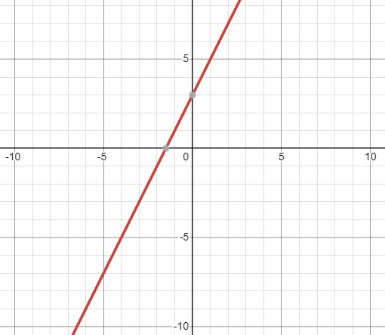
Equations with multiple solutions
Two lines are coincident if they lie one on top of the other.

Slide 3
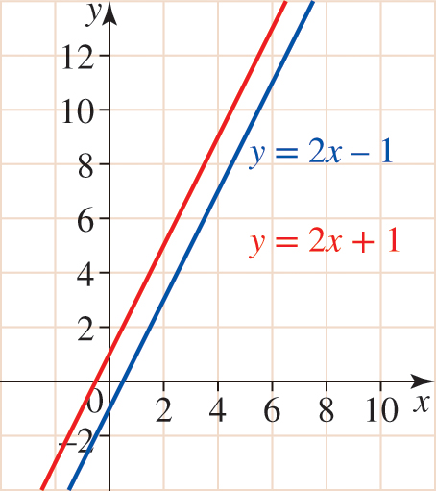
Equations with no solutions
If two lines do not intersect, there is no simultaneous solution to the equations.

Slide 4
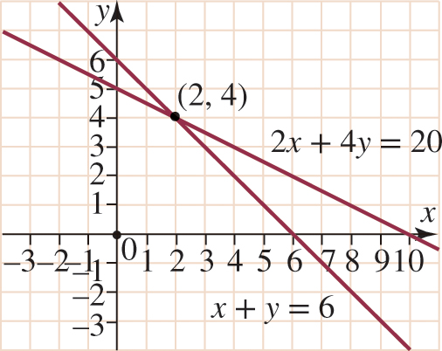
Equations with one solutions
Use the graphs of the given simultaneous equations to determine the point of intersection
$$\left\{\begin{matrix}x=2 \\ y=4\end{matrix}\right.$$

Slide 5
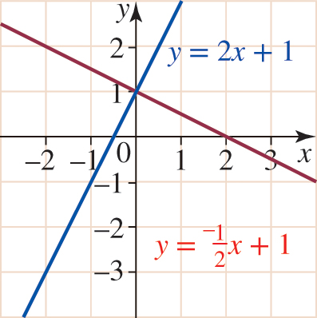
Equations with one solutions & Perpendicular lines
$$\left\{\begin{matrix}x=0 \\ y=1\end{matrix}\right.$$

Slide 6
1) Solve the system using substitution
x + y = 5
y = 3 + x
Step 1: Solve an equation for one variable.
The second equation is
already solved for y!
Step 2: Substitute
x + y = 5 x + (3 + x) = 5
2x + 3 = 5
2x = 2
x = 1
Step 3: Solve the equation.

Slide 7
1) Solve the system using substitution
$$\left\{\begin{matrix}x=1 \\ y=4\end{matrix}\right.$$
x + y = 5
y = 3 + x
x + y = 5
(1) + y = 5
y = 4
Step 4: Plug back in to find the other variable.
(1, 4)
(1) + (4) = 5
(4) = 3 + (1)
Step 5: Check your solution.
The solution is (1, 4). What do you think the answer would be if you graphed the two equations?

Slide 8
①
②
Elimination
Method
$$y$$
$$2x+3y$$
$$x$$
$$x$$
$$y$$
$$y$$
$$=16$$
$$−$$
$$x$$
$$x$$
$$2x+2y$$
$$y$$
$$y$$
$$=12$$
$$y=4$$
Substitute $y$ into either equation to find $x$.
$$2x+(2×4)=12$$
$$2x+8=12$$
$$\left\{\begin{matrix}x=2 \\ y=4\end{matrix}\right.$$
How can we check
$x$ and $y$
are correct?
$$2x=4$$
$$x=2$$

Slide 9
①
②
Elimination
Method
$$3x+4y=29$$
$$−$$
$$3x+2y=19$$
$$2y=10$$
$$y=5$$
Substitute $y$ into either equation to find $x$.
$$3x+(2×5)=19$$
$$3x+10=19$$
$$\left\{\begin{matrix}x=3 \\ y=5\end{matrix}\right.$$
How can we check
$x$ and $y$
are correct?
$$3x=9$$
$$x=3$$

