Slide 1
Solving Quadratic Equations

Slide 2
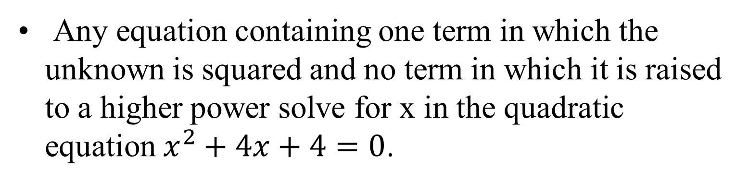
Quadratic graphs & equations
Any equation containing one term in which the unknown is squared and no term in which it is raised to a higher power solve for x in the quadratic equation $x^{2}+4x+4=0$.
$$y$$
$$y$$
$$y$$
$$x=−5$$
$$x$$
$$x$$
$$x$$
$$x=5$$
$$x=2$$
$$x^{2}−25=0$$
$$x^{2}−4x+4=0$$
$$x^{2}+4=0$$

Slide 3

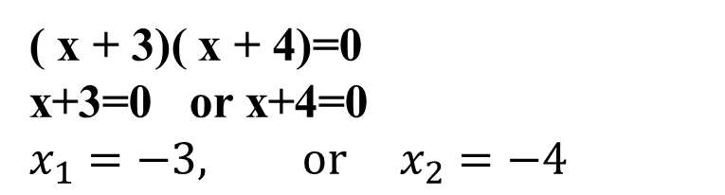
The Null Factor Law
The Null Factor Law states that if the product of two numbers is zero then one or both of the numbers must equal zero.
( x + 3)( x + 4)=0
x+3=0 or x+4=0
$$x_{1}=−3, or{ x}_{2}=−4$$

Slide 4
Factoring Trinomial Squares
Put everything into two sets of brackets.
Ex. x² – 14x + 49 =0
(x -7)(x -7) = 0
x=7
–14
– 7
– 7
49

Slide 5
Factoring Monic Trinomials 1st Scenario: a = 1
For example: x² – 14x + 49 coefficient of x² =1 x² =1 • x²

Slide 6
Factoring Trinomials
We will factor trinomials such as
x² + 7x + 12 back into binomials.
*reverse of FOIL/table
7
3
4
If the x² term has no coefficient (other than 1)...
12
x² + 7x + 12
Step 1: List all pairs of numbers that multiply to equal the constant, 12.
12 = 1 • 12
= 2 • 6
= 3 • 4

Slide 7
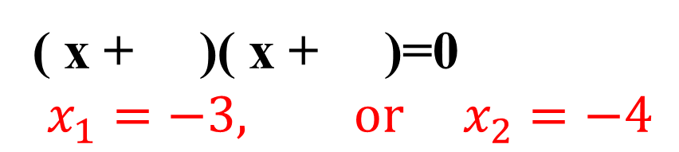
Solving Equations
7
x² + 7x + 12=0
3
4
12
Step 2: Choose the pair that adds up to the middle coefficient.
12 = 1 • 12
= 2 • 6
= 3 • 4
Step 3: Fill those numbers into the blanks in the binomials:
( x + )( x + )=0
$$x_{1}=−3, or{ x}_{2}=−4$$
3
4
x² + 7x + 12 = ( x + 3)( x + 4)=0

Slide 8
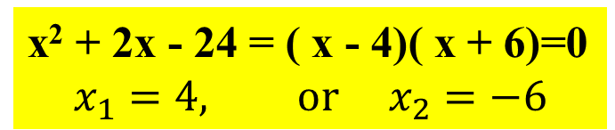
Solving Equations
2
– 4
6
Solving. x² + 2x – 24=0
-24
This time, the constant is negative!
Step 1: List all pairs of numbers that multiply to equal the constant, -24. (To get -24, one number must be positive and one negative.)
-24 = 1 • -24, -1 • 24
= 2 • -12, -2 • 12
= 3 • -8, -3 • 8
= 4 • -6, - 4 • 6
Step 2: Which pair adds up to 2?
Step 3: Write the binomial factors.
x² + 2x - 24 = ( x - 4)( x + 6)=0
$$x_{1}=4, or{ x}_{2}=−6$$

Slide 9
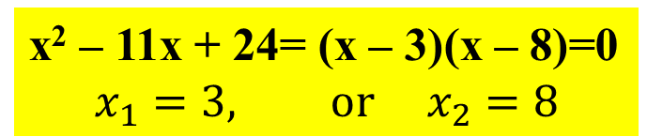
Solving Equations
Solving. x² – 11x + 24=0
–11
This time, the middle factor is negative!
– 3
– 8
Step 1: List all pairs of numbers that multiply to equal the constant, 24. (Since the middle factor is negative, the numbers used to get 24 must also be negative.)
24
24 = -1 • -24
= -2 • -12
= -3 • -8
= -4 • -6
Step 2: Which pair adds up to -11?
Step 3: Write the binomial factors.
x² – 11x + 24= (x – 3)(x – 8)=0
$$x_{1}=3, or{ x}_{2}=8$$

Slide 10
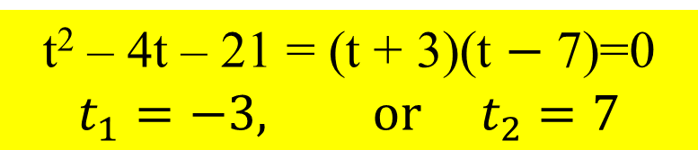
Equation #1:
t² – 4t – 21=0
-4
1) Factors of -21:
1 • -21, -1 • 21
3 • -7, -3 • 7
3
-7
-21
2) Which pair adds to (- 4)?
3) Write the factors.
t² – 4t – 21 = (t + 3)(t $−$ 7)=0
$$t_{1}=−3, or{ t}_{2}=7$$

Slide 11
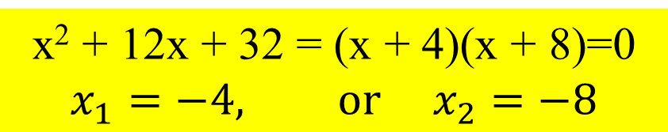
Equation #2:
x² + 12x + 32=0
12
1) Factors of 32:
1 • 32
2 • 16
4 • 8
4
8
32
2) Which pair adds to 12 ?
3) Write the factors.
x² + 12x + 32 = (x + 4)(x + 8)=0
$$x_{1}=−4, or{ x}_{2}=−8$$

Slide 12
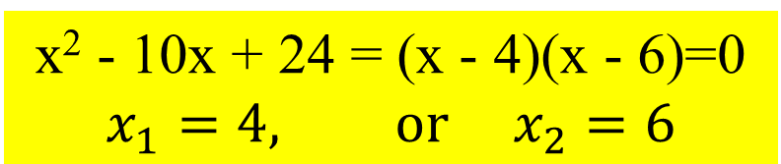
Equation #3:
x² - 10x + 24=0
-10
1) Factors of 32:
1 • 24
2 • 12
3 • 8
4 • 6
-1 • -24
-2 • -12
-3 • -8
-4 • -6
-4
-6
24
2) Which pair adds to -10 ?
None of them adds to (-10). For the numbers to multiply to +24 and add to -10, they must both be negative!
3) Write the factors.
x² - 10x + 24 = (x - 4)(x - 6)=0
$$x_{1}=4, or{ x}_{2}=6$$

Slide 13
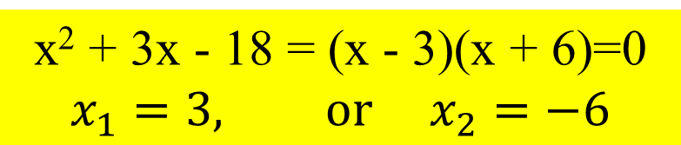
Equation #4:
x² + 3x – 18=0
3
1) Factors of -18:
1 • -18, -1 • 18
2 • -9, -2 • 9
3 • -6, -3 • 6
-3
6
-18
2) Which pair adds to 3 ?
3) Write the factors.
x² + 3x - 18 = (x - 3)(x + 6)=0
$$x_{1}=3, or{ x}_{2}=−6$$

Slide 14
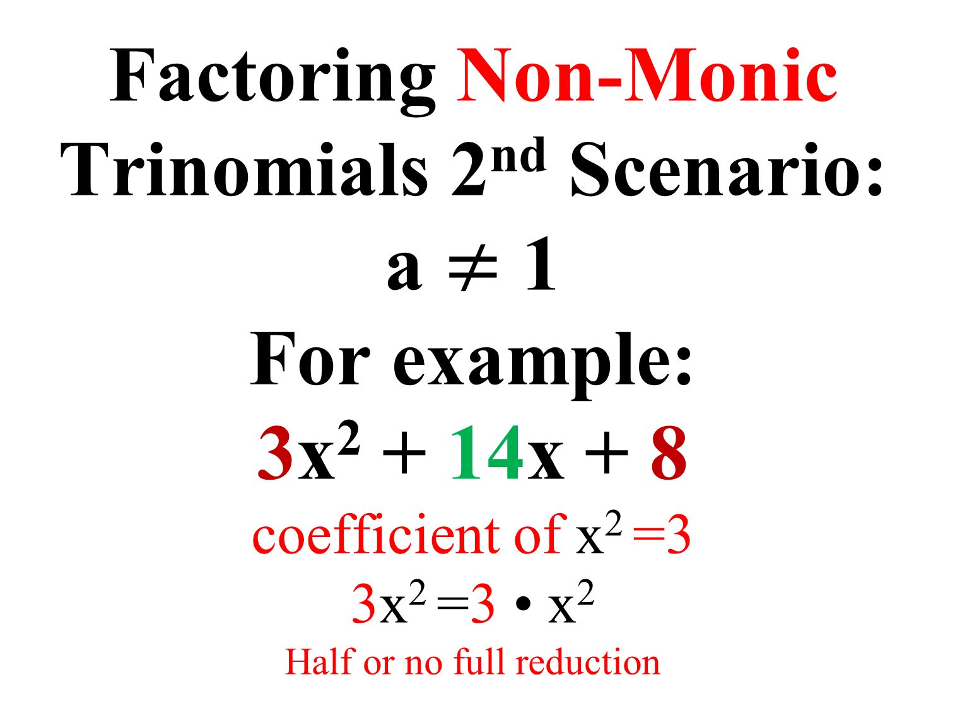
Factoring Non-Monic Trinomials 2nd Scenario:
a $≠$ 1
For example:
3x² + 14x + 8
coefficient of x² =3
3x² =3 • x²
^{Half or no full reduction}

Slide 15
Factoring Trinomials
Factor. 3x² + 14x + 8
14
2
12
Step 1: Multiply 3 • 8 = 24 (the leading coefficient & constant).
24
Step 2: List all pairs of numbers that multiply to equal that product, 24.
24 = 1 • 24
= 2 • 12
= 3 • 8
= 4 • 6
Step 3: Which pair adds up to 14?
This time, the x² term DOES have a coefficient (other than 1)!

Slide 16
Factoring Trinomials
14
2
12
Factor. 3x² + 14x + 8
24
Step 4: Write temporary factors with the two numbers.
2
( x + )( x + )
12
3
3
Step 5: Put the original leading coefficient (3) under both numbers.
4
2
( x + )( x + )
12
3
3
2
( x + )( x + )
Step 6: Reduce the fractions, if possible.
4
3
Step 7: Move denominators in front of x.
( 3x + 2 )( x + 4 )

Slide 17
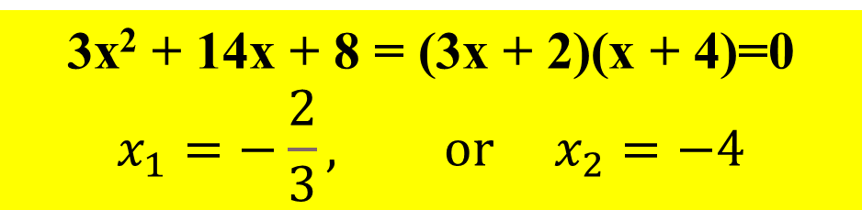
Solving Equations
14
2
12
24
Solving. 3x² + 14x + 8=0
You should always check the factors by distributing, especially since this process has more than a couple of steps.
( 3x + 2 )( x + 4 )
= 3x • x + 3x • 4 + 2 • x + 2 • 4
= 3x² + 14 x + 8
√
3x² + 14x + 8 = (3x + 2)(x + 4)=0
$$x_{1}=−\frac{2}{3}, or{ x}_{2}=−4$$

Slide 18
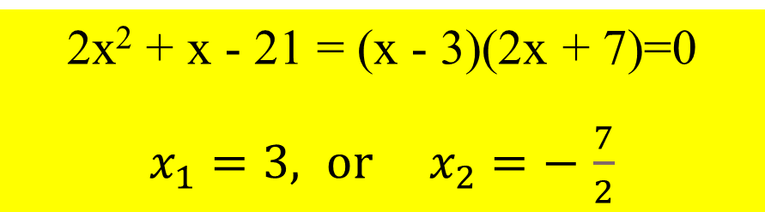
Equation #5:
2x² + x – 21=0
1) Multiply 2 • (-21) = - 42;
list factors of - 42.
1 • -42, -1 • 42
2 • -21, -2 • 21
3 • -14, -3 • 14
6 • -7, -6 • 7
1
2) Which pair adds to 1 ?
-6
7
-42
3) Write the temporary factors.
( x - 6)( x + 7)
2
2
4) Put “2” underneath.
3
( x - 6)( x + 7)
5) Reduce (if possible).
2
2
6) Move denominator(s)in
front of “x”.
( x - 3)( 2x + 7)
2x² + x - 21 = (x - 3)(2x + 7)=0
$x_{1}=3, or{ x}_{2}=−$ $\frac{7}{2}$

Slide 19
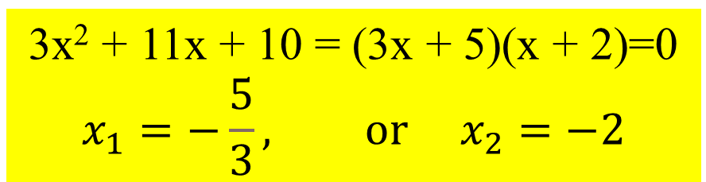
Equation #6:
3x² + 11x + 10=0
1) Multiply 3 • 10 = 30;
list factors of 30.
11
1 • 30
2 • 15
3 • 10
5 • 6
5
6
2) Which pair adds to 11 ?
30
3) Write the temporary factors.
( x + 5)( x + 6)
3
3
4) Put “3” underneath.
2
( x + 5)( x + 6)
5) Reduce (if possible).
3
3
6) Move denominator(s)in
front of “x”.
( 3x + 5)( x + 2)
3x² + 11x + 10 = (3x + 5)(x + 2)=0
$$x_{1}=−\frac{5}{3}, or{ x}_{2}=−2$$

Slide 20
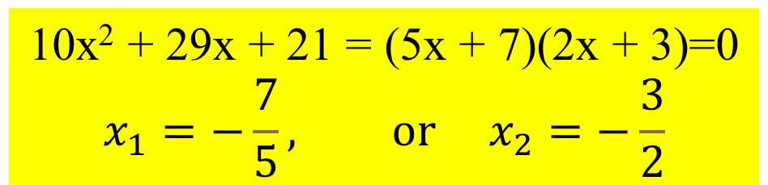
Equation #7:
10x² + 29x + 21=0
5 • 42
6 • 35
7 • 30
10 • 21
15 • 14
1) Multiply 10 • 21 = 210;
list factors of 30(2-digit numbers).
29
15
14
2) Which pair adds to 29 ?
210
3) Write the temporary factors.
( x + 15)( x + 14)
10
10
4) Put “10” underneath.
3
7
( x + 15)( x + 14)
5) Reduce (if possible).
10
10
6) Move denominator(s)in
front of “x”.
2
5
( 2x + 3)( 5x + 7)
10x² + 29x + 21 = (5x + 7)(2x + 3)=0
$$x_{1}=−\frac{7}{5}, or{ x}_{2}=−\frac{3}{2}$$

Slide 21
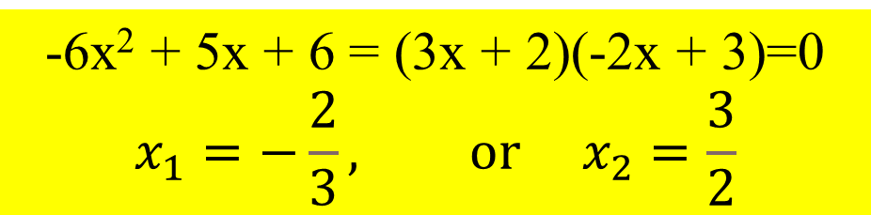
Equation #8:
-6x² + 5x + 6=0
1) Multiply -6 • 6 = -36;
list factors of -36.
-2 • 18
-3 • 12
-4 • 9
-6 • 6
2 • -18
3 • -12
4 • -9
6 • -6
5
-4
9
2) Which pair adds to 5 ?
-36
3) Write the temporary factors.
( x - 4)( x + 9)
-6
-6
4) Put “-6” underneath.
+2
+3
( x - 4)( x + 9)
5) Reduce (if possible).
-6
-6
6) Move denominator(s)in
front of “x”.
+3
-2
( 3x + 2)( -2x + 3)
-6x² + 5x + 6 = (3x + 2)(-2x + 3)=0
$$x_{1}=−\frac{2}{3}, or{ x}_{2}=\frac{3}{2}$$

Slide 22
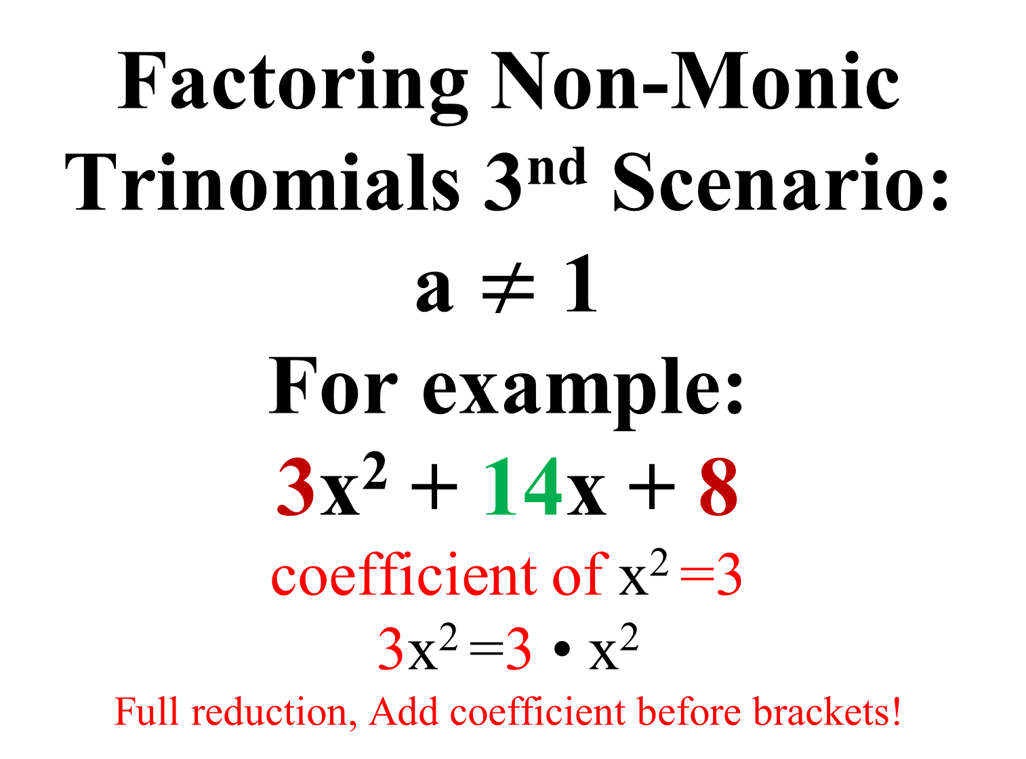
Factoring Non-Monic Trinomials 3nd Scenario:
a $≠$ 1
For example:
3x² + 14x + 8
coefficient of x² =3
3x² =3 • x²
Full reduction, Add coefficient before brackets!

Slide 23
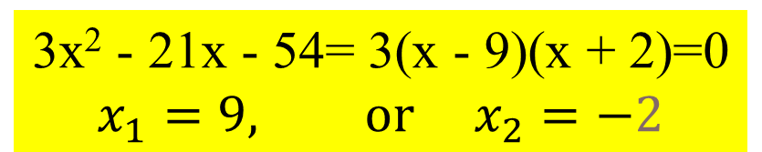
Equation #9:
3x² - 21x – 54=0
1) Multiply 3 • -54 = -162;
list factors of -162.
-21
-2 • 81
-3 • 54
-6 • 27
-9 • 18
2 • -81
3 • -54
6 • -27
9 • -18
-27
6
2) Which pair adds to -21 ?
-162
3) Write the temporary factors.
( x - 27)( x + 6)
3
3
4) Put “3” underneath.
9
2
( x - 27)( x + 6)
5) Reduce to no denominator.
3
3
6) Full reduction but Because of coefficient 3, Add 3 to front.
3(x - 9)( x + 2)
3x² - 21x - 54= 3(x - 9)(x + 2)=0
$$x_{1}=9, or{ x}_{2}=−2$$

Slide 24
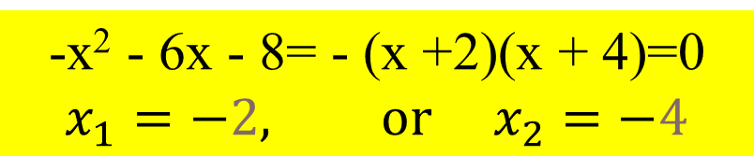
Equation #10:
-x² - 6x – 8=0
1) Multiply -1 • -8 = 8;
list factors of 8.
1 • 8
2 • 4
-1 • -8
-2 • -4
-6
-2
-4
2) Which pair adds to -6 ?
8
3) Write the temporary factors.
( x - 2)( x - 4)
-1
-1
4) Put “-1” underneath.
+2
+4
( x - 2)( x - 4)
5) Reduce to no denominator.
-1
-1
6) Full reduction, Because of coefficient -1, Add -1 to front.
- (x +2)( x + 4)
-x² - 6x - 8= - (x +2)(x + 4)=0
$$x_{1}=−2, or{ x}_{2}=−4$$

