Slide 1
Starter
On graph paper…draw a set of axes for x values -4 to 2; and y values -2 to 15.
Plot the graph of $y=x^{2}+4x+3$on the axes.
You can use the table below to help if needed.
$$x$$ | -4 | -3 | -2 | -1 | 0 | 1 | 2
$$x^{2}$$ | 16 |  |  |  |  | 1
$$+4x$$ | -16 |  |  |  |  | 4
$$+3$$ | 3 |  |  |  |  | 3
$$y$$ | 3 |  |  |  |  | 8

Slide 2
Quadratic Equations
LO: to identify solutions of a quadratic equation and solve quadratic equations graphically
Identify solutions of a quadratic equation from a graph
Solve quadratic equations graphically when $y=0$

Slide 3
Quadratic Functions
Quadratic Function
A quadratic function is a function that can be written in the form
f(x) = ax² + bx + c
For real numbers a, b, and c, with a ≠ 0.

Slide 4
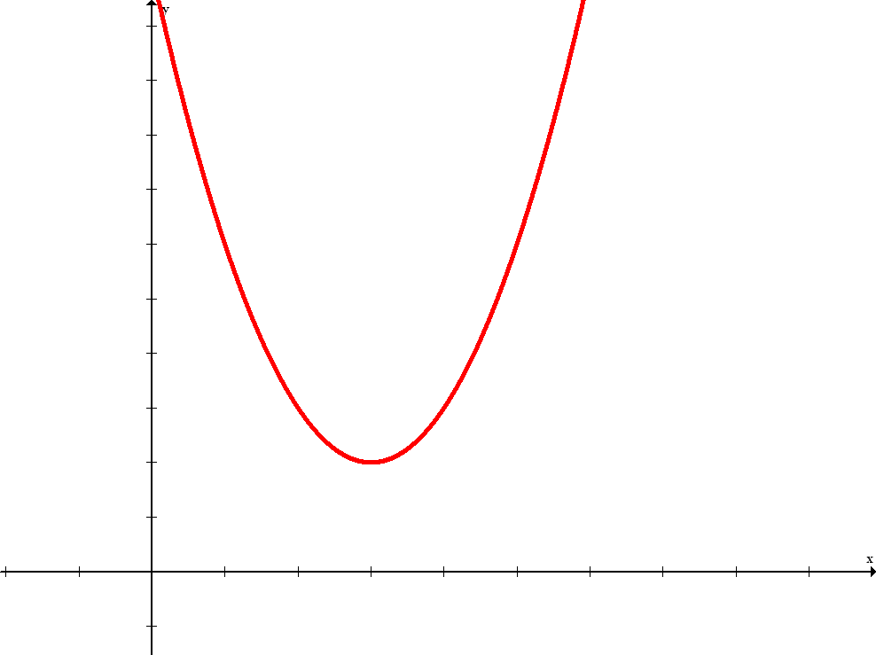
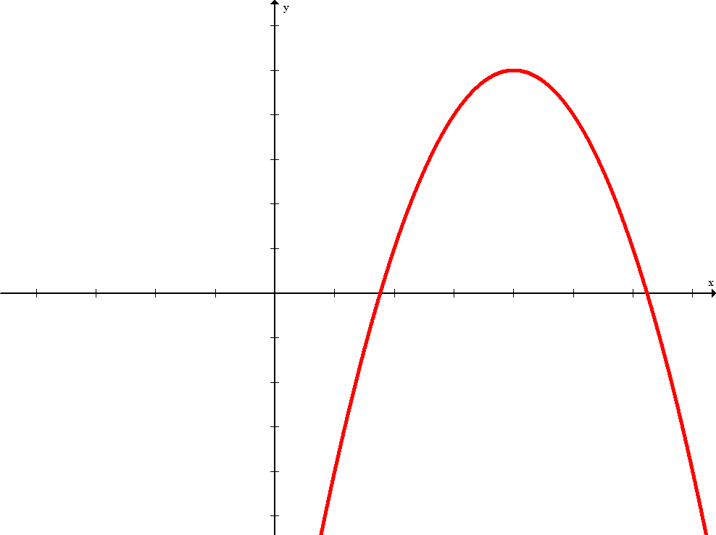
Definitions
The graph of every quadratic function is a parabola.
The vertex is the lowest point on a parabola that opens upward, or the highest point on a parabola that opens downward.

Slide 5
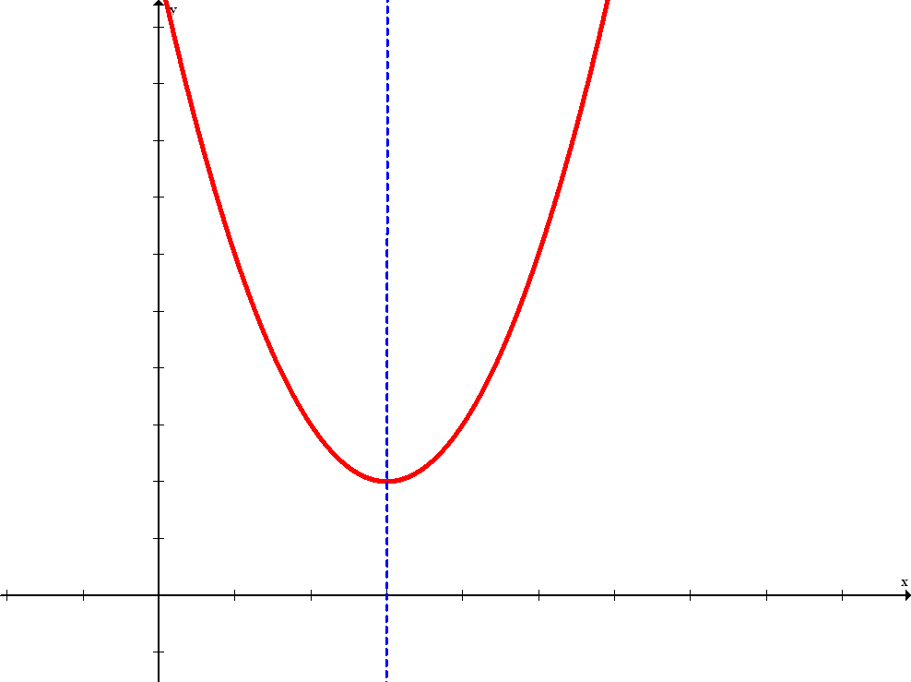
Definitions
Graphs of quadratic equations have symmetry about a line through the vertex. This line is called the axis of symmetry.
The sign of a, the numerical coefficient of the squared term, determines whether the parabola will open upward or downward.

Slide 6
Vertex of a Parabola
Vertex of a Parabola
The parabola represented by the function f(x) = ax² + bx + c will have vertex

Slide 7
Axis of Symmetry of a Parabola
Axis of Symmetry
For a quadratic function of the form f(x) = ax² + bx + c, the equation of the axis of symmetry of the parabola is

Slide 8
Quadratic Equation
0 = ax² + bx + c
ax² is the quadratic term.
bx is the linear term.
c is the constant term.
The highest exponent is two; therefore, it is a quadratic equation.

Slide 9
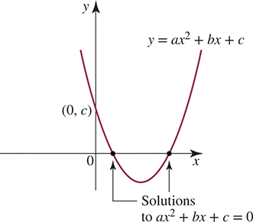
Parabola
The graph of y=a$x^{2}$+b$x$+c is in the shape of a parabola.
The graph can be used to locate the solutions to quadratic equations such as a$x^{2}$+b$x$+c =0.

Slide 10
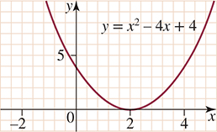
Quadratic equations with only one solution
For example, the graph of y= $x^{2}$−4$x$+4 has only one touch point at $x$=2. Therefore, equation $x^{2}$−4$x$+4 =0 has one solution $x$=2.

Slide 11
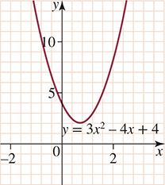
Quadratic equations with no solutions
For example, the graph of y = 3$x^{2}$−4$x$+4 does not intersect the x-axis and so 3$x^{2}$−4$x$+4=0 has no real solutions.

Slide 12
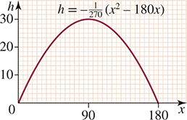
Quadratic equations with two solutions
For example, the graph of $h=−\frac{1}{270}\left(x^{2}−180x\right)$ intersects the x-axis at 2 points and so $−\frac{1}{270}\left(x^{2}−180x\right)$ =0 has 2 solutions (that is, $\left\{\begin{matrix}x_{1}=0 \\ x_{2}=180\end{matrix}\right.$).

Slide 13
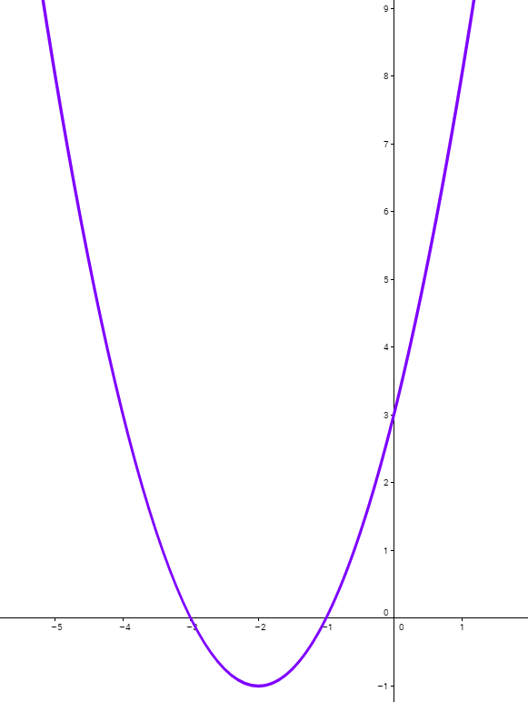
The graph is
$$y= x^{2}+4x+3$$
What do we call this shape of graph?
What is the solution of $x^{2}+4x+3$=0?

Slide 14
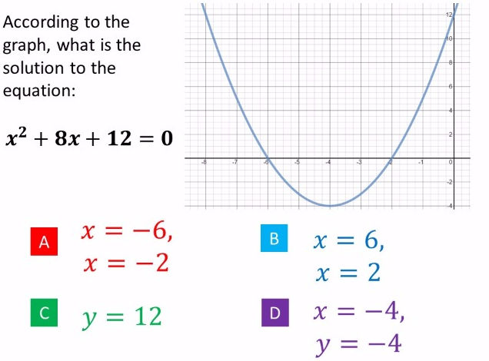
According to the graph, what are the Solutions of:
$$x^{2}+8+12=0$$

Slide 15
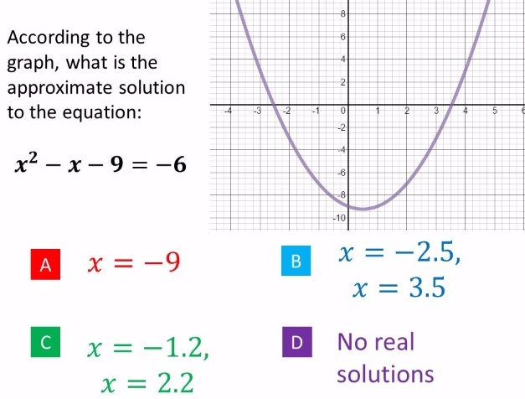
According to the graph, what are the approximate solutions to the equation:
$$x^{2}−x−9=0$$

Slide 16
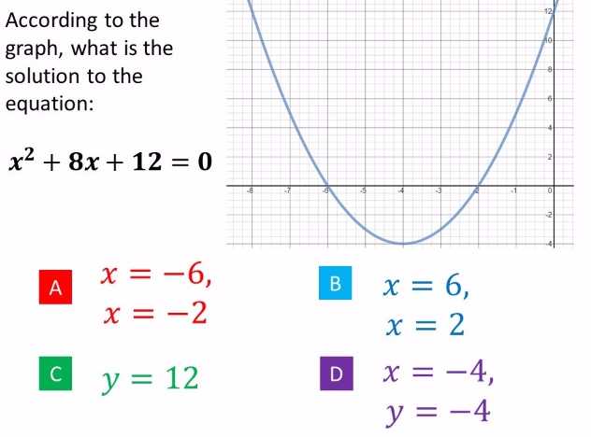
According to the graph, what are the approximate solutions to the equation:
$$x^{2}+8x+12=6$$
$$x=6$$
$$x=2$$
$$x=−0.75$$
$$x=−7.25$$
$$x=−6$$
$$x=−2$$
$$x=−1$$
$$x=−7$$

Slide 17
Tasks
Identify roots of a quadratic function from a graph
Solve quadratic equations graphically when $y=0$

Slide 18
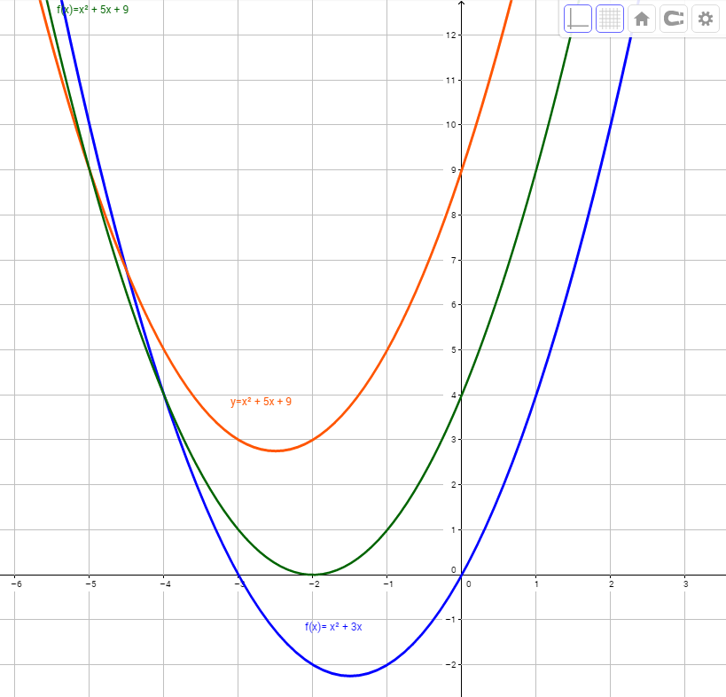
Notes:
What are graph functions? What are equations and their solutions?

