Slide 1
Solving Quadratic Equations
Notes:
https://create.kahoot.it/details/8b5ebe1c-a3a0-4bd0-b7f0-b4ed887ae806
https://quizizz.com/admin/quiz/634e172d2d6a2b001e8a33c3?source=quiz_share
Factorising Expanding https://quizizz.com/admin/quiz/634f09ac36d72a001de82056?source=quiz_share
https://quizizz.com/admin/quiz/582f883a39225944669c54ac?source=quiz_share

Slide 2
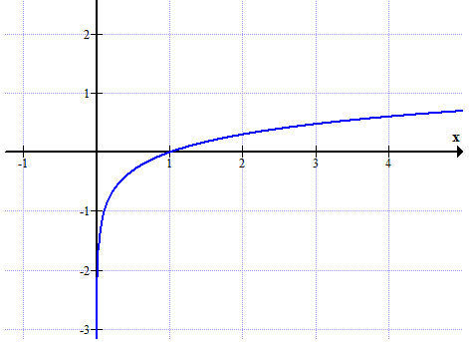
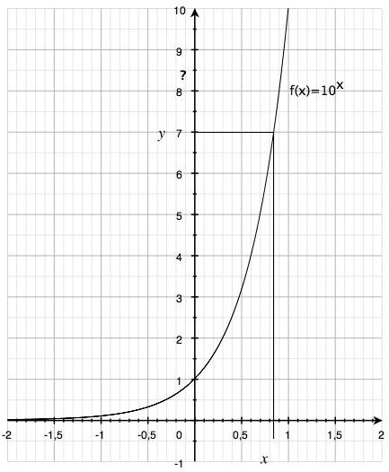
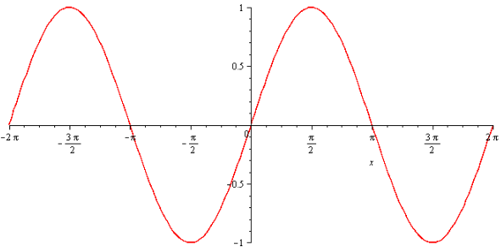
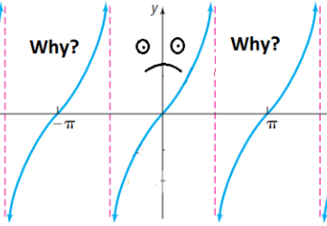
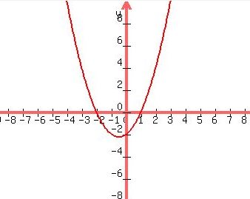
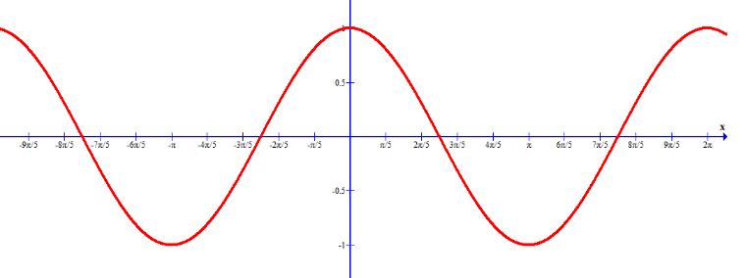
Starter --match up
$$1. y=\sin{x}$$
$$2. y=\cos{x}$$
$$3. y=\tan{x}$$
4. $y=\log{x}$
5. $y={10}^{x}$
6. $y=x^{2}$+ $x$- 6
A
B
C
D
E
F
Notes:
https://create.kahoot.it/details/bef55d5e-0c56-4477-a21a-94d63998174c
https://quizizz.com/admin/quiz/626190dc627182001dbe31ff?source=quiz_share
https://create.kahoot.it/details/cb0f9bcd-16d0-468c-ae95-314ab603eb47

Slide 3
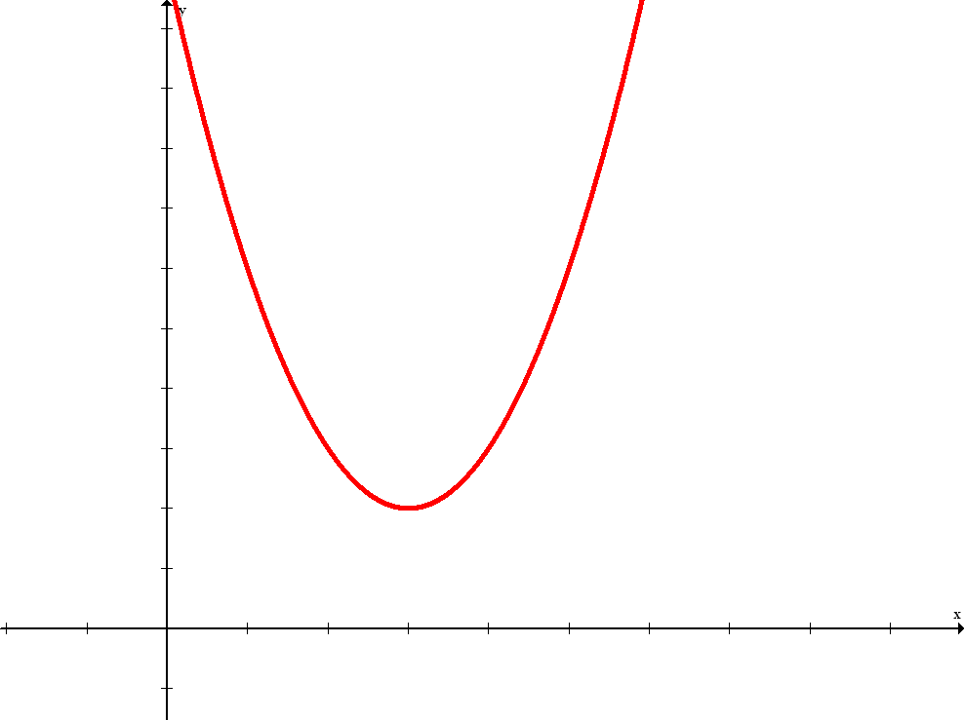
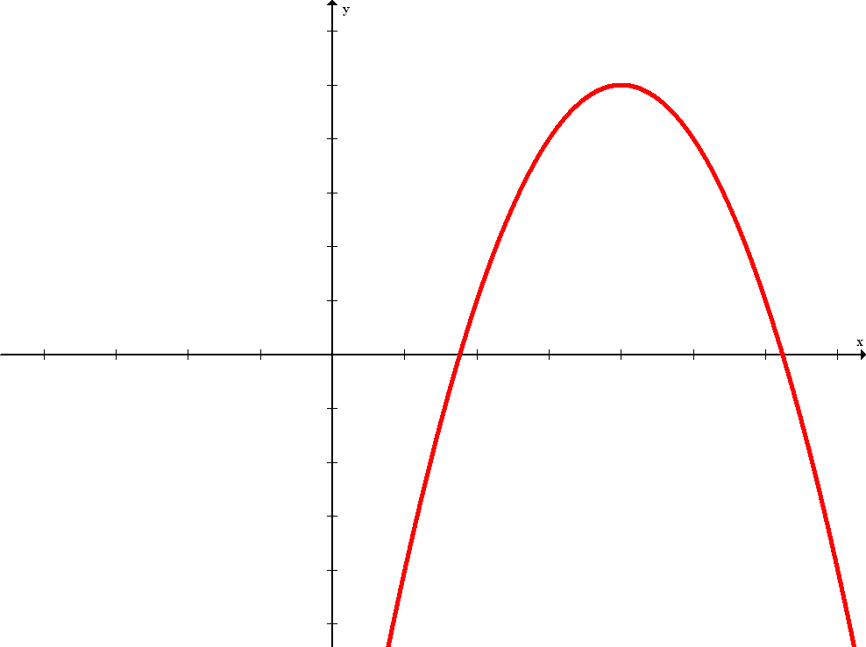
Definitions
The graph of every quadratic function is a parabola.
The vertex is the lowest point on a parabola that opens upward, or the highest point on a parabola that opens downward.

Slide 4
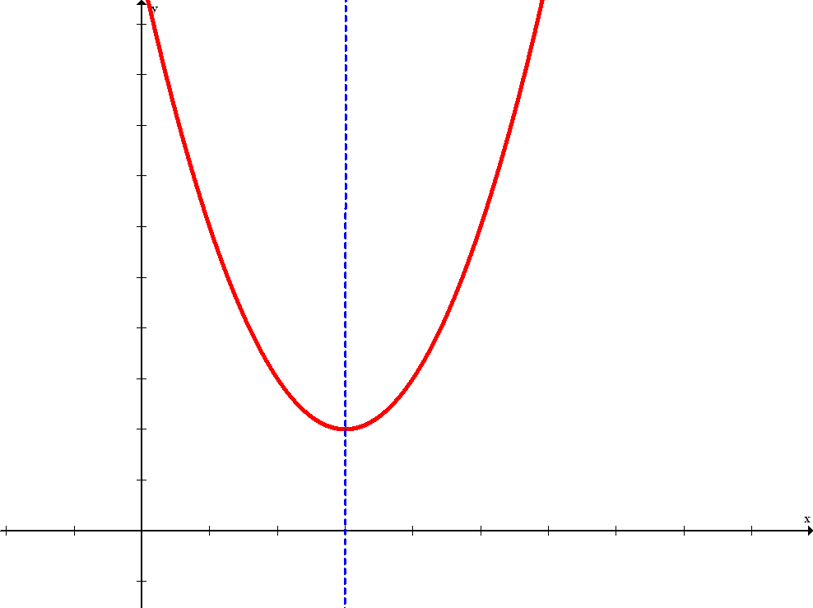
Definitions
Graphs of quadratic equations have symmetry about a line through the vertex. This line is called the axis of symmetry.
The sign of a, the numerical coefficient of the squared term, determines whether the parabola will open upward or downward.

Slide 5
Vertex of a Parabola
Vertex of a Parabola
The parabola represented by the function f(x) = ax² + bx + c will have vertex

Slide 6
Axis of Symmetry of a Parabola
Axis of Symmetry
For a quadratic function of the form f(x) = ax² + bx + c, the equation of the axis of symmetry of the parabola is

Slide 7
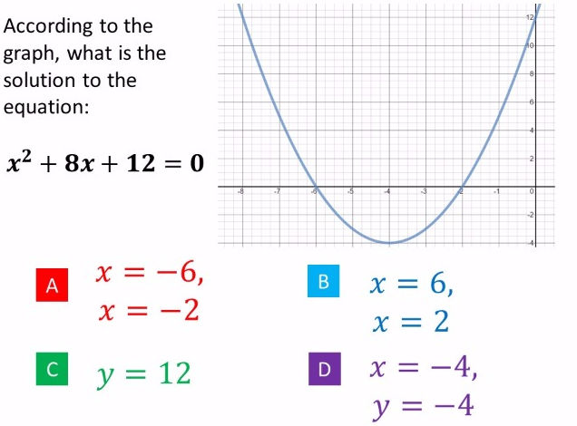
According to the graph, what are the Solutions of:
$$x^{2}+8+12=0$$

Slide 8
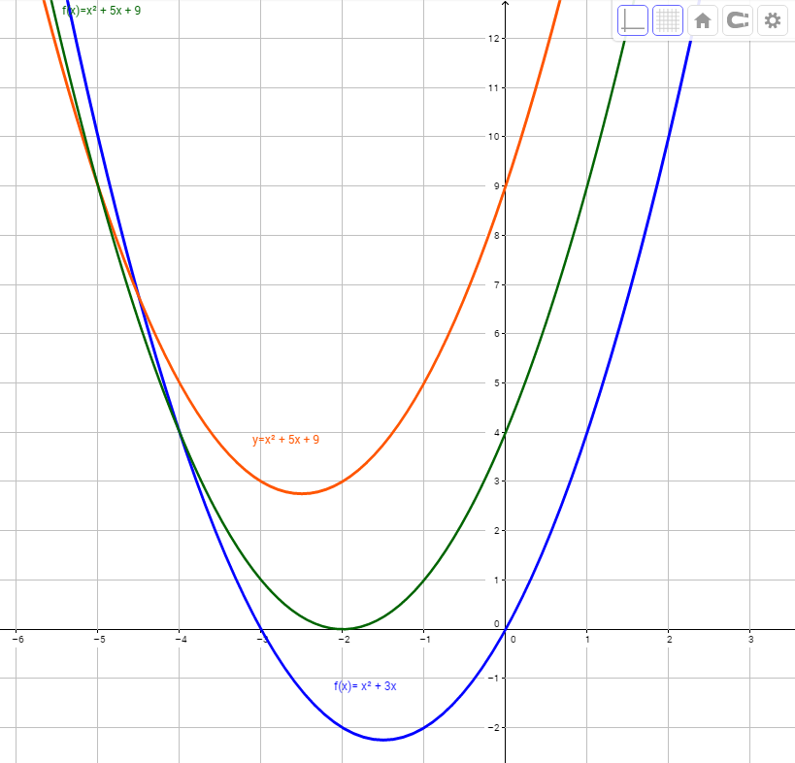
Notes:
What are graph functions? What are equations and their solutions?

Slide 9
Quadratic graphs & equations
Any equation containing one term in which the unknown is squared and no term in which it is raised to a higher power solve for x in the quadratic equation $x^{2}+4x+4=0$.
$$y$$
$$y$$
$$y$$
$$x=−5$$
$$x$$
$$x$$
$$x$$
$$x=5$$
$$x=2$$
$$x^{2}−25=0$$
$$x^{2}−4x+4=0$$
$$x^{2}+4=0$$

Slide 10
The Null Factor Law
The Null Factor Law states that if the product of two numbers is zero then one or both of the numbers must equal zero.
( x + 3)( x + 4)=0
x+3=0 or x+4=0
$$x_{1}=−3, or{ x}_{2}=−4$$

Slide 11
Factoring Trinomial Squares
Put everything into two sets of brackets.
Ex. x² – 14x + 49 =0
(x -7)(x -7) = 0
x=7
–14
– 7
– 7
$$ax^{2}+bx+c=0$$
$a$= 1, $b$ = – 14, $c$= 49
49

Slide 12
Factoring Monic Trinomials 1st Scenario: a = 1 For example: x² – 14x + 49 coefficient of x² =1 x² =1 • x²

Slide 13
Factoring Trinomials
We will factor trinomials such as
x² + 7x + 12 back into binomials.
*reverse of FOIL/table
7
3
4
If the x² term has no coefficient (other than 1)...
12
x² + 7x + 12
Step 1: List all pairs of numbers that multiply to equal the constant, 12.
12 = 1 • 12
= 2 • 6
= 3 • 4

Slide 14
Solving Equations
7
x² + 7x + 12=0
3
4
12
Step 2: Choose the pair that adds up to the middle coefficient.
12 = 1 • 12
= 2 • 6
= 3 • 4
Step 3: Fill those numbers into the blanks in the binomials:
( x + )( x + )=0
$$x_{1}=−3, or{ x}_{2}=−4$$
3
4
x² + 7x + 12 = ( x + 3)( x + 4)=0

Slide 15
Factoring Non-Monic Trinomials 2nd Scenario: a $≠$ 1 For example: 3x² + 14x + 8 coefficient of x² =3 3x² =3 • x²
^{Half or no full reduction}

Slide 16
Factoring Trinomials
Factor. 3x² + 14x + 8
14
$$ax^{2}+bx+c=0$$
$a$= 3, $b$ = 14, $c$= 8
2
12
Step 1: Multiply 3 • 8 = 24 (the leading coefficient & constant).
24
Step 2: List all pairs of numbers that multiply to equal that product, 24.
24 = 1 • 24
= 2 • 12
= 3 • 8
= 4 • 6
Step 3: Which pair adds up to 14?
This time, the x² term DOES have a coefficient (other than 1)!

Slide 17
Factoring Trinomials
14
2
12
Factor. 3x² + 14x + 8
24
Step 4: Write temporary factors with the two numbers.
2
( x + )( x + )
12
3
3
Step 5: Put the original leading coefficient (3) under both numbers.
4
2
( x + )( x + )
12
3
3
2
( x + )( x + )
Step 6: Reduce the fractions, if possible.
4
3
Step 7: Move denominators in front of x.
( 3x + 2 )( x + 4 )

Slide 18
Solving Equations
14
2
12
24
Solving. 3x² + 14x + 8=0
You should always check the factors by distributing, especially since this process has more than a couple of steps.
( 3x + 2 )( x + 4 )
= 3x • x + 3x • 4 + 2 • x + 2 • 4
= 3x² + 14 x + 8
√
3x² + 14x + 8 = (3x + 2)(x + 4)=0
$$x_{1}=−\frac{2}{3}, or{ x}_{2}=−4$$

Slide 19
Equation #5:
2x² + x – 21=0
1) Multiply 2 • (-21) = - 42; list factors of - 42.
1 • -42, -1 • 42
2 • -21, -2 • 21
3 • -14, -3 • 14
6 • -7, -6 • 7
1
2) Which pair adds to 1 ?
-6
7
-42
3) Write the temporary factors.
( x - 6)( x + 7)
2
2
4) Put “2” underneath.
3
( x - 6)( x + 7)
5) Reduce (if possible).
2
2
6) Move denominator(s)in front of “x”.
( x - 3)( 2x + 7)
2x² + x - 21 = (x - 3)(2x + 7)=0
$x_{1}=3, or{ x}_{2}=−$ $\frac{7}{2}$

Slide 20
The Quadratic Formula
Another alternative to solving quadratic equations which don’t factorise easily is to use the quadratic formula.
For equations of the form ${ax}^{2}+bx+c=0$:
Discriminant =$Δ$= $b^{2}−4ac$
$$x=\frac{−b± \sqrt{b^{2}−4ac}}{2a}$$
This formula is given to you in the formula book

Slide 21
Discriminant
Match the quadratic equation to the sketch of its graph
$Δ$>0
$Δ$=0
$Δ$<0
$$y$$
$$y$$
$$y$$
$$x=−5$$
$$x$$
$$x$$
$$x$$
$$x=5$$
$$x=2$$
$$x^{2}−25=0$$
$$x^{2}−4x+4=0$$
$$x^{2}+4=0$$

Slide 22
The Quadratic Formula
Solve the equation: ${9x}^{2}+15x+5=0$. Give your answer correct to 2 decimal places.
$$a=9, b=15, c=5$$
Discriminant= $b^{2}−4ac$= ${15}^{2}−4×9×$5=45
$$x=\frac{−15± \sqrt{{15}^{2}−4(9)(5)}}{2(9)}$$
$$x=\frac{−15± \sqrt{45}}{18}$$
$$x=−0.46 or x=−1.21$$
1. Identify a, b and c
2. Substitute into the formula
3. Use your calculator to solve for $x$

