Slide 1
Starter
Solve this equation by factorising:
$$x^{2}−9x+18$$
$${3x}^{2}+11x−4$$
$$x^{2}−12x−13$$
B
A*
A*

Slide 2
The Quadratic Formula
Grade A
21/10/2022
Learning Objectives:
Able to identify a, b and c in the quadratic formula
Able to substitute into the quadratic
formula correctly
Able to solve a quadratic equation using
the quadratic formula

Slide 3
Discriminant
Match the quadratic equation to the sketch of its graph
$$x^{2}−4x+4=0$$
$$x^{2}−25=0$$
$$x^{2}+4=0$$
$$y$$
$$y$$
$$y$$
$$x=−5$$
$$x$$
$$x$$
$$x$$
$$x=5$$
$$x=2$$
$$x^{2}−25=0$$
$$x^{2}−4x+4=0$$
$$x^{2}+4=0$$

Slide 4
The Quadratic Formula
Another alternative to solving quadratic equations which don’t factorise easily is to use the quadratic formula.
For equations of the form ${ax}^{2}+bx+c=0$:
Discriminant =$Δ$= $b^{2}−4ac$
$$x=\frac{−b± \sqrt{b^{2}−4ac}}{2a}$$
This formula is given to you in the formula book

Slide 5
Discriminant
Match the quadratic equation to the sketch of its graph
$Δ$>0
$Δ$=0
$Δ$<0
$$y$$
$$y$$
$$y$$
$$x=−5$$
$$x$$
$$x$$
$$x$$
$$x=5$$
$$x=2$$
$$x^{2}−25=0$$
$$x^{2}−4x+4=0$$
$$x^{2}+4=0$$

Slide 6
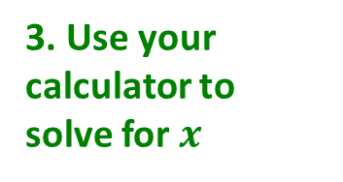
The Quadratic Formula
Solve the equation: ${9x}^{2}+15x+5=0$. Give your answer correct to 2 decimal places.
$$a=9, b=15, c=5$$
Discriminant= $b^{2}−4ac$= ${15}^{2}−4×9×$5=45
$$x=\frac{−15± \sqrt{{15}^{2}−4(9)(5)}}{2(9)}$$
$$x=\frac{−15± \sqrt{45}}{18}$$
$$x=−0.46 or x=−1.21$$
1. Identify a, b and c
2. Substitute into the formula
3. Use your calculator to solve for $x$

Slide 7
The Quadratic Formula
On your mini whiteboard, use the quadratic formula to solve the equation:
$${3x}^{2}+8x+2=0$$
$$x=\frac{−8± \sqrt{8^{2}−4(3)(2)}}{2(3)}$$
$$x=\frac{−8± \sqrt{40}}{6}$$
$$x=−0.28 or x=−2.39$$

Slide 8
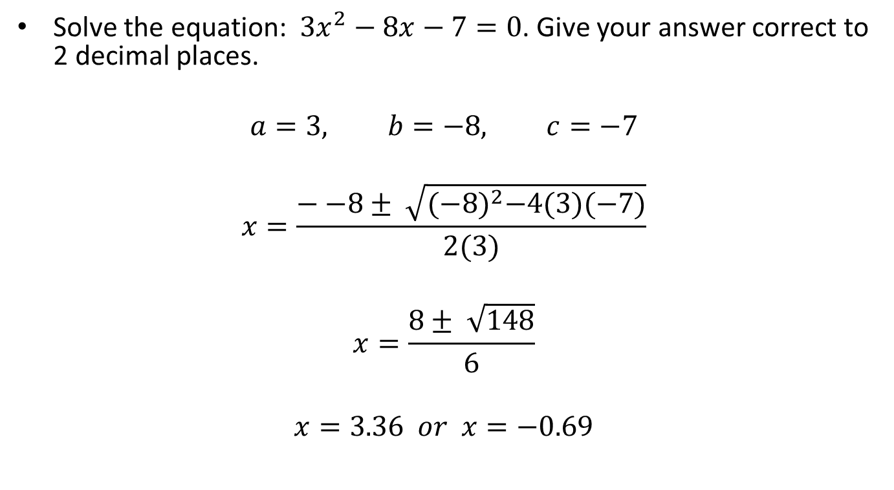
The Quadratic Formula
Solve the equation: ${3x}^{2}−8x−7=0$. Give your answer correct to 2 decimal places.
$$a=3, b=−8, c=−7$$
$$x=\frac{−−8± \sqrt{{(−8)}^{2}−4(3)(−7)}}{2(3)}$$
$$x=\frac{8± \sqrt{148}}{6}$$
$$x=3.36 or x=−0.69$$

Slide 9
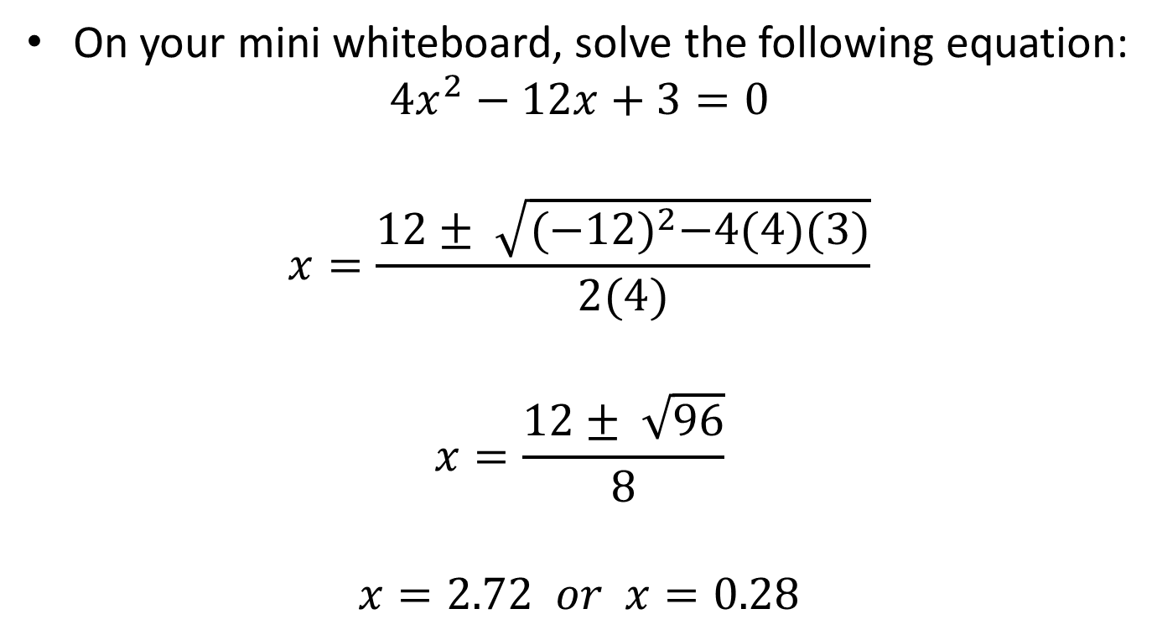
The Quadratic Formula
On your mini whiteboard, solve the following equation:
$${4x}^{2}−12x+3=0$$
$$x=\frac{12± \sqrt{{(−12)}^{2}−4(4)(3)}}{2(4)}$$
$$x=\frac{12± \sqrt{96}}{8}$$
$$x=2.72 or x=0.28$$

Slide 10

The Quadratic Formula
Solve the equation: ${7x}^{2}−9x−3=0$. Give your answer correct to 2 decimal places.
$$a=7, b=−9, c=−3$$
$$x=\frac{−−9± \sqrt{{(−9)}^{2}−4(7)(−3)}}{2(7)}$$
$$x=\frac{9± \sqrt{81−−84}}{14}$$
$$x=\frac{9± \sqrt{165}}{14}$$
$$x=1.56 or x=−0.27$$

Slide 11
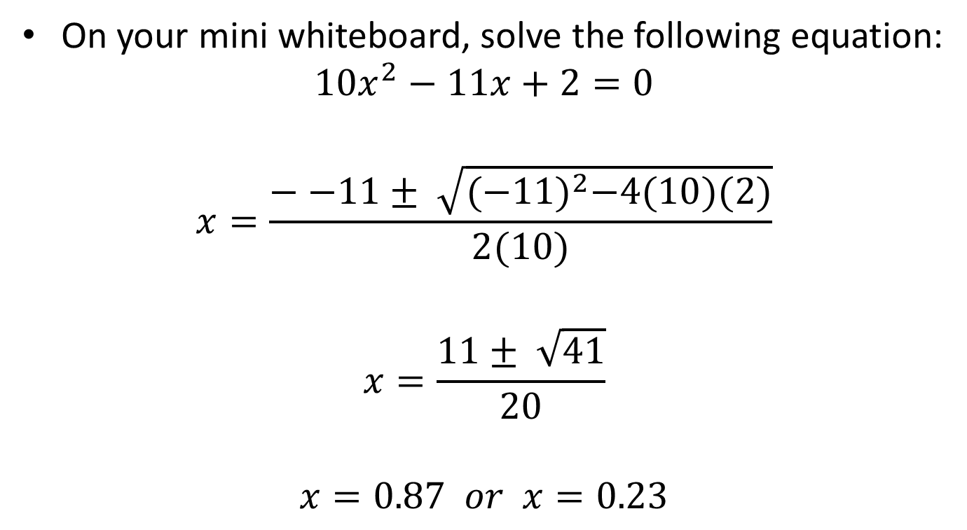
The Quadratic Formula
On your mini whiteboard, solve the following equation:
$${10x}^{2}−11x+2=0$$
$$x=\frac{−−11± \sqrt{{(−11)}^{2}−4(10)(2)}}{2(10)}$$
$$x=\frac{11± \sqrt{41}}{20}$$
$$x=0.87 or x=0.23$$

Slide 12
Starter
Show that you get the same answer regardless of method use to solve the equation:
$$x^{2}−6x+8=0$$
using:
factorising
the formula
completing the square

Slide 13
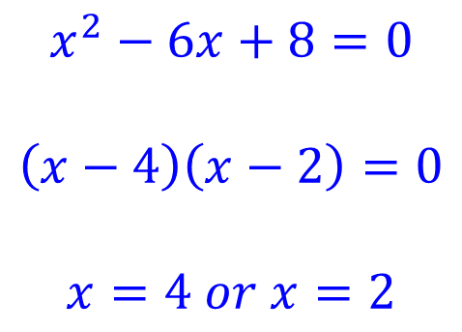
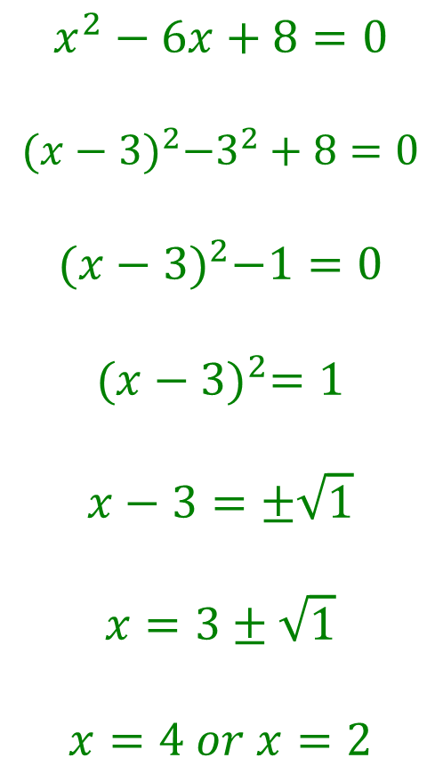
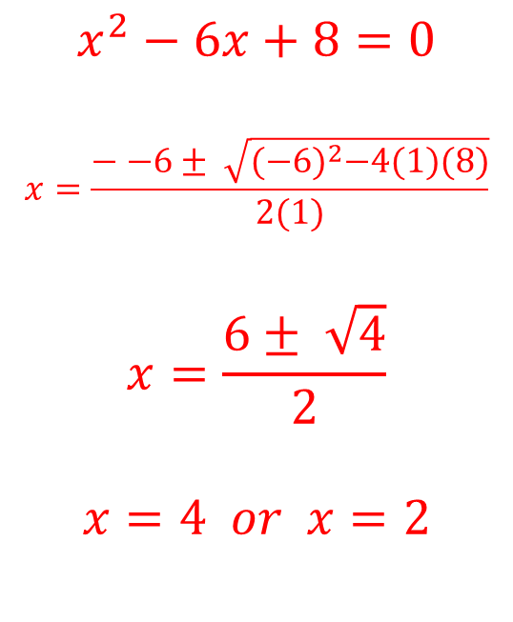
Starter
$$x^{2}−6x+8=0$$
$$\left(x−4\right)\left(x−2\right)=0$$
$$x=4 or x=2$$
$$x^{2}−6x+8=0$$
$$x=\frac{−−6± \sqrt{{(−6)}^{2}−4(1)(8)}}{2(1)}$$
$$x=\frac{6± \sqrt{4}}{2}$$
$$x=4 or x=2$$
$$x^{2}−6x+8=0$$
$${(x−3)}^{2}−3^{2}+8=0$$
$${(x−3)}^{2}−1=0$$
$${(x−3)}^{2}=1$$
$$x−3=±\sqrt{1}$$
$$x=3±\sqrt{1}$$
$$x=4 or x=2$$
Always try to factorise first!
If the question says to give your answer to $x$dp or $x$sf, it doesn’t factorise, so use the formula or complete the square!

