Slide 1
Estimating probabilities
9B

Slide 2
Subjective probabilities
The probability is assigned a value just on the basis of experience. Such probabilities are called subjective probabilities, and whether or not they are accurate estimates of the true probability would be open to dispute.

Slide 3
Probabilities from data
A better way to estimate an unknown probability is by experimentation. The proportion of trials that resulted in this event is called the relative frequency of the event.
Relative frequency of event A=$\frac{\text{number} \text{of} \text{times} \text{event} \text{A} \text{occurs}}{\text{number} \text{of} \text{trials}}$

Slide 4
Probabilities from data
When the number of trials is sufficiently large, the observed relative frequency of an event A becomes close to the probability Pr(A). That is,
Pr(A)≈$\frac{\text{number} \text{of} \text{times} \text{event} \text{A} \text{occurs}}{\text{number} \text{of} \text{trials}}$ for a large number of trials

Slide 5
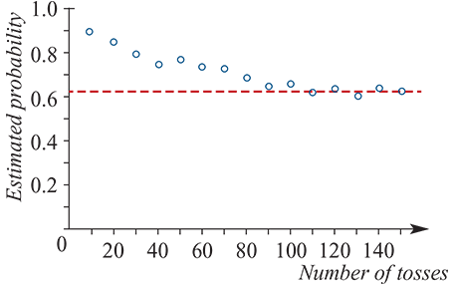
proof
Probability that a drawing pin will land ‘point up’ when it is tossed. Since a drawing pin is not symmetrical, not equally likely outcomes.
Our strategy: toss the drawing pin many times and count the number of times it lands point up. We can then calculate the relative frequency:
Relative frequency of ‘point up’
=$\frac{\text{number} \text{of} \text{times} \text{drawing} \text{pin} \text{landed}\text{ ‘}\text{point} \text{up}\text{’}}{\text{number} \text{of} \text{trials}}$
The graph: a drawing pin is tossed 150 times, with the probability of the drawing pin landing point up estimated every 10 throws.

Slide 6
Example
In order to investigate the probability that a drawing pin lands point up, Katia decides to toss it 50 times and to count the number of favourable outcomes, which turns out to be 33. Mikki repeats the experiment, but she tosses the same drawing pin 100 times and counts 62 favourable outcomes.
1. What is Katia’s estimate of the probability of the drawing pin landing point up?
2. What is Mikki’s estimate?
3. Which of these is the preferred estimate of the probability from these experiments?
4. Based on the information available, what would be the preferred estimate of the probability?
1. From Katia’s information: Pr( point up)≈$\frac{33}{50}$=0.66
2. From Mikki’s information: Pr( point up)≈$\frac{62}{100}$=0.62
3. Since Mikki has estimated the probability from a larger number of trials, her estimate would be preferred to Katia’s.
4. Based on the information available, the preferred estimate of the probability would be found by combining the data from both experiments, and so maximising the number of trials. In total, 95 favourable outcomes were observed in 150 tosses, and this gives a ‘best’ estimate of the probability of$\frac{95}{150}$ =0.63.

Slide 7
Simulation
The word simulate means to pretend or to imitate. In statistics, simulation is a way to model a random experiment, such that simulated outcomes closely match real-world outcomes. Simulation does not involve repeating the actual experiment. Instead, more complex probabilities can be estimated via multiple trials of an experiment which approximates the actual experiment, but can be carried out quickly and easily.

Slide 8
Probabilities from area
In the previous section we used the model of equally likely outcomes to determine probabilities. We counted both the outcomes in the event and the outcomes in the sample space, and used the ratio to determine the probability of the event.
This idea can be extended to calculate probabilities when areas are involved, by assuming that the probabilities of all points in the region (which can be considered to be the sample space) are equally likely.

Slide 9
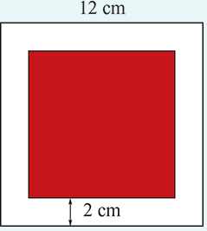
example
Suppose that a square dartboard consists of a red square drawn inside a larger white square of side length 12 cm, as shown.
If a dart thrown at the board has equal chance of landing anywhere on the board, what is the probability it lands in the red area? (Ignore the possibility that it might land on the line or miss the board altogether!)
Pr(landing in the red area)=$\frac{\text{area} \text{of} \text{red} \text{square}}{\text{area} \text{of} \text{dartboard}}$ =$\frac{64}{144}$= $\frac{4}{9}$

Slide 10
Section summary
1. When a probability is unknown, it can be estimated by the relative frequency obtained through repeated trials of the random experiment under consideration. In this case,
Pr(A)≈$\frac{\text{number} \text{of} \text{times} \text{event} \text{A} \text{occurs}}{\text{number} \text{of} \text{trials}}$ for a large number of trials
2. Whichever method of estimating probability is used, the rules of probability hold:
Pr(A)≥0, for each event A
Pr(ɛ)=1
The sum of the probabilities of all the outcomes of a random experiment equals 1.

