Slide 1
Combining events
9D

Slide 2
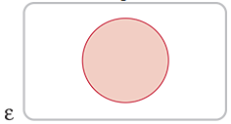
Sets and set notation
The empty set, denoted by ∅, is the set consisting of no elements. This is different from {0}, which is a set containing one element, 0.
Sets, and the relationships between sets, can be illustrated clearly by using Venn diagrams. The universal set ɛ is usually shown as a rectangle, and a subset of ɛ as a circle.
The number of elements in a set A is usually denoted n(A). For example, if A={2,4,6}, then n(A)=3.

Slide 3
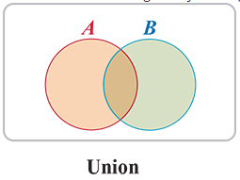
Union
If A and B are any two sets, then the union of A and B, denoted A∪B, is the set of all elements in A or B (or both). This is shown on a Venn diagram by shading both sets A and B.
For example, if A is the set of students in a school who play hockey, and B the set of students who play tennis, then the union of A and B is the set of students who play either hockey or tennis or both.

Slide 4
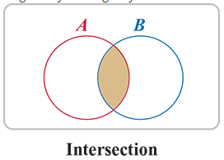
Intersection
The intersection of A and B, denoted A∩B, is the set of elements that are in both A and B. This is shown on a Venn diagram by shading only the area contained in both A and B.
For example, the intersection of the two sets previously described is the set of students who play both hockey and tennis.

Slide 5
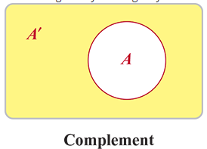
Complement
As previously, note that the complement of A, denoted A′, is the set of all elements of ɛ that are not in A. This is shown on a Venn diagram by shading only the area outside A.
The complement of the set of students who play hockey in a school is the set of students who do not play hockey.

Slide 6
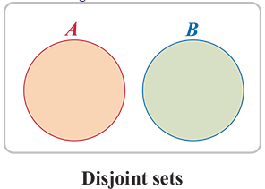
Disjoint or mutually exclusive sets
Two sets A and B are said to be disjoint or mutually exclusive if they have no elements in common, that is, if A∩B=∅. The Venn diagram below shows two sets that are mutually exclusive.
If A is the set of girls who play hockey in a school and B is the set of boys who play hockey, then A and B are mutually exclusive, as no student can belong to both sets.

Slide 7
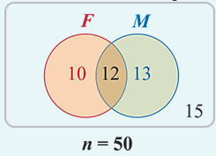
Example
Fifty students were asked what they did on the weekends. A total of 35 said they went to football matches, the movies or both. Of the 22 who went to football matches, 12 said they also went to the movies. Show this information on a Venn diagram.
1. How many students went to the movies but not to football matches?
Let F denote the set of students who attend football matches and M denote the set of students who attend movies.
Hence, from the information given, n(F∪M)=35, n(F)=22 and n(F∩M)=12.
1. Students who go to the movies but not to football matches are found in the region F′∩M, and from the diagram n(F′∩M)=13.

Slide 8
Example
Fifty students were asked what they did on the weekends. A total of 35 said they went to football matches, the movies or both. Of the 22 who went to football matches, 12 said they also went to the movies. Show this information on a Venn diagram.
2. How many went neither to football matches nor to the movies?
Let F denote the set of students who attend football matches and M denote the set of students who attend movies.
Hence, from the information given, n(F∪M)=35, n(F)=22 and n(F∩M)=12.
2. Those who attend neither are found in the region F′∩M′, and from the diagram n(F′∩M′)=15.

Slide 9
Example
Consider the same example. What is the probability that a student chosen at random from this group of 50:
1. went to the movies but not to football matches
2. went neither to football matches nor to the movies?
To determine the probability of these events, divide by the size of the sample space in each case.
1. Pr(F′∩M)=$\frac{\text{n}\text{(}\text{F}\text{′∩}\text{M}\text{)}}{\text{n}\text{(ɛ)}}$=$\frac{13}{50}$
2. Pr(F′∩M′)= $\frac{\text{n}\text{(}\text{F}\text{′∩}\text{M}\text{)}}{\text{n}\text{(ɛ)}}$= $\frac{15}{50}$= $\frac{3}{10}$

Slide 10
The addition rule
The probability of A or B or both occurring can be calculated using
Pr(A∪B)=Pr(A)+Pr(B)−Pr(A∩B)
This is called the addition rule for combining probabilities. This rule also applies in situations where the outcomes are not equally likely; it is always true.

Slide 11
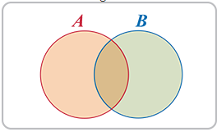

The addition rule -- Proof
n(A∪B)=n(A)+n(B)−n(A∩B)
(As the intersection has been counted twice, in both n(A) and n(B), we must subtract it.)
Dividing through by n(ɛ) gives
$\frac{\text{n}\text{(}\text{A}\text{∪}\text{B}\text{)}}{\text{n}\text{(ɛ)}}$= $\frac{\text{n}\text{(}\text{A}\text{)}}{\text{n}\text{(ɛ)}}$+ $\frac{\text{n}\text{(}\text{B}\text{)}}{\text{n}\text{(ɛ)}}$− $\frac{\text{n}\text{(}\text{A}\text{∩}\text{B}\text{)}}{\text{n}\text{(ɛ)}}$
Now, if each of the outcomes in ɛ is equally likely to occur, then each term in this expression is equal to the probability of that event occurring. This can be rewritten as:
Pr(A∪B)=Pr(A)+Pr(B)−Pr(A∩B)

Slide 12
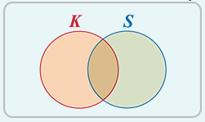

Example
If one card is chosen at random from a well-shuffled deck, what is the probability that the card is a king or a spade?
Let event K be ‘a king’. Then K={king of spades, king of hearts, king of diamonds, king of clubs} and n(K)=4.
Let event S be ‘a spade’. Then S={ace of spades,king of spades,queen of spades,…} and n(S)=13.
The event ‘a king or a spade’ corresponds to the union of sets K and S. We have
Pr(K)= $\frac{4}{52}$,Pr(S)= $\frac{13}{52}$,Pr(K∩S)= $\frac{1}{52}$
and so, using the addition rule, we find
Pr(K∪S)= $\frac{4}{52}$+ $\frac{13}{52}$− $\frac{1}{52}$= $\frac{16}{52}$=0.3077(correct to 4 decimal places)

Slide 13
Section summary
Venn diagrams are often useful for solving problems involving sets.
For any two events A and B, the addition rule can be applied:
Pr(A∪B)=Pr(A)+Pr(B)−Pr(A∩B)
If the two events A and B are mutually exclusive, then Pr(A∩B)=0 and therefore Pr(A∪B)=Pr(A)+Pr(B).

