Slide 1
Multi-stage experiments
9C
Notes:
https://create.kahoot.it/details/24647872-cc59-4729-82d2-8c6a56a72885
https://www.transum.org/Maths/Activity/Venn/

Slide 2
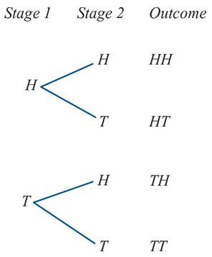
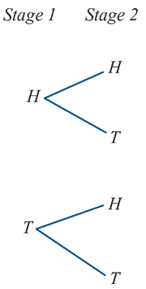
multi-stage experiments
Often we are interested in probabilities which arise from more complex multi-stage experiments. That is, they are concerned with experiments which could be considered to take place in more than one stage.
For example, when considering the outcomes from tossing two coins (or tossing one coin twice) we should consider the possible outcomes in two stages:
the outcome from coin 1
followed by the outcome from coin 2.
In such cases, it is helpful to list the elements of the sample space systematically by means of a tree diagram as shown.
The sample space is
ɛ={HH,HT,TH,TT}

Slide 3
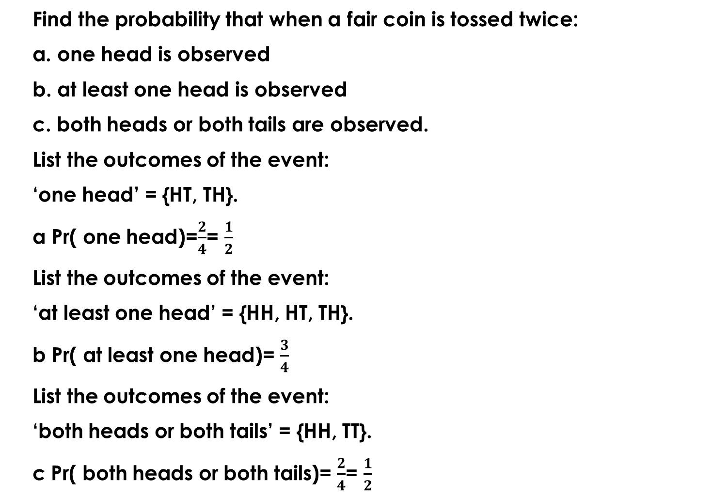
example
Find the probability that when a fair coin is tossed twice:
a. one head is observed
b. at least one head is observed
c. both heads or both tails are observed.
List the outcomes of the event:
‘one head’ = {HT, TH}.
a Pr( one head)=$\frac{2}{4}$= $\frac{1}{2}$
List the outcomes of the event:
‘at least one head’ = {HH, HT, TH}.
b Pr( at least one head)= $\frac{3}{4}$
List the outcomes of the event:
‘both heads or both tails’ = {HH, TT}.
c Pr( both heads or both tails)= $\frac{2}{4}$= $\frac{1}{2}$

Slide 4
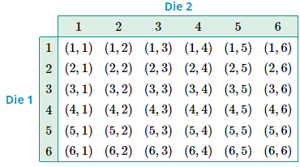
Sample space in a table
When listing the outcomes for a two-stage experiment, it can also be convenient to display the sample space in a table. For example, when rolling two dice (or a single die twice) there is the possibility of {1,2,3,4,5,6} on die 1 (or the first roll), and {1,2,3,4,5,6} on die 2 (or the second roll). So the sample space for this experiment can be written as:

Slide 5
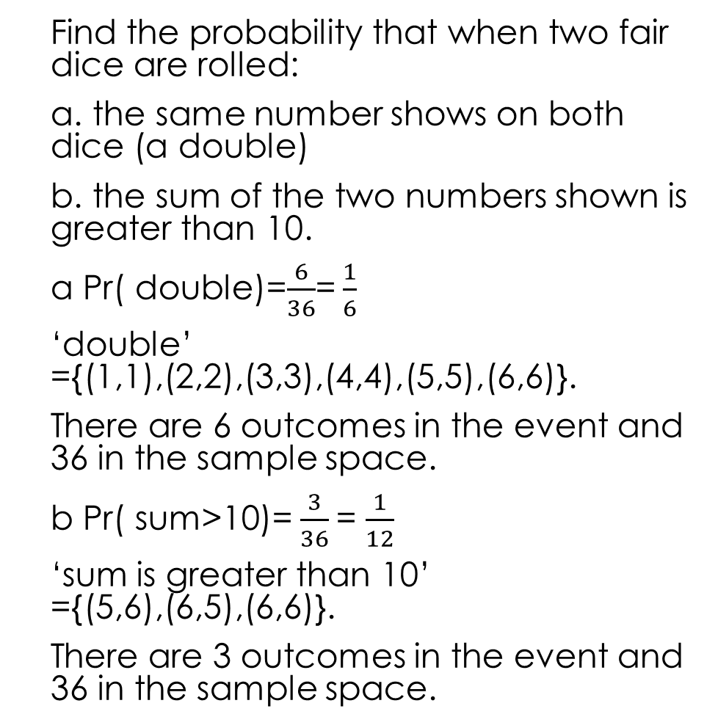
Sample space in a table: example
Find the probability that when two fair dice are rolled:
a. the same number shows on both dice (a double)
b. the sum of the two numbers shown is greater than 10.
a Pr( double)=$\frac{6}{36}$= $\frac{1}{6}$
‘double’ ={(1,1),(2,2),(3,3),(4,4),(5,5),(6,6)}.
There are 6 outcomes in the event and 36 in the sample space.
b Pr( sum>10)= $\frac{3}{36}$= $\frac{1}{12}$
‘sum is greater than 10’ ={(5,6),(6,5),(6,6)}.
There are 3 outcomes in the event and 36 in the sample space.

Slide 6
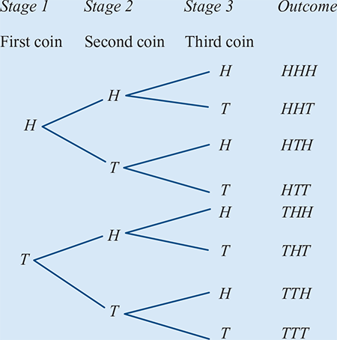
Tree diagrams
When the experiment involves more than two stages, it is best to use a tree diagram to determine all of the possible outcomes.
Thus the required sample space is
ɛ={HHH,HHT,HTH,HTT,THH,THT,TTH,TTT}

Slide 7
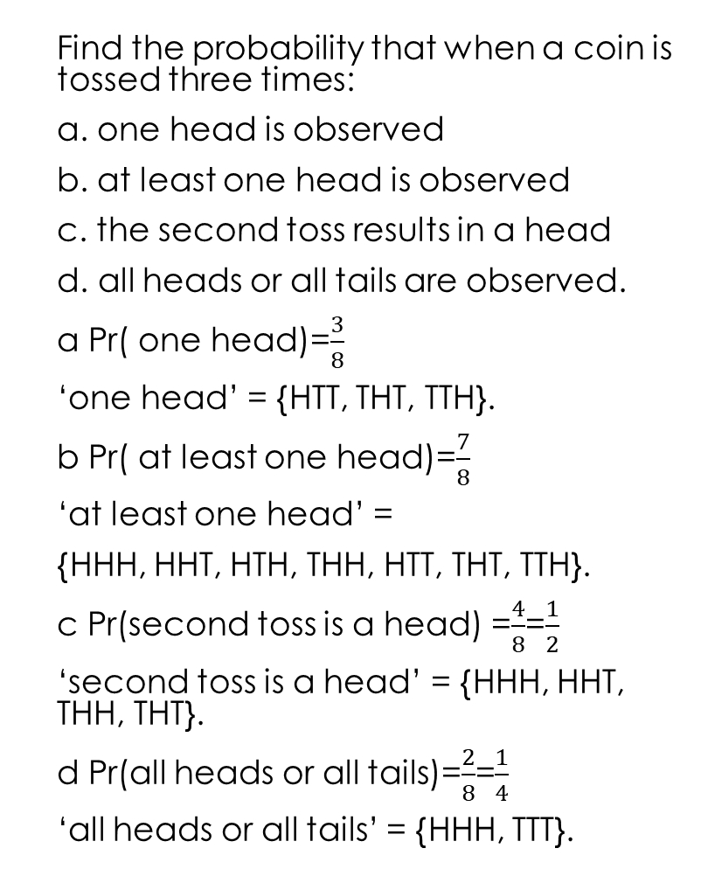
Tree diagrams: Example
Find the probability that when a coin is tossed three times:
a. one head is observed
b. at least one head is observed
c. the second toss results in a head
d. all heads or all tails are observed.
a Pr( one head)=$\frac{3}{8}$
‘one head’ = {HTT, THT, TTH}.
b Pr( at least one head)=$\frac{7}{8}$
‘at least one head’ =
{HHH, HHT, HTH, THH, HTT, THT, TTH}.
c Pr(second toss is a head) =$\frac{4}{8}$=$\frac{1}{2}$
‘second toss is a head’ = {HHH, HHT, THH, THT}.
d Pr(all heads or all tails)=$\frac{2}{8}$=$\frac{1}{4}$
‘all heads or all tails’ = {HHH, TTT}.

Slide 8
Section summary
The sample space for a two-stage experiment can be displayed using a tree diagram or a table. If an experiment involves more than two stages, then a tree diagram should be used.

Slide 9
